Slide 1
By Md Imran Khan & Asheref Illiyan
An economic analysis of Indian emigrants in Saudi Arabia during covid-19 pandemic

Slide 2
Introduction
India: Second most populated country in the world, largest number of Indians living abroad (18 million)
Saudi Arabia: Third largest destination country for the migrants, hosting largest number of migrants 2.5 million from India in 2020
Remittances to India: fell by 0.2% in 2020 as compared to 2019 and with 17% drop in remittances from United Arab Emirates only.
Labour migration to the Saudi Arabia had started from Kerala after the oil boom of 1970s.

Slide 3
Continue
Uttar Pradesh and Bihar: limited expansion of education, lack of employment opportunities, less industrialized state, agriculture occupational state supplies labour for the menial work in the gulf countries
The current pandemic of COVID-19 has not only changed the life style of billions of persons in the world but also severely disturbed their livelihood.
Travel ban and business restrictions has frozen the movement of people, changed the occupational status and consumption pattern of people in almost every country.
The kingdom had identified its first Coronavirus case on 2nd march 2020, a person returning from Iran via Bahrain
The government of the Saudi Arabia imposes multiple restrictions to prevent the transmission of Coronavirus such as halting Hajj and Umrah, ban of international flights, temporary shutting of mosques, night curfew, proper lockdown etc.

Slide 4
Literature Review
Datt et al. (2021) in their paper titled, "The COVID-19 Pandemic and Migrant Workers from Rural Bihar’ describes that the second wave of Coronavirus majorly affected the migrant’s family in Bihar because the first wave of Coronavirus was concentrated to the urban areas and rural agriculture activities has not been much affected. One fifth of the sample respondents went to the destination for work but still waiting to resume the work and 94% of the migrant family has been adversely affected due to spread of Coronavirus
Ansari et al. (2021), in their paper titled "Covid 19 And Its Implications For Gulf Migrants: Some Reflections From Kerala”, reveals the fact that 45% of the migrants return to Kerala due to disruption of employment status during Coronavirus pandemic. 10% reported the reason of return being low wages, 5% because of expiry of contract, 15% due to nationalization, 5% due to poor working conditions and 10% due the bad behavior of the employer

Slide 5
Continue
Chowdhury et al. (2021), in their study titled "The Impact of COVID-19 on the Migrant Workers and Remittances Flow to Bangladesh”, study reported that the remittances to Bangladesh rose by 54% in July 2020 compare to December 2019, despite 67% fall in employment. The rose in remittances was result of increase in formal transactions of remittances.
Jahan et al. (2021), in their study titled "Impact of Covid-19 Lockdown on Socio-Economic Conditions of Semi-Skilled Returnee Migrant Workers of Bangladesh”, study confirms that majority of the migrants (54%) return back to the country due to shutdown of work during pandemic, however 15% of the respondents return back due to visa renewal issue and 15% due to contract renewal issue.

Slide 6
Continue
Oyando et al. (2021), in their paper titled "Assessing equity and the determinants of socio-economic impacts of COVID-19: results from a cross-sectional survey in three counties in Kenya”, study analyzes the level of disruption even after the one year of Coronavirus spread. In the sample data 42% respondents reported the school disruption, 46% reported mental health problems, 30% of them reported domestic tensions or domestic violence’s, 36% reported communal violence’s and 44% reported food disruptions

Slide 7
Continue
Burton et al. (2020), in their study titled "The impact of the Covid-19 pandemic and the lockdown on the health and living conditions of undocumented migrants and migrants undergoing legal status regularization”, study reveals the fact that migrants faced huge difficulties in accessing the basic necessity during pandemic. Poor mental health and avoidance of health service during the pandemic was exercised by the migrants. Consequently disruption of working hours and reduction of income created a situation for undocumented migrants of unavailability of food
Alkhamshi et al. (2021), in their paper titled, "Covid-19 Pandemic: Psychological, Social and Economic Impacts on Saudi Society” study confirms that 44.6% of the respondents reported loss of his job or his primary income due to pandemic, however 52.8% were worried about losing his job. 51.6% of the respondents were not able to manage his expenses, however 52.6% of the respondents were using his savings to manage the expenses

Slide 8
Objective of the study
Understanding the economic impact of COVID-19 on Indian migrants working in Saudi Arabia
Understanding the emotional well being of the migrants during COVID-19 lockdown

Slide 9
Methodology
The present study attempts to analyze the economic impact on Indian male migrants in Saudi Arabia during COVID-19 pandemic.
The study is quantitative in nature and based on both primary and secondary data
Multistage sampling techniques were used to collect the sample data.
A sample of 150 migrants were collected, working in Saudi Arabia and belong to Uttar Pradesh and Bihar in the month of march-April 2021
We had not included the responses of skilled labour and incomplete responses into the study, therefore, analysis of the paper is based on 100 samples only. The 60 sample responses belongs to migrants from Uttar Pradesh and 40 sample responses from Bihar.

Slide 10
Result & Discussion (Demographic profile)
Source: Calculated by Authors from sample survey

Slide 11
Occupational structure of the migrants
Source: Calculated by Authors from sample survey

Slide 12
Migrant’s working experience
Source: Calculated by Authors from sample survey

Slide 13
Migrant’s Earnings and Remittances
Source: Calculated by Authors from sample survey

Slide 14
Migrant’s source of income and family structure
Source: Calculated by Authors from sample survey

Slide 15
Comparison to total COVID-19 cases

Slide 16
Comparison of total COVID death

Slide 17
Migrant’s working hour during lockdown
Source: Calculated by Authors from sample survey

Slide 18
Return of Migrants during Lockdown
Source: Calculated by Authors from sample survey

Slide 19
Migrant’s earning loss and change in remittances

Slide 20
Paired Sample t- Test
Source: Calculated by Authors from sample survey

Slide 21
Emotional wellbeing of the migrants during pandemic

Slide 22
Feeling depressed during pandemic

Slide 23
Feeling lonely during pandemic

Slide 24
Chi-Square Test of emotional well-being within different state of origin
Source: Calculated by Authors from sample survey

Slide 25
Conclusion
Migration of unskilled and semi-skilled labour from Uttar Pradesh and Bihar were started after the oil boom of 1970s
The current study observes that majority of the migrants (52%) from these states are earning below 2500 SAR
47% of the migrants reported per month remittances even less than 1000 SAR in a month.
Migrants from Bihar remitting more money than the migrants from Uttar Pradesh
Majority of the migrants (80%) do not have other source of income except earning from Saudi Arabia.
43% of the respondent confirm that they did not worked during the lockdown period of the pandemic, however, 53% worked less than 8 hours in a day.

Slide 26
Conclusion
Most of the migrants remit less amount during the lockdown period than before the lockdown period.
The result of paired sample t-test confirms that there is significant difference in remittances before and during pandemic
The study also reveals the fact that the migrants from Uttar Pradesh were felt to be more depressed, nervous and lonely than the migrants of Bihar, because the spread of coronavirus and death due to Coronavirus were high in Uttar Pradesh in comparison to Bihar
Chi square test result confirms that there is a significant difference of feeling nervous, depress and lonely across the different states of origin of the migrants

Slide 27
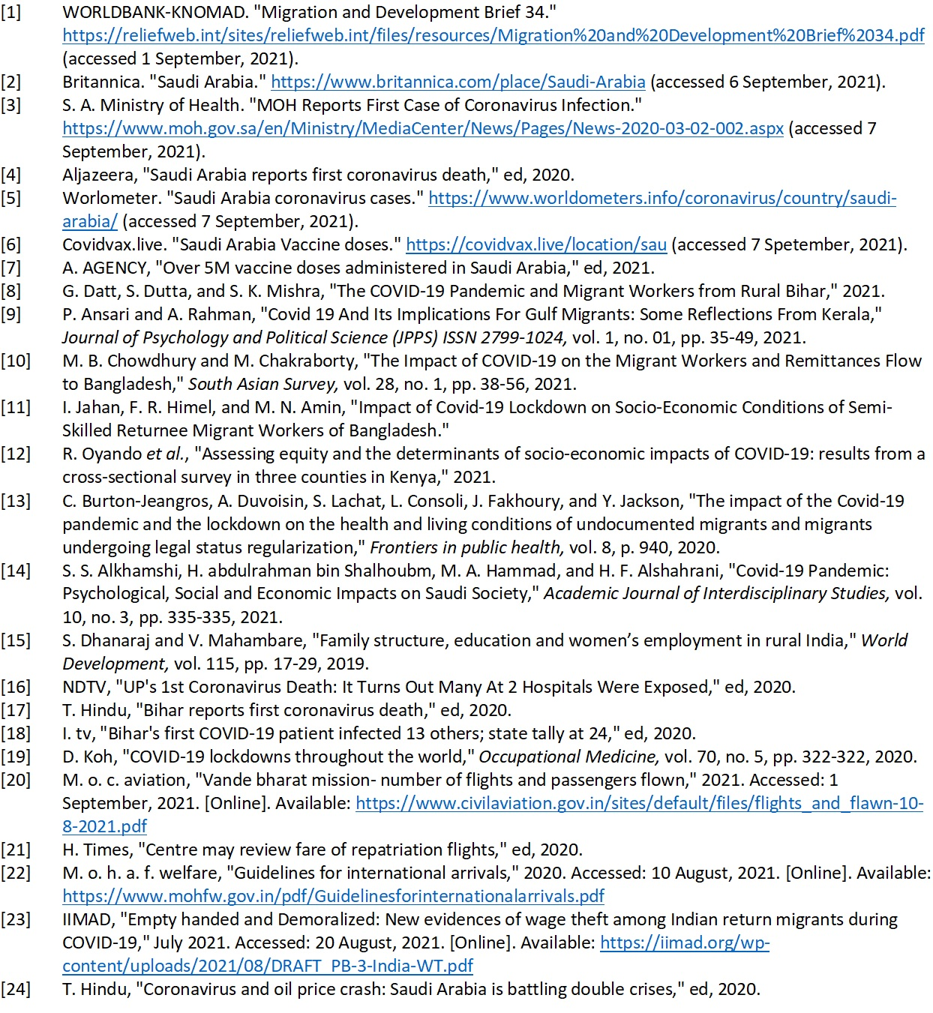
References

