Slide 1
An analytical conductive study to RMG ( Ready-Made Garment) sector workers health state, the economic resillience status, and the contamination footing scenario in Bangladesh
Tajrin Rahman Tisha
Department of Development Studies
Student of 4th year 7th Semester
Bangladesh University of Professionals (BUP)

Slide 2
Introduction
01
Censorious contribution
Every 3 European & every 5 American wears manufactured clothes of Bangladesh
02
Export condition
83% overall export
.
03
Creating
Empowerment
4.4 million workers

Slide 3
Why RMG sector called the lifeline of the economy of BD????
In the fiscal year 2019-2020, the percentage of RMG contribution to GDP is 12.26%.

Slide 4
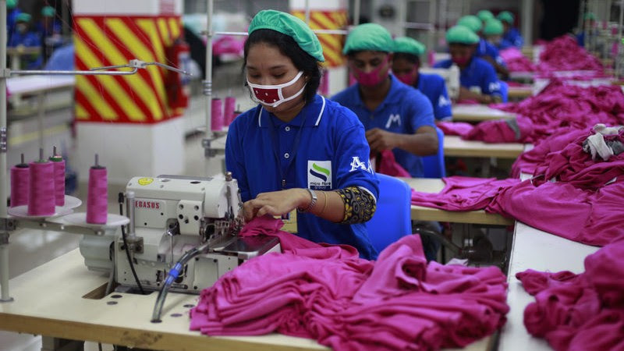
According to World Bank, total 4621 export oriented garments industries produced almost garments export products worth of 34.13 billion$

Slide 5
Why are their health deteriorating despite all these successes?
Their wages are quite low
Most of them are slum dwellers
Quite differences between their wages and their standard of living
They spend more money on entertainment than on a balanced diet
They raise money for various social & cultural festivals which is why they are seen to be suffering from malnutrition

Slide 6
Contamination upsetting the imbalance environment……
So if we think of why contamination is spreading, we will notice that the raw materials that are thrown away in the garments are dumped in the river or anywhere, it pollutes the water, pollutes the environment as well as the air.
The garment industry is one of the biggest polluters on the planet. These industries generate one fifth of the world’s industrial water pollution ans use 20,000 chemicals, many of them carcinogenic, to make clothes.

Slide 7
More health vulnerabilities??
Unsafe work environment(fire collapse)
Unhygienic workplace condition
Sexual harassment
Also more genuinely sexually transmitted diseases such as HIV/AIDS

Slide 8
A fruitful decision can be…

Slide 9
Conclusion
The RMG industry in Bangladesh is huge
It is a main source of foreign exchange for the last 25 years
The minimum wage is not a living wage
The RMG industry in BD has a history of disaster
The way to solve highlighted issues is to maintain a clean and dry workplace, including storage rooms and shipping areas`
Enhancing occupational health and safety needed more
Strengthening the labour inspectorate is important ( previous incident like Tazreen & Rana plaza)

