Slide 1
Paper Title
AN ETHNOGRAPHIC STUDY OF RICKSHAW PULLERS IN LUCKNOW CITY, UTTAR PRADESH (INDIA)
Paper Presenting By,
Ph. D. Scholar: Milind Sen(At CSSEIP,UoH)
At International e-Conference on Changes State, Economy, Public Health and Society, January 16-17, 2022. Which organized by The Center for Academic & Professional Career Development and Research(CAPCDR)

Slide 2
Outline
Introduction of ethnographic study of Rickshaw pullers
Literature reviews
Methods &Photographic Technique
Finding Conclusion

Slide 3
Introduction
Rickshaw pulling, even though an outdated mode of transport. But still famous in India (Census of India 1981 Series-26, n.d.).
Rickshaw word comes from the Japanese word 'Jinrikisha' which means human-powered vehicles. Rickshaws are called by different names in different countries as 'becak' Indonesia, ‘cyclo’ in Phnom Penh of Cambodia, and in Vietnam (Khan et al., 2012).
In India, a rickshaw has first seen in Shimla in around 1880. About twenty years later was introduced in Kolkata(Samanta & Roy, 2013).

Slide 4
Cont..
Cycle Rickshaw pulling activity is an important occupation of the informal sector, where a million of poor not only serve the transportation needs of the society but also try to meet out their own economic and employment needs. Rickshaws are a mode of human powered transport; a runner draws a three wheeled cart which seats one or two persons.
Rickshaw since then is a mode of transportation and cheapest source of transport activities. Despite the economic importance of this industry to the low-income families and eco-friendly benefits of this occupation, the public attitudes towards the cycle rickshaws in India, by and large, are negative and there use is being phased out in many Indian cities.
The socio-economic conditions of rickshaw pullers are miserable. No government plans have considered their contribution in terms of service and economy. There are no job security and welfare provisions for them. They are bound to work even late at night and at odd hours and in inclement weather conditions without any protection or safety. There are virtually no medical facilities or rest shelters for them. They are subjected to social ignorance, apathy and injustice. All these people are being treated as out caste and unwanted burden on the society.

Slide 5
Literature Review
India has made a remarkable progress in different sectors of the economy since last three decades. However, the benefit could not percolate to bottom level. However, different strategies have been made from time to time to improve the economic status of poor and population engaged in unorganized sector, but their conditions are still unsatisfactory (Ali 2009).
People who belong to lower segment of the society, their deterioration continue day by day particularly in rural masses where More than 70% population resides. Unemployment, illiteracy, unhygienic health conditions and discrimination regarding distribution of resources and assets is common (Ali 2012, Madan 1971).
A big segment of the rural population migrates to the urban centres for earning income and livelihood (Bhatt 1989).
Due to lack of money, education, industrial skills, these immigrated rural people especially, victims of natural calamities (flood, drought) as well as socio-religious factors could not find employment in the formal sector and other related sectors (Charles 2002).
they prefer the business of rickshaw pulling to get quick cash earning and employment. It is the fact that now rickshaw pulling has become a popular source of income and employment among the rural immigrants in the urban masses (Begum and Binayak 2004).

Slide 6
Method& Photographic Technique
The study was conducted an ethnographic study of Rickshaw pullers in Lucknow city, Uttar Pradesh, India September- October 2021. I used observation and semi-structured and in-depth interviewed of RPs .
30 RPs, interviews and observed, during 46 days.The study has tried why? Respondents have chosen Lucknow city for their livelihood. The study has found rickshaw pullers different groups of lower section of the society. The study has highlighted social culture distinguished among respondents.
Data was collected through field-notes, audio recordings and photographic technique. During the field sites I has observed and asked several question regarded socio-culture, socio-economics condition, family size, health issues, isolation, and low protein intake and socio-culture different between RPs .

Slide 7
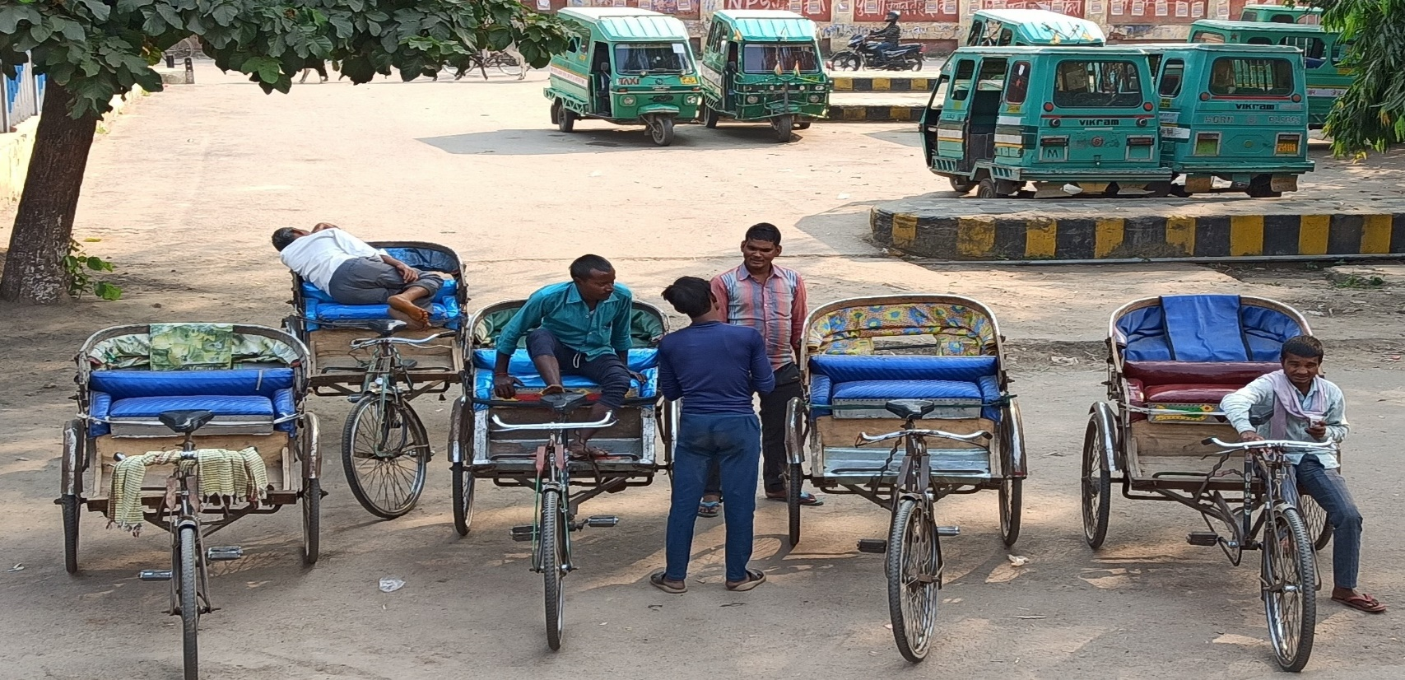
Photographic observation of the Rickshaw Pullers
Rickshaw Pullers are waiting for passengers in Auto-stand, Behind Lucknow Railway station

Slide 8
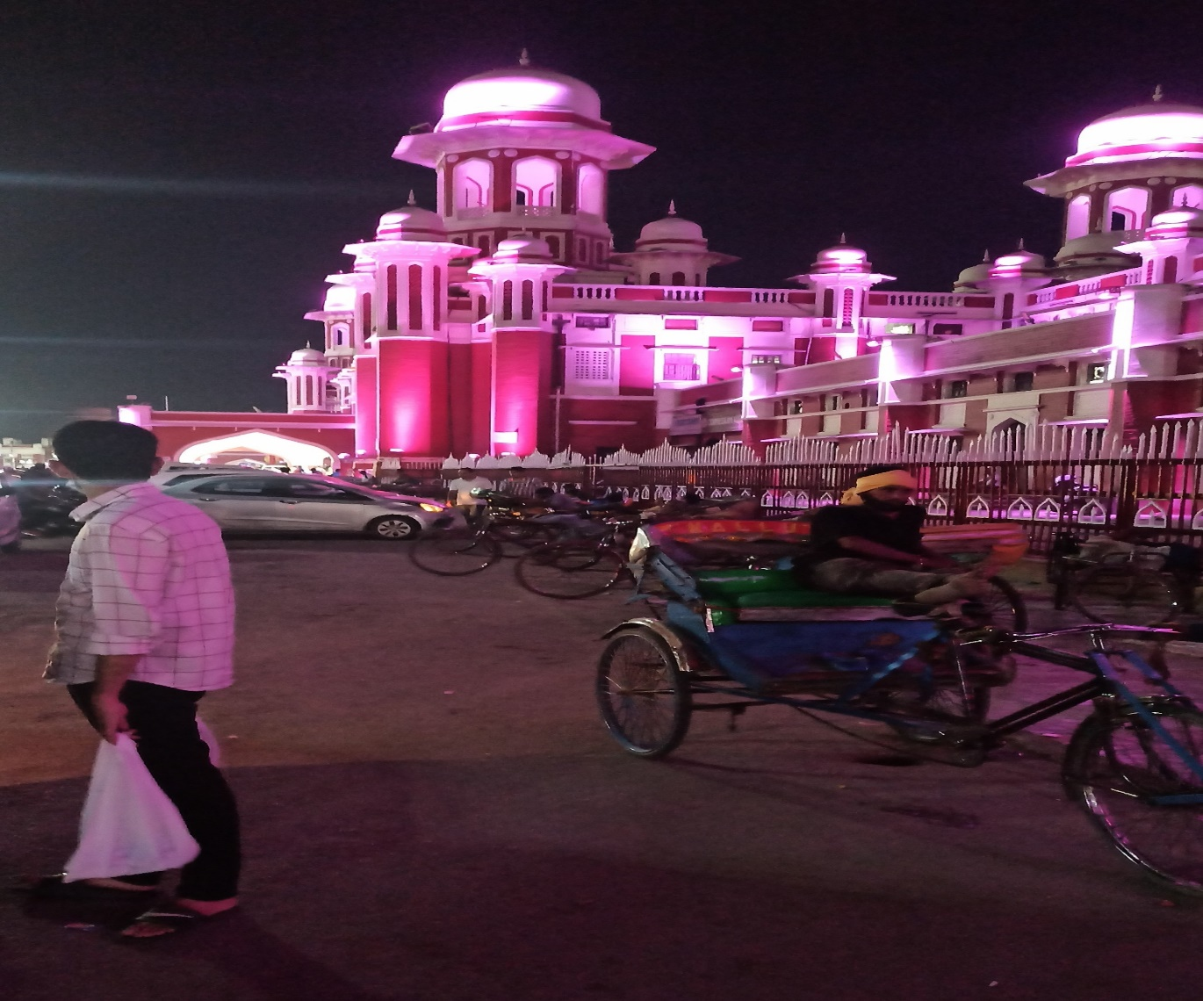
Cont..
Rickshaw Pullers in Charbagh railway station in mid-night

Slide 9
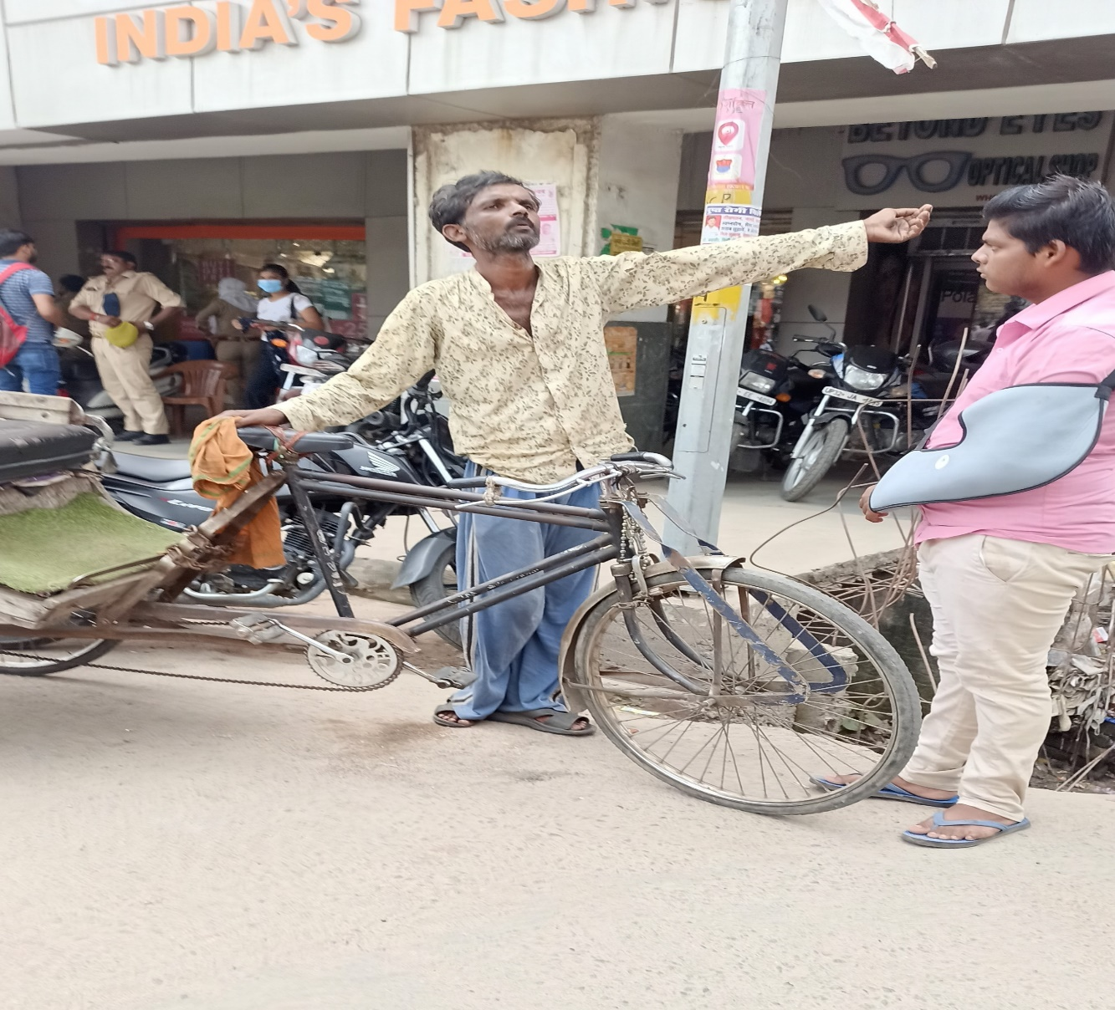
Cont..
Physique and dress sense of a rickshaw puller in CBD, Lucknow city

Slide 10
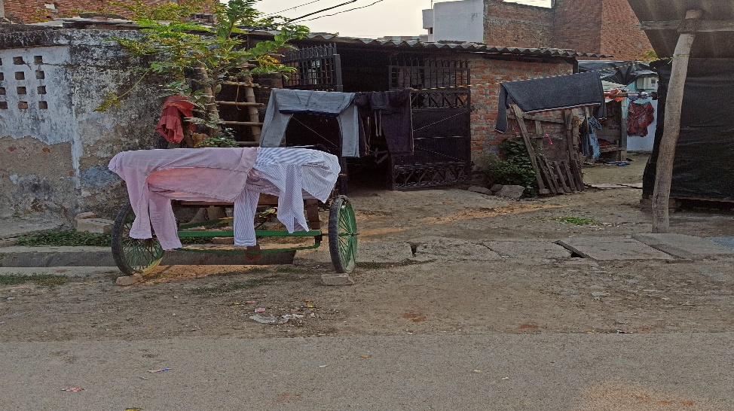
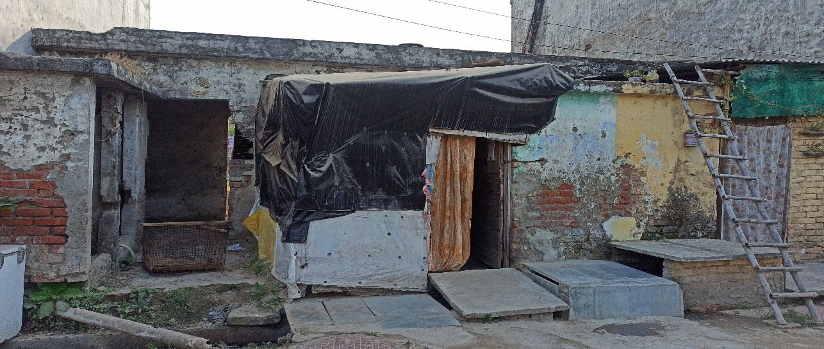
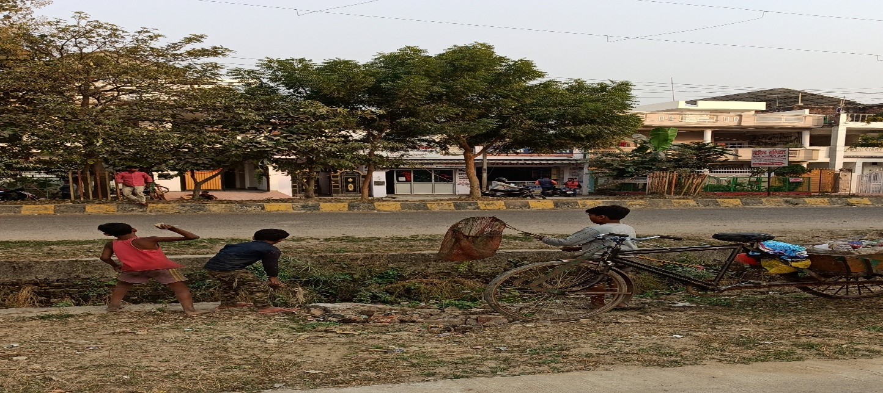
Cont..
Dwelling condition of RPs, and their children, Rickshaw colony behind the residential building in Lucknow city

Slide 11
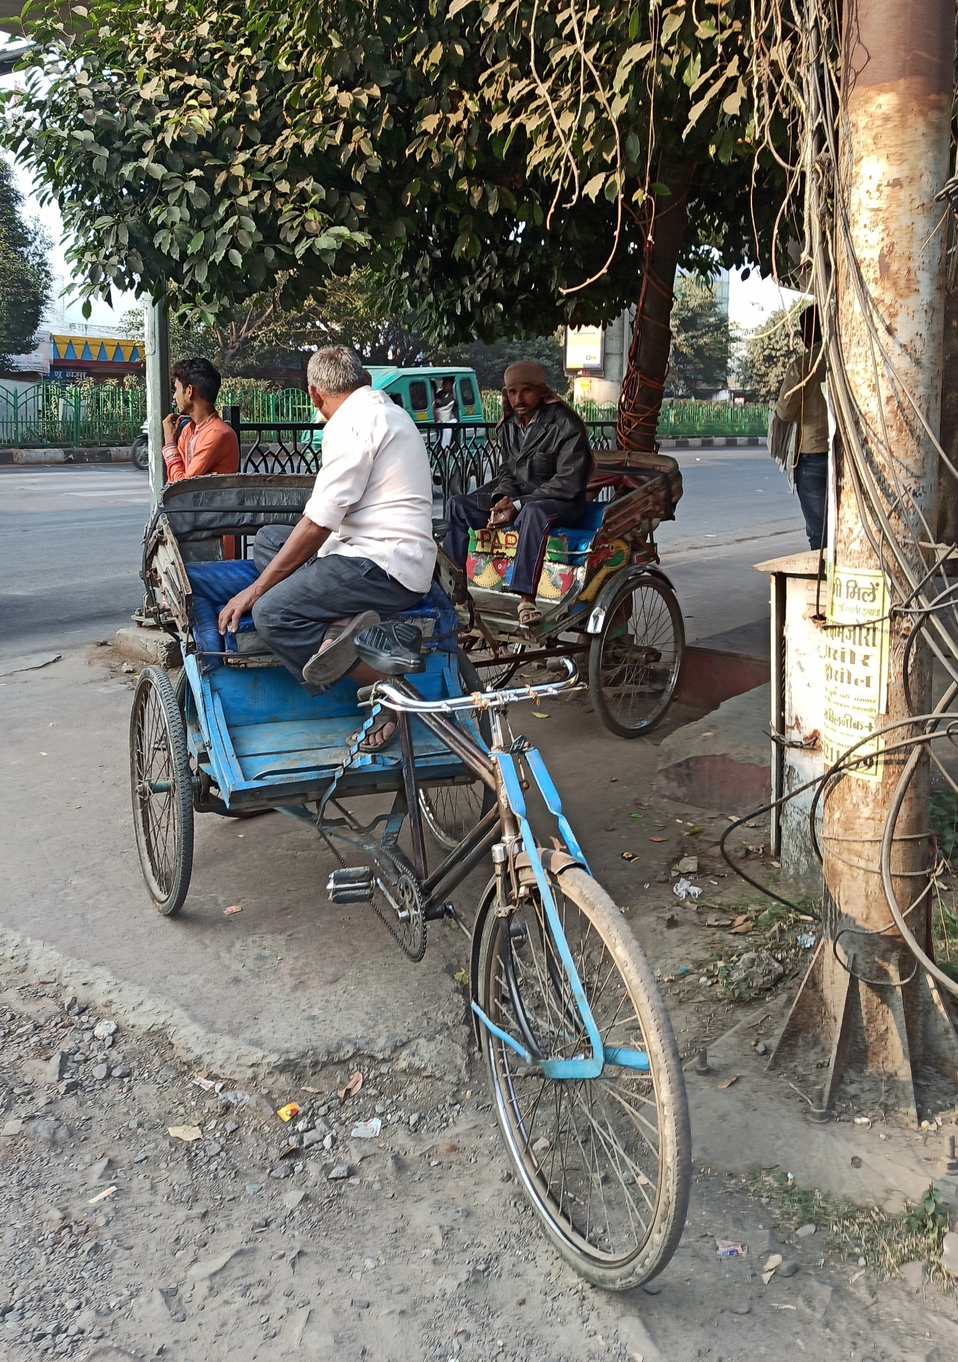
Cont..
Difference between Rickshaw pullers base on different social groups in Alambagh Lucknow city

Slide 12
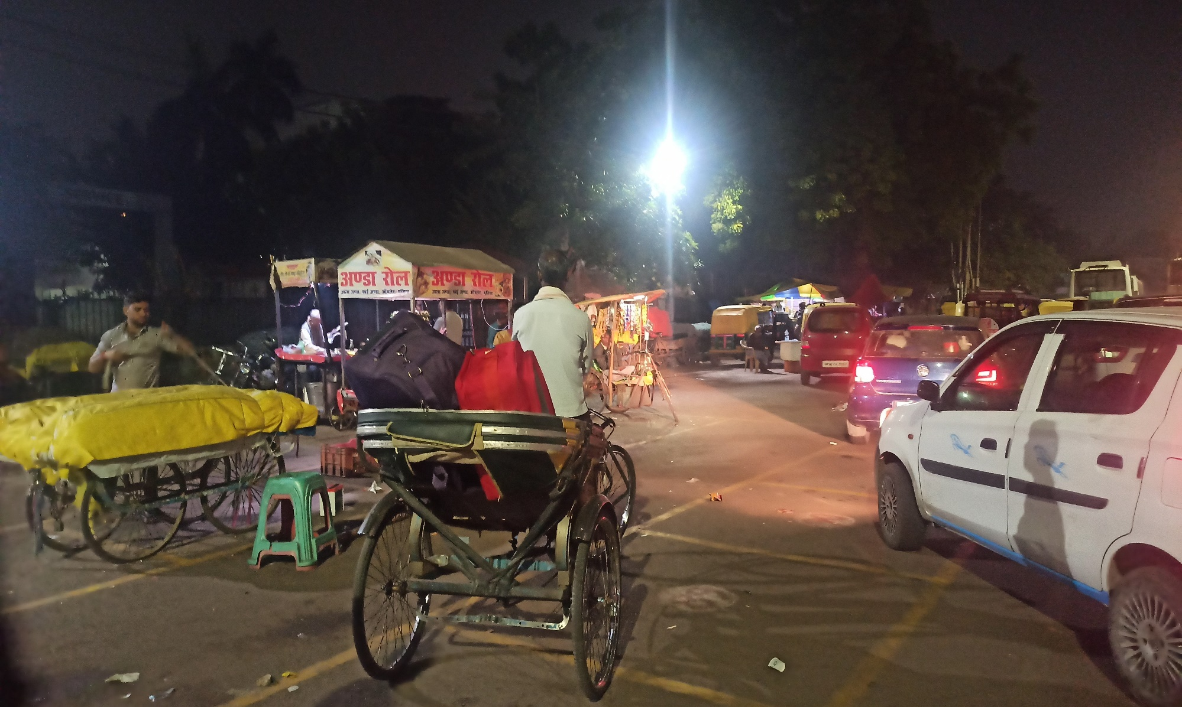
Cont..
Mid-Night working RPs in, Lucknow city

Slide 13
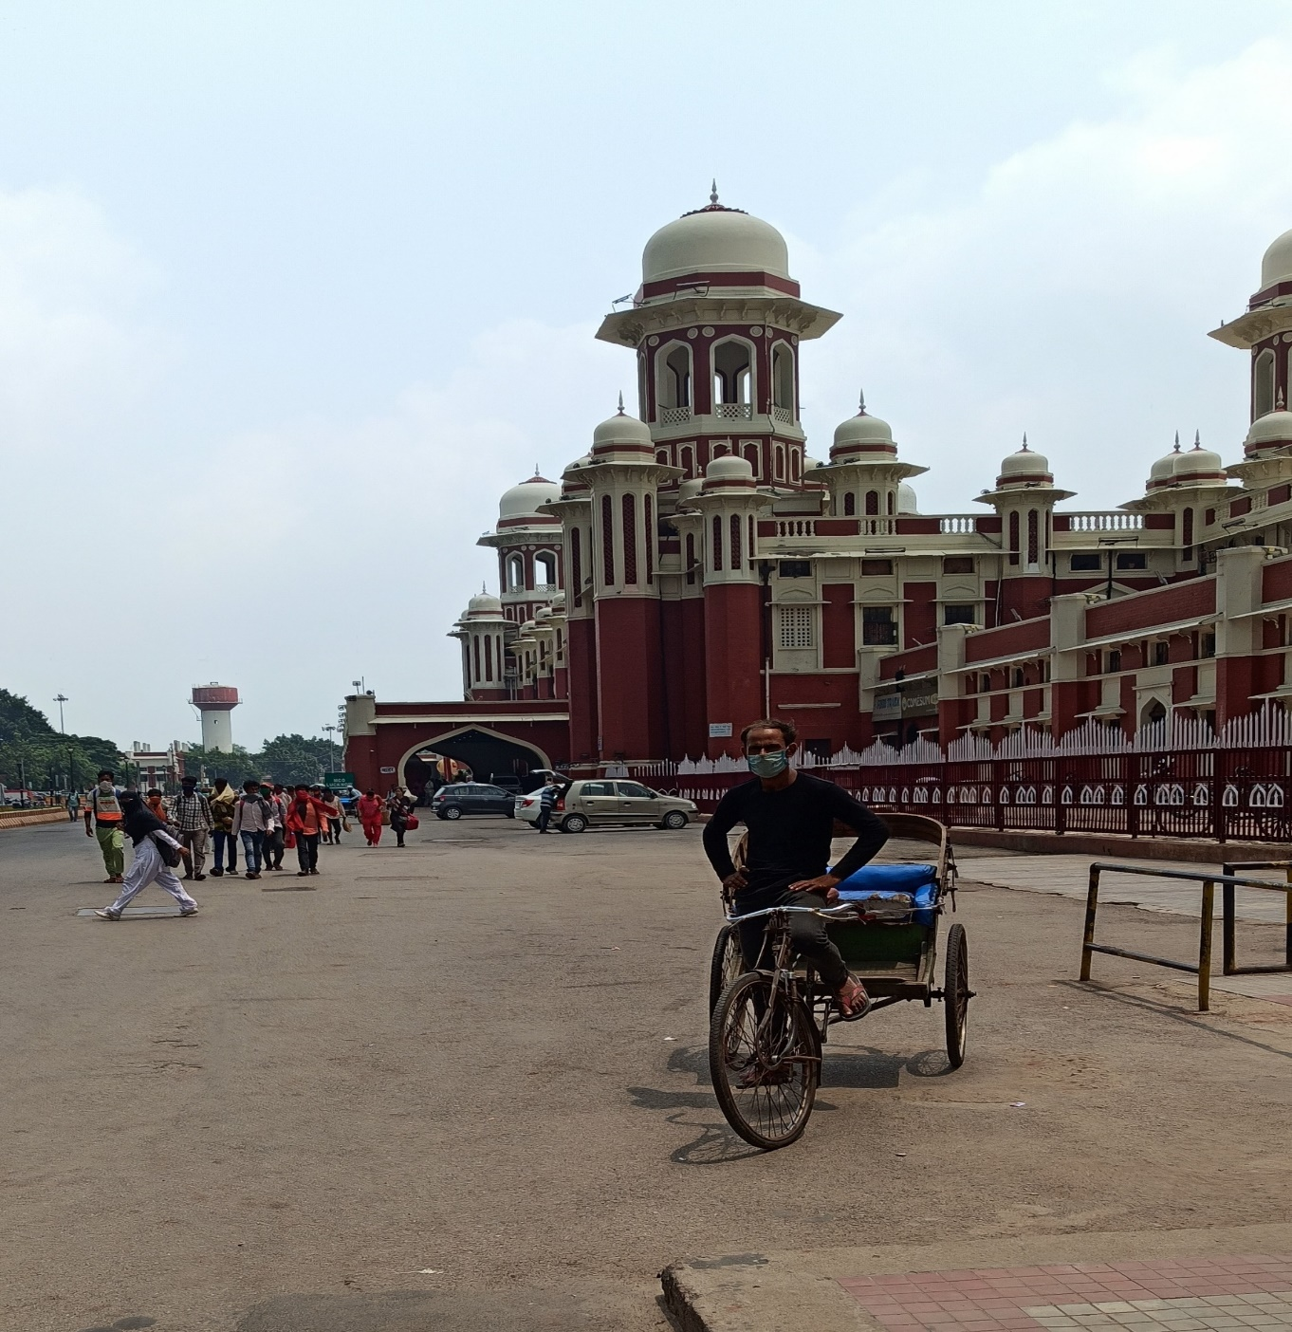
Cont..
Charbagh railway station in Lucknow city

Slide 14
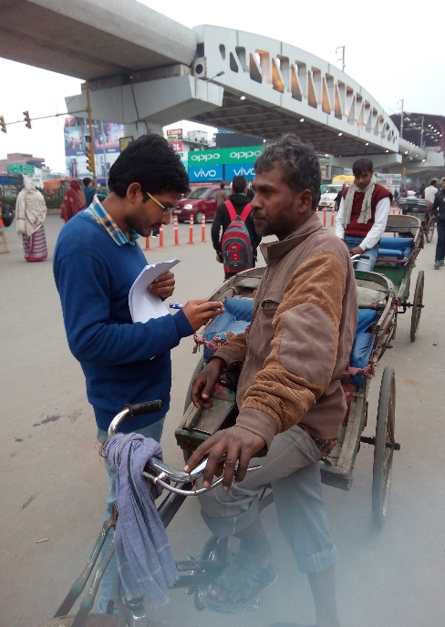
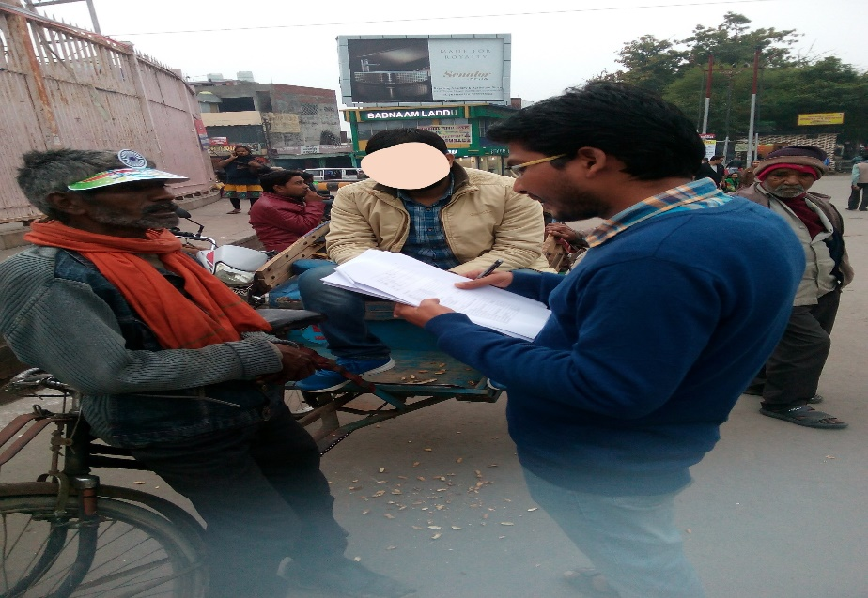
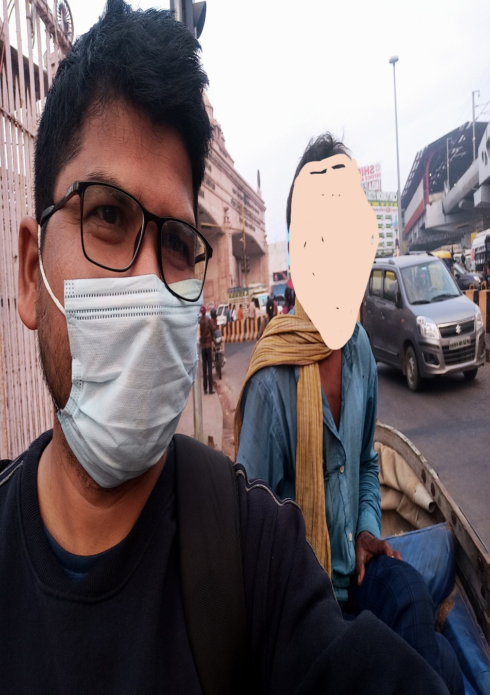
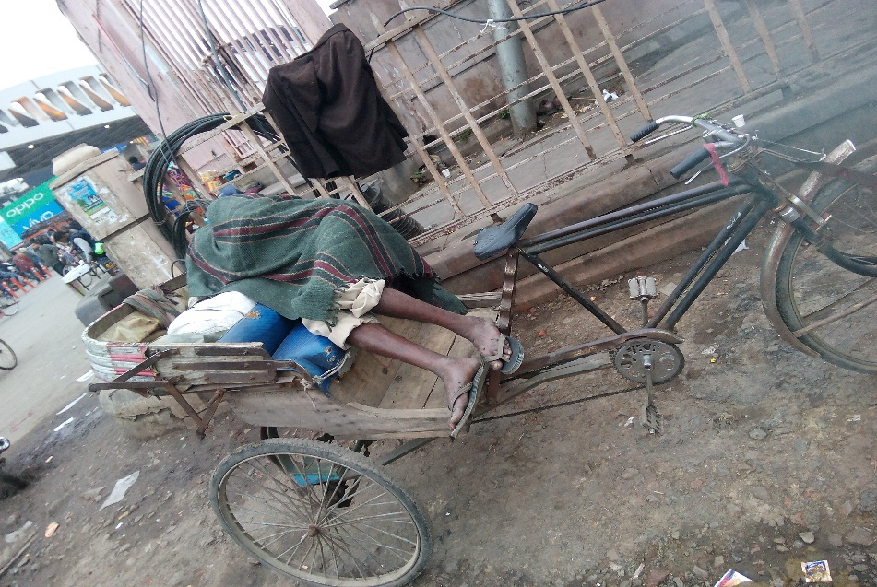
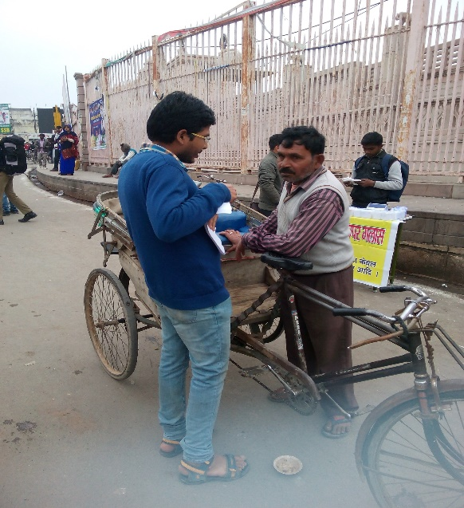
Cont..
Clothing habits among different socio-culture groups of RPs in Lucknow city

Slide 15
Finding and Conclusion
This Ethnographic study has revealed Rickshaw pullers come from different socio-culture backgrounds. 85percent Rickshaw pullers belonged to Hindus, the rest Muslims. Within Hindus has social division Indian caste system, 65percent were scheduled caste, 15 percent of other backward community people, rest of the general categories.
The Muslins community was the same hierarchy as the Hindus community. Rickshaw pullers are most of their neighbor's Districts as Hardoi, Unnao, Rae Bareilly, Sitapur, Lakhimpur Khiri districts migrating to Lucknow city for their livelihood.
During the interaction with rickshaw pullers, the research found most of them landless, agricultural, daily wages laborers , small landholders large family size. More than 96 percent of rickshaw pullers are non-local citizens. They are migrating to Lucknow city for their livelihood. The study has found no local jobs opportunities.

Slide 16
Cont..
Rickshaw pullers are a marginalized section of society. They are poor socio-economics cultural background section of society. Rickshaw pullers are bearing dirty, clothing and illiterate, unskilled, unemployment's and overburden of the family members. An ethnographic study has found the same culture but a different social status in the Indian social hierarchy. The Hindu rickshaw pullers are celebrating Holi and Dussehra. The Muslim RPs celebrate Ramazan and Eid-al-Fitr, together. The study has highlighted most rickshaw pullers migrated to Lucknow city alone and few with family. The study has highlighted the reality of dwelling conditions not good both origin and destination place.
The face-to-face interaction observed most of the rickshaw pullers have passed the night at open spaces on a rickshaw, railway stations, bus stands, Jhuggi/Slums, and a few rickshaw pullers living rented houses. This ethnographic study has revealed current novel coronal virus rupture their life and livelihood. 25 March 2020, India has suddenly declared a nationwide lockdown. They are lost jobs, shelter, food, fear of the virus infection, and are afraid lost near and dear. They are invisible citizens of the city. Most of them don't have proper documents.

Slide 17
Cont..
They live together with three or six members in slums or small rented rooms. They are sharing a kitchen, toileted, drinking water, and space. The study has found most rickshaw pullers enter this profession early age. The study has found why? They chose rickshaw pulling as their livelihood because of no need for formal or training. They are struggling double burden, one chronic poverty another historical subaltern of the Indian society.
The study has observed rickshaw pullers overnight working same time they did not get enough money to pay rickshaw rent or take a meal. The study has also found a high rate of school dropout of their children. The study has proposed government of India should take action effective policy implementation as social security, financial inclusion through a skill development program and subsidized loan for their established new business because Rickshaw pullers are facing competition from modern mean of transportation e.g. e-rickshaw, auto, etc.

Slide 18
Thank You

