Slide 1
An Empirical Study to Measure Effectiveness of Training Program Between Existing and Potential Women Entrepreneurs
Sania Sami
Indian Institute of Social Welfare and Business Management

Slide 2
“Empowering women is a prerequisite for creating a good nation, when women are empowered, a society with stability is assured.” - APJ Abdul Kalam (2013)
Indian Institute of Social Welfare and Business Research

Slide 3
Objective of the Study
Primary Objective
Measures the effectiveness of the training program in promoting entrepreneurship between women.
Hypothesis Formulated
Null hypothesis (H1): The training program was not effective.

Slide 4
Training
It is believed that training is vital is keeping updated with rapidly changing technology, concept, belief and business environment.

Slide 5
Women Entrepreneur Training
Idrus et al., 2014
40 women entrepreneurs in Malaysia
understand the effectiveness of training
Ismail, 2018
Review of impact of assessment
entrepreneurship training program -positive influence on both existing and potential entrepreneurs
Botha,2006
180 women included -116 women of them 15 women were potential women entrepreneurs
Result-the women entrepreneurship program - boost their business's efficiency and profitability.
entrepreneurship training combined with other nature of the package of interventions such as micro-finance or grants that widely influences the success of the program
Result-that women entrepreneur program (WNP) and not also trained women to build their own business & expand their business.
Training is required at all level of organisation for business success-results in running the business, improves their confidence, increase profitability and increase turnover.
obtain financial assistance for business and creative problem solving as their most important knowledge and skills for their business.

Slide 6
Women Entrepreneurship Training and Skill Development Program (WET&SDP)
Phase 1
Trainees' were divided into potential and existing women entrepreneurs.
Phase 3
Training were provided to women on following tracks
Unleashing Entrepreneurship
Identifying Business Opportunities & Leadership Skills
Compliance & Legal Formalities
Enhancing Networking & Work Life Balance Skill
Financial Awareness & Sustainable Entrepreneurship
Digital & Technological Skill
Phase 4
Post - assessment of trainees business skill and knowledge
Phase 5
Mentoring and counselling post one-week training program
Follow up- quaterly assessment post training beside providing financial assistance and mentoring.
Phase 2
Pre - assessment of trainees business skill and knowledge

Slide 7
RESEARCH METHODOLOGY
Research Design : descriptive and analytical research designs
The training was imparted: between 45 women of them 24 were existing entrepreneurs and 21 were potential entrepreneurs.
McNemar test was used to measure the effectiveness of the training program.

Slide 8
Women Entrepreneurship Training and Skill Development Program (WET&SDP)
Potential Women Entrepreneurs (21)
Established Women Entrepreneurs and their Business Profile (24)
Majority were aged between 23-28 i.e., 38.5% followed by the age group of 30-39.
About 42.85 % of the respondents i.e., 9 women were graduates.
The majority of the respondents (47.6 %) were married and (48.6%) were unmarried and only (1%) of trainees was a widow.
Aged between 36-43 (34.57%).
Graduates (33.3%) and postgraduates (25%).
Married- 17 (70.8 %) whereas 6- unmarried and 1-widow.
Sole proprietorship (45.8%) and partnership business (37.5%)
(75%) -registered whereas (25%)-unregistered business.
(29.2%) -annual turnover range between Rs 5 – 10 lacs. (25%) - Rs 50000-1.5 lac and (20.8%) - Rs 10 lac.
Trainees -manufacturing, trading, and service sectors.

Slide 9
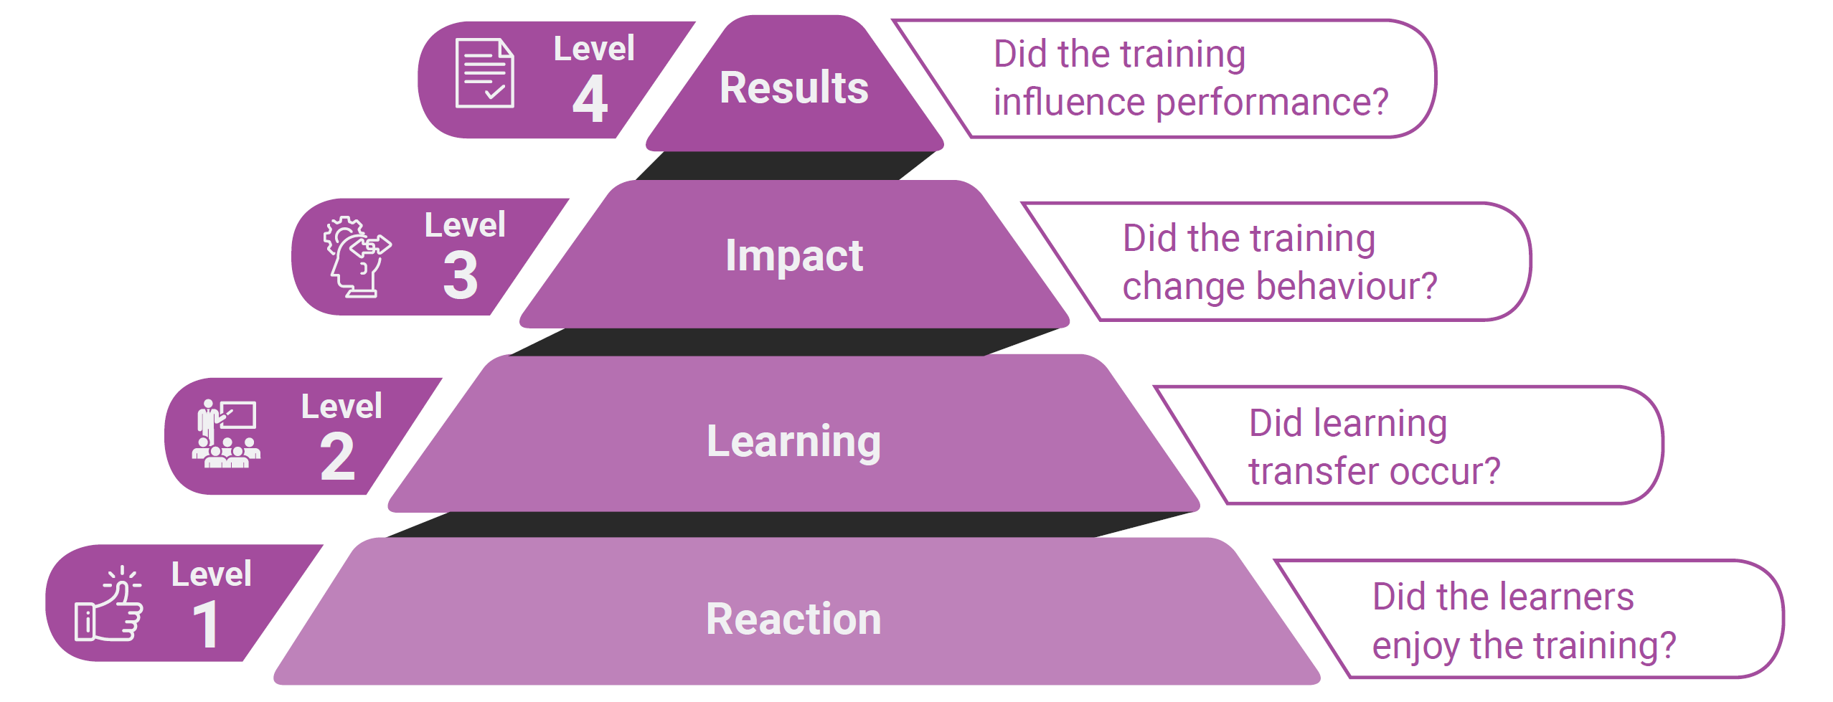
Effectiveness of Training Model: Kirkpatrick Model

Slide 10
McNemar test
“Are you convinced that you will start up a business after the program?”-Potential Entrepreneurs
Potential entrepreneurs |  |  |  |  | Existing entrepreneurs
Pre-training | Post-training |  | Total | Sig. | Pre-training | Post-training |  | Total | Sig.
 | Yes | No |  |  |  | Yes | No
Yes | 14 | 0 | 14 | .031 | Yes | 5 | 0 | 5 | .000
No | 6 | 1 | 7 |  | No | 18 | 1 | 19
Total | 20 | 1 | 21 |  | Total | 23 | 1 | 24
Before training, 14 women responded “Yes” and 7 responded “No”. Post-training responses 20 women responded “Yes” and 1 respond “No”. The McNemar test recognized that some 6 trainees change their response from “No” to “Yes” and only 1 trainee response remain unchanged. p-value is significant it means that the training program was effective.
“Are you convinced that your business will grow after the program?”-Existed Entrepreneurs
The training program was effective
From the same table, it was also found that the training program was also effective in the case of established entrepreneurs as the p-value was highly significant.

Slide 11
SUMMARY OF FINDINGS, CONCLUSION, SUGGESTION, AND FUTURE SCOPE
This chapter is intended for findings, based on the interpretations of the previous chapter, suggestions, focused on the findings of the present study, an overall conclusion.

Slide 12
Future Scope And Limitation Of The Study
Future Scope
limitation
sustainability, innovation, entrepreneurial stress, and personality variables that can be included in a future training.
Today’s youth can be tomorrow’s well-headed entrepreneurs.
Only Kolkata region was included in the study.
Longitudinal study is required to measure and generalize the overall effectiveness of the training.
Training was imparted to only forty-five women, and thus to measure the overall effectiveness of such training and skill development programs more women must be included in the research.

Slide 13
Sania Sami
MPhil (IISWBM)

