Slide 1
International e-Conference on Changes State, Economy, Public Health and Society January 16-17, 2022
Business Authenticity and Society : Propositions avoiding conflicts between consumers and producers.
Dr Fatima Ezzahra OUBOUTAIB (Presenter), Pr Abdellatif AITHEDA, and Pr Soumiya MEKKAOUI.
Research Team in Marketing Management and territorial communication. Morocco
Research Team in Marketing Management and Territorial Communication
National School of Commerce and Management

Slide 2
Plan
Literature Review: from Authenticity to Business Authenticity
Context of research
Purpose and Methodology
Results / Discussion
Conclusion

Slide 3
Authenticity’s quest…
influences the motivations of tourists seeking to discover other cultures (Maccannell 1973; Cohen 1988; Asplet and Cooper 2000).
is a feature of the modern consumer who seeks to trace a link with his origins and to satisfy a lack (Cova and Cova, 2001), hoped sense of history (Napoli et al., 2014)
the characteristic of a craft product of an art craft because it is made by an original designer (Bergadaà 2008).

Slide 4
Authenticity approaches
The perception of authenticity is related to different criteria : handmade production (Camus, 2000), manufacturing by an artisan (Bergadaà,2008), naturals ingredients (Carroll & Swaminathan, 2000).
From the business authenticity’s literature, product can acquire authenticity by building a sense around the perception of nostalgia, cultural symbolism, sincerity and job's passion
Objective is related to only object
Constructive : authenticity is socially constructed, different consumers may have different interpretations of the authenticity of an object
Existential : is a perceived concept, it
refers to the emotions of the individual and the consumer’ authentic self during consumption

Slide 5
Social responsibilities :
Social responsibilities concept is often conceptualized as firm activities that go beyond the exclusive economic interests, but that benefit also the society ( Davis 1973).
Doing well by doing good to the society (Aguilera et al. 2007)
SR organizational activities designed to make a positive impact on society, if businesses only engage in SR when there is fast pay off, then they may miss chances to mark a positive difference in the society.

Slide 6
Authenticity and Social responsibilities of Producer : toward a deep dialogue of conflictual interest
Make a positive effect on the society by being true to the core mission of the business
Producers should have a rich and shared sense of their production’s values and purpose
BOTH THE
Process production focuses on collective how know of the society
AND
Clear communication of these values Beverland 2005
The quest for authenticity gives consumer the opportunity to find one's personal identity namely one's true self and one's more or less emotionally rich history (Napoli, 2014; Camus, 2007).
Consumer meets authenticity in the reconstruction of the local past that allows them to live the real life with a minimum respect of collective imaginary of the society (Cova and Cova, 2004).
Responsive producers are willing to listen to and learn from consumers, including critics, who bring a different perspective to the issues. In this way, they are connected to their social context and remain aware of its needs and expectations (Carroll 1979).

Slide 7
When are a producer’s SR efforts most likely to be perceived as authentic by consumers?

Slide 8
Context of research
National strategy : Moroccan Green Plan (Digital orientation 2020-2030)
The cooperative sector has a pilot place in the programs of sustainable development, economic, social and solidarity with a growth in the number of members from 5749 to 15,737 between 2007 and 2011; and from 15,737 to more than 30,000, between 2011 and 2018
Morocco has several local products Argan oil,
honey, saffron, olive oil…

Slide 9
Research design
Research objectives | Explore the possible relationship between Business authenticity and social responsibilities of producers Determine the core orientation of this relationship
Methodology | Qualitative research with Nvivo Triangulation between theory and semi-directive interviews with producers

Slide 10
Results and discussions

Slide 11
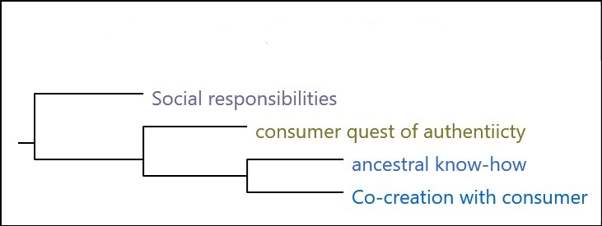
Similarity Analysis (with Nvivo)
3 Branches

Slide 12
Business Authenticty’s Cloud

Slide 13
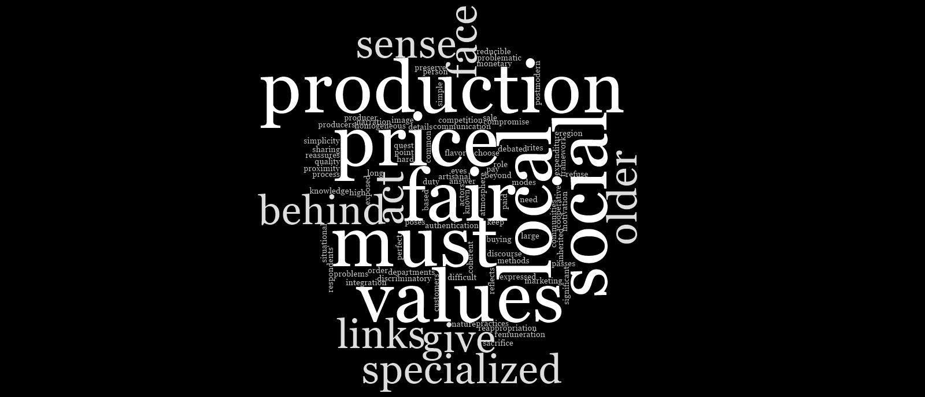
Business Authenticity's challenges

Slide 14
Results
-Real production values
-Authentic intention of production
-Qualification by the society (local tribe)
-Valuation of consumption rituals (differences are a great rich)
-Business authenticity challenges :
-Production costs (social and societal aims)
-Technological invention (Young consumer)
-Non-perfect competition (globalization)
Increasing of Business authenticity
Regression of Business authenticity

Slide 15
Conclusion/ Implications
Globalization has caused a greater interest to the business authenticity .
-> Managers should aim at capitalizing on these results by improving their communication's arguments, for example :
offering supplements about the real identity (Who they are?)
traditional production's process and its values for the society (mark the long-lasting real value)

Slide 16
Conclusion/ Implications
In a global context, the business authenticity seems problematic for producers. This can be partially explained by increased differences between societies.
-> Given that authenticity is very linked to the origin culture and area, it is then logical to assume that globalization is not inline with its characteristic. Producers should more invest to their real identity and specificity.

Slide 17
Conclusion/ Implications
Above discussion reflects that attributions of authenticity are ever-changing in that these may change over time and place (within the society)
Authenticity’s definition are being constructed and reconstructed by both consumers and their real-social values, business authenticity is evaluated along these two core dimensions.

Slide 18
Thank You For Your Attention

