Slide 1
Assessment of different environmental parameters for better understanding impact of abiotic pollutants on public health
in and around Jhariya coalfields
Md. Imran Ahmad
Research Associate
niTza Bioventure, Hyderabad, India

Slide 2
CCONTENTONTENTS
INTRODUCTION
OBJECTIVES
STUDY AREA
METHODOLOGY
RESULTS
DISCUSSION
CONCLUSION

Slide 3
Introduction
Due to rapid industrialization and increase in population, there is a huge requirement of energy production to fulfill all the necessities of the overall population.
Coal is one of the major sources of energy as it is used in electricity generation, steel production, cement manufacturing etc.
Therefore coal production as well as coal mining has enormously increased in India. Coal mining leads to air pollution and soil contamination in the local environment (Saini et al., 2016).

Slide 4
Objectives
To determine the air pollution status in and around Jharia coalfield Dhanbad, Jharkhand, India.
To determine the soil quality in and around Jharia coalfield Dhanbad, Jharkhand, India.

Slide 5
Study Area
Features | Dhanbad
Latitude | 23⁰37’3’’ N - 24⁰04’ N
Longitude | 86⁰06’30’’ E - 86⁰50’E
Elevation (above mean sea level) | 222 m
Area | 2,090 Km²
Population (2011 Census) | Total | 26,82,662
 | Urban | 15,59,416
 | Rural | 11,23,246
Density (people per Km²) | 1,284
Mining Activities | Coal, Fire Clay
Industries | Cement factories, Coal washeries, Refractories, Hard Coke Oven Plants, Beehive Coke Oven Plants, Bricks and other miscellaneous industries.

Slide 6
Methodology
Air Quality Index
According to Central Pollution Control Board (CPCB), the Air Quality Index (AQI) is an index for reporting daily air quality. It tells us how clean or polluted air is, and what associated health effects might be a concern for us.
AQI was calculated by the formula given by Rao and Rao (1989).

Slide 7
Air Quality Assessment
PM_{2.5} - Portable Aerosol Spectrometer
PM₁₀ - Portable Aerosol Spectrometer
SO₂ - Portable Gas Sampler
NO₂ - Portable Gas Sampler

Slide 8
Heavy Metal Analysis
Air dried sample of will be digested with HNO₃ and HClO₄ in 9:4 ratio at 80 °C until a clear transparent solution will be obtained (Tyler, 1974).
The solution will be filtered and maintained to 25 mL with double distilled water.
The concentrations of heavy metals in filtrate of soil samples will be determined with the help of Inductively coupled plasma mass spectrometry (ICP-MS).

Slide 9
Physico-chemical parameter
Bulk Density - Gravimetric method
Power of Hydrogen (pH) - pH meter
Electrical conductivity (EC) - Electrical conductivity meter
Organic Carbon (OC) - Walkley and Black, 1934
Available Nitrogen (N) - kjeldahl method
Available Phosphorus - Bray’s method

Slide 10
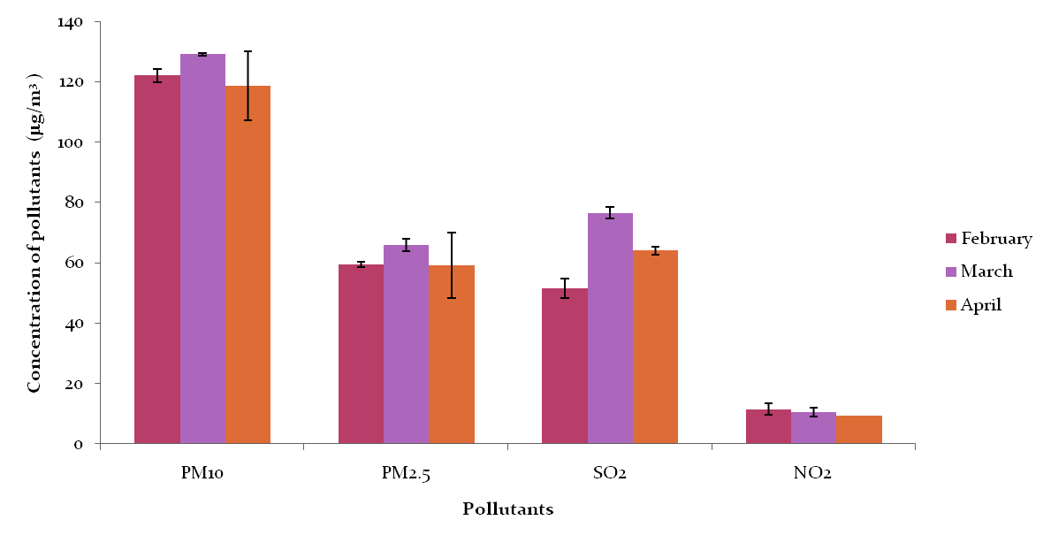
Results
Figure: Graphical representation of Concentration of different air pollutants at (S-1) CIMFR.
Notes:
10

Slide 11
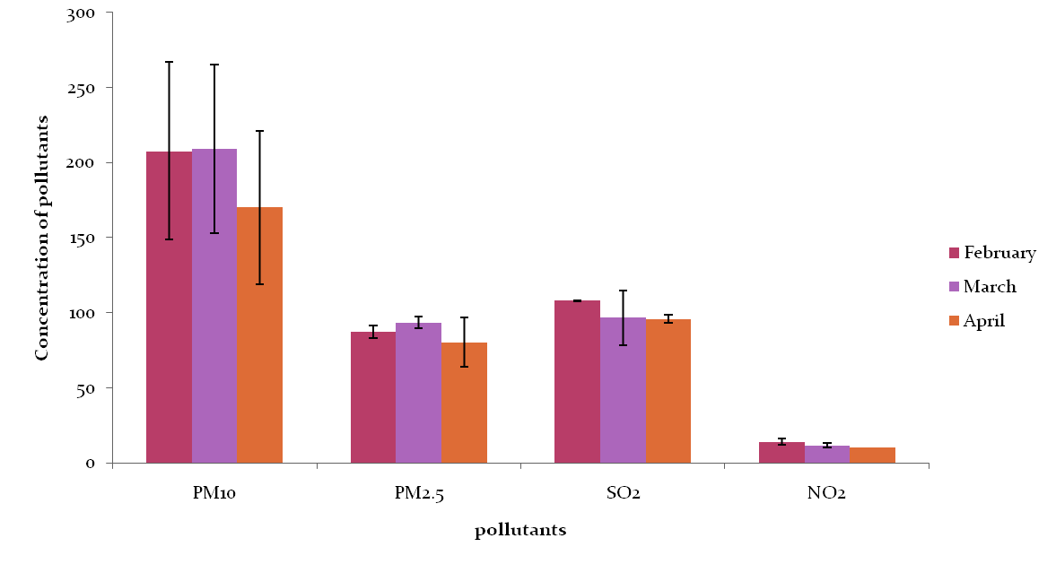
Figure: Graphical representation of Concentration of different air pollutants at (S-2) Digwadih.

Slide 12
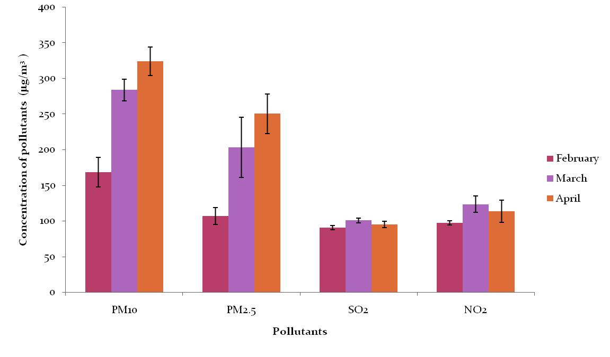
Figure: Graphical representation of Concentration of different air pollutants at (S-3) Jharia.

Slide 13
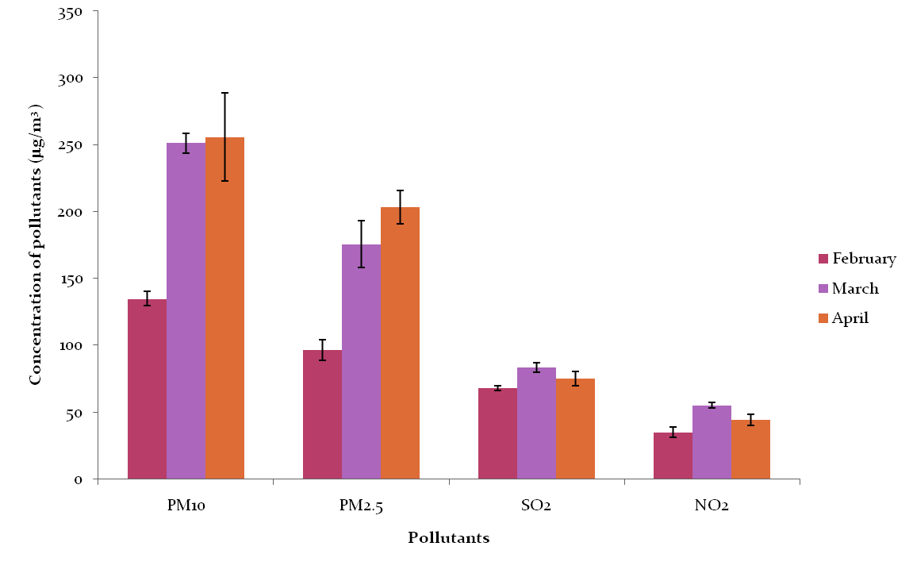
Figure: Graphical representation of Concentration of different air pollutants at (S-4) Chasnala.

Slide 14
Air Quality index (AQI)
Site | Months |  |  | Average
 | February | March | April
CIMFR | 74.87 | 86.844 | 77.28 | 79.665
Digwadih | 126.365 | 124.96 | 108.9925 | 120.1058
Jharia | 145.314 | 225.501 | 250.296 | 207.037
Chasnala | 121.617 | 178.782 | 185.985 | 162.128

Slide 15
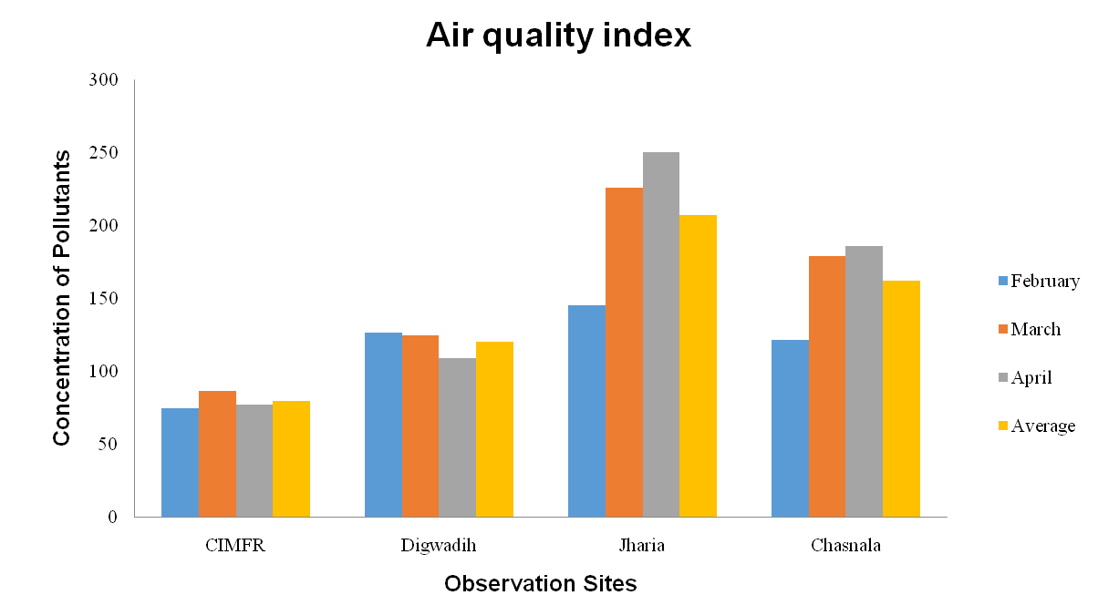
Figure: Graphical representation of air quality index of different site

Slide 16
Concentrations of heavy metals of Jharia
Sl. No. | Heavy Metal | Concentrations (ppm)
1 | Mn | 582.645
2 | Zn | 100.665
3 | Ni | 60.985
4 | Cu | 51.755
5 | Pb | 55.16
6 | Cr | 144.41
7 | Cd | 0.42

Slide 17
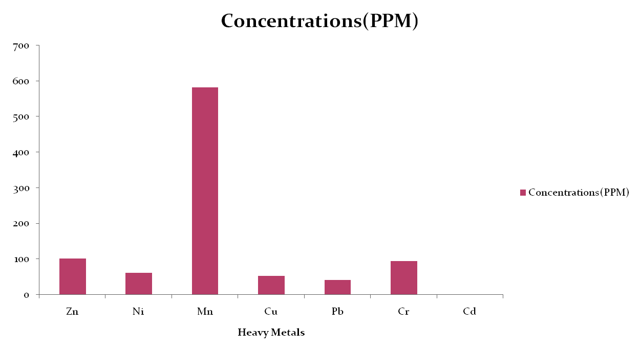

Slide 18
Soil Physico-chemical properties of Jharia
Sl. No. | Soil properties | Average Value
1 | pH | 5.515
2 | Bulk Density | 1.324 g/cc
3 | Electrical conductivity | 0.15 dS/m
4 | Water Holding Capacity | 58.91 %
5 | Organic Carbon | 0.069 %
6 | Available Nitrogen | 72.2 kg/ha
7 | Available Phosphorous | 4.24 kg/ha
8 | Available Potassium | 353.92 kg/h

Slide 19
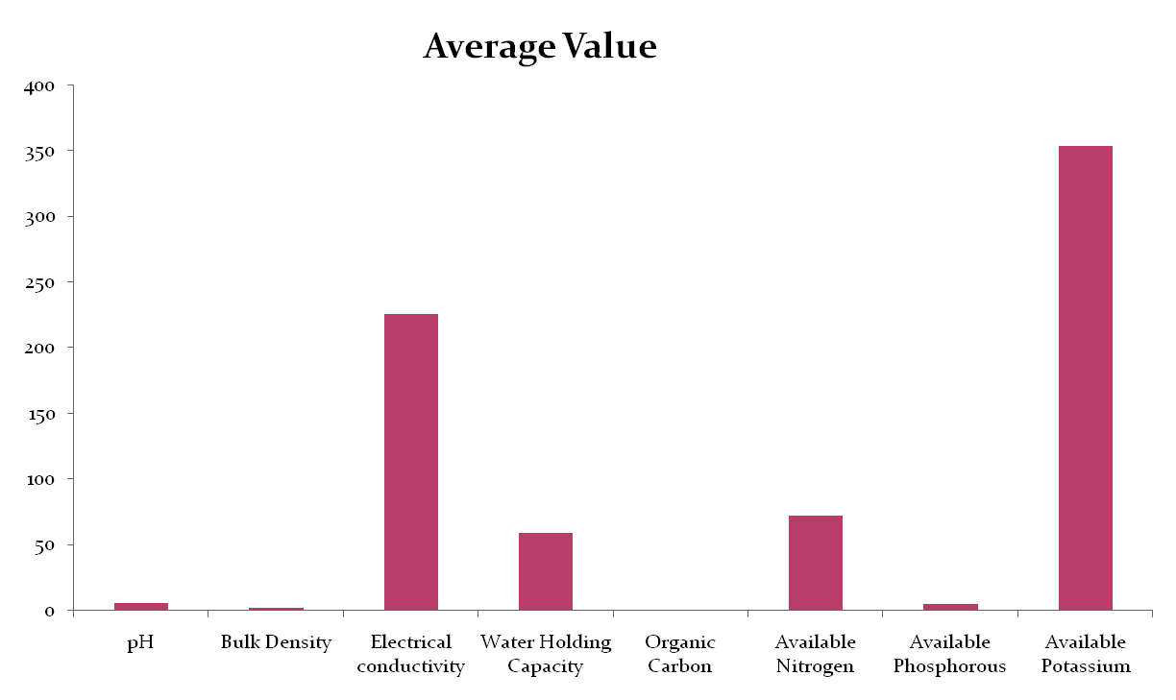

Slide 20
Conclusion
According to AQI most unhealthy air is of Jharia and most healthy is of CIMFR.
It also concluded that the soil samples collected from the coal mining areas are poor in organic carbon, available nitrogen and available phosphorus due to lower amount of microbial activities in the Jharia soil samples.
Bulk densities of the soil samples are in medium range.. pH of the sampling sites is slightly acidic in nature, under these (acidic) conditions of soils, growth of plant is affected. The soil sample at the sampling sites was not found suitable for plant growth.
Soils around the Jharia coal mine were also contaminated with heavy metals. The concentrations of Mn, Zn, Cr, Ni, Cu, Pb, Cd is 582.645, 100.665, 93.625, 60.98, 51.755, 41.26 and 0.42 respectively, which deteriorates the properties of the existing soil layers in the area that’s limits the ability of the soil to support vegetation.

Slide 21
References
Ali, H., Khan, E. &Sajad, M. A. (2013).Phytoremediation of heavy metals-concepts and applications. Chemosphere, 91(7), 869-881.
Bera, S., Ahmad, M. &Dey, M. (2017). Satellite Image Based Study for Land Use Land Cover Changed due to Mining Activity during (1987 to 2011) at Dhanbad District of Jharkhand. International Journal for Scientific & Development, 4(12), 962-965.
Chaulya, S. K. (2004). Spatial and temporal variations of SPM, RPM, SO 2 and NO x concentrations in an opencast coal mining area. Journal of Environmental Monitoring, 6(2), 134-142.
Goswami, S.(2015) Impact of Coal Mining on Environment: A Study of Raniganj and Jharia Coal Field in India.
Mishra, N. & Das, N. (2017). Coal Mining and Local Environment: A Study in Talcher Coalfield of India. Air, Soil and Water Research, 10, 1178622117728913.
Mondal, G. C., Singh, A. K., Singh, T. B., Singh, S., Singh, K. K. &Tewary, B. K. (2009). Assessment of Air quality in and around west-bokaro coalfields, Hazaribagh. Indian J Environ Prot, 29(7), 577-591.
Pandey, B., Agrawal, M. & Singh, S. (2014). Assessment of air pollution around coal mining area: emphasizing on spatial distributions, seasonal variations and heavy metals, using cluster and principal component analysis. Atmospheric Pollution Research, 5(1), 79-86.
Prathap, A., Kujur, V., Chakraborty, S. & Bhattacharya, T. (2016). Assessment of soil characteristics in the vicinity of open cast coals mine and its suitability for vegetative reclamation in Charhi and Kuju of Jharkhand, India. Journal of environmental biology, 37(4), 523.
Rai, A. K., Paul, B. & Singh, G. (2011). A study on physico chemical properties of overburden dumps materials from selected coal mining areas of Jharia coalfields, Jharkhand, India. International Journal of Environmental Sciences, 1(6), 1350.
Yadav, S. K., Jain, M. K., & Patel, D. K. (2018). Monitoring of Air Pollution in Different Regions Along Road Network, Jharia Coalfield, Dhanbad, India. In Environmental Pollution (pp. 125-134).Springer, Singapore.

Slide 22
Thank You

