Slide 1
Nutritional Assessment of School-Going Children in district Doda of Jammu & Kashmir, India
Dr. Om Raj Katoch
Faculty, Department of Economics
Government Degree College Batote, J&K
University of Jammu, India
Email: orkatoch@gmail.com
Mob. +91-9419166014

Slide 2
What is Manutrition?
2021
The condition of a person that is influenced by the intake and utilization of nutrients is called nutritional status
a) Stunting:
Children who are less than two standards deviation below the median of the reference population in terms of height-for-age are considered short for their age or stunted.
b) Wasting:
Children who are less than two standards deviation from the median of the reference population in terms of body-mass-index for age are considered wasted.
(c) Underweight:
Children who are less than two standards deviation from the median of the reference population in terms of weight-for-age are considered underweight.
(d) Overweight:
Children who are above two standards deviation from the median of the reference population in terms of weight-for-age are considered overweight.

Slide 3
Malnutrition
2021
Malnutrition among children is a major public health problem in India . As per the Estimate of NFHS -5, malnutrition in J&K
Stunting
26.9 Percent
Wasting
19 Percent
Underweight
21 Percent
Overweight
9.6 Percent

Slide 4
Objectives of Study
2021
The present study was carried out in district Doda of Jammu & Kashmir with the following objectives:
To know the prevalence of undernutrition among school going children of 6-14 years old in primary and middle schools of district Doda of Jammu & Kashmir.
To construct the composite index of anthropometric failure (CIAF) based on three – stunting, wasting and underweight - commonly used indicators of undernutrition.

Slide 5
Importance of CIAF
2021
A development economist [Sved Peters Berg] argues that conventional indices i.e. stunting, wasting and underweight are not sufficient for measuring the overall prevalence of undernutrition among young children. These conventional indicators of malnutrition indicated different aspects of anthropometric failure. By using these indices only, we failed to answer the question as how many undernourished children are there in a particular region.
Stunting
26.9 Percent
Wasting
19 Percent
Underweight
21 Percent
Overweight
9.6 Percent

Slide 6
Material & Methods
2021
Area under Study
Sample Size - 360
Questionnaire
Anthropometric Measurement
Statistical Analysis -epi info 7
(available at www.cdc.gov)

Slide 7
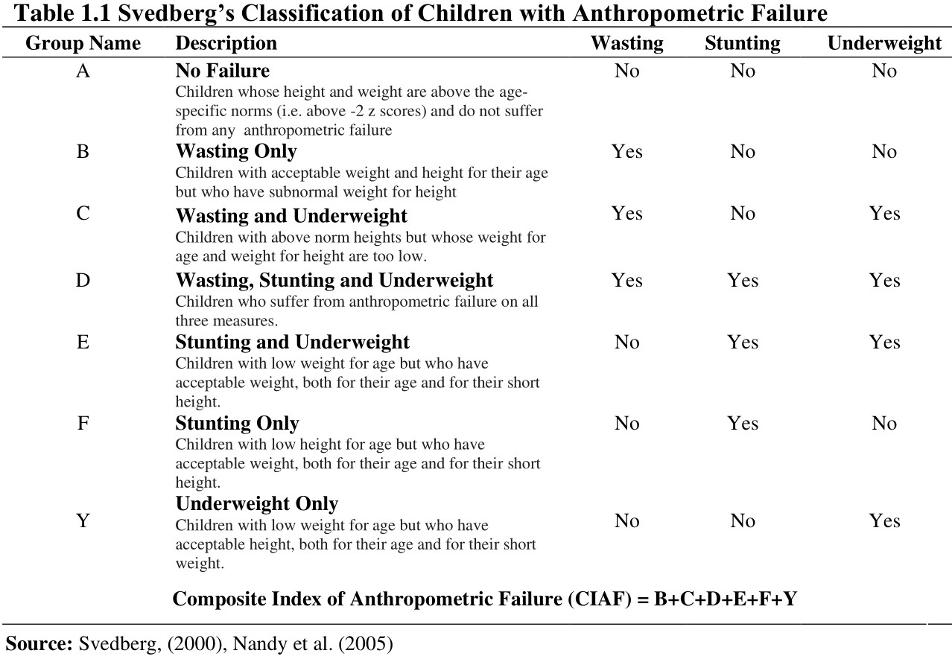

Slide 8
Results & Discussion
Table 1.2. Nutritional status among school-going children by gender (6 – 14 years) (n = 360)
Nutritional Status | Male (n=184) | Female (n=176) | Total (n=360 | Chi-Square (χ²) | Odds Ratio (OR) (95%CI)
Stunting (Height-for-Age) | 35 (19.02) | 41 (23.30) | 76 (21.11) | χ² = 0.9865* P = 0.320591 | 1.29 (0.78-2.15)
Wasting (BMI-for-Age) | 10 (5.44) | 24 (13.64) | 34 (9.44) | χ² = 7.0751** P = 0.007816 | 2.75 (1.27-5.93)
Underweight (Weight-for-Age) | 10 (5.43) | 22 (12.50) | 32 (8.89) | χ² = 14.1832** P = 0.000166 | 2.49 (1.14-5.41)
Source: Field Survey, Values in brackets are in percentages *Not significant ** Significant at 95% level

Slide 9
Results & Discussion
Fig. 1.1 Prevalence of undernutrition by gender (6-14 years) (n=360)

Slide 10
Results & Discussion
Table 1.3 Nutritional status among school-going children by zones (6-14 Years) n=360)
Nutritional Status | Zone-Assar (n=120) | Zone-Bhagwah (n=120) | Zone-Doda (n=120) | Total (=360) | Chi-Square (χ²)
Stunting (Height-for-Age) | 23 (19.17) | 34 (28.33) | 19 (15.83) | 76 (21.11) | χ² = 6.0378** P = 0.048855
Wasting (BMI-for-Age) | 10 (8.33) | 13 (10.83) | 11 (9.17) | 34 (9.44) | χ² = 0.4547* P = 0.796638
Underweight (Weight-for-Age) | 11 (9.17) | 16 (13.33) | 5 (4.17) | 32 (8.89) | χ² = 6.2424** P = 0.044105
Source: Field Survey, Values in brackets are in percentages *Not significant ** Significant at 95% level

Slide 11
Results & Discussion
Fig. 1.2 Prevalence of undernutrition by zone (6-14 years) (n=360)

Slide 12
Results & Discussion
Table 4. Subgroups of anthropometric Failure among children aged 6 – 14 years
Group Name | Description | Zone-Assar (n=120) |  | Zone-Bhagwah (n=120) |  |  | Zone-Doda (n=120) |  |  | Total (n=360)
 |  | No. of Children | % |  | No. of Children | % |  | No. of Children | % |  | No. of Children | %
A | No Failure | 62 | 51.67 |  | 39 | 32.50 |  | 80 | 66.67 |  | 181 | 50.28
 | Children whose height and weight are above the age-specific norms (i.e. above -2 z scores) and do not suffer from any anthropometric failure
B | Wasting Only | 10 | 8.33 |  | 13 | 10.83 |  | 11 | 9.17 |  | 34 | 9.44
 | Children with acceptable weight and height for their age but who have subnormal weight for height
C | Wasting and Underweight | 5 | 4.17 |  | 3 | 2.50 |  | 2 | 1.67 |  | 10 | 2.78
 | Children with above norm heights but whose weight for age and weight for height are too low.
D | Wasting, Stunting and Underweight | 2 | 1.67 |  | 3 | 2.50 |  | 0 | 0.00 |  | 5 | 1.78
 | Children who suffer from anthropometric failure on all three measures.
E | Stunting and Underweight | 7 | 5.83 |  | 12 | 10.00 |  | 3 | 2.50 |  | 22 | 6.11
 | Children with low weight for age but who have acceptable weight, both for their age and for their short height.
F | Stunting Only | 23 | 19.17 |  | 34 | 28.33 |  | 19 | 15.83 |  | 76 | 21.11
 | Children with low height for age but who have acceptable weight, both for their age and for their short height.
Y | Underweight Only | 11 | 9.17 |  | 16 | 13.33 |  | 5 | 4.17 |  | 32 | 11.39
 | Children with acceptable height for their age but who have subnormal weight for age
CIAF = B+C+D+E+F+Y = |  | 58 | 48.33 |  | 81 | 67.5 |  | 40 | 33.33 |  | 179 | 49.72
Source: Field Survey,

Slide 13
Conclusion
The prevalence of child undernutrition based on the different classification of CIAF, enables us to interpret the conventional indices of child undernutrition in terms of overall prevalence.
The overall CIAF for zones – Assar, Bhagwah and Doda were reported as 48.33 percent, 67.5 percent, and 33.33 percent respectively.
CIAF in respect of zone Bhagwah was observed as the highest.
The CIAF for Doda was observed as low (33.33 percent)
The overall CIAF in the study area was reported as 67.5 percent.
Reasons
Income, Lack of irrigational facilities, etc.

Slide 14
Thank You

