Slide 1
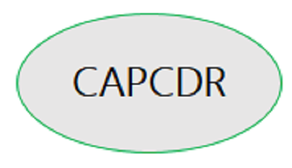
MARK LOUIE B. PAULO
mark.paulo076@gmail.com
LIZA NUR S. TAPANG
lizatapang1990@gmail.com
JOHN PAUL C. MERCADO
jm6781736@gmail.com
CATHERINE L. ENRIQUEZ
cathenriquez2018@gmail.com
College Of Teacher Education, Zamboanga Peninsula Polytechnic State University Student, Bachelor of Secondary Education - Major in Mathematics

Slide 2
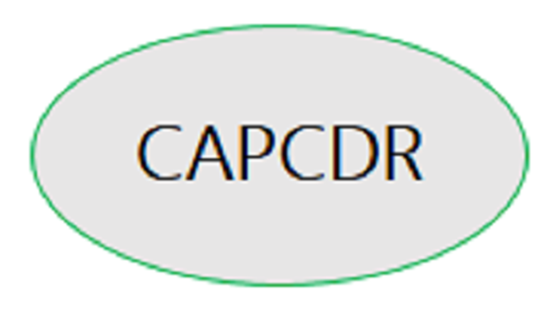
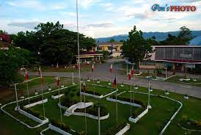
Zamboanga Peninsula Polytechnic State University RT Lim Boulevard, Zamboanga City

Slide 3
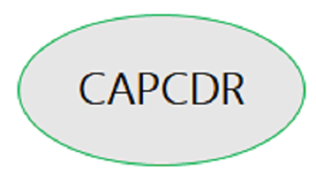
Exploring Preservice Teachers’ Attitude Towards Learning Mathematics: Basis for Curricular Enrichment

Slide 6
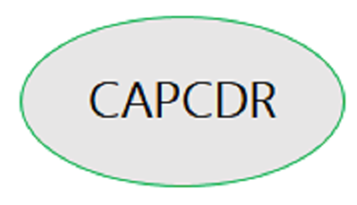

Slide 7
Research Question 1 “What is the profile of the respondents in terms of;
Sex;
Age;
Course; and
Year Level”
Variable | F | %
Sex
Male | 62 | 31
Female | 138 | 69
Total | 200 | 100
Age
18-23 | 167 | 83.5
24-29 | 23 | 11.5
30-35 | 7 | 3.5
36-41 | 3 | 1.5
Total | 200 | 100

Slide 8
Year Level | F | %
First Year | 37 | 18.5
Second Year | 71 | 35.5
Third Year | 73 | 36.5
Fourth Year | 19 | 9.5
Total | 200 | 100

Slide 9
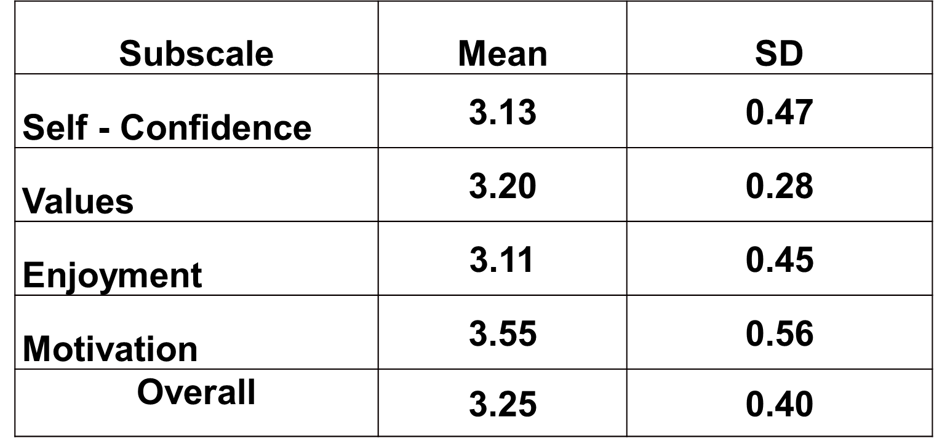
Research Question 2: “What is the level of attitude towards learning mathematics among preservice teachers, in terms of Self – Confidence, Values, Enjoyment and Motivation?”

Slide 10
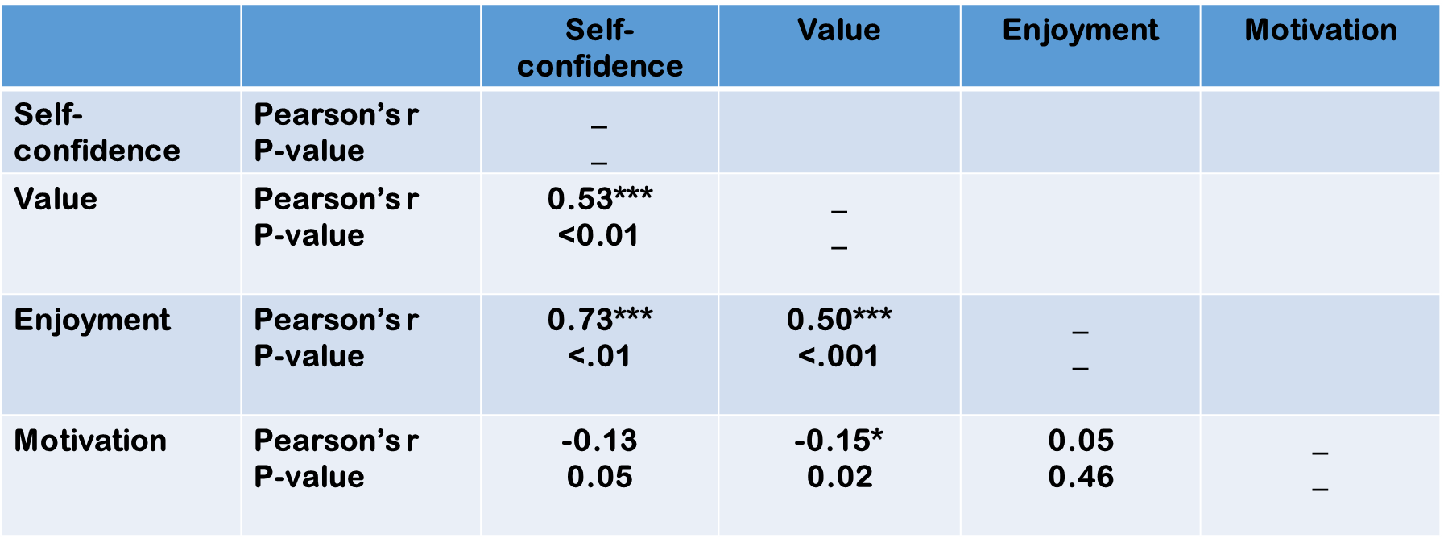
Research Question 3: “Is there a significant relationship between Self – Confidence, Values, Enjoyment and Motivation of the Preservice teachers ?”

Slide 11
IMPACT /OUTCOMES OF THE STUDY
For the Math Teachers
It gives ideas on how and what strategies they going to use for daily teaching.
It gives insights on how they going to encourage the learners in developing their positive attitudes of learning mathematics.
It gives brainstorming of what should they change, add, and improve in their teaching methods/strategies to awaken the interest of the learners.

Slide 12
IMPACT /OUTCOMES OF THE STUDY
For the Preservice Teacher
It gives importance in their daily life as a future teacher, why they need to learn mathematics during school days.
It gives realization on their part on how mathematics help their daily lives.

Slide 13
CONCLUSIONS
Preservice teachers have moderate positive attitude towards learning mathematics
There is a significant positive relationship between Self – confidence, value and enjoyment.
There is a significant negative relationship between value and motivation.

Slide 14
Assess math attitudes among Preservice teachers at the beginning of every Math course.
Math teachers in higher education may create learning activities that can alter or minimize negative attitudes towards learning Mathematics.
Conduct further investigation with a wider scope and greater participants to improve this study.

Slide 15
REFERENCES
Primi, C., Bacherini, A., Beccari, C., & Donati, M. A. (2020). Assessing math attitude through the Attitude Toward Mathematics Inventory–Short form in introductory statistics course students. Studies in Educational Evaluation, 64, 100838.
Tapia, M., & Marsh, G. E. (2002). Confirmatory Factor Analysis of the Attitudes toward Mathematics Inventory.
https://bewhitespace.com/blog/2017/03/the-importance-of-attitude-how
https://scholar.google.com.ph/scholar?q=investigating+students%E2%80%99+attitu
de+towards+learning+mathematics&hl=en&as_sdt=0&as_vis=1&oi=scholar

Slide 16
Thank you

