Slide 1
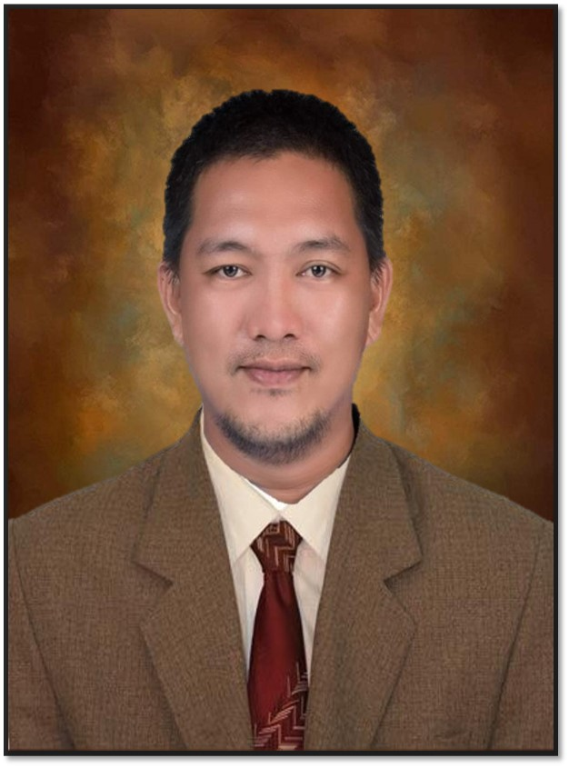
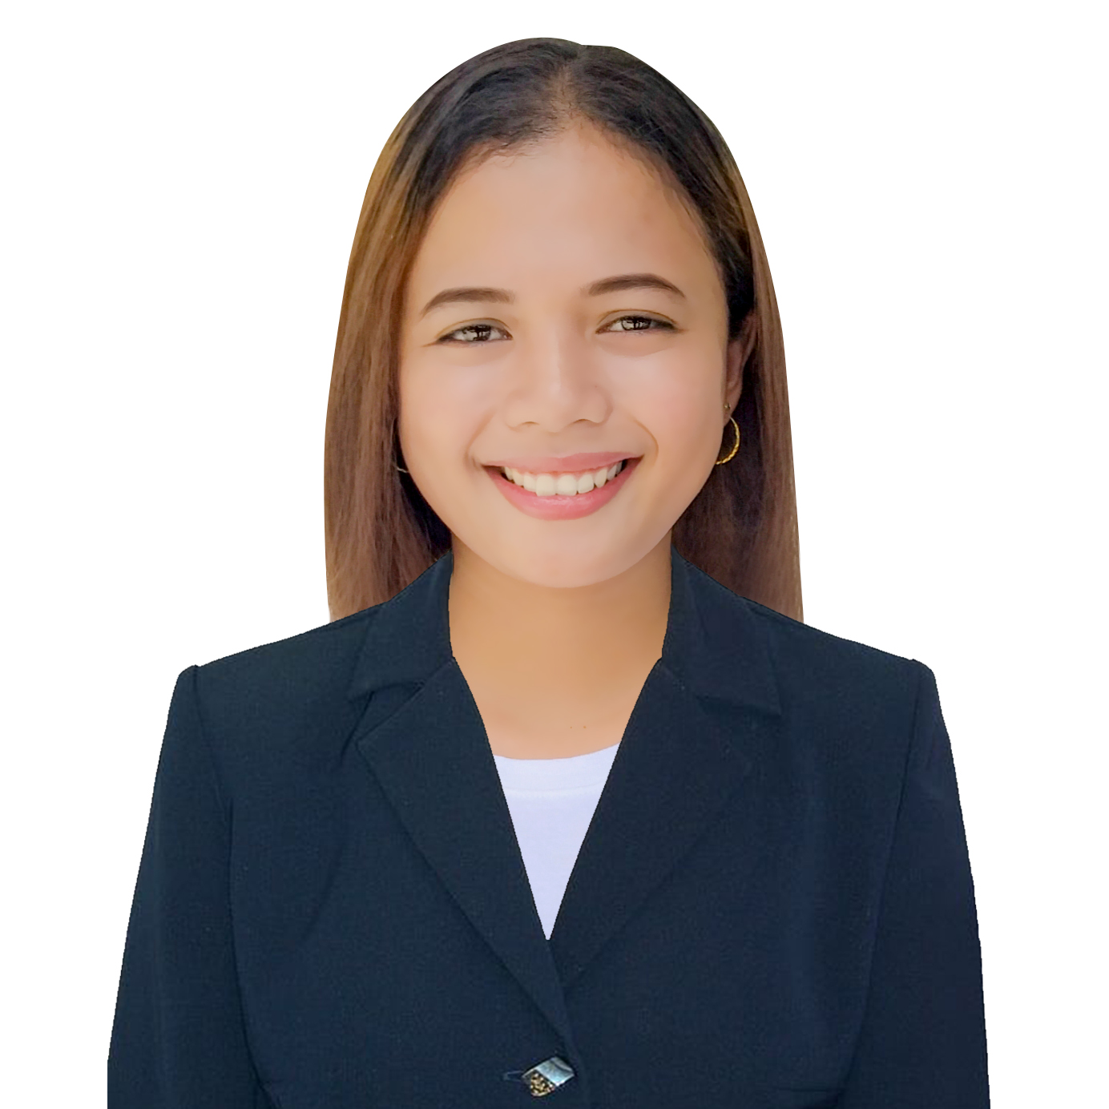
JOB SATISFACTION OF SECONDARY SCHOOL TEACHERS VIS-À-VIS TEACHERS EFFICIENCY IN WORK PERFORMANCE
International Virtual Conference on Challenges in Education, Business and Technology
February 20-21, 2022 | Via Zoom Conferencing
ASST. PROF. RYAN TEOFEL P. ARPON
RHEAMY N. BALIBER, MAED
BILIRAN PROVINCE STATE UNIVERSITY

Slide 2
INTRODUCTION JOB SATISFACTION OF SECONDARY SCHOOL TEACHERS VIS-À-VIS TEACHERS EFFICIENCY IN WORK PERFORMANCE
Toropova (2021) specified that teacher shortage is an international problem thus, teacher job satisfaction merits closer attention. Not only is job satisfaction closely related to teacher retention, but it also contributes to the well-being of teachers and their over-all wok performance or work efficiency.
International Virtual Conference on Challenges in Education, Business and Technology | February 20-21, 2022 | Via Zoom Conferencing

Slide 3
OBJECTIVES JOB SATISFACTION OF SECONDARY SCHOOL TEACHERS VIS-À-VIS TEACHERS EFFICIENCY IN WORK PERFORMANCE
The study generally aimed at determining the teachers’ job satisfaction vis-à-vis teacher’s efficiency in work performance. Specifically, purportedly aimed to: 1) Ascertain the teachers’ job satisfaction; 2) Determine the teachers’ efficiency in work performance; 3) Design a Training and Development Program for Teachers.
International Virtual Conference on Challenges in Education, Business and Technology | February 20-21, 2022 | Via Zoom Conferencing

Slide 4
METHOD JOB SATISFACTION OF SECONDARY SCHOOL TEACHERS VIS-À-VIS TEACHERS EFFICIENCY IN WORK PERFORMANCE
This quantitative study made use of a descriptive survey design to find out the secondary school teacher’s job satisfaction and efficiency in work performance in the Districts of Naval, Division of Biliran. Furthermore, the respondents of this study composed of 142 teachers. Stratified random sampling was employed in choosing the teacher respondents of this study so that there will be appropriate representation of the teachers per school.
International Virtual Conference on Challenges in Education, Business and Technology | February 20-21, 2022 | Via Zoom Conferencing

Slide 5
FINDINGS JOB SATISFACTION OF SECONDARY SCHOOL TEACHERS VIS-À-VIS TEACHERS EFFICIENCY IN WORK PERFORMANCE
No. | Statement | WM | Description
1. | Being able to keep busy all the time | 3.68 | Satisfied
2 | The chance to work alone on the job | 3.56 | Satisfied
3 | The chance to do different things from time to time | 3.67 | Satisfied
4 | The chance to be "somebody" in the community | 3.51 | Satisfied
5 | The way my boss handles his/her workers | 3.54 | Satisfied
6 | The competence of my supervisor in making decisions | 3.59 | Satisfied
7 | Being able to do things that don't go against my conscience | 3.50 | Neither satisfied nor dissatisfied
8 | The way my job provides for steady employment | 3.89 | Satisfied
9 | The chance to do things for other people | 3.77 | Satisfied
10 | The chance to tell people what to do | 3.56 | Satisfied
11 | The chance to do something that makes use of my abilities | 3.65 | Satisfied
12 | The way company policies are put into practice | 3.50 | Neither satisfied nor dissatisfied
13 | My pay and the amount of work I do | 3.56 | Satisfied
14 | The chances for advancement on this job | 3.52 | Satisfied
15 | The freedom to use my own judgment | 3.58 | Satisfied
16 | The chance to try my own methods of doing the job | 3.63 | Satisfied
17 | The working conditions | 3.49 | Neither satisfied nor dissatisfied
18 | The way my co-workers get along with each other | 3.70 | Satisfied
19 | The praise I get for doing a good job | 3.65 | Satisfied
20 | The feeling of accomplishment I get from the job | 3.63 | Satisfied
 | AWM | 3.61 | Satisfied
International Virtual Conference on Challenges in Education, Business and Technology | February 20-21, 2022 | Via Zoom Conferencing

Slide 6
FINDINGS JOB SATISFACTION OF SECONDARY SCHOOL TEACHERS VIS-À-VIS TEACHERS EFFICIENCY IN WORK PERFORMANCE
The table above presents the level of teachers’ job satisfaction. It shows the responses of the teachers as to their level of job satisfaction which revealed an over-all result as “Satisfied” (AWM=3.61).
The result means that in terms of job satisfaction most of them were just satisfied on their job.
International Virtual Conference on Challenges in Education, Business and Technology | February 20-21, 2022 | Via Zoom Conferencing

Slide 7
FINDINGS JOB SATISFACTION OF SECONDARY SCHOOL TEACHERS VIS-À-VIS TEACHERS EFFICIENCY IN WORK PERFORMANCE
No. | Statement | WM | Description
1 | How much can you do to get through to the most difficult students? | 3.84 | Quite A Bit
2 | How much can you do to help your students think critically? | 3.77 | Quite A Bit
3 | How much can you do to control disruptive behavior in the classroom? | 3.83 | Quite A Bit
4 | How much can you do to motivate students who show low interest in school work? | 3.88 | Quite A Bit
5 | To what extent can you make your expectations clear about student behavior? | 3.75 | Quite A Bit
6 | How much can you do to get students believe they can do well in school work? | 3.91 | Quite A Bit
7 | How well can you respond to difficult questions from your students? | 3.77 | Quite A Bit
8 | How well can you establish routines to keep activities running smoothly? | 3.82 | Quite A Bit
9 | How much can you do to help your students’ value learning? | 3.94 | Quite A Bit
10 | How much can you gauge your student comprehension of what you have taught? | 3.83 | Quite A Bit
11 | To what extent can you craft good questions for your students | 3.84 | Quite A Bit
12 | How much can you do to foster student creativity | 3.80 | Quite A Bit
13 | How much can you do to get children to follow classroom rules? | 3.82 | Quite A Bit
14 | How much can you do to improve the understanding of a student who is falling | 3.81 | Quite A Bit
15 | How much can you do to calm a student who is disruptive or noisy? | 3.86 | Quite A Bit
16 | How well can you establish a classroom management system with each group of students? | 3.84 | Quite A Bit
17 | How much can you do to adjust your lessons to the proper level for individual students? | 3.85 | Quite A Bit
18 | How much can you use from a variety of assessment strategies? | 3.82 | Quite A Bit
19 | How well can you keep a few problem students from ruining the entire lesson? | 3.76 | Quite A Bit
20 | To what extent can you provide an alternative explanation or example when students are confused? | 3.75 | Quite A Bit
21 | How well can you respond to defiant students? | 3.66 | Quite A Bit
22 | How much can you assist families in helping their children do well in school? | 3.64 | Quite A Bit
23 | How well can you implement alternative strategies in your classroom? | 3.80 | Quite A Bit
24 | How well can you provide appropriate challenges for every capable student? | 3.76 | Quite A Bit
 | AWM | 3.81 | Quite A Bit
International Virtual Conference on Challenges in Education, Business and Technology | February 20-21, 2022 | Via Zoom Conferencing

Slide 8
FINDINGS JOB SATISFACTION OF SECONDARY SCHOOL TEACHERS VIS-À-VIS TEACHERS EFFICIENCY IN WORK PERFORMANCE
The foregoing table disclosed the responses of the teachers as to their level of efficiency which revealed an over-all result of “Quite A Bit” with an average weighted mean of 3.81.
International Virtual Conference on Challenges in Education, Business and Technology | February 20-21, 2022 | Via Zoom Conferencing

Slide 9
FINDINGS JOB SATISFACTION OF SECONDARY SCHOOL TEACHERS VIS-À-VIS TEACHERS EFFICIENCY IN WORK PERFORMANCE
Significant Relationship between Teacher’s Job Satisfaction to Teacher’s Efficiency
Variable | r-value | Sig. (2-tailed) | Decision
Teacher’s Job Satisfaction to Teacher’s Efficiency | .222 | .347 | Ho Accepted
International Virtual Conference on Challenges in Education, Business and Technology | February 20-21, 2022 | Via Zoom Conferencing

Slide 10
CONCLUSION JOB SATISFACTION OF SECONDARY SCHOOL TEACHERS VIS-À-VIS TEACHERS EFFICIENCY IN WORK PERFORMANCE
Based on the findings of the study, it could be concluded that the secondary teachers in the Districts of Naval, Division of Biliran were just satisfied and quite a bit efficient of their work performance.
International Virtual Conference on Challenges in Education, Business and Technology | February 20-21, 2022 | Via Zoom Conferencing

Slide 11
RECOMMENDATIONS JOB SATISFACTION OF SECONDARY SCHOOL TEACHERS VIS-À-VIS TEACHERS EFFICIENCY IN WORK PERFORMANCE
1. School heads are encouraged to actively support, work and collaborate with teachers for the betterment and improvement of the teachers in terms of job satisfaction and efficiency of their work performance.
2. There should be a peer mentoring and/or counselling for the teachers. Proper and adequate technical assistance should also be provided to teachers, most especially those with low performance at school.
3. School heads should implement the designed Training and Development Program for teachers for the satisfaction and efficiency of teachers in their teaching job.
International Virtual Conference on Challenges in Education, Business and Technology | February 20-21, 2022 | Via Zoom Conferencing

Slide 12
JOB SATISFACTION OF SECONDARY SCHOOL TEACHERS VIS-À-VIS TEACHERS EFFICIENCY IN WORK PERFORMANCE
THANK YOU!
International Virtual Conference on Challenges in Education, Business and Technology | February 20-21, 2022 | Via Zoom Conferencing

