Slide 1
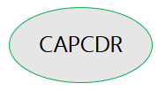
Footprints of Post-Covid Sequelae, Pros-Cons and Communal Impressions
5th CAPCDR International Conference on
Post-COVID-19 Paradigm Shift in Social Science, Technology and Public Health
November 23-25, 2022.
Yatreek G Bhagat
(Assistant Professor)
S.S.Jaiswal College Arjuni/Morgaon, Dist Gondia (MS). 441701.
Mob.No – 9021973552
Email - ygb008@gmail.com
(ISNI: 0000000505092482)

Slide 2
Content
Economical
Educational
Social
Mental
Physical

Slide 6
