Slide 1
St. Petersburg Peter the Great Polytechnic University, St. Petersburg, Russia
Integration of Islamic banking systems and its impact on market share and bank profit (Case study of Central Asia)
PHD student : Faryal Dehqan

Slide 2
2
Relevance
Islamic banking and financial institutions first started in 1963, almost fifty years ago, as an interest-free bank in Egypt. The bank in question was a savings bank that could open branches, but was forced to cease operations in 1974 due to threats from the Egyptian state system. In 1974, establishment of Islamic banks and Islamic Development Bank was recommended in Pakistan. In the 80s, Islamic banks and various Islamic financial institutions started their activities in Islamic countries. At this time, countries like Iran and Pakistan decided to introduce Islamic banking in all banking sectors.
2
Notes:
Definition of resilience
Source
The ability of the system to reduce the probability of a shock, control the shock in case of occurrence (sudden reduction of performance) and quick recovery after the shock (restoration of normal performance).
[7]
The ability of societies, their physical, social, political and economic systems, their buildings and settlements and to withstand the risks caused by tensions and pressures that can quickly bounce back, accept future threats and face them.
[9]
It is referred to as the organization's ability to face disturbances in order to maintain the organization's configuration or create a new organization configuration that is more suitable to the new environmental conditions.
[21]
Resilience means tolerance and coping and recovery of the organization after a catastrophic event or a crisis or difficult conditions.
[15]

Slide 3
3
Banking
1. Participation: including participation, mudarabah,
Agriculture, Mesakat and Isisena.
2. Commercial transactions and contracts: including
Installment sale of Murabahah, purchase of debt by shares.
3. Service contracts: warranty, letter
3
3

Slide 4
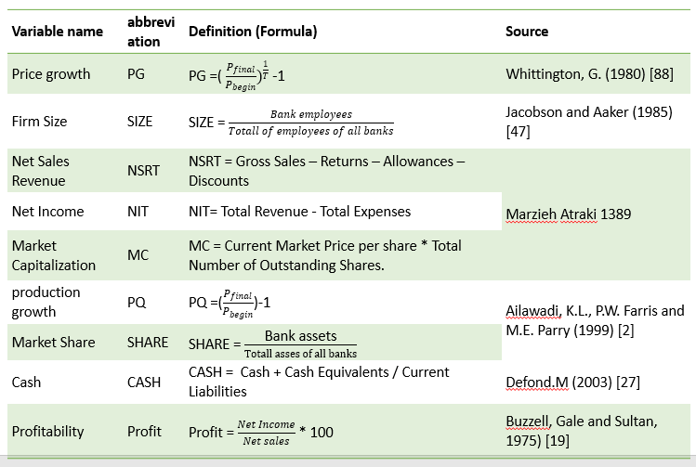
4
Research Variables

Slide 5
5
Data and Methodology
SHAREit = β₀ + β₁ × X₁ + β₂ × X₂ + β₃ × X₃ + β₄ × X₄+ β₅ × X₅ + β₆ × X₆ + β₇ × X₇ + β₈ × X₈ + µit
Where:
i refers to an individual bank, and t refers to time.
β₀ are constants, β₁ − β₈ are coefficients. µit are the error
Terms.
Dependent term (share) = refers to the market share of Central Asia Bank.
Independent variable (X1 or profit) = refers to the profitability of Central Asia banks.
Independent variable (X2 or size) = refers to the size of Central Asia banks' products.
Independent variable (X3 or MC) = refers to the market capitalization of Central Asia banks.
Independent variable (X4 or PG) = refers to the increase in the price of Central Asia banking services.
Independent variable (X5 or NIT) = refers to the net income of Central Asia banks.
Independent variable (X6 or NSRT) = refers to the net sales of Central Asia banks.
Independent variable (X7 or CASH) = refers to the cash flow of Central Asia banks.
Independent variable (X8 or PQ) = refers to the growth of Central Asia banking products.
variable | Obs | Mean | Std. Dev | Min | Max
PG | 65 | 0.01 | 0.001 | 0.007 | 0.01
SIZE | 65 | 16.28 | 0.59 | 14.55 | 17.22
Cash | 65 | 3.05 | 0.87 | 1.5 | 5
PQ | 65 | 0.68 | 0.08 | 0.49 | 0.88
NSRT | 65 | 17.83 | 0.40 | 17.11 | 18.41
NIT | 65 | 1.12 | 0.17 | 0.8 | 1.47
MC | 65 | 0.06 | 0.01 | 0.01 | 0.08
Profit | 65 | 9.72 | 7.97 | -4 | 37.19
SHARE | 65 | 1.93 | 4.17 | 0.01 | 14.45
5
5

Slide 6
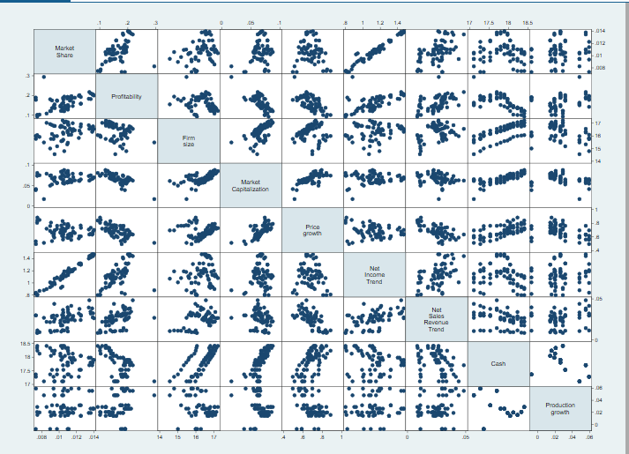
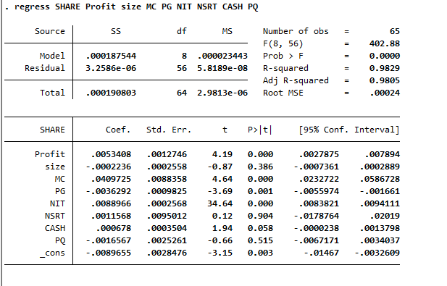
7
Main results
Index | K2 | RMSEA | GFI | AGFI | CFI | NFI | IFI
Calculated value | 1.285 | 0.082 | 0.91 | 0.90 | 0.90 | 0.90 | 0.91
Acceptable level | ≤3 | ≤0.1 | 0.90≤ | 0.90≤ | 0.90≤ | 0.90≤ | 0.90≤
Result | + | + | + | + | + | + | +
6
6

Slide 7
10
Things to do
Growth through strategic partnerships and mergers:
Partnership with fintech companies
Merger and Acquisition (A&M) process with other banks
Growth through innovative investments:
Capabilities of artificial intelligence and artificial recognition
Blockchain technology and distributed ledger (DLT)
Robotic automation process
Increasing cyber security
According to this process, banks are either forgotten and destroyed or created anew.
7
7

Slide 8
11
11
Вклад (теоретический, практический)
Contribution (theoretical, practical)
Theoretical contribution
user:
Bank managers
New investors to open a commercial bank
Practical contribution
user:
Government
Commercial bank investors
Commercial bank CEO
Commercial bank financial managers
Central bank
And the ministry of finance
8
8
8
8
8

Slide 9
12
Thank you for your attention!
Email: faryaldehqan@yahoo.com
Link : Faryal Dehqan (researchgate.net)
Theoretical contribution
Does your study define a new conversation (theory/lens/paradigm) or divert an existing conversation into a meaningfully different area?
Practical contribution
Who and how can use your results in activities?
9
9
9

