Slide 1
The Features of the Operation of the Blagoveshchensk-Heihe Cross-Border Bridge in the Far East in the Context of the COVID-19 Pandemic
OLGA ZALESSKAIA

Slide 2
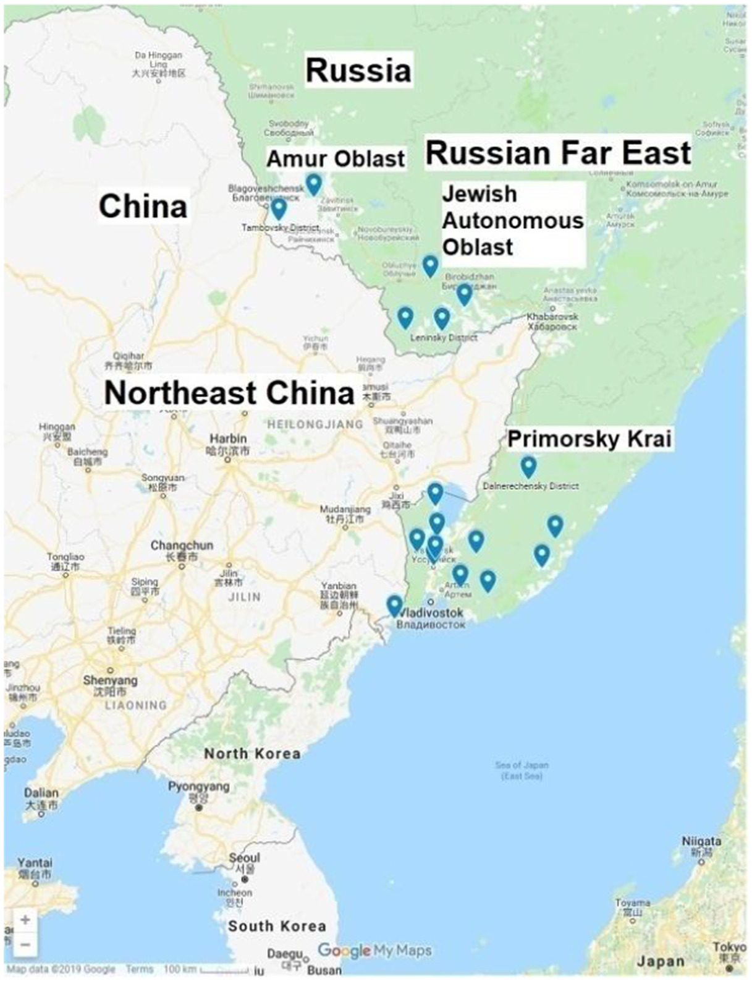
INTRODUCTION
China and Russia have a long border in the Far East (more than 4,000 km). The bordering regions of Russia (Amur Region, the Jewish Autonomous Region, Primorsky Krai and Khabarovsk Krai) and China (Heilongjiang, Jilin and Liaoning provinces) are directly involved and have impact on bilateral relations.

Slide 3
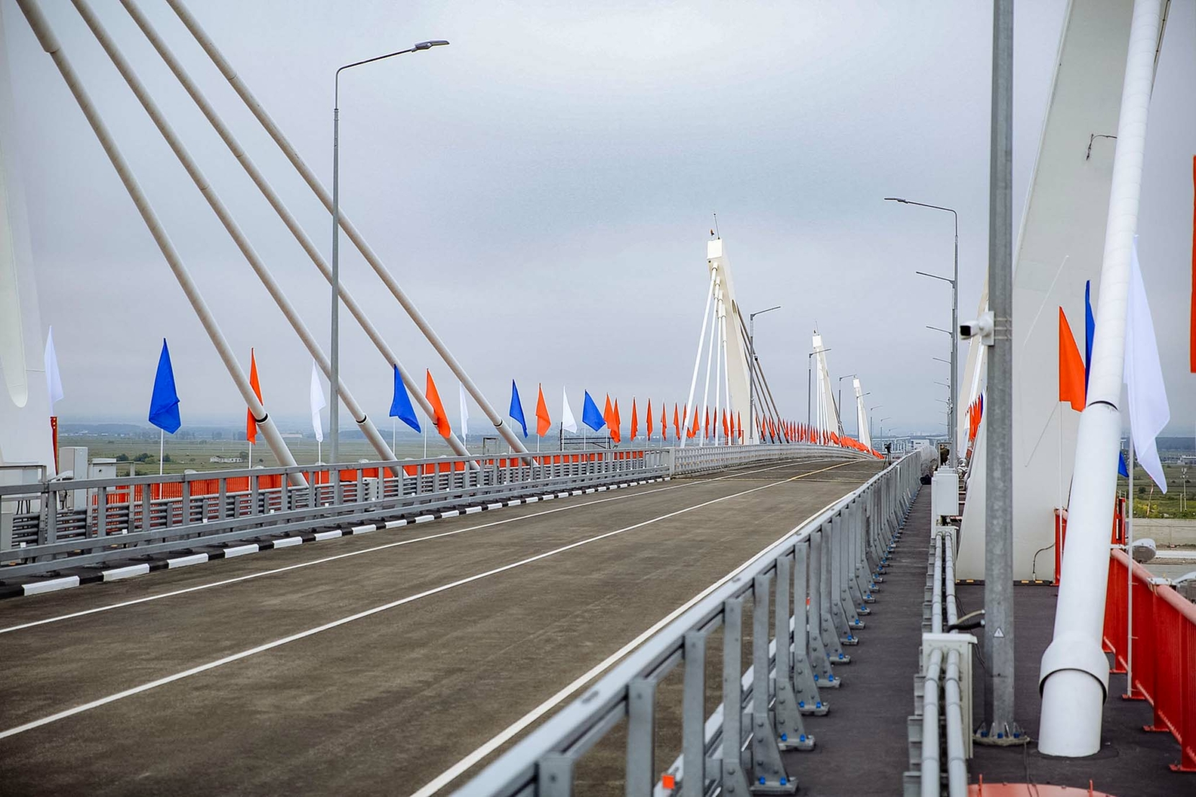
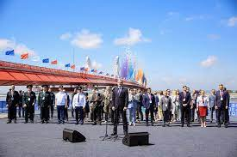
The opening procedure of the bridge,
10 June 2022

Slide 4
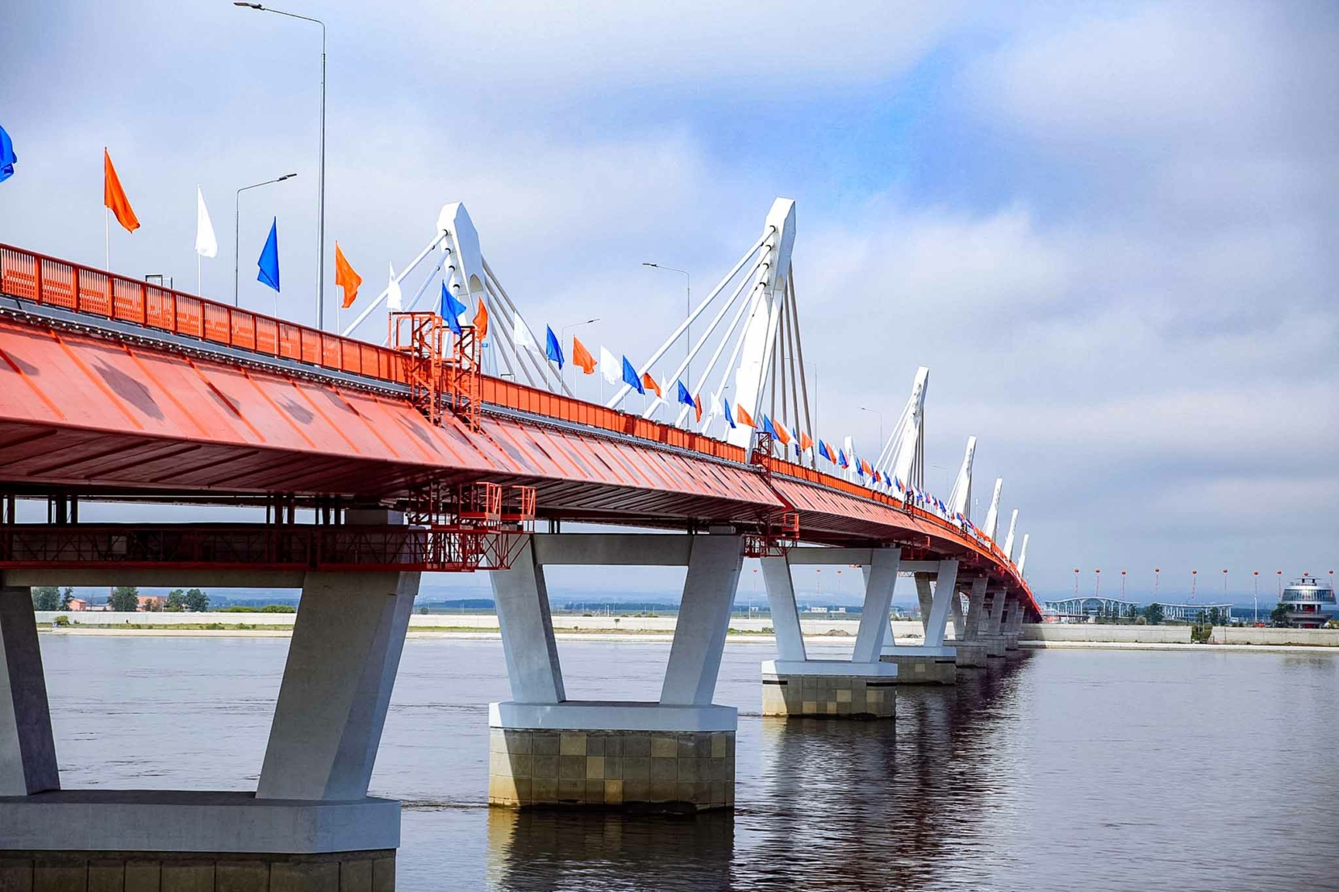
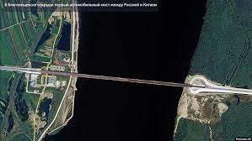

Slide 5
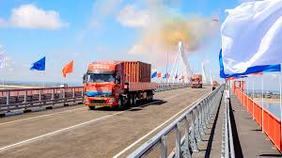
Interesting facts
- 20 kilometres is the total length of the bridge crossing.
- 1,080 metres is the length of the bridge across the Amur.
- 13 kilometres - length of access roads in Russia.
- 6 kilometres - length of access roads in China.
- 600 trucks, 160 buses and 60 cars will be able to cross the bridge every day.
- 4 million tonnes of freight
and 2 million passengers
annually can be carried
on the international bridge.

Slide 6
conclusion
The pandemic has made serious adjustments to the prospects for the operation of this facility.
Today china is closed and, unfortunately, increasingly closed to russia. the payback period of the blagoveshchensk - heihe bridge, built under a concession agreement and closed because of the covid-19 pandemic, is likely to increase.
The main question that remains is whether the countrues are too late with the opening of this bridge? is it as necessary in the current geopolitical and economic environment as it was in the 1990s or not?

