Slide 1
Perspective Drawings of Senior High School Students in Housekeeping and Technical Drafting: A Theory Development Approach
Department of Education Division of Cebu City, Cebu, Philippines
5th International Conference on Post-COVID-19 Paradigm Shift in Social Science, Technology, and Public Health
Reynaldo V. Moral, PhD
Master Teacher I/ Research Coordinator
IREO Inc., Head of Editorial Board
November 23-25, 2022
Venue: Zoom Platform
Center for Academic & Professional Career
Development and Research (CAPCDR)
Upashi-8023, Bangladesh
Victor Rey B. Lomocso
Teacher I
Eugene Embalsado
Teacher III

Slide 2
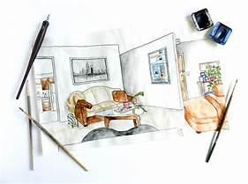
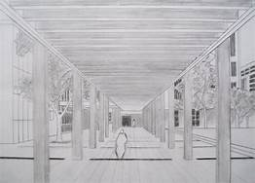
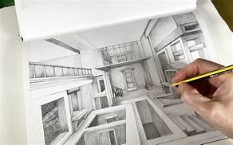
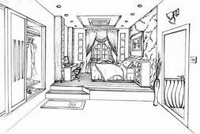

Slide 4
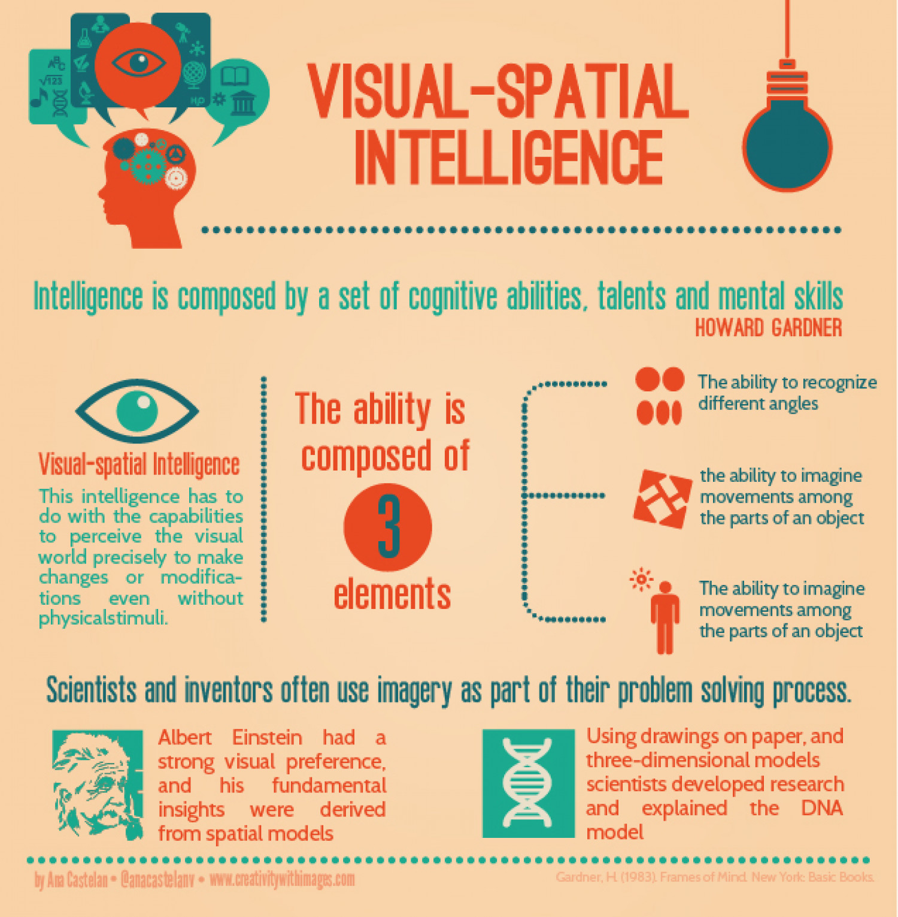

Slide 5
Context and Rationale
Drawing plays a vital role in the development of humans’ cognitive domain.
It can help them learn how to write and think creatively, develop hand-eye coordination, sharpen analytic skills, and conceptualize ideas (Adetunji, 2016).
There is consistency between the drawings and interviews of the children on the COVID-19 pandemic (Duran, 2020).
The competency achievement of students as an intern in the housekeeping department needs to be evaluated through the performance assessment (Jubaedah et al., 2019).

Slide 6
Context and Rationale
It is observed that some Grade 12 students show an inclination in the field of drawing and are currently taking technical drafting and housekeeping.
Unfortunately, the current school year 2021-2022 shows that their Mean Percentage Score (MPS) in Technical Drafting is 60.0% and 44.33% for the first semester.
More so, their MPS in Housekeeping reveals 59.0% and 54.21% which indicates very alarming that needs to be compared for the next semester.
To formulate an academic strategic plan that will give the senior high school students the advantage they will need in making the transition from high school to college.

Slide 7
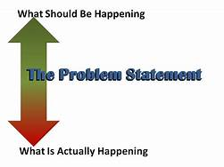
Basic Research Questions
1. What are the students’ images in technical drafting and housekeeping based on the drawings they have created?
2. How do senior high school students describe their perceptions of teacher presence in the technical drafting and housekeeping class?
3. What aspects of perspective drawing do senior high school students perceive as essential to a teacher’s presence in technical drafting and housekeeping class?
4. What immediate strategic plan may be formulated based on the findings of the study?

Slide 8
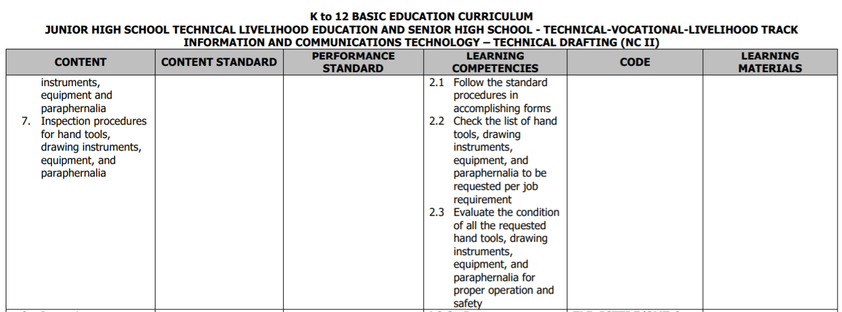
Innovation, Intervention, and Strategy

Slide 9
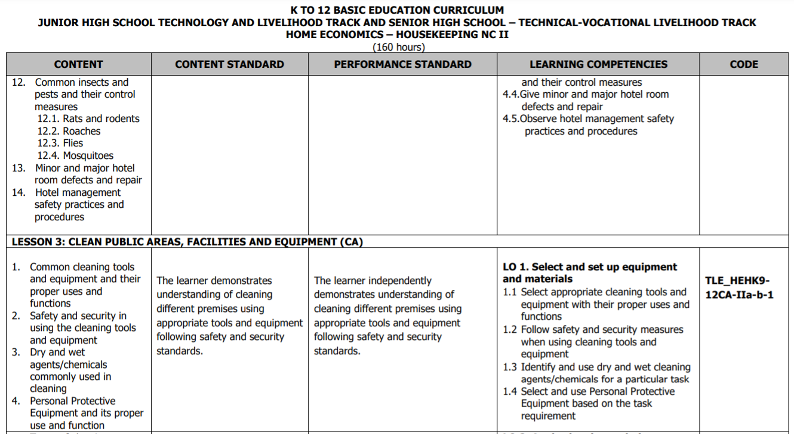
Innovation, Intervention, and Strategy

Slide 10
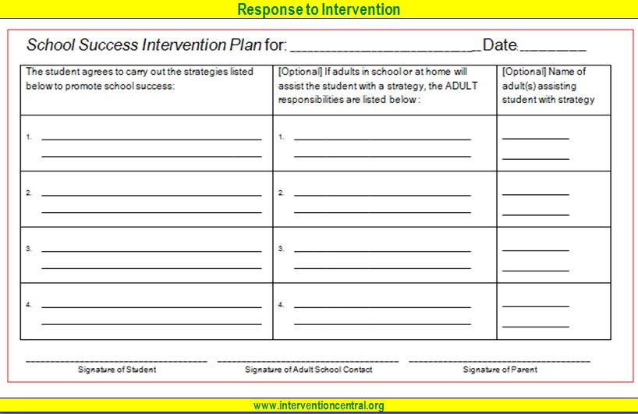
Innovation, Intervention, and Strategy

Slide 11
Implementation Phase
Choose a day of the week to conduct a Temperature Check with students. This could be something they do at the beginning of a meeting/class, towards the end of a class, or asynchronously.
2) Send out a Google Form as a quick way for students to tell you how they are feeling and what support they need. (Download and customize our free Google Forms template for facilitating virtual temperature checks.) Consider asking students to rate how they are feeling on a scale of 1-5, check off specific feelings that they're experiencing (e.g., happy, hungry, anxious, overwhelmed, bored, etc.), and share additional details about why they think they are feeling this way.

Slide 12
Implementation Phase
3) Have students complete these Temperature Checks on a regular basis (once per week or once per month, if not more frequently) in an agreed-on period so they have a regular pulse of what is happening within our school and in our student’s lives.
4) If we identify a student who needs extra support, we will ensure to find time to check in with them individually and help connect them with any additional resources they may need.
5) Finally, the findings of the study lead to creating sound dissemination to increase awareness of the making of basic research to the TVL teachers and, therefore, maximize the impact that the research can have in improving the educational outcomes of the senior high school graduating students that will benefit from it

Slide 13
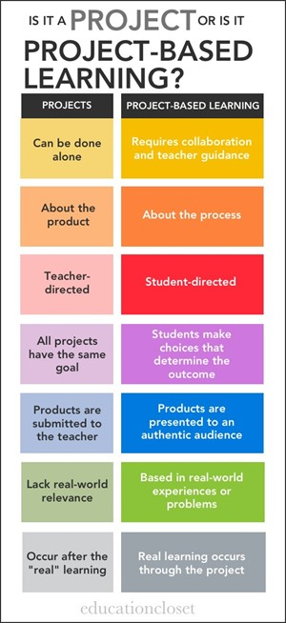
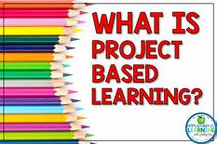
Any programmatic or instructional approach that utilizes multifaceted projects as a central organizing strategy for educating students. When engaged in project-based learning, students will typically be assigned a project or series of projects that require them to use diverse skills

Slide 14
Data Gathering Methods
A perspective drawing lesson plan was provided in this study adapted from Thrive Collective (Minton, 2020).
1.1 What art skill, subject area, or big idea is being taught (the art “learning”)?
1.2 What will the students produce by the end of the class (the “project”)?
1.3 How does that art skill translate into an everyday life skill (the life “learning”)?

Slide 15
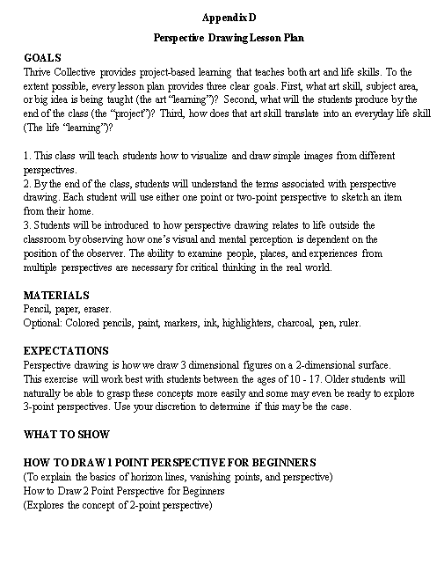
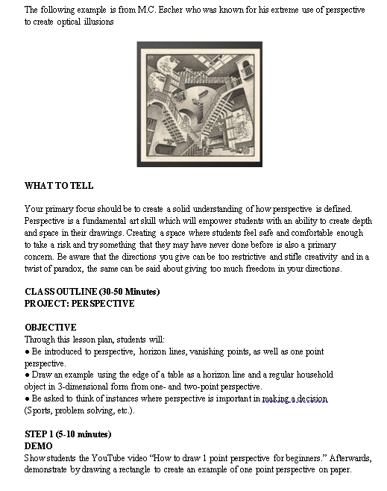
Data Gathering Methods

Slide 16
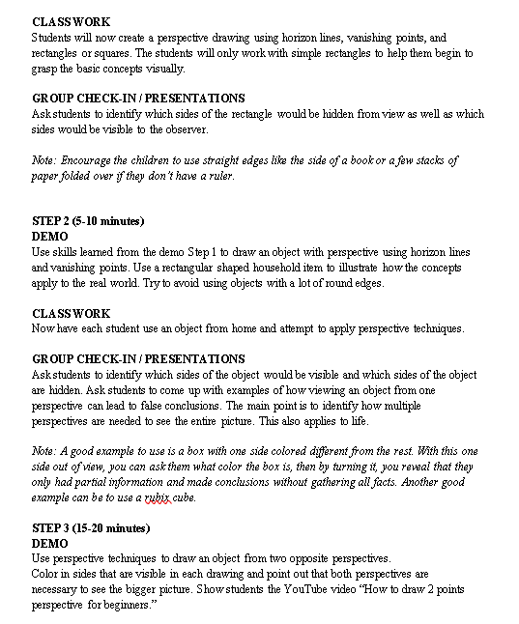
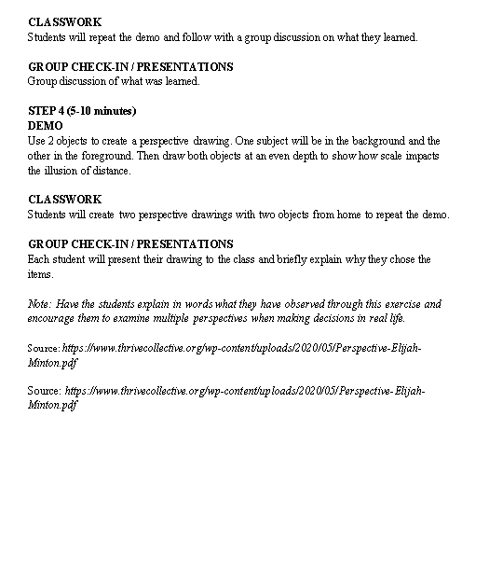
Data Gathering Methods

Slide 17
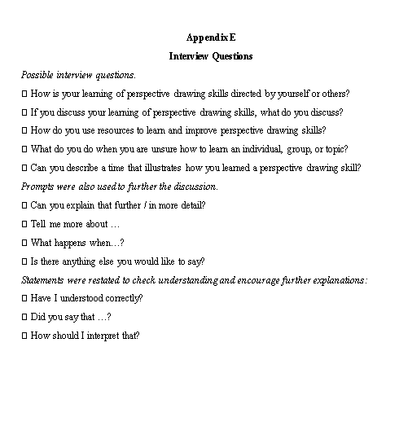
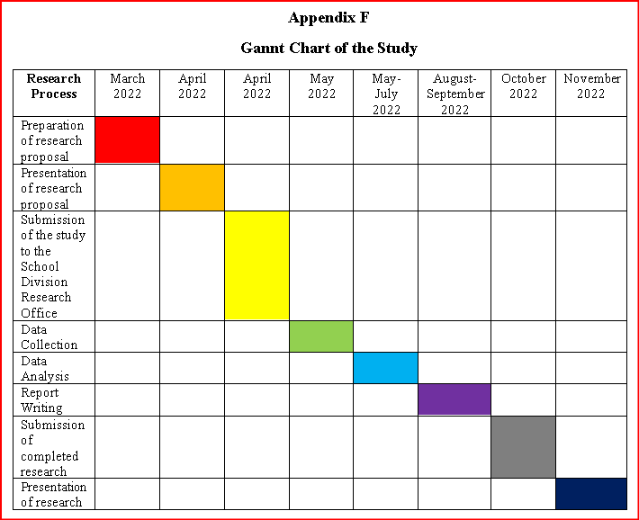
Data Gathering Methods

Slide 18
What is theory development?
Theories are formulated to explain, predict, and understand phenomena and, in many cases, to challenge and extend existing knowledge within the limits of critical bounding assumptions. The theoretical framework is the structure that can hold or support a theory of a research study.

Slide 23
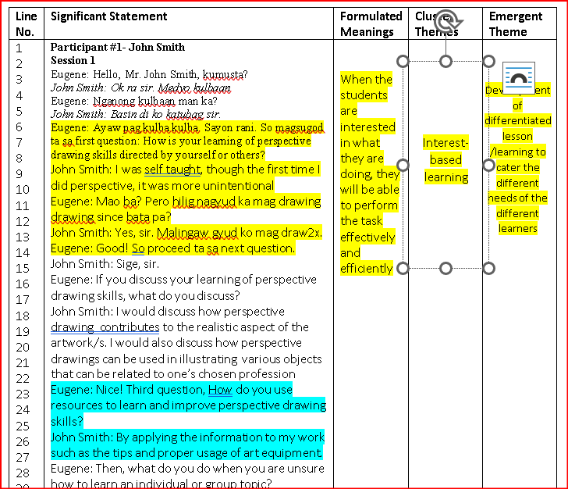
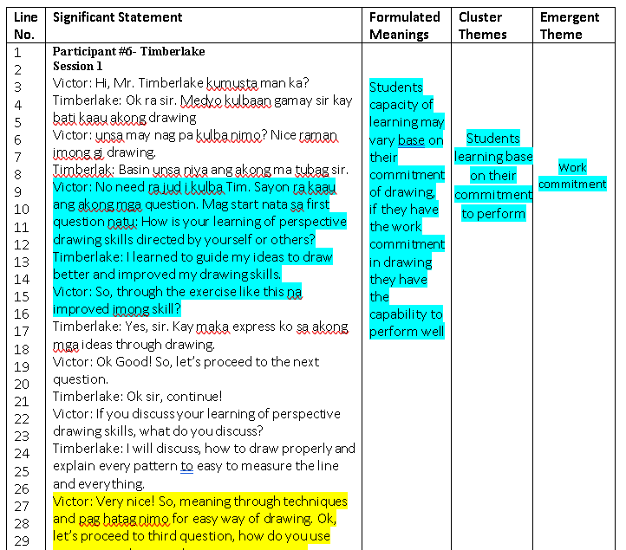
Collaizi Method of Data Gathering

Slide 24
Findings of the Study
Four Emerging Themes:
Varying Aspects of Learning
Technologically-Driven Instruction
Work Commitment
Creativity

Slide 25
Findings of the Study
Three propositions were drawn up:
When the students are interested in what they are doing, they will be able to perform the task effectively and efficiently.
“I was self-taught, though the first time I did perspective, it was
more unintentional. But still, I enjoy of what I am doing while
keeps on drawing and drawing (P1, Lines 6-14)”.

Slide 26
Findings of the Study
2) Students learn by imitating others on how they do things aided by technology.
“In order for me to learn and improve perspective drawing
skills I must practice finding the horizon line, seeing objects as
shapes and emphasize my perspective through videos
from YouTube sir (P7, Lines 80-83)

Slide 27
Findings of the Study
2) Students learn by imitating others on how they do things aided by technology.
“In order for me to learn and improve perspective drawing
skills I must practice finding the horizon line, seeing objects as
shapes and emphasize my perspective through videos
from YouTube sir (P7, Lines 80-83)

Slide 28
Findings of the Study
3) Solving problems could be done gradually by using mental visual perceptions.
“As a student, it helps relieve stress because sometimes
when I draw, I tend to forget my problem and can help
I improve my drawing skills…(P4, Lines 132-137)

Slide 29
Three hypotheses were derived:
1) Students’ abilities could be recognized based on their drawings.
2) The power of students’ imagination could be put into practice.
3) Life skills are influenced by the students’ intellectual capacity with the guidance of the teachers.

Slide 30
Theory generated
Students’ perspective drawings are brought by imagery in relation to real-world problems.

Slide 31
Recommendations:
Teachers should balance the number of group activities if needed to encourage the students’ self-regulated learning and pave the way to discover their individual competencies.
Students must value the importance of technical skills when working using their visual-spatial intelligence for the development of their metacognition.
A parallel study may be conducted across the K to 12 curriculum in which the competencies from the syllabi are being enhanced in the long run.

Slide 33
https://libguides.usc.edu/writingguide/theoreticalframework#:~:text=Definition,theory%20of%20a%20research%20study.
https://www.johnlovett.com/perspective-drawing#:~:text=Perspective%20drawing%20is%20a%20technique,to%20the%20use%20of%20perspective.
https://www.scribbr.com/methodology/thematic-analysis/#:~:text=Thematic%20analysis%20is%20a%20method,meaning%20that%20come%20up%20repeatedly.
https://zienjournals.com/index.php/jpip/article/view/62

Slide 34
The Proponents
Victor Rey B. Lomocso
Eugene Embalsado
Reynaldo V. Moral, PhD
Teacher I
Teacher III
Master Teacher I /
Research Coordinator/
IREO, Inc. Head of Editorial Board

