Slide 1
EFFECTS OF PERSONALITY ON THE PERFORMANCE OF EDUCATIONAL LEADERS AND TEACHERS AT KASIGLAHAN VILLAGE NATIONAL HIGH SCHOOL UTILIZING THE BIG FIVE PERSONALITY TEST
Sunnylyn B. Ceniza
Kasiglahan Village National High School

Slide 2
ABSTRACT
Personality is difficult to assess and evaluate without appropriate, accurate and proper tools. In support to this, according to the study of Abutalib (2012), psychologists use questions, which reports or reflects individual’s feelings, preferences and behaviors and allocate the individuals responses into numerical values to measure patterns of answers across several items. The study aims to determine the Effects of Personality on the Performance of Educational Leaders and Teachers at Kasiglahan Village National High School utilizing the Big Five Personality Test using t-test, ANOVA, and correlation through SPSS.

Slide 3
ABSTRACT
The study revealed that educational leaders and teachers have the same performance whatever personality type they have and probably personality type might have little to none influence to the performance of educational leaders and teachers.
The analyzed data also showed that there is no significant difference on the performance of teachers according to their personality. It can be said that educational leaders and teachers have the same performance regardless of their personality type and the results also signify that the numerical rating of educational leaders and teachers are almost identical which imply that personality has a very low impact on the performance of educational leaders and teachers specifically the personalities categorized Big Five Personality Test.

Slide 4
ABSTRACT
Data revealed that there is a strong negative correlation between the personality of educational leaders and teachers to their performance. The Personality can be strongly negatively correlated to the decrease in the performance of educational leaders and teachers. This could mean that by any chance, personality can be a cause of the decrease in the performance of educational leaders and teachers. However, there is no enough evidence to state that this correlation exists in the teaching personnel of Kasiglahan Village National High School.
The researcher shared the results of this study in school-based research forum in line with the preparation of the upcoming district and division-based research conference. This study was used as a basis of formulation of intervention to increase teachers’ job satisfaction through the implementation of Project 5Ps (Perceiving Personality to Proliferate Productivity and Performance) as well as basis for creation of guidelines and policies that will lessen or prevent the negative relationship of personality to the performance of educational leaders and teachers
Keywords: Personality, Educational Leaders, Teachers, Educational Management

Slide 5
Methodology
Participants and/or Sources of Data
Statement of the Problem
Specifically, this study seeks to find answers to the following queries:
What is the performance of educational leaders and teachers based on their personality types?
Is there any significant difference between the performance of the teachers based on their personality types?
Is there any significant statistical correlation between the personality types of educational leaders and teachers to their performance?

Slide 6
Methodology
Participants and/or Sources of Data
I. RESEARCH DESIGN
This descriptive research aims to assess the personality typed of educational leades and teachers in Kasiglahan Village National High School through the utilization of an adapted instrument, and the gathered data and results can be a basis on the formulation of programs, projects and/or activities to address possible issues towards understanding educator’s personality and its possible effect to their performance as a member of the organization. This involves statistical treatment such as t-test, ANOVA and correlation on the mean score of educational leaders and teachers on the personality type test and the performance using the IPCRF of educational leaders and teachers.

Slide 7
Methodology
Participants and/or Sources of Data
II. PARTICIPANTS
The participants of the study are educational leaders and teachers of Kasiglahan Village National High School on a voluntary and non-compulsory basis. There are 90 volunteer educational leaders and teachers which represented all eight (8) academic departments. Teachers will self-asses their personality type through the adapted instrument with 5-point Likert scale (1-Disagree to 5-Agree).

Slide 8
Methodology
Participants and/or Sources of Data
III. INSTRUMENT
To achieve the objective of this study, the researcher adapted and revised the survey instrument, the NEO Big 5 Scales.
The questionnaire is composed of 25 items that can be considered as the indicators to determine your personality type within the Big Five Personality Test. To determine the personality type of educational leaders and teachers, items will be rated though Five (5) point Likert scale and were scored as 5-Agree, 4-Slightly Agree, 3-Neutral, 2-Slightly Disagree, 1-Disagree.

Slide 9
Methodology
Participants and/or Sources of Data
III. INSTRUMENT
The total score per set of indicators will determine the personality type of educational leaders and teachers then it will be analyzed through t-test and ANOVA to determine if the personality of educational leaders and teachers is correlated to their performance based on the IPCRF of the respondents.

Slide 10
Data Collection and Data Analysis
The research tool/instrument was administered on volunteer teachers. The data gathered out of the Likert questionnaire will be analyzed through statistical treatment such as t-test, ANOVA, and correlation utilizing the Statistical Package for Social Sciences (SPSS).
The data analysis tool will be mean, ANOVA, and correlation with the use of the Statistical Package for Social Sciences (SPSS).

Slide 11
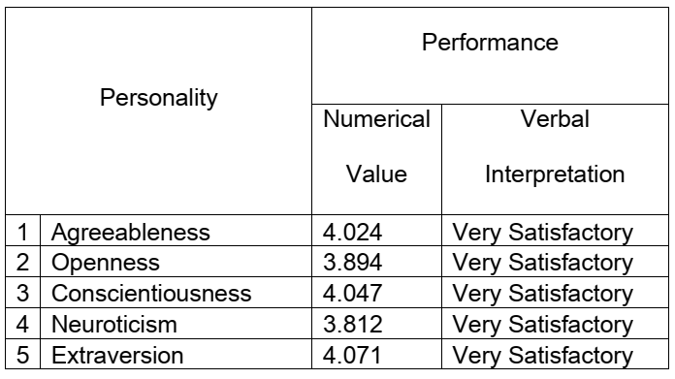
RESULTS
Discussion of Results and Recommendations
Table 1 shows that teachers performed very satisfactorily regardless of their personality type and with almost the same numerical rating. However, educational leaders and teachers that are in Extraversion personality type have the highest performance rating of 4.071 and Neuroticism personality type have the lowest performance rating of 3.812. It can be concluded that educational leaders and teachers have the same performance whatever personality type they have and probably personality type might have little to none influence to the performance of educational leaders and teachers.

Slide 12
RESULTS
Discussion of Results and Recommendations
Table 2 shows that based on the analysis of data the computed f-value of .252 is greater that the level of significance of .05. Therefore, the null hypothesis is accepted. There is no significant difference on the performance of teachers according to their personality. It can be said that educational leaders and teachers have the same performance regardless of their personality type and the results also signify that the numerical rating of educational leaders and teachers are almost identical which imply that personality has a very low impact on the performance of educational leaders and teachers specifically the personalities categorized Big Five Personality Test.

Slide 13
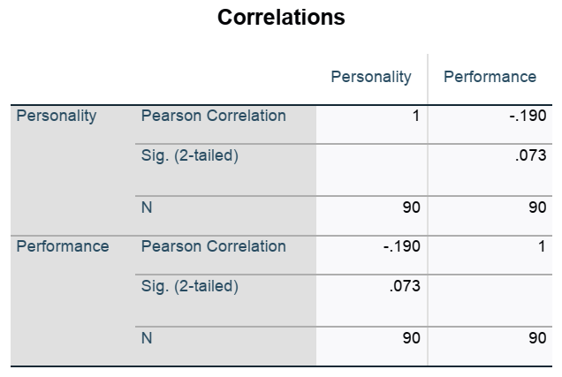
Table 3 shows that there is a strong negative correlation between the personality of educational leaders and teachers to their performance with r-value of -.190. Personality can be strongly negatively correlated to the decrease in the performance of educational leaders and teachers. This could mean that by any chance, personality can be a cause of the decrease in the performance of educational leaders and teachers.
Therefore, the null hypothesis is rejected. There is a significant statistical correlation between the personality types of educational leaders and teachers to their performance. However, there is not enough evidence to state that this correlation exists in the teaching personnel of Kasiglahan Village National High School. there is no enough evidence to state that this correlation exists in the teaching personnel of Kasiglahan Village National High School.
RESULTS
Discussion of Results and Recommendations

Slide 14
CONCLUSIONS & RECOMMENDATION
School administrators and key leaders must formulate programs, projects and activities that can guarantee the understanding and realization of the personality type of educational leaders and teachers to increase effectiveness, efficiency and performance of teachers.
Create an awareness campaign that will lessen or prevent the negative relationship of personality to the performance of educational leaders and teachers such as team building activities, community linkages, school-based open forum, personal and professional growth and development; and strengthening the core mechanism of faculty association.

Slide 15
Thank you and God Bless!
Sunnylyn B. Ceniza
sunnylyn.bautista@deped.gov.ph
09508995804

