Slide 1
PREPARATION OF HERBAL PRODUCTS FROM WASTE FLOWER OF TEMPLE OF BHILWARA, RAJASTHAN, INDIA
Dr. Gunmala Gugalia,
Principal,
SDM PG Girls College,
Bhilwara(Rajasthan)

Slide 2
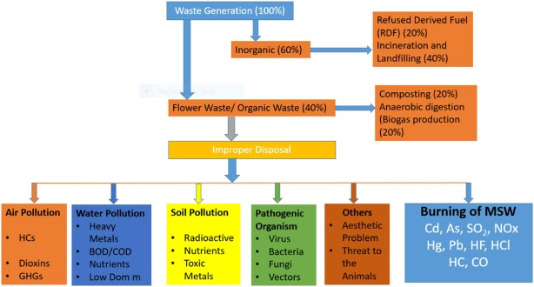
Introduction
Floral waste, generated primarily from events like weddings, funerals, and other celebrations, poses several environmental and logistical challenges. Here are some problems associated with floral waste.

Slide 3
USING FLORAL WASTE FOR VERMICOMPOST
Vermicomposting is a sustainable and environmentally friendly method for managing organic waste, including floral waste. Here's a step-by-step methodology for vermicomposting floral waste:
Separation and Collection
Shredding
Worm Selection
Vermicomposting Bin Setup
Add Floral Waste
Turning and Mixing
Harvesting

Slide 4
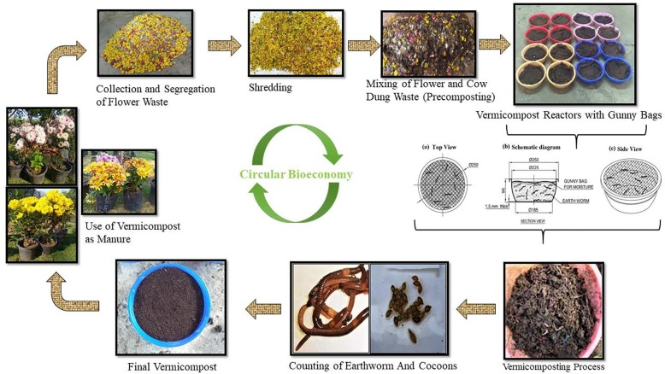

Slide 5
Biogas Generation From floral waste
Biogas generation from floral waste involves the anaerobic digestion of organic materials to produce methane-rich gas.
Here's a methodology for biogas generation from floral waste
Collection and Separation
Size Reduction
Mixing and Homogenization
Batch or Continuous Digester Setup
Inoculation with Microorganisms
Temperature and pH Regulation
Gas Collection System
Gas Storage
Biogas Utilization

Slide 6
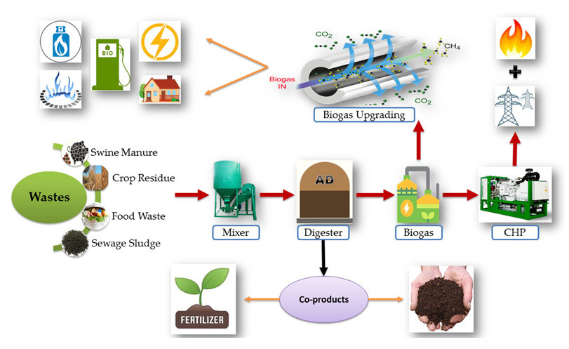
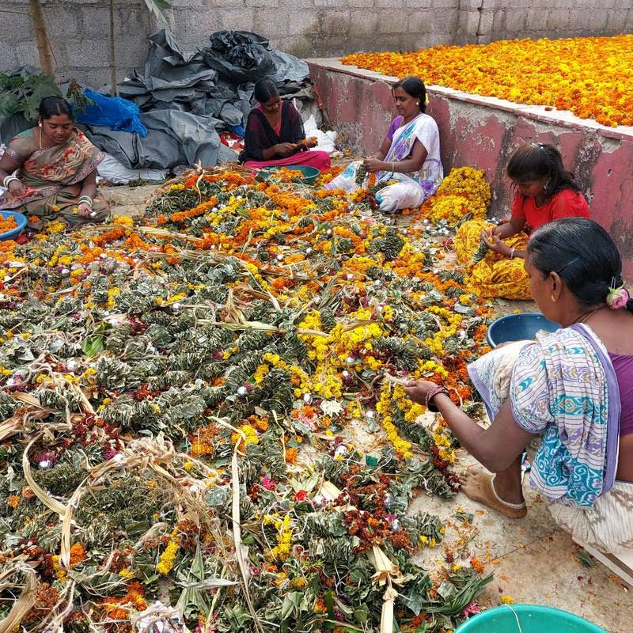

Slide 7
Dyes Regenerated From Floral Waste

Slide 8
Extraction of Essential Oils from floral Waste
Essential oils are extracted floral waste by Hydrodistilation Process

Slide 9
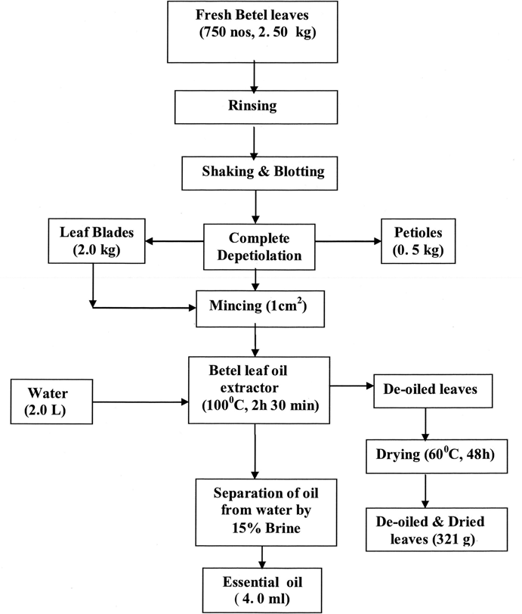
Process for preparation of essential oils

Slide 10
OTHER APPLICATIONS OF FLORAL WASTES
Preparation of Hand Made Paper
Medicinal Value
Preparation of Holi Colors
Preparation of incense sticks

Slide 11
Conclusion
Floral waste can be recycled and utilized in a variety of ways.
different ways to use temple waste for one or more useful products—vermicompost, biogas, dyes, incense sticks, etc.
This research will provide an alternative method of managing waste

Slide 12
Thank You

