Slide 1
“ The G20 and Sustainable Development Goal: Bridging Global Commitments for a Sustainable Future”
Presented By – Pooja
(Research Scholar, Department of Management, Indira Gandhi University, Meerpur)
Under the supervision of Dr Samridhi
(Associate Professor, Department of Management, Indira Gandhi University, Meerpur)

Slide 2
Introduction
The G20 or a group of twenty is an international forum for government and central bank governors from countries and the European Union.
The establishment of G20 is mainly to discuss and coordinate financial policy, related to international financial stability. The primary focus of the G20 is on economic and financial matters, but the G20 has also addressed the issues related to sustainable development goals.
All G20 members represent 2/3 of the world’s population, 80% of GDP, or 75% of global trade.
The main objective of the G20 is to maintain international financial stability and to promote sustainable economic growth or reduce worldwide poverty.
The G20 meeting is held once a year and is held in all the member countries. In which country this meeting is held, that country presided over the meeting in that year and played the role of chairman.

Slide 3
G20 Member Countries
Argentina | China | Indonesia | Mexico | Türkiye
Australia | France | Italy | Russia | United Kingdom
Brazil | Germany | Japan | Saudi Arabia | United States

Slide 4
Literature Review
Author & Year | Findings
(Lesch 2015). | This study emphasizes the importance of sustainable development goals or the agenda of adopting sustainable development goals for all countries. This study highlights that the G20 plays an important role in the implementation of SDGs with its organizing power and concludes that it is important that the G20 aligns its policies with the SDGs.
(Lay et al., 2017). | This study highlights the need for a policy to establish interlinkages between goals. This study describes that the G20 should promote coordination in trade or investment policy to support SDG. This study describes that the G20 partnership with Africa should not only emphasize economic and financial criteria but should also consider sustainable development goals.

Slide 5
Author & Year | Findings
(Walker et al., 2019) | This study focuses on challenges faced by G20 countries in achieving sustainable development goals. This study reveals that G20 countries face many challenges in achieving sustainable development goals even the best-performing countries cannot achieve the target of sustainable development goals by 2030. To achieve targets, it is necessary to address inequality, decarbonize the energy system, and make land use and food systems sustainable
(Berger et al., 2019). | This study focuses on the fact that for sustainable development it is necessary to increase FDI and facilitate sustainable FDI. For this, it is necessary to engage in multistakeholder consultation, ensure shared responsibility, encourage cooperative activities, and focus on national efforts with the multilateral framework.
(Goyal & Kureja, 2020). | The study reveals that the G20 facilitates its member nations in achieving sustainable development goals. G20 provides a platform for coordination, cooperation, or progress tracking, and for taking collective actions regarding common challenges, which is vital for global development. The findings of the study reveal that G20 countries are making great efforts to achieve the targets, but no G20 nation has yet achieved the sustainable development goal.

Slide 6
Research Gap
After reviewing as above, it was found that most studies have been done that G20 helps in achieving sustainable development goal targets. But how the G20 can promote sustainable development goals, the study regarding it, is very limited. This study will fill this gap.
Research Methodology
This study is based on a descriptive research design. Secondary data are collected from different secondary sources such as research papers, journals, reports, and different relevant websites. Various kinds of charts, pictures, and diagrams were used for the analysis and presentation of the data. This study will provide a comprehensive view regarding the role of G20 in achieving Sustainable development goals.
Objective of this study
To know the role of G20 in achieving sustainable development goal
To know the position of G20 nations in sustainable development goal
Discussion
Role of G20 in achieving Sustainable Development Goals

Slide 7
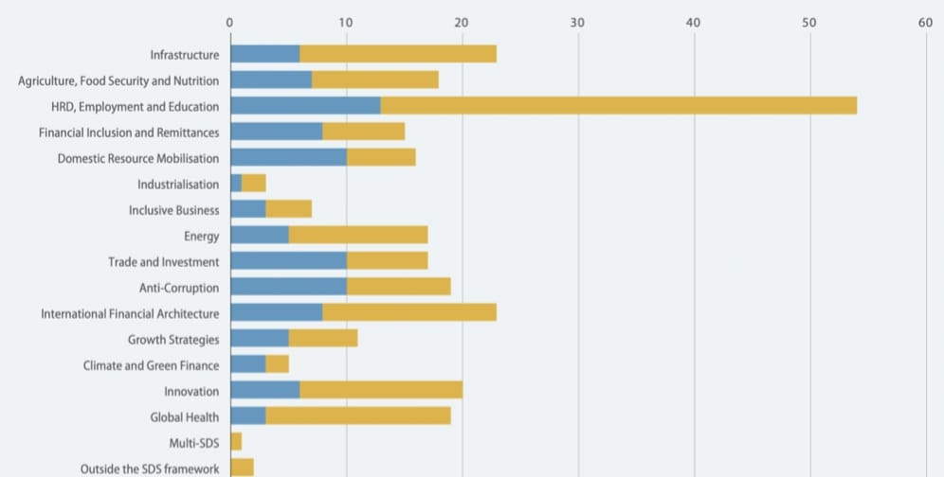
Focuses area of G20 on SDG Number of actions taken by G20 in the sustainable development area (2010-2019)

Slide 8
How G20 contribute to achieving sustainable development goal.
Infrastructure
Trade & Development
Climate action
Financial Inclusion
Gender Equality
Economic cooperation and Coordination
Global Health

Slide 9
Positions of G20 in Sustainable Development Goals
Country Name | Rank | score
Argentina | 51 | 73.69
Australia | 40 | 75.90
Brazil | 50 | 73.69
Canada | 26 | 78.50
China | 63 | 72.01
France | 6 | 82.05
Germany | 4 | 83.36
India | 112 | 63.45
Indonesia | 24 | 78.79
Italy | 24 | 78.79
Japan | 21 | 79.41
Republic of Korea | 31 | 78.06
Mexico | 80 | 69.71
Russia | 49 | 73.79
Saudi Arabia | 94 | 67.69
South Africa | 64 | 110
Türkiye | 72 | 70.78
United Kingdom | 11 | 81.65
United States | 39 | 75.91

Slide 10
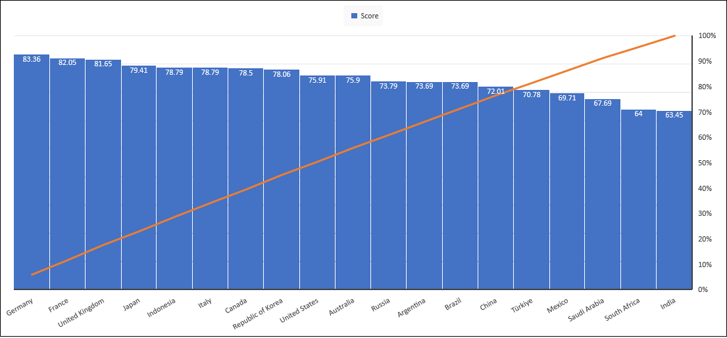
SDI SCORE OF G20 (2023)

Slide 11
Some countries are doing very well regarding the achieving of target SDGs like France, Germany, UK. However, some countries lag behind the target of achieving SDGs like India. India's ranking in achieving the SDG goal is 112. European Union and African Union are also included in G20. In the summit held G20 in India on 9 September 2023, the African Union was also included in G20.
Conclusion
In 2015, United Nations members agreed to the 2030 agenda or 17 sustainable development goals. G20 countries also expressed their commitment to achieving different sustainable development goals. However different data shows that the world is not on track to achieve its goals by 2030.
Sustainable development goal covers all aspects of education, a healthy environment, and protection of all areas of the world, it aims to end poverty, and hunger, fight diseases, women empowerment, and climate change, and protect biodiversity from loss or pollution.
But to achieve this goal the world must act with strong resolve or the government should also take responsibility. According to the 2019 report on sustainable development, there is no possibility of achieving the sustainable development goal by 2030.
This report found that the global community is on the right track in achieving these goals. But to achieve other goals it is necessary to achieve primary school enrolment, reduce mortality rate, and gender equality. Mostly the target till 2030 is very far to achieve, it is goal 2, goal 11, goal 13 goal 16, and goal 17.

Slide 12
Implication of the study
G20 includes 19 countries or two regional bodies European Union or African Union(as of 2023). G20 members represent 85% of global GDP 75% of global trade or 2/3 of the world population.
This study provides a comprehensive view of the role of G20 countries in achieving sustainable development goals. This study also reveals the current position of G20 countries in achieving sustainable development goals.
This study helps understand the importance of G20 and also will be helpful to know how G20 can promote SDGs. This study will also be helpful to diplomats or policymakers in making effective leverage of the G20 summit or in developing strategy.
This study will help understand the importance of influential groups like G20 or international cooperation

