Slide 1
IMPACT OF TEXTILES IN AGRICULTURE INDUSTRY
Mrs.M.Sasikala Saravanan
M.Sc., MBA., PGDCA., UGC-JRF., NET., TNSET., (Ph.D).,
Assistant Professor,
Department of Fashion and costume Designing
Holy Cross College, Tiruchirapalli, TamilNadu, India-620 002
hanuman2389@gmail.com

Slide 2
INTRODUCTION
Agriculture is the backbone of our country. Now it is saying that textile can be the backbone of agriculture. Textile fabrics have a long history of use in agro-tech sectors to protect, gather and store products. Between the 18th century and the end of the 19th century, agricultural development was occurred, which saw a massive and rapid increase in agricultural productivity and vast improvements in farm technology.
From then, Textiles have always been used extensively in the course of food production, most notably by the fishing industry in the form of nets, ropes and lines but also by agriculture and horticulture for a variety of covering, protection and containment applications.

Slide 3
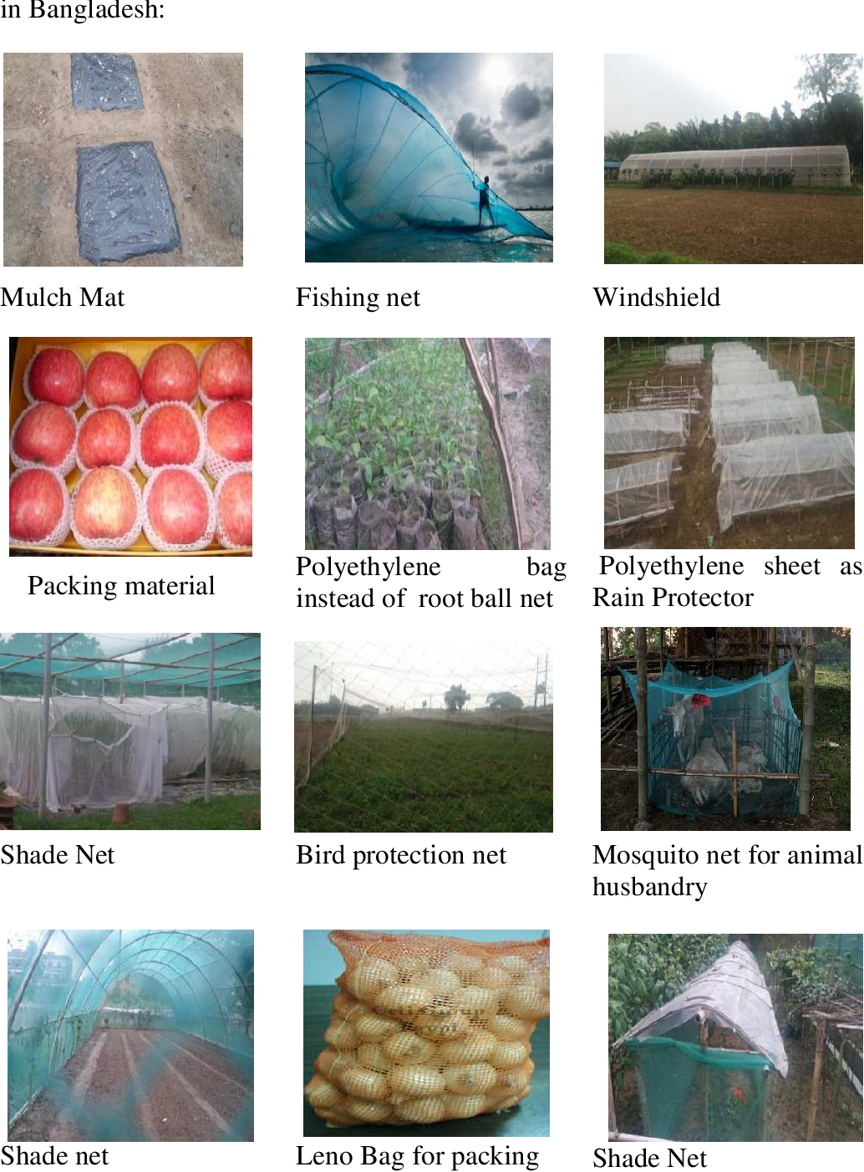

Slide 4
HISTORY OF AGRO TEXTILE:
Agriculture is the backbone of our country. Now it is saying that textile can be the backbone of agriculture. Textile fabrics have a long history of use in agro-tech sectors to protect, gather and store products. Between the 18th century and the end of the 19th century, agricultural development was occurred, which saw a massive and rapid increase in agricultural productivity and vast improvements in farm technology. From then, Textiles have always been used extensively in the course of food production, most notably by the fishing industry in the form of nets, ropes and lines but also by agriculture and horticulture for a variety of covering, protection and containment applications.

Slide 5
MANUFACTURING PROCESSES OF AGRO TEXTILES:
Several techniques of fabric production can be used to produce agro-textiles. Each method offers specific advantages for particular product.
The techniques are:
WEAVING AND WOVEN PRODUCTS:
KNITTING
NON-WOVEN

Slide 6
NEXT-GENERATION OF AGRO-TEXTILES
Plastic-based mulching film utilization in horticulture extensively caused a serious environmental impact due to non-biodegradability. The plastic film waste causes environmental pollution, so to mitigate such problems, biodegradable and renewable materials were used for soil mulching. Various biodegradable materials are natural polymers including starch, cellulose, and chitosan which were efficiently designed to retain their mechanical and physical properties during their implementation until the end of their life span. These materials were directly introduced into the soil as they have been degraded by soil micro flora which converts them into carbon dioxide or methane and water.

Slide 7
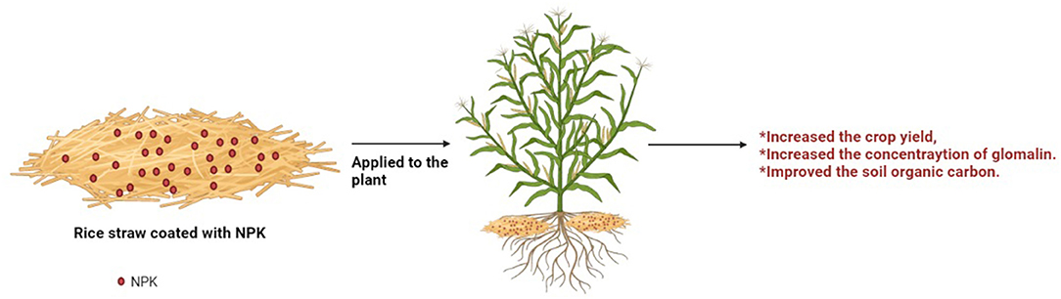

Slide 8
CONCLUSION
Agro-textiles provide potential applications in agriculture fields where agro-textile covers help crops to germinate and grow faster. Moreover, it has an overall impact on the plant morphology such as higher plant heights and leaf areas. A variety of fibers from agro-textiles tends to help by improving soil conditions, and also provide organic carbon to the soil when degraded. Next-generation agro-textiles seem to have an inclination toward eco-friendly and biodegradable material drawn from agriculture or farms.

Slide 9
REFERENCES:
Agro-textile Products & Their Usage By- Mrs. Manisha A. Hira Scientist C Sasmira, Mumbai
https://www.textileblog.com/agrotextiles-and-its-future-in-bangladesh/
http://www.textilemedia.com/technical-textiles/new-textile-materials/agrotextiles/
http://www.textileworld.com/Issues/2005/September/Nonwovens-Technical_Textiles/Agrotextiles-A_Growing_Field
https://textilelearner.net/agro-textile-products-their-properties-and-uses/

