Slide 1
ASSESSMENT OF THE ANCHOR BORROWER PROGRAMME ON SMALL HOLDER FARMERS IN ZARIA LOCAL GOVERNMENT AREA OF KADUNA STATE BY
MUHAMMAD ZUBAIRU

Slide 2
Introduction
Agricultural production over the years has experienced various farming innovations/programmes which are aimed to addressed the problems faced by smallholder farmers, but the efforts has not yielded the desired result.
Anchor borrower programme (ABP) is one the renewed credit scheme intervention programme along other chain of programmes.
ABP was conceived out by the CBN in collaboration with state government, anchor companies (Off-takers) and other stakeholders to resolve and achieve a strong viable agricultural base economy with a more integrated value chains, enhanced food security, eradicating rural poverty and increase productivity in the sector.

Slide 3
Introduction Cont.
These are some of the peculiar problems of the farmers that the ABP recognized which were not addressed in the previous programmes that is incorporated into ABP model which includes the following:
Problems encountered by farmers. | Anchor Borrower Programme model
Credit constraint/high cost of farm inputs | Credit provision in cash and kind
Poor use of farming technique/low crop yield | Comprehensive farming education/high crop yield
Market uncertainty/Price volatility | Guarantee sale of harvest by the anchor companies (Off-takers) at an agreed future market price.
Lack of commitment after harvest by farmers/ unemployment | Investment opportunities in derivatives from the sale proceeds.
Poor monitoring and evaluation of the programme. | Effective monitoring and supervision by all the stakeholders involved.
Loss of harvest due to flood, drought or natural disaster. | Insurance cover (NAIC)

Slide 4
Research Objectives
Main objective of the study:
To access the impact of the anchor borrower programme on smallholder farmers in the study area.
Specific objective of the study:
To examine the socioeconomic characteristics of the respondents in the study area.
To analyse the various innovations introduced by the anchor borrower programme and the extent of implementation on the beneficiaries in the study area.
To analyse the extent of output, income and profitability of small holder farmers under the anchor borrower programme in the study area.
To examine the extent of the anchor borrower programme impacts on the welfare of the participating small holder farmers in the study area.`

Slide 5
Literature Review
Conceptual Definition.
Anchor Borrower Programme and Smallholder farmers
Theoretical Literature.
theories of agricultural technology adoption: theory of innovation decision process, theory of individual innovativeness, theory of rate of adoption and theory of perceived attributes
impact evaluations models: before and after model, participant and non-participant model and the project objectives, inputs, output, effects, impacts and beneficiary evaluation models.
Empirical Literature.
Relevant existing's literatures were reviewed which revealed different findings and conclusions.

Slide 6
The Study Area
The study was carried out in Zaria Local Government Area of Kaduna State.
Zaria LGA is politically composed of thirteen (13) council wards which include; Dambo, Dutsen-Abba, Gyallesu, Kaura, Kufena, Kwarbai A, Kwarbai B, Limancin-Kona, Tudun-Wada, Tukur-Tukur, Unguwan-Fatika, Unguwan-Juma and Wuciciri.

Slide 7
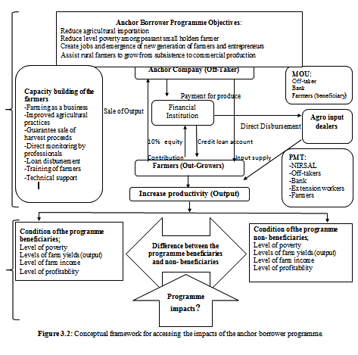
Conceptual Framework

Slide 8
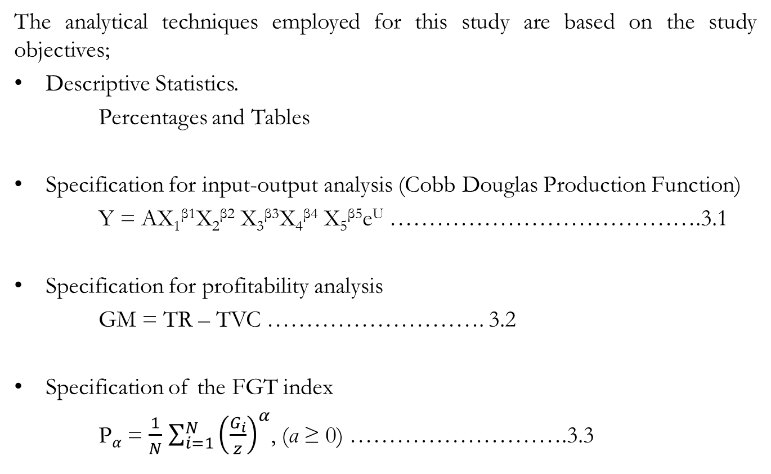
Models (Analytical Techniques)
The analytical techniques employed for this study are based on the study objectives;
Descriptive Statistics.
Percentages and Tables
Specification for input-output analysis (Cobb Douglas Production Function)
Y = AX₁^{β1}X₂^{β2} X₃^{β3}X₄^{β4} X₅^{β5}e^{U} ………………………………….3.1
Specification for profitability analysis
GM = TR – TVC ………………………. 3.2
Specification of the FGT index
P$α$= $\frac{1}{N}$ $\sum_{i=1}^{N}{{\left(\frac{G_{i}}{z}\right)}^{α}}$, (α ≥ 0) ……………………….3.3

Slide 9
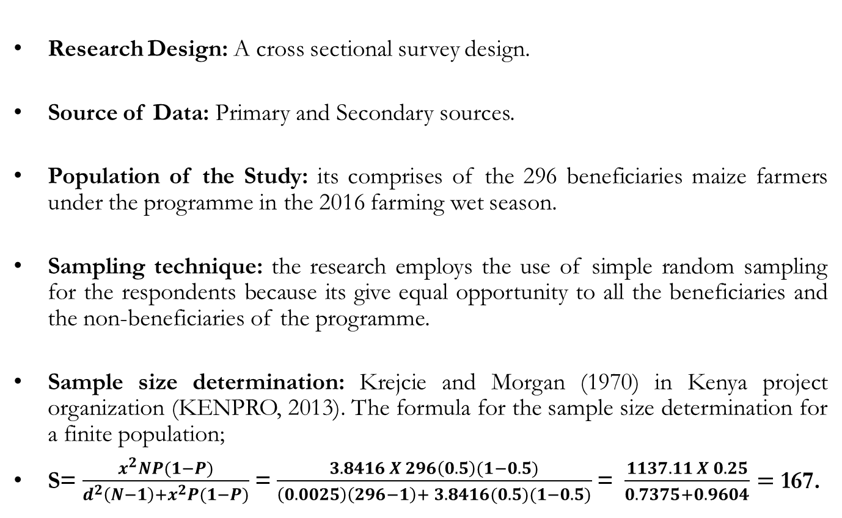
Research Design, Sources of Data, Population, Sampling Technique and Sample Size Determination
Research Design: A cross sectional survey design.
Source of Data: Primary and Secondary sources.
Population of the Study: its comprises of the 296 beneficiaries maize farmers under the programme in the 2016 farming wet season.
Sampling technique: the research employs the use of simple random sampling for the respondents because its give equal opportunity to all the beneficiaries and the non-beneficiaries of the programme.
Sample size determination: Krejcie and Morgan (1970) in Kenya project organization (KENPRO, 2013). The formula for the sample size determination for a finite population;
S= $\frac{x^{2}NP(1−P)}{d^{2}\left(N−1\right)+x^{2}P(1−P)}$=$\frac{3.8416 X 296\left(0.5\right)(1−0.5)}{\left(0.0025\right)\left(296−1\right)+ 3.8416(0.5)(1−0.5)}$= $\frac{1137.11 X 0.25}{0.7375+0.9604}=$ 167.

Slide 10
Questionnaire
Questionnaire administration was the major instrument for data collection and interview.
Questionnaire administered and retrieved.
Smallholders farmers Beneficiaries | Questionnaire Administered 167 | Questionnaire Retrieved 156 | Questionnaire not Retrieved 11
Non-beneficiaries | 84 | 78 | 6
 | 251 | 234 | 17

Slide 11
Major Findings
Findings from the demographic and socioeconomic characteristics of the respondents revealed that majority were male, married in their youthful age of 31-45 years and have attained different level of education.
The programme succeeded in the creation of additional economic activity as new generation of farmers emerged under the ABP.
Farming innovations introduced under the ABP revealed that credit is the major farming innovation introduced, though 52% said the loan given was not sufficient and about 93% said it was disbursed late.
Farming insurance was a total failure as majority of the beneficiaries farmers were not insured.
About 98% of the respondents were satisfied about the marketing arrangement under the ABP.
Also about 87.8% received teams of monitoring and supervision at the beginning of the farming activity only.
In another innovation, about 83% of the respondents went through various farm training innovation by the ABP.

Slide 12
On input-output analysis
Variables | Beneficiaries |  |  |  | Non-beneficiaries
 | Coef. | Std.error | t-stat | P-value | Coef. | Std.error | t-stat | P-value
llabour | 0.418986 | 0.199024 | 2.11 | 0.037 | 0.834734 | 0.289368 | 2.97 | 0.004
lseed | 0.145962 | 0.261883 | 0.56 | 0.578 | 0.327615 | 0.2624574 | 0.12 | 0.901
lfert | 0.165232 | 0.169136 | 0.98 | 0.330 | -0.328278 | 0.3354062 | -0.98 | 0.331
lherb | 0.403287 | 0.222795 | 1.81 | 0.072 | 0.257674 | 0.1645936 | 1.57 | 0.122
C | -0.38301 | 0.445848 | -0.86 | 0.392 | 0.190070 | 0.6007173 | 0.32 | 0.753
Return to Scale | 1.13347 | - | - | - | 1.091745 | - | - | -
Efficiency Parameter | 1.466693 | - | - | - | 1.209334 | - | - | -
Result from linear regression above shows that both beneficiaries and non-beneficiaries are both experiencing increasing return to scale. In terms of efficiency of production, the efficiency parameter of the beneficiaries is higher than the non-beneficiaries and this is because of the intervention of the ABP.

Slide 13
On the extent of Profitability
Farmers | Beneficiary (N= 156) | Non-beneficiary (N= 78)
Total Revenue | ₦23,664,000.00 | ₦8,731,450.00
Total Variable Cost | ₦21,457,800.00 | ₦7,253,900.00
Profit Margin | ₦2,206,200.00 | ₦1,477,550.00
The profitability analysis below reveals that at the programme participation level, small household farmers have a higher gross margin more than the non-beneficiaries of the anchor borrower programme.

Slide 14
On the extent of the programme impacts on the welfare of its beneficiaries and non-beneficiaries
Index | Beneficiaries | Non-beneficiaries
Mean Annual Income 2/3rd of Mean Income 1/3rd of Mean Income | ₦ 81,962.82 ₦ 54,641.88 ₦ 27,320.94 | ₦ 87.083.97 ₦ 58,055.98 ₦ 29,027.99
Headcount Index Core Poor | 9.62% | 12.82%
Moderate Poor | 42.95% | 19.23%
Non-Poor | 47.44% | 67.95%
Poverty Gap Index Core Poor | 0.1103 (11.03%) | 0.1216 (12.70%)
Moderate Poor | 0.0817 (8.17%) | 0.08733 (8.73%)
Poverty Severity Core Poor | 0.0697 (6.97%) | 0.1211 (12.11%)
Moderate Poor | 0.0385 (3.85%) | 0.4197 (4.20%)
The results of the farmer’s poverty status show that there is high incidence of head count index among the beneficiaries farmers as is higher than that of the non-beneficiaries while the result poverty depth indices (FGT₁) and poverty severity indices (FGT₂) among the beneficiaries in the study area are low as compared to the non-beneficiaries in the study area.

Slide 15
Conclusion
The study has found out that the anchor borrower programme intervention has the tendency of improving the agricultural production if farm inputs are properly disbursed at the appropriate time and the full implementation of the innovations introduced by the programme.

Slide 16
Recommendations
The study recommend that lapses identified in some of the activities of the programme such as insufficient and late disbursement of cash and farm inputs to farmers should be improved.
The study also recommend high commitment of all the stakeholders involved especially in the area of monitoring and supervision.
The ABP has shown some potentials of a promising success among the beneficiaries of the programme despite the setbacks experienced, thus the programme should be extended to more communities and local governments in the state.

Slide 17
THANK YOU

