Slide 1
AN ANALYTICAL STUDY OF COMPARISON BETWEEN STATE NUTRITIONAL INDEX (SNI) AND HDI FOR INDIAN STATES
1
Urvisha J. Mataliya
Dr. Vijay S. Jariwala

Slide 2
Introduction
What is malnutrition?
Types of malnutrition
Economic growth vs Nutritional status of India
GHI -2023
Construction of State Nutritional Index (SNI)

Slide 3
Literature review
(Rosenbloom et al., 2008) Researchers have developed a Global Nutritional Index (GNI) modelled on the Human Development Index (HDI), which is based on three indicators of nutritional status- deficit, excess, and food security. The results of this study showed that Japan has achieved first rank (0.989) and the United States (0.806) has obtained the last rank in developed countries. Estonia (0.943) ranked first in transition, while Tajikistan (0.629) obtained the last rank in transition countries. The Republic of Korea has secured first rank in the case of low-mortality developing countries. Algeria (0.876) achieved first rank in high-mortality developing countries, while Sierra Leone obtained the last rank in the high-mortality developing countries.
(Kanjilal et al., 2010) This study indicated that across all major states, the lowest prevalence of stunting among children was found in Kerala, whereas more than half of the children below five years old were found stunted in Uttar Pradesh (57%), followed by Bihar (56%), Gujarat (52%), and Madhya Pradesh (50%).

Slide 4
Naaz & Akram, 2017) The study explored the major achievements and shortcomings of progress made on key indicators related to the nutritional status of children and adults in the last decade by making a comparative analysis of the NFHS-3 and NFHS-4 factsheets. The results showed that in the case of stunted, Bihar was the worst-performing state, while Kerala was the best-performing state. In terms of wasted, Manipur state was the best-performing state, while Jharkhand was the worst-performing state. In the case of severely wasted children, results indicated that Jharkhand and Manipur were the worst and best-performing states, respectively. In the case of underweight, Jharkhand was the worst-performing state, while Mizoram was the best-performing state.
(Soheylizad et al., 2016) They have studied the correlation between malnutrition status of children under five years and Human Development Index (HDI) Worldwide. A significant negative correlation was found between the prevalence of stunting and wasting with HDI. A positive correlation was observed between overweight and HDI.
(Rajaram et al., 2003)The study assessed the nutritional status of children below five years. The results showed that the relative prevalence of underweight and wasting were high in Kerala, but the prevalence of stunting was medium. In Goa, relative prevalence of wasting and underweight were very high and prevalence of stunting was high as compared to Kerala.

Slide 5
Objectives
To inquire and compare the nutritional status of children under five years across the States of India by using NFHS-4 and NFHS-5 data
To prepare the State Nutritional Index and compare its rank with Human Development Index rank

Slide 6
Methodology
To compare the nutritional status of children under five years across the states of India, a State Nutritional Index (SNI) is developed based on the five indicators of malnutrition: stunted, wasted, severely wasted, underweight, and overweight.
Calculations are made for 27 states of India. Data for the SNI have been considered from the National Family Health Survey 4 (NFHS-4) (2015-16) and NFHS-5 (2019-21) for 27 states of India.
The SNI rank of NFHS-5 has been compared with the HDI rank of 2020. Because the NFHS-5 survey was completed in 2019-21, it is logical to compare it with the HDI rank of 2020. Which makes the comparison more reliable.

Slide 7
For getting normalized value used following formula
For negative indicator = (Max_{i}-X_{i}) / (Max_{i}- Min_{i}) ……. (1)
When,
Max_{i} = Maximum value of i indicator
X_{i} = Actual value of i indicator
Min_{i} = Minimum value of i indicator
For the construction of SNI we go for weightage mean
Example (Andhra Pradesh)
=Sum (stunted, wasted, severely wasted, underweight, overweight) *1/5…… (2)
= Sum (0.63+0.60+0.65+0.40+0.91) *1/5
= (3.19) *1/5
= 0.64

Slide 8
Results
Table-1 Comparison between the SNI rank of NFHS-4 and NFHS-5
Malnutritional Status | NFHS-4 | NFHS-5
Best | Manipur (SNI-0.86) | Manipur (SNI – 0.95)
Worst | Jharkhand (SNI – 0.2) | Gujarat (SNI- 0.24)
Source – Authors own calculation

Slide 9
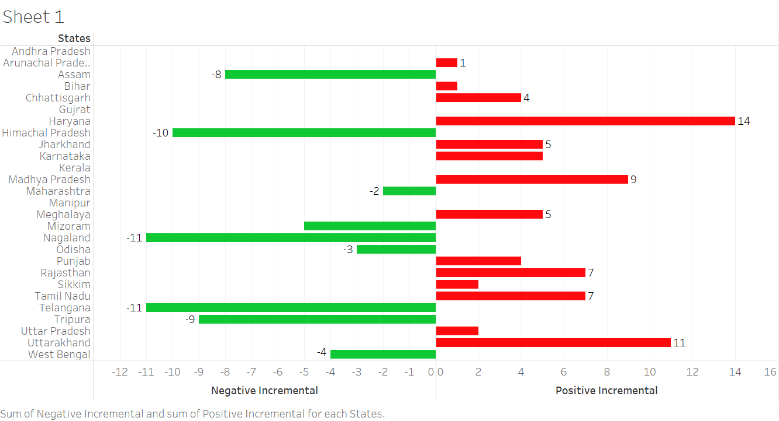
Changes in SNI rank from NFHS-4 (2015-16) to NFHS-5 (2019-21)

Slide 10
Table – 2 Prevalence of malnutrition in NFHS-5 (2019-21)
Malnutrition type | Best | Worst
Stunted | Sikkim | Meghalaya
Wasted | Mizoram | Maharashtra
Severely Wasted | Manipur | Maharashtra
Underweight | Mizoram | Bihar
Overweight | Madhya Pradesh | Mizoram
Source – Authors own calculations

Slide 11
Table -3 Bottom Five states of India according to HDI and SNI rank for NFHS-5 (2019-21)
Table -4 Top Five states of India according to HDI and SNI rank for NFHS-5 (2019-21)
Sr. No | State Nutritional Index | Human Development Index
1 | Jharkhand | Bihar
2 | Madhya Pradesh | Uttar Pradesh, Madhya Pradesh, Jharkhand
3 | Gujarat, Karnataka | Assam, Chhattisgarhi, Odisha
4 | Bihar | West Bengal
5 | Chhattisgarh | Andhra Pradesh, Tripura
Sr. No | State Nutritional Index | Human Development Index
1 | Manipur | Kerala
2 | Mizoram | Himachal Pradesh, Sikkim
3 | Himachal Pradesh | Haryana, Maharashtra, Tamin Nadu, Punjab
4 | Nagaland | Manipur, Mizoram
5 | Kerala | Karnataka, Nagaland, Uttarakhand
Source - Authors own calculations
Source - Authors own calculations

Slide 12
Differences observed between HDI rank and SNI rank in the year 2020 in 27 Indian states

Slide 13
Table – 5 Categorization of Indian states based on State Nutritional Index value and Human Development Index value using criteria of Human Development Index for 2020
Classification | HDI | SNI
Very High Category (> 0.800) | NIL | Haryana, Manipur, Punjab
High Category (0.700 to 0.799) | Himachal Pradesh, Kerala, Sikkim | Kerala, Mizoram, Tamil Nadu, Uttarakhand
Medium Category (0.550 to 0.699) | Note- All the states except three states (Himachal Pradesh, Kerala, Sikkim) are fall into the medium category | Andhra Pradesh, Arunachal Pradesh, Himachal Pradesh, Madhya Pradesh, Meghalaya, Odisha, Rajasthan, Sikkim
Low Category (<0.550) | NIL | Assam, Bihar, Chhattisgarh, Gujarat, Jharkhand, Karnataka, Maharashtra, Nagaland, Telangana, Tripura, West Bengal
Source – Authors own calculations

Slide 14
Conclusion
The results show that one state is performing best in some indicator, but the performance in the other indicators need to be improve
If some states perform best in HDI, it doesn’t mean that their nutritional status is also good
In economics, HDI is considered an indicator of economic development which also includes human development. Results indicate that HDI does not emphasised on nutritional status. So, when policymakers think about human development, they should also consider nutritional index like SNI with HDI simultaneously.

Slide 15
Thank you

