Slide 1
Research Paper Presentation
On
“To Develop Nobel Prize “ATTOSECOND” Theory By
Verilog Programming & Verify by Test Programming”
MR. SATYENDRA PRASAD
mathworktech@gmail.com
Dr. A.P.J. Abdul Kalam Technical University, Lucknow
Research Paper Presentation
on
“To Develop Nobel Prize “ATTOSECOND” Theory By
Verilog Programming & Verify by Test Programming”
MR. SATYENDRA PRASAD
Dr. A.P.J. Abdul Kalam Technical University, Lucknow
mathworktech@gmail.com

Slide 2
Outline
Introduction
Attosecond
Interface Diagram
Interface between Equation and Verilog Programming
Interface between Equation and Test Bench Programming
Graphical Parameter
Bit Table for Pulse generation equation
Software
Verification
Epwave form
Conclusion
References
Research Paper Presentation
on
“To Develop Nobel Prize “ATTOSECOND” Theory By
Verilog Programming & Verify by Test Programming”
MR. SATYENDRA PRASAD
Dr. A.P.J. Abdul Kalam Technical University, Lucknow
mathworktech@gmail.com

Slide 3
Introduction
Attosecond generation is a generating technique to generate attosecond pulse of different time interval by change the wave length of different type radiation wave.
To develop Attosecond generation equation by Verilog programming.
In order to develop the equation in to programming language by define the all the parameter in Verilog system.
All the bits of the input and output are fix bit.
All the interfacing parameter between equations into the Verilog syntex is fixing.
Interfacing between Verilog programming and Test bench programming is verify the Verilog programming of the equation by the test bench programming. Electronic Design Automation software is used to get the output of Verilog programming.
Electronic Design Automation software is used to get the output of Test bench programming.
Output of Verilog programming and output of the test bench programming is verifying the programming of equation of Attosecond generation pulse. Both output of Verilog and test bench programming show in wave form on the software.
Research Paper Presentation
on
“To Develop Nobel Prize “ATTOSECOND” Theory By
Verilog Programming & Verify by Test Programming”
MR. SATYENDRA PRASAD
Dr. A.P.J. Abdul Kalam Technical University, Lucknow
mathworktech@gmail.com

Slide 4
Attosecond
Attosecond Theory
Attosecond physics, also known as attophysics. It is generally attosecond science.
It is a branch of physics that deals with light-matter interaction phenomena.
Attosecond (10⁻¹⁸ s) photon pulses are used to unravel dynamical processes in matter with unprecedented time resolution.
Attosecond Equation
To generate a traveling pulse with an ultra-short time duration.
Two key elements are needed:
1. Bandwidth
2. Central wavelength of the electromagnetic wave.
Lower-limit in the minimum duration exploitable for a given pulse central wavelength. This limit is the optical cycle. Generation of attosecond pulses is given below
Tpulse =λ/c in fs,
Where c is the speed of light.
λ is central wavelength .
Fs is femtosecond
1 femtosecond =10⁻¹⁵ seconds
Research Paper Presentation
on
“To Develop Nobel Prize “ATTOSECOND” Theory By
Verilog Programming & Verify by Test Programming”
MR. SATYENDRA PRASAD
Dr. A.P.J. Abdul Kalam Technical University, Lucknow
mathworktech@gmail.com

Slide 5
Interface Diagram
Attosecond Pulse Generation | Verilog Programming | Test Bench Programming | Verification
Tpulse Equation | To program the Equation | To program the Equation | Run both program simultaneously
Data Table obtained from equation | Data program | Data Program | Both data & equation Run at a time and get output
Research Paper Presentation
on
“To Develop Nobel Prize “ATTOSECOND” Theory By
Verilog Programming & Verify by Test Programming”
MR. SATYENDRA PRASAD
Dr. A.P.J. Abdul Kalam Technical University, Lucknow
mathworktech@gmail.com

Slide 6
Interface between Equation and Verilog Programming
It is an interfacing the equation parameter to Verilog parameter.
Now
λ =A
C=B
Tpulse=Res
Width = 8 bit
Input width A = 8 bit
Input width B = B bit;
Output width Res = 8 bit;
These are the interchange parameter for Verilog Programming.
Research Paper Presentation
on
“To Develop Nobel Prize “ATTOSECOND” Theory By
Verilog Programming & Verify by Test Programming”
MR. SATYENDRA PRASAD
Dr. A.P.J. Abdul Kalam Technical University, Lucknow
mathworktech@gmail.com

Slide 7
Interface between Equation and Test Bench Programming
It is an interfacing the equation parameter to Test Bench parameter.
Now
λ =A
C=B
Tpulse=Res
WIDTH = 8 bit
Input width A = 8 bit
Input width B = B bit;
Output width Res = 8 bit;
These are the interchange parameter for Test Bench Programming.
Research Paper Presentation
on
“To Develop Nobel Prize “ATTOSECOND” Theory By
Verilog Programming & Verify by Test Programming”
MR. SATYENDRA PRASAD
Dr. A.P.J. Abdul Kalam Technical University, Lucknow
mathworktech@gmail.com

Slide 8
Graphical Parameter
Parameter Analysis for Wavelength
50000Unit =100 nm
100000Unit = 200nm
150000Unit = 300nm
200000Unit = 400nm
250000Unit = 500nm
Parameter Analysis for Velocity of Light
1Unit=3*10^(7)m/s
10Unit=10*3*10^(7)m/s
Parameter Analysis for Tpulse
1 Sec = 1*10^(-18) Fs
10 Sec=10*10^(-18) Fs
20Sec= 20*10^(-18) Fs
30Sec= 30*10^(-18) Fs
40Sec= 40*10^(-18) Fs
50Sec= 50*10^(-18) Fs
70Sec= 70*10^(-18) Fs
500
400
300
200
100
0
Wavelength
(λ) nm
Demonstration Graph (λ vs. C)
Research Paper Presentation
on
“To Develop Nobel Prize “ATTOSECOND” Theory By
Verilog Programming & Verify by Test Programming”
MR. SATYENDRA PRASAD
Dr. A.P.J. Abdul Kalam Technical University, Lucknow
mathworktech@gmail.com
0 1 2 3 4 5 6 7 8 9 10
Velocity of Light (C) m/s
50
40
30
20
10
0
Functional Graph(Tpulse= λ/c)
Tpulse
0 100 200 300 400 500
Wavelength(λ) nm

Slide 9
Time pulse generation
Parameter Analysis for Wavelength
50000Unit =100nm
100000Unit = 200nm
150000Unit = 300nm
200000Unit = 400nm
250000Unit = 500nm
For Infrared(IR) radiation
λ = 800nm (1nm=10^(-9)m
c= 3*10^(8) m/s
Tpulse= λ /c= 2.67fs
Research Paper Presentation
on
“To Develop Nobel Prize “ATTOSECOND” Theory By
Verilog Programming & Verify by Test Programming”
MR. SATYENDRA PRASAD
Dr. A.P.J. Abdul Kalam Technical University, Lucknow
mathworktech@gmail.com

Slide 10
Bit Table for Pulse generation equation
This table generated from Attosecond pulse generation equation
Research Paper Presentation
on
“To Develop Nobel Prize “ATTOSECOND” Theory By
Verilog Programming & Verify by Test Programming”
MR. SATYENDRA PRASAD
Dr. A.P.J. Abdul Kalam Technical University, Lucknow
mathworktech@gmail.com
SNo. | λ | C | Tpulse
1 | 100 | 10 | 10
2 | 200 | 10 | 20
3 | 300 | 10 | 30
4 | 400 | 10 | 40
5 | 500 | 10 | 50
6 | 600 | 10 | 60
7 | 0 | 0 | undefined

Slide 11
Software
Research Paper Presentation
on
“To Develop Nobel Prize “ATTOSECOND” Theory By
Verilog Programming & Verify by Test Programming”
MR. SATYENDRA PRASAD
Dr. A.P.J. Abdul Kalam Technical University, Lucknow
mathworktech@gmail.com

Slide 12
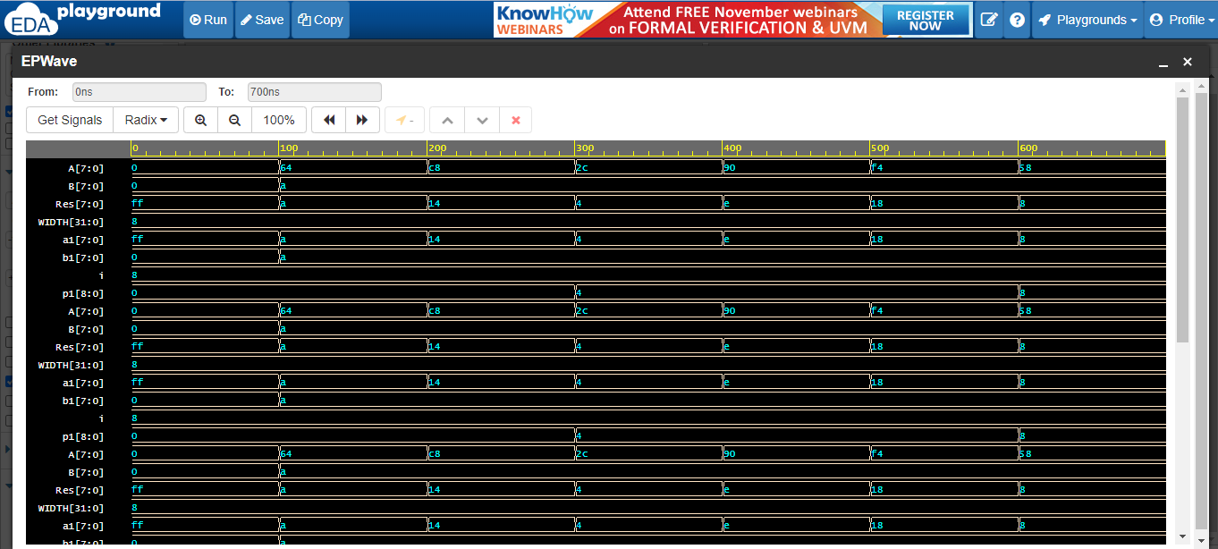
Verification
Research Paper Presentation
on
“To Develop Nobel Prize “ATTOSECOND” Theory By
Verilog Programming & Verify by Test Programming”
MR. SATYENDRA PRASAD
Dr. A.P.J. Abdul Kalam Technical University, Lucknow
mathworktech@gmail.com

Slide 13
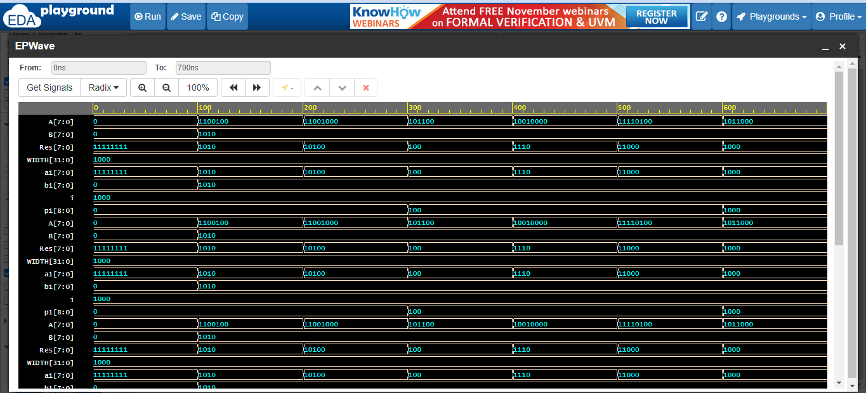
Epwave form
Research Paper Presentation
on
“To Develop Nobel Prize “ATTOSECOND” Theory By
Verilog Programming & Verify by Test Programming”
MR. SATYENDRA PRASAD
Dr. A.P.J. Abdul Kalam Technical University, Lucknow
mathworktech@gmail.com

Slide 14
Conclusion
For Verilog Output:
Input of the Simulation is show in wave form.
Output of the Simulation is show in wave form.
For Test Bench Verification:
Input of Test Bench Verification is show in wave form.
Output of Test Bench Verification is show in wave form.
Research Paper Presentation
on
“To Develop Nobel Prize “ATTOSECOND” Theory By
Verilog Programming & Verify by Test Programming”
MR. SATYENDRA PRASAD
Dr. A.P.J. Abdul Kalam Technical University, Lucknow
mathworktech@gmail.com

Slide 15
References
"Attosecond spectroscopy wins 2023's Nobel Prize in Physics". Big Think. 3 October 2023. Retrieved 3 October 2023.
https://www.mpg.de/20915252/nobel-prize-physics-2023-ferenc-krausz
Sato SA (2021). "First-principles calculations for attosecond electron dynamics in solids". Computational Materials Science. 194: 110274. arXiv:2011.01677. doi:10.1016/j.commatsci.2020.110274. ISSN 0927-0256. S2CID 226237040
Research Paper Presentation
on
“To Develop Nobel Prize “ATTOSECOND” Theory By
Verilog Programming & Verify by Test Programming”
MR. SATYENDRA PRASAD
Dr. A.P.J. Abdul Kalam Technical University, Lucknow
mathworktech@gmail.com

