Slide 1
Research Paper Presentation
On
To Develop Nobel Prize “Quantum Dot” Theory
By Verilog Programming & Verify by Test Bench Programming
MR. SATYENDRA PRASAD
mathworktech@gmail.com
Dr. A.P.J. Abdul Kalam Technical University, Lucknow

Slide 2
Outline
Introduction
Quantum Dot
Interface Diagram
Interface between Equation and Verilog Programming
Interface between Equation and Test Bench Programming
Graphical Parameter
Bit Table for Quantum Dot equation
Software
Verification
Epwave form
Conclusion
References

Slide 3
Introduction
Quantum dots, also called semiconductor nanocrystals.
It is semiconductor particles a few nanometres in size.
It have optical and electronic properties that differ from those of larger particles.
As a result of quantum mechanical effects.
They are a central topic in nanotechnology and materials science

Slide 4
Quantum Dot Theory
Quantum dots are theoretically described as a point-like, or zero dimensional entity.
Most of their properties depend on the dimensions, shape, and materials of which Quantum Dot are made.
Quantum Dot present different thermodynamic properties from their bulk materials.
One of these effects is melting-point depression.
Optical properties of spherical metallic Quantum Dot are well described

Slide 5
Quantum Dot Equation
The radius of the quantum dot affects the wavelength of the emitted light due to quantum confinement.
This equation describes the effect of changing the radius of the quantum dot on the wavelength λ of the emitted light.
Emission energy :
ΔE = hc/λ
ΔE =K/λ
where c is the speed of light
hc=K constant

Slide 6
Interface Diagram
Quantum Dot Generation | Verilog Programming | Test Bench Programming | Verification
Quantum Dot Equation | To program the Equation | To program the Equation | Run both program simultaneously
Data Table obtained from equation | Data program | Data Program | Both data & equation Run at a time and get output

Slide 7
Interface between Equation and Verilog Programming
It is an interfacing the equation parameter to Verilog parameter.
Now
k =A
λ =B
ΔE =Res
Width = 8 bit
Input width A = 8 bit
Input width B = B bit;
Output width Res = 8 bit;
These are the interchange parameter for Verilog Programming.

Slide 8
Interface between Equation and Test Bench Programming
It is an interfacing the equation parameter to Test Bench parameter.
Now
k =A
λ =B
ΔE =Res
WIDTH = 8 bit
Input width A = 8 bit
Input width B = B bit;
Output width Res = 8 bit;
These are the interchange parameter for Test Bench Programming.

Slide 9
Graphical Parameter
K=h*c
Parameter Analysis for Wavelength
50000Unit =100 nm
100000Unit = 200nm
150000Unit = 300nm
200000Unit = 400nm
250000Unit = 500nm
ΔE =K/λ
Demonstration Graph (K vs. λ)
0 100 200 300 400 500
Wavelength(λ) nm
Energy (E)
ΔE vs. λ
0 100 200 300 400 500
Wavelength(λ) nm

Slide 10
Quantum Dot generation
Calculation of constant (h*c)
K=h*c=6.626*10^(-34)*3*10*(8)
K =1.98*10^(-25) m^(3)*kg/s^(2)
~ 2*10^(-25) m^(3)*kg/s^(2)
Parameter Analysis for constant (k)
0.5Unit =1.98*10^(-25) m^(3)*kg/s^(2)
1Unit =5000*1.98*10^(-25) m^(3)*kg/s^(2)
Parameter Analysis for Wavelength
50000Unit = 500nm
100000Unit = 400nm
150000Unit = 300nm
200000Unit = 200nm
250000Unit = 100nm
ΔE = hc/λ
=>ΔE =K/λ
where k=h*c
800nm (1nm=10^(-9)m
ΔE =1.98*10^(-25) m^(3)*kg/s^(2)/800*10^(-9)m
ΔE =0.002475 *10^(-34) J
ΔE =2.475*10^(-37) J

Slide 11
Bit Table for Quantum Dot equation
This table generated from Attosecond pulse generation equation
SNo. | k | λ | ΔE
1 | 20 | 2 | 10
2 | 20 | 1 | 20
3 | 20 | 0.50 | 40
4 | 20 | 0.25 | 80
5 | 20 | 0.1 | 200
6 | 20 | 0.01 | 2000
7 | 0 | 0 | undefined

Slide 12
Software

Slide 13
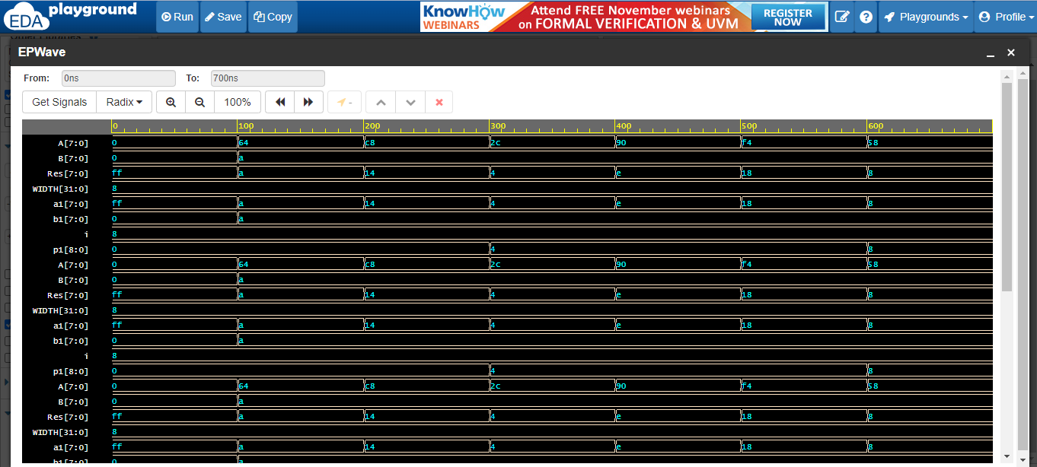
Verification

Slide 14
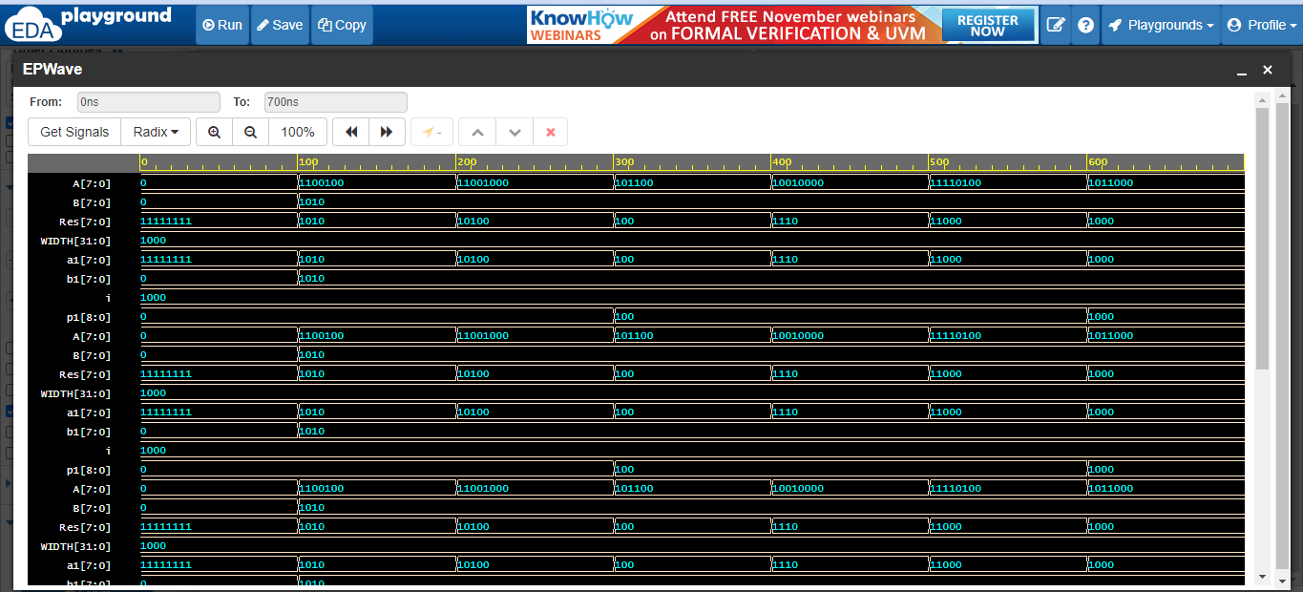
Epwave form

Slide 15
Conclusion
For Verilog Output:
Input of the Simulation is show in wave form.
Output of the Simulation is show in wave form.
For Test Bench Verification:
Input of Test Bench Verification is show in wave form.
Output of Test Bench Verification is show in wave form.

Slide 16
References
"The Nobel Prize in Chemistry 2023". NobelPrize.org. Retrieved 6 October 2023.
https://www.nobelprize.org/prizes/chemistry/2023/popular-information/
Palma, Jasmine; Wang, Austin H. (6 October 2023). "One Small Quantum Dot, One Giant Leap for Nanoscience: Moungi Bawendi '82 Wins Nobel Prize in Chemistry". The Harvard Crimson.
https://en.wikipedia.org/wiki/Brus_equation

