Slide 1
Threads of Transformation: Fostering an Entrepreneurial Mindset in Fashion
Ms. Anshu Singh Choudhary AP, ASFDT, Amity University

Slide 2
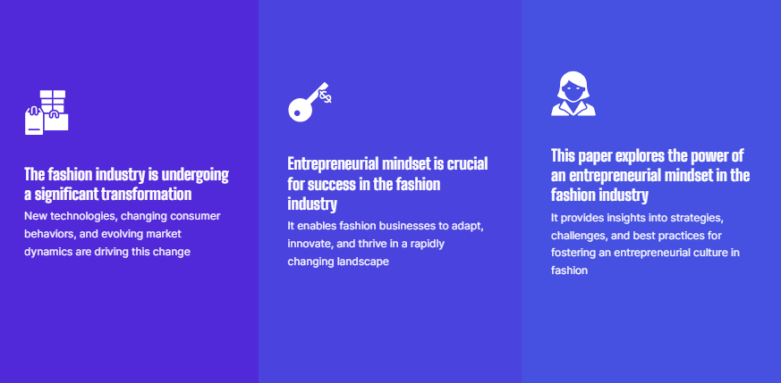

Slide 6
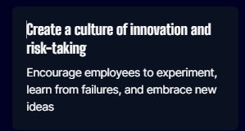
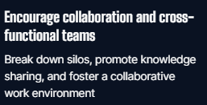
Nurturing an Entrepreneurial Mindset: Key Strategies and Best Practices

Slide 8
Encourage a mindset of experimentation and learning
Create a safe environment for taking risks, learning from failures, and embracing new ideas
Reward and recognize innovation and
entrepreneurial
behavior
Celebrate and incentivize employees who demonstrate an entrepreneurial mindset
Provide resources and support for innovation
Invest in research and development, technology, and infrastructure that enable innovation

Slide 10
Collaboration and Networking: Fueling Entrepreneurial Growth in Fashion
Join fashion incubators and accelerators
These programs provide mentorship, resources, and networking opportunities for fashion entrepreneurs
Build strategic partnerships and collaborations
Collaborate with other brands, influencers, and organizations to leverage each other's strengths and reach new audiences
Attend industry events and conferences
Connect with like-minded professionals, industry experts, and potential collaborators

Slide 11
Embracing Digital Transformation: Pivotal for Entrepreneurial Success in Fashion
Leverage social media and digital marketing
Use social platforms to build brand awareness, engage with customers, and drive sales
Adopt e-commerce and omnichannel retail strategies
Offer a seamless shopping experience across online and offline channels
Harness the power of data and analytics
Use data to gain insights into customer behavior, optimize operations, and drive informed decision-making

Slide 12
Measuring Success: Metrics and Indicators for Evaluating Entrepreneurial Mindset in Fashion
Revenue growth and profitability
Measure financial performance and profitability to evaluate the success of entrepreneurial initiatives
Customer satisfaction and loyalty
Monitor customer feedback, reviews, and retention rates to assess the impact of entrepreneurial strategies on customer satisfaction
Employee engagement and Satisfaction
Track employee satisfaction, engagement, and involvement in innovation projects to gauge the impact of an entrepreneurial culture

Slide 13
Thank You

