Slide 1
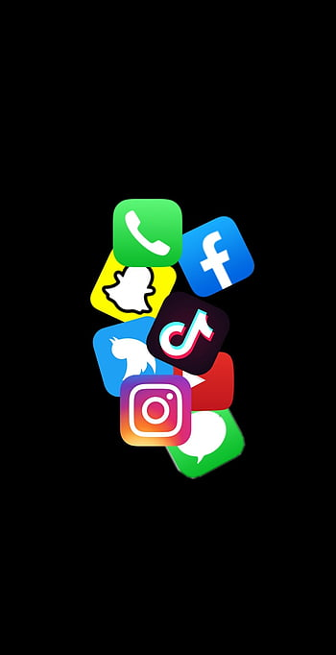
Exploring the Influence of Online Platforms on Well-Being: The Intersection of Social Media and Mental Health
Authors:
*Dr. Abdal Ahmed
Asst. Professor
*Alfia Firoz
Student MBA, Final Year
*Dr. Sumera Qureshi
*Shama Nargis
*Chems EDDINE Boukhedimi

Slide 2
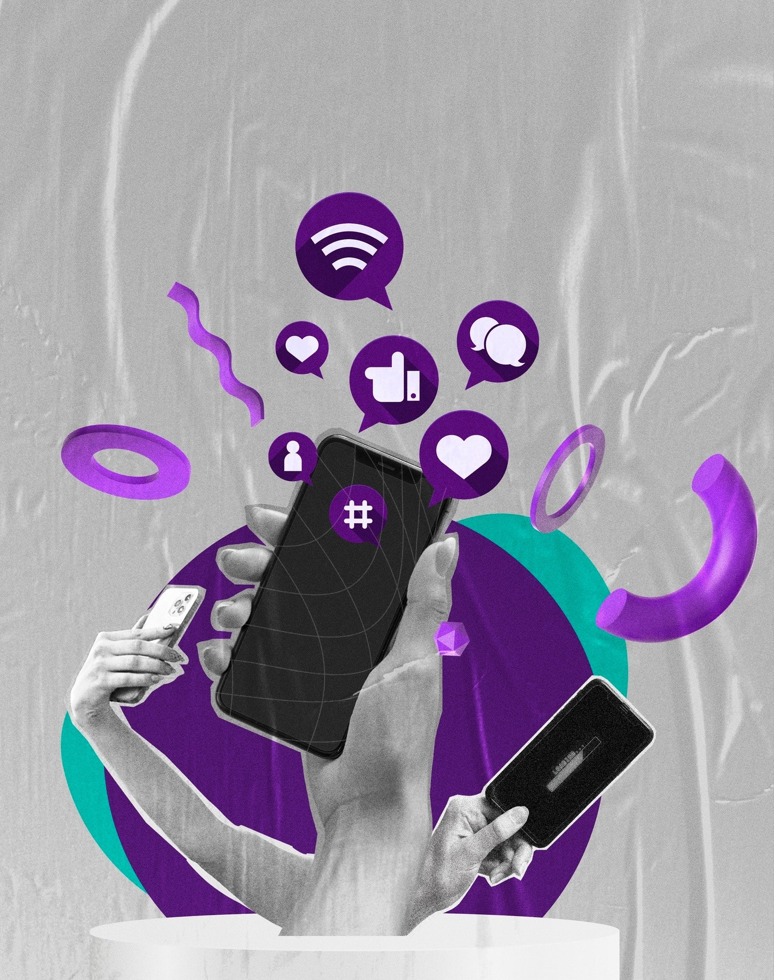
Introduction
Social media has become an integral part of our lives, but what is its impact on mental well- being? This presentation investigates the role of online platforms in shaping our mental health.
Research has shown both positive and negative effects, making it crucial to understand the nuances. By examining the latest studies, we can gain insights into how social media inﬂuences our well-being.

Slide 3
Research Objectives
To provide an analysis of the positive impacts of social media on mental health, exploring how these platforms can enhance well-being through connection, support, and information dissemination.
To investigate the negative implications of social media usage on mental health, examining issues such as social comparison, addiction, and cyber-bullying.
To synthesize existing literature on the topic and offer a comprehensive overview of the current state of knowledge regarding the relationship between social media and mental well-being.

Slide 4
Positive Effects
While excessive use of social media can lead to negative outcomes, it also has positive effects on mental well-being.
Research suggests that online platforms can provide a sense of belonging and social support. Additionally, they offer opportunities for self-expression, creativity, and community engagement. It is important to recognize these positive aspects alongside the potential risks.

Slide 5
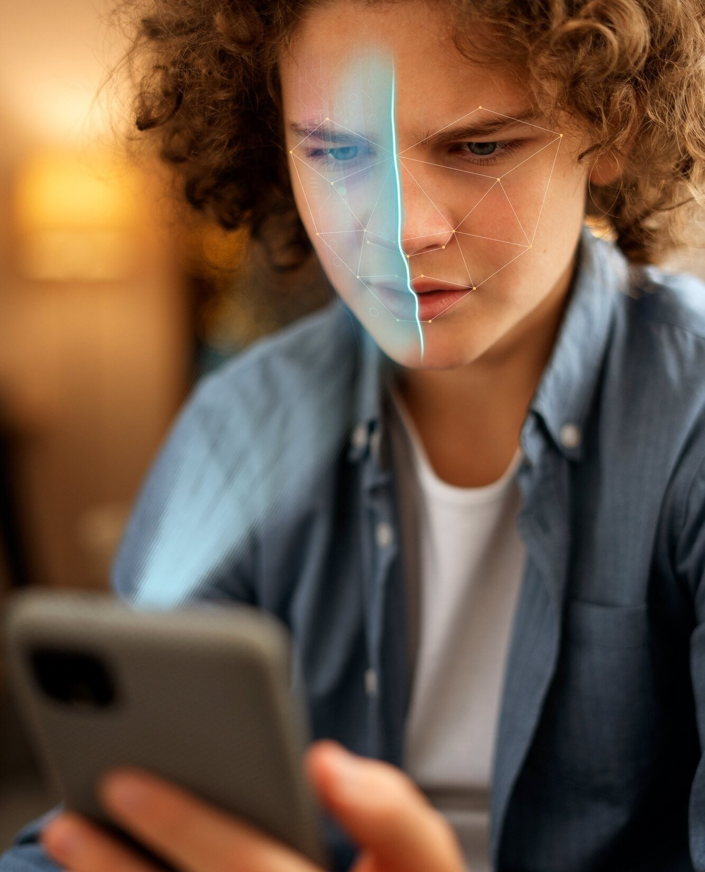
Negative Effects
Social media can have detrimental effects on mental well-being.
Comparison, cyber-bullying, and addiction are some of the negative consequences associated with excessive use. The constant exposure to highlight reels and idealized portrayals can lead to unrealistic expectations and feelings of inadequacy. Understanding these negative effects is crucial for developing strategies to mitigate their impact.

Slide 6
Factors Inﬂuencing Impact
jshjhs
Several factors inﬂuence the impact of social media on mental well- being. Individual vulnerability, usage patterns, and online social support play signiﬁcant roles.
Personal characteristics, such as self-esteem and emotional resilience, can shape how individuals respond to online interactions. The type and duration of social media use, as well as the quality of online connections, also contribute to the overall impact.

Slide 7
Strategies for Well-Being
To promote mental well-being in the digital age, it is crucial to adopt effective strategies.
Digital detox, mindful usage, and setting boundaries can help individuals maintain a healthy relationship with social media.
Building ofﬂine connections, seeking professional help, and practicing self-care are also essential.
By implementing these strategies, individuals can navigate the online world while safeguarding their mental well-being.

Slide 8
Conclusion
Social media's impact on mental well-being is complex and multifaceted. While it offers opportunities for connection and self- expression, it also presents risks such as comparison and cyberbullying.
By understanding the factors inﬂuencing impact and adopting strategies for well-being, we can harness the beneﬁts of social media while mitigating the potential harms. It is crucial to promote digital well-being and foster a balanced relationship with online platforms.

Slide 9
Thank you !

