Slide 1
AN ANALYSIS OF FACTORS AFFECTING TO INVESTOR’S DECISION FOR VARIOUS INVESTMENT AVENUES -A CASE STUDY OF INVESTORS OF BARDOLI CITY OF GUJARAT
1
Dr. Vijay S. Jariwala
Dr. Pankaj Gandhi

Slide 2
Introduction
Indian scenario of Investment
Types of investment

Slide 3
Literature review
(Hu, 2017) Have conducted research on “Investors' perceptions towards potential investment avenues”. The study's goal is to understand why an investor chooses a particular investment strategy. It has been discovered that the motivations behind investing preferences vary depending on the type of investment. The investment objectives, such as risk, return, safety, and liquidity of the investment, are what determine the investor's preference on Investment Avenue.
(S.Hemalatha, April 2019) Have conducted research on “Factors Affecting Individual Investors' Investing Decisions in Relation to Selected Individual Investors”. The study's goal was to identify factors that affected investment choices. The elements impacting investment decision-making have been found to vary by gender, age, occupation, internet use, level of computer literacy, and use of online trading.

Slide 4
(Elizabeth, September 2018) Have conducted research on “A Conceptual Framework for Emerging Investment Avenues”. The goal of the study is to comprehend the variables influencing various investment decisions and the many avenues for investment that are available on the capital market. According to research, Warren Buffet has said that "success in investing doesn't connect with I.O. after you are above the 25 level, what you need is the temperament to restrict the impulse that brings individuals into difficulty in investing." Thus, an investor shouldn't put all of his or her eggs in one basket.
(Disha, April, 2018) Have conducted research on “A Comparative Analysis of Investor Perceptions of Stocks and Derivatives. The purpose of the research is to compare and analyze the variables that influence investors' decisions when choosing stocks and derivatives. It has been discovered that there are a number of beneficial features that make equity investments simpler for investors, and as a result, investors prefer to make stock investments. It is also stated that investors perceived derivatives to be riskier than stock. Identified the investors' perceptions of equity and derivatives. It has been determined that investors' perceptions of stocks and derivatives are identical.

Slide 5
Research Gap
The main barrier to the expansion of India's economic development is the disregard for how the common people of India behave towards investment, particularly in various investment avenues. It is important to determine the causes of this kind of human behavior in order to channel idle savings into various investment avenues and spark investor interest in those avenues. This paper seeks to establish a connection between investors and the various investment avenues that will ultimately be advantageous for the prosperity of our nation.

Slide 6
Research Objectives
The main objectives of this study are to identify the factors that influence investors in various financial market investment outlets. The secondary objectives include:
To understand the investors' demographics
To ascertain the effects of a demographic profile on several aspects those affect an investment opportunity.

Slide 7
Research Methodology
The purpose of the current research is to identify the factors that influence investors in various financial market investment outlets.
The descriptive research design was used in this paper. The data was acquired using a standard questionnaire, and only primary data was used.
The researcher used the non probability convenience sampling method. The sample was collected from 100 individual retail investors from Bardoli city.
A variety of statistical approaches, including the one-sample t-test, have been used for the testing of hypotheses in order to measure various phenomena and analyze the acquired data effectively and efficiently to reach reasonable conclusions.
The collected data was analyzed using statistical tools such as SPSS for tabulation and data modification.

Slide 8
Analysis of Findings
Table 2 Age
Table 1 Gender
Gender | Frequency | Percent
Female | 67 | 67.0
Male | 33 | 33.0
Total | 100 | 100.0
Age | Frequency | Percent
Below 25 | 26 | 26.0
26-35 | 35 | 35.0
36-45 | 31 | 31.0
Above 45 | 8 | 8.0
Total | 100 | 100.0

Slide 9
Analysis of Findings
Table 3 Marital Status
Marital status | Frequency | Percent
Married | 18 | 18.0
Unmarried | 82 | 82.0
Total | 100 | 100.0

Slide 10
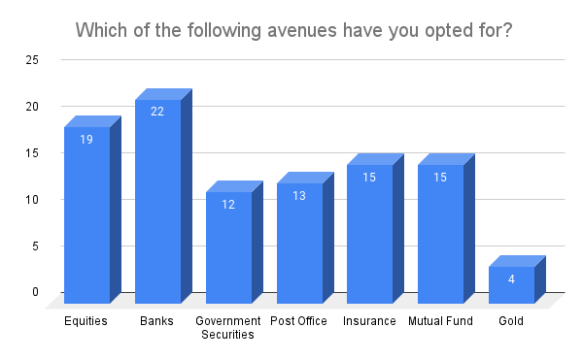
Analysis of Findings
Figure 1 which of the following avenues have you opted for?

Slide 11
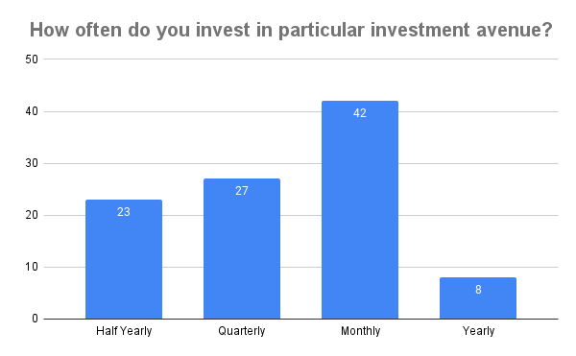
Analysis of Findings
Figure 2 how often do you invest in particular Investment Avenue?

Slide 12
Analysis of Findings
Table 4 One-Sample Statistics
 | N | Mean | Std. Deviation | Std. Error Mean
Return Rate | 100 | 1.84 | 1.170 | .117
Risk Level | 100 | 2.28 | .922 | .092
Diversification | 100 | 2.37 | .971 | .097
Ease of Access | 100 | 2.46 | .947 | .095
Economic Growth | 100 | 2.42 | 1.017 | .102
Awareness | 100 | 2.27 | .993 | .099
Availability of Finance | 100 | 2.17 | 1.129 | .113

Slide 13
Analysis of Findings
Table 5 One-Sample Test
 | Test Value = 2
 | t | df | Sig. (2-tailed) | Mean Difference | 95% Confidence Interval of the Difference
 |  |  |  |  | Lower | Upper
Return Rate | -1.368 | 99 | .174 | -.160 | -.39 | .07
Risk Level | 3.037 | 99 | .003 | .280 | .10 | .46
Diversification | 3.811 | 99 | .000 | .370 | .18 | .56
Ease of Access | 4.856 | 99 | .000 | .460 | .27 | .65
Economic Growth | 4.130 | 99 | .000 | .420 | .22 | .62
Awareness | 2.718 | 99 | .008 | .270 | .07 | .47
Availability of Finance | 1.506 | 99 | .135 | .170 | -.05 | .39

Slide 14
Research Hypothesis
H0: Factor affected in different investment avenues respondent are not agreed for return rate.
H1: Factor affected in different investment avenues respondent are agreed for return rate.
From the preceding table, it can be determined that a significant value of 0.174, which is greater than 0.05, indicates that the null hypothesis (H0), which states that factors that affect return rates on various investment avenues, is accepted.
H0: Factor affected in different investment avenues respondent are not agreed for risk level.
H1: Factor affected in different investment avenues respondent are agreed for risk level.
From the preceding table, it can be concluded that a significant value of 0.003, which is less than 0.05, indicates that the null hypothesis (H0) is rejected, the alternative hypothesis (H1) is accepted, and the factors influencing the various investment avenues that respondents have chosen to pursue are not all agreed upon as to the appropriate level of risk.

Slide 15
Research Hypothesis
H0: Factor affected in different investment avenues respondent are not agreed for diversification.
H1: Factor affected in different investment avenues respondent are agreed for diversification.
With the help of the above table, it can be inferred that a significant value of 0.00, or less than 0.05, indicates that the null hypothesis (H0) is rejected, the alternative hypothesis (H1) is accepted, and the factors affecting the respondents' agreement to diversify their investments are not significant.
H0: Factor affected in different investment avenues respondent are not agreed for ease of access.
H1: Factor affected in different investment avenues respondent are agreed for ease of access.
As shown in the preceding table, a significant value of 0.00, or less than 0.05, indicates that the null hypothesis (H0) is rejected, the alternative hypothesis (H1) is accepted, and the factors affecting the respondents' various investment options are not all agreed upon for the sake of accessibility.

Slide 16
Research Hypothesis
H0: Factor affected in different investment avenues respondent are not agreed for economic of growth.
H1: Factor affected in different investment avenues respondent are agreed for economic of growth.
From the above table, it can be determined that a significant value of 0.00, which is less than 0.05, indicates that the null hypothesis (H0) is rejected and that alternative hypothesis (H1) and Factor affecting different investment channels respondents are not agreed upon for economic growth.

Slide 17
Research Hypothesis
H0: Factor affected in different investment avenues respondent are not agreed for awareness.
H1: Factor affected in different investment avenues respondent are agreed for awareness.
The significant value of 0.008 in the preceding table, which is less than 0.05, indicates that the null hypothesis (H0) is rejected, the alternative hypothesis (H1) is accepted, and the factors affecting the respondents' awareness of various investment avenues are not all agreed upon.
H0: Factor affected in different investment avenues respondent are not agreed for availability of finance.
H1: Factor affected in different investment avenues respondent are agreed for availability of finance.
From the preceding table, can be deduced that a significant value of 0.135, which is greater than 0.05, indicates that the null hypothesis (H0), which states that factors affecting various investment avenues affect respondents' financial availability, is accepted.

Slide 18
Conclusion
This study concentrated on the elements influencing the behavior and portfolio of individual investors. It bolsters the widely held belief regarding the impact of the independent variables of investing purpose and risk profile.
It also looked at how the performance of a person's portfolio and the perceived extent of investor behavior can affect one another. Risk is one of several topics associated with investing in different investment avenues that have been investigated in terms of investor attitudes and perceptions.
Men are more likely than women to invest. Those with lower salaries are more inclined to put their money into different investment options than those with higher income levels.
Since tax rates are always rising, the majority of individuals invest in order to save money on taxes.
More participants in this survey put their money in banks. In order to keep investors' faith, more advertisements should occasionally be released. Growth and income are people's key investing goals.

Slide 19
Thank you

