Slide 1
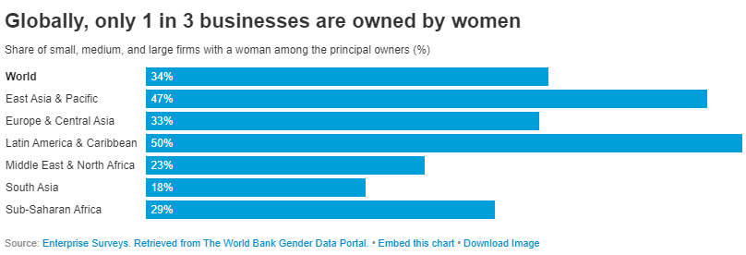
Today's world is at the pinnacle of development and along with it, its influence is constantly increasing in all spheres of life (Teresa Kodongan & Yohanis Pandie, 2022). Due to the touch of technology, people are finding new ways and trying to succeed through business ventures. As a result, the number of new entrepreneurs in the world is growing by the day (Simovic, 2022). There are 582 million entrepreneurs worldwide and 31 million in the US and according to statistics on female entrepreneurs in the United States, there are 71 female business owners for every 100 male business owners (Wise, 2022). Many of them have achieved success at their highest level. One of them is Oprah Winfrey, whose net worth is $3.5 billion (Williams, 2022). However, Asian women lag far behind in this regard; among the top 15 best female entrepreneurs in the world, only one is from South Asia, Indra Nooyi, who has an estimated net worth of over $290 million (Agarwal, 2022). Social barriers, political conflicts, and economic insecurity are cited as reasons for this (Basu & Goswami, 1999). In many parts of South Asia, girls are still denied equal rights (Makinson, 1994).

Slide 2
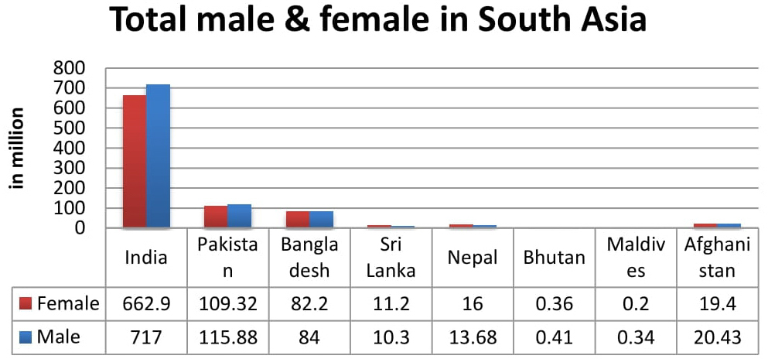

Slide 3
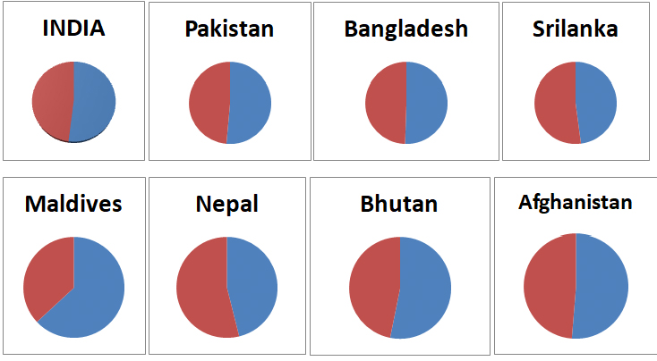
sex ratio in South Asia countries in percent

Slide 4
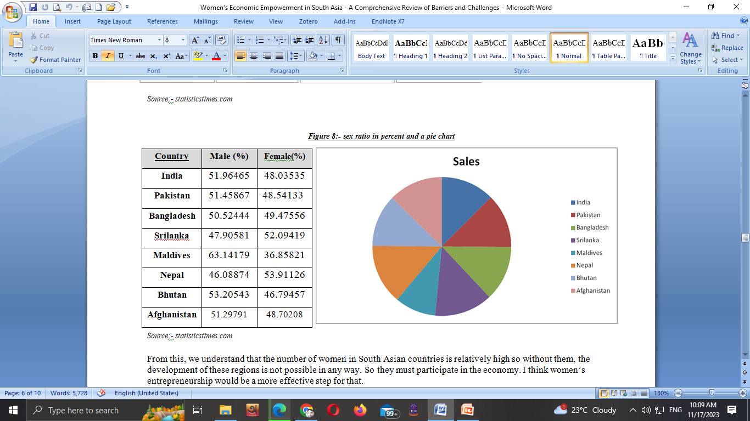
sex ratio in percent and a pie chart

