Slide 1
Impact of Diclofenac on Vultures Authors- Mandan Savita Rathod Nikita R. C. Patel Institute of Pharmaceutical Education and Research Shirpur Contacts- a.mandan@rediffmail.com

Slide 2
Abstract
The world is home to 23 different species of vultures.
Since the mid-1990s.
There has been a drop in the number of vultures in South East Asia.
This decline has been attributed mainly to a decline of over 90% in the Indian Gyps species, which includes the Indian white-backed vulture, Gyps bengalensis, Indian vulture.
Based on experimental research, diclofenac, a nonsteroidal anti-inflammatory medicine, is the cause of renal failure that results in vulture death.

Slide 3
Introduction
Long-lived vultures have bald heads, hooked beaks, and large bodies. Exceptional heads, necks, and vision.
They must go foraging for themselves. And rarely, if at all, consume carrion in place of preying on living things.
Both old world (accipitrid) and new world vultures belong to the vulture family cathartid vultures.
Global vultures such as the Turkey vultures inhabit the Americas, whereas old world vultures are found in Europe, Asia, and Africa.
As soon as they truly In order to preserve some habitats, vultures are essential.

Slide 4
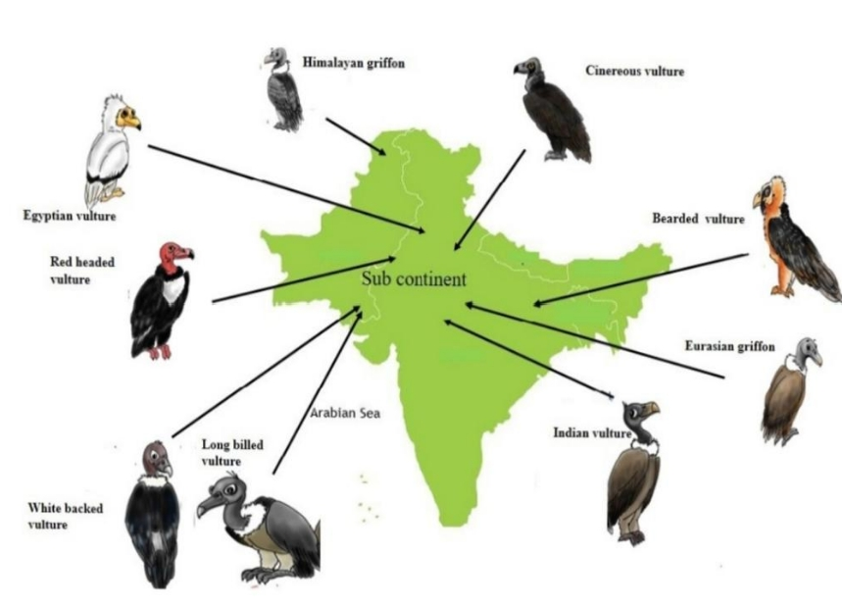
Variety Of Vultures

Slide 5
Link between diclofenac use in livestock and Vultures toxicity:
The drug is ingested by vultures when they eat the carcasses of animals that received diclofenac treatment just prior to death.
Victims of diclofenac-contaminated tissues, vultures die within days of experiencing renal failure; postmortem examinations reveal widespread visceral gout .
Comparable observations have been made with wild G. Indicus and Bengalensis carcasses found all over the Indian subcontinent (2). Currently, diclofenac has been recognised as a possible hazard to three species of vultures in the Indian subcontinent

Slide 6
Vultures Sp. In Risk
Five other Gyps vultures found in Asia, Europe, and Africa may also be at risk from diclofenac and other NSAIDs. Gyps africanus and Gyps fulvus were thus subjected to toxicological testing

Slide 7
Antibiotic used
Diclofenac sodium inhibits cyclo-oxygenase activity, which reduces the synthesis of prostaglandin from arachidonic acid.
These pharmacodynamic effects are comparable to those of other non-steroidal anti-inflammatory drugs.
It has anti-inflammatory, antipyretic, and analgesic properties.
It also inhibits platelet aggregation and has deleterious effects on the mucosae of the stomach and intestine.
When given orally to rats, the pharmacological NOEL for antiphlogistic effects was 0.1 mg/kg bw (paw oedema) following a single dosage.

Slide 8
The protective dose (PD50) of diclofenac when given intraperitoneally prevented rabbits from dying when arachidonic acid was administered intravenously.
A single 0.1 mg/kg bw dose in foetal rats was shown to cause a low oral effective dose of 0.4 mg/kg bw every six hours (or 1.2 mg/kg bw/day) is recommended for the treatment of human pain.
The two main metabolites, 4’-hydroxydiclofenac and 3’-hydroxydiclofenac, exhibit acute toxicity that is comparable to that of the parent compound.

Slide 9
However, they only show 1/15 to 1/200 of the activity of diclofenac in various pharmacological animal models, and they only inhibit prostaglandin synthesis at elevated concentrations (IC 50 in vitro being 5 to 8 times higher).
In contrast, there is hardly any difference made by the remaining 4 metabolites.
From these studies, a pharmacological LOEL of 0.1 mg/kg bw. 3 can be determined. It is demonstrated that oral dosages of a solution containing radiolabelled diclofenac are rapidly and completely absorbed by the rat.

Slide 10
CONTROLLING MEASURES TO STOP DECLINE OF VULTURE SPECIES:
Diclofenac is widely used, and India is the primary reason for the vulture species’ extinction.
Proposals have been made to encourage conservation and completely prohibit the use of diclofenac in livestock.
Breeding centres are also working to halt the extinction. From the vulture species previously stated .
As of right now, there are less alternatives to toxicity medications like meloxicam, which must be put to use right away.

Slide 11
Conclusion
Scavenger birds like vultures are very ecologically special species.
They are very aware of the natural world. Vision, a peculiar stomach with an extremely low pH
These qualities are appropriate for their positions since they have the ability to remove and discard cow carcasses Terrible infections in human beings.
It was determined that diclofenac posed a serious risk to vulture populations and seriously harmed them.
It’s necessary to use less dangerous alternatives to treat diseases in livestock medications like meloxicam.

Slide 12
References:
1.Old World Vultures Reflect Effects of Environmental Pollutants Through Human Encroachment Sonja C. Krüger,a,b Andre Botha,c William Bowerman,d Brent Coverdale,a Meredith L. Gore,e Linda van den Heever,f L. Jen Shaffer,g Hanneline Smit‐Robinson,f,h Lindy J. Thompson,b,c and Mary Ann Ottingeri.
2.Veterinary pharmaceuticals and declining Cape Griffon Vulture (Gyps Coprotheres) numbers: A potential threat to developing embryos Leandra Wiid, Vinny Naidoo.
3.Impact of Diclofenac a Non-steroidal Antiinflammatory Veterinary Pharmaceutical Drug On Vultures Roheela Yasmeen1*, Laiba Asif1 And Samia Djeffal21Lahore Garrison University, Lahore,
4. Non-Steroidal Anti-Inflammatory Drugs (NSAIDS) and their Effect on Old World Vultures: A Scoping Review Authors: Jimenez-Lopez, Omar, Ponder, Julia, Nault, Andre, and Bueno, Irene Source: Journal of Raptor Research

Slide 13
Thank You

