Slide 1
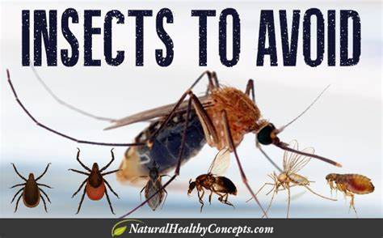
7th CAPCDR International Conference on " Public Health and Technology",
December 25-26, 2023
Presentation
on
Insects and Public Health: A Comprehensive Review
Dr C. Narasimha Rao
Lecturer in Zoology
Govt. Degree College, Mydukur
YSR Dist., A.P., India., 516172.

Slide 2
Introduction
The Animalia kingdom consists a total of 1,552,319 globally described species distributed among 40 phyla
Arthropoda phylum consists 1,242,040 species, making up approximately 80% of the total species within the kingdom
E. O. Wilson approximates 10 quintillion insects coexisting at any given time
Insecta is a largest group
Three-part body structure comprising the head, thorax, and abdomen, along with three pairs of jointed legs, compound eyes, and a pair of antennae with a chitinous exoskeleton

Slide 3
Insects play pivotal roles such as
Decomposing and recycling nutrients,
Dispersing seeds,
Upkeeping soil structure and fertility,
Exerting control over populations of various organisms in diverse capacities—serving as predators, parasites, parasitoids, disease agents, and vectors.
Serve as a significant food source for a wide range of taxa, including amphibians, reptiles, birds, fish, arthropods, other invertebrates, and mammals

Slide 4
Useful to mankind on one side, on the other hand, they cause many diseases
Carry many disease-causing microorganisms and play a role in the spread of diseases in humans.
According to WHO, over 17% of all infectious diseases are vector-borne, and they are responsible for over 700,000 annual deaths
Considering all reported estimates for goods and services, invasive insects incur a minimum annual global cost of US$70.0 billion.
Additionally, associated health costs surpass US$6.9 billion per year.

Slide 5
Insects and Public Health
Spreading many diseases and adversely affecting public health
Pathogenic vectors
As pathogenic vectors, spreading bacteria, viruses, protozoans and a variety of parasites, causing a large number of human deaths around the world
The transmission of vector-borne diseases is influenced by various factors, such as
The breeding environment of the vectors, population density in the area, and rapid urbanization.
Stagnant water bodies, dense tall grass

Slide 6
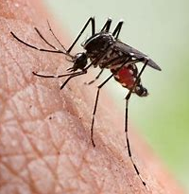
Mosquitos
Mosquito-borne diseases have a global presence, affecting more than 150 countries.
These illnesses, transmitted by mosquitoes, afflict over 500 million individuals worldwide and result in approximately 1 million fatalities.
In India alone, about 40 million people contract mosquito-borne infections annually
Chikungunya, Dengue fever, Zika fever and Yellow fever can be caused by Aedes mosquito.
Japanese encephalitis and West Nile fever caused by the Culex mosquito and Malaria can be caused by female Anopheles mosquito.

Slide 7
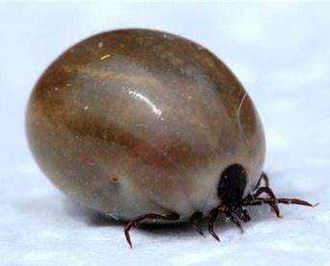
Ticks
Small parasitic organisms inhabiting wooded areas and fields
They depend on blood from humans or animals for sustenance
Carriers of a range of serious diseases,
The incidence of tick-borne diseases has increased by over twofold in the past 13 years, as indicated by a 2018 report from the CDC
Crimean-Congo hemorrhagic fever, Lyme disease, Tick-borne encephalitis, Relapsing fever, Tularaemia and Rickettsial disease

Slide 8
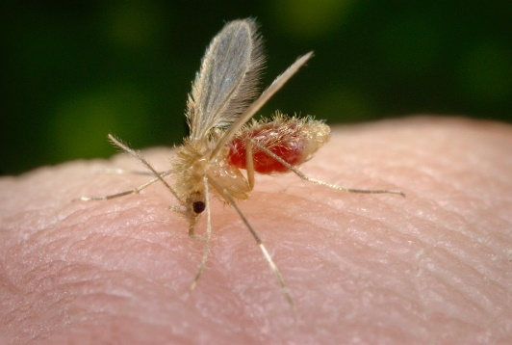
Sand flies
belonging to the family Psychodidae, are dainty, gnat-like insects that feed on a range of mammals and occasionally other vertebrates like reptiles and amphibians
Numerous species of sand flies serve as notable public health nuisances and act as vectors for diseases.
Leishmaniasis, bartonellosis, and sandfly fever

Slide 9
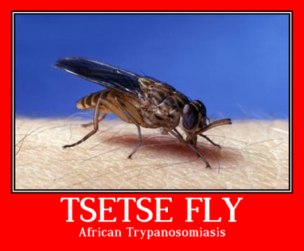
Tse-tse Flies
Human African trypanosomiasis, commonly referred to as sleeping sickness,
Protozoans belonging to the genus Trypanosoma cause the illness, and it is spread to humans through the bites of tsetse flies (glossina).
Primarily impacting impoverished populations residing in isolated rural areas of Africa, the disease is typically fatal when left untreated.

Slide 10
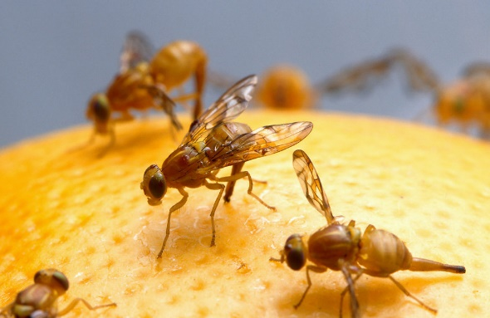
House flies
House flies are primary agents in transmitting of various enteric diseases through fecal contamination of food, water.
Typhoid, cholera, dysentery, diarrhea and some of urogenital infections also transmitted by house flies

Slide 11
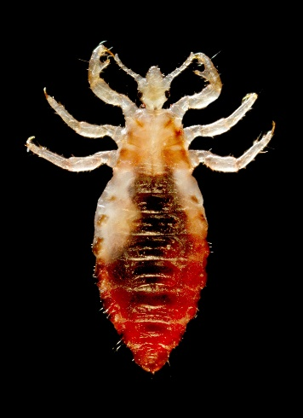
Lice
Parasitic insects that inhabit various parts of the human body,
including the head and body, as well as the pubic area.
These parasitic creatures sustain themselves by feeding on human blood.
Typhus, Louse-borne relapsing fever are common diseases caused by Lice.
Epidemic typhus, also known as louse-borne typhus, is a rare infectious disease caused by the bacterium Rickettsia prowazekii.

Slide 12
Preventive measures
Vaccination
Insect repellents
wearing protective clothing
Bed nets
Regular tick checks
Environmental management,
Proper waste disposal
Educational campaigns, community engagement, vector control programs, and animal population management

Slide 13
The National Vector Borne Diseases Control Programme (NVBDCP) serves as a comprehensive initiative to prevent and control vector-borne diseases, including Malaria, Japanese Encephalitis (JE), Dengue, Chikungunya, Kala-azar, and Lymphatic Filariasis.
The World Health Assembly endorsed the "Global Vector Control Response (GVCR) 2017–2030" in 2017. This framework offers strategic guidance to countries and development partners, emphasizing the critical reinforcement of vector control as a foundational strategy for disease prevention and outbreak response

Slide 14
Conclusion
In conclusion, while insects are indispensable to ecosystems, contributing to various ecological processes, their role as vectors poses significant threats to human health.
The global impact of insect-borne diseases, costing billions annually, necessitates robust preventive measures.
Vaccination, repellents, protective clothing, and environmental management are crucial components.
The collaborative efforts of programs like NVBDCP and global initiatives such as GVCR underscore the importance of a coordinated approach.
By prioritizing public awareness, community engagement, and effective vector control, we can mitigate the adverse effects of insect-borne diseases, safeguarding global well-being.

Slide 15
Thank You

