Slide 1
Examining the Efficacy of Psychosocial Support in Cancer Management: A Systematic Review of Interventions in Nigeria Awoniyi Adeola Roseline¹ adeola.awoniyi@swft.nhs.uk, South Warwickshire University NHS Foundation. FOGBONJAIYE, Seun Samuel (Ph.D)² Department of Economics, Southwestern University Nigeria, Ogun State. 4gbonjayeseun@gmail.com

Slide 2
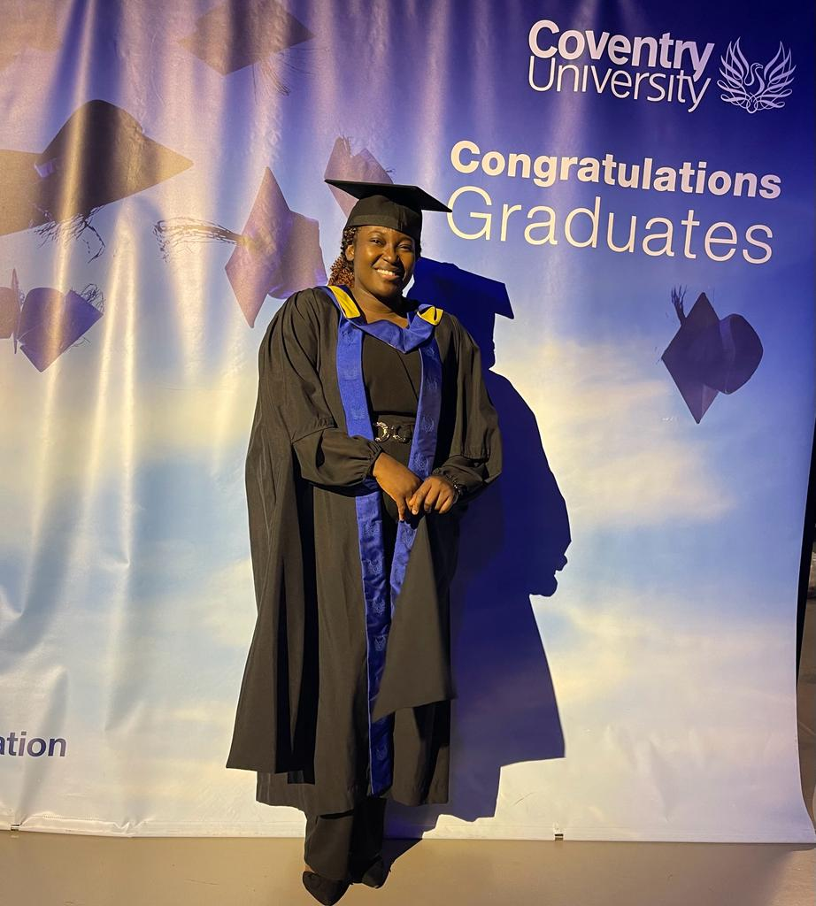
Authors profile

Slide 3
Author 1
AWONIYI ADEOLA ROSELINE is a dedicated and passionate female registered nurse with a
robust academic background in nursing. Holding a Master of Nursing Science from Coventry
University, UK (2022) and a Bachelor of Nursing Science from Istanbul Gelisim University,
Turkey (2021), she also earned Diplomas in Midwifery (2014) and General Nursing (2011) from
ECWA School of Midwifery and Nursing in Egbe, Nigeria. Registered with the Nursing and
Midwifery Councils of Nigeria and the United Kingdom, she brings a wealth of knowledge and
over 7 years of experience in patient care.
Currently employed at South Warwickshire University NHS Foundation in the UK as a
Registered Nurse, Roseline is committed to promoting health, preventing illnesses, and reducing
maternal and infant mortality. With a focus on holistic and individualized person-centered care,
she has successfully attended to over 200 deliveries and resuscitated more than 20 neonates. As
an effective communicator, she establishes therapeutic relationships with clients, relatives, and
healthcare teams.
Roseline&#39;s educational journey to the master&#39;s level has enhanced her ability to work holistically,
serve as an advocate, and employ a family-centered approach. Beyond her clinical duties, she is
excited about nursing research and aims to conduct studies that improve the quality of care and
services for patients and their families. Prepared to meet the challenging demands of the nursing
profession, Roseline is a dutiful, smart, and intelligent nurse contributing significantly to the
healthcare field.

Slide 4
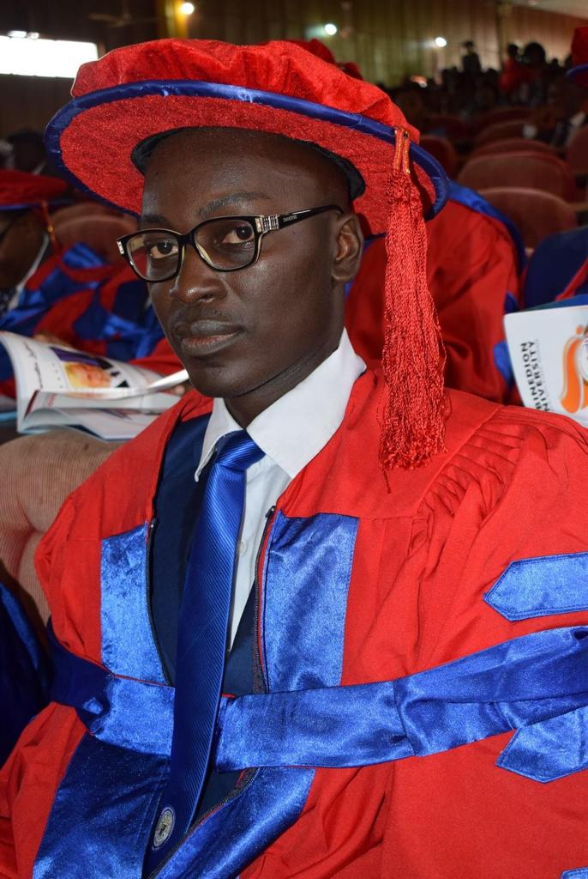

Slide 5
Co-Author 2
Bio: Dr Fogbonjaiye was the former Director of General Studies and Entrepreneurship and the
present coordinator at the Centre for Human Capital Development. In addition to a sustained
academic record of excellence, he has demonstrated a strong aptitude for research and training
which has earned him opportunity to present papers at several conferences across the globe.
He is a trusted Consultant, Strategist and a reliable analyst. He has advised the government on
major issues which includes access to healthcare, public financing, managing corruption, peace
and conflict resolution, cultural integration, political framework, religion restriction and
behavioral systems. He enjoys proffering solution to economic and real life problems through
research. He is a certified member of several international leadership and training organizations
such as the Pan African Center for Human Resource Development, International Association for
Continuing Education Training U.S.A. and the Gary Schwammlein Global Leadership Network.

Slide 6
Introduction
Cancer is a deadly illness and pervasive health challenge, not only affects the physical well-being of individuals but also significantly impacts their psychosocial health. In Nigeria, where the burden of cancer is steadily rising with an estimated mortality of 71,000 annually, there is a growing recognition of the need for comprehensive care that extends beyond medical treatments. This systematic review aims to evaluate the efficacy of psychosocial support interventions in the management of cancer in Nigeria. The review encompasses a comprehensive analysis of existing literature, focusing on studies conducted and diagnosis in Nigeria over the past decade. Various psychosocial support interventions, ranging from counselling and support groups to educational programs, will be examined for their impact on the psychological, emotional, and social well-being of cancer patients.

Slide 7
Psychosocial support available in cancer management
Counselling
Support group
Psychoeducation
Mindful exercise
Financial support
Spiritual counselling
Notes:
Group support and counselling is the commonest support available in various oncology departments within healthcare settings in Nigeria. A major activity carried out at the various session include psychoeducation on how to deal with different complications that come with chemotherapy, deep breathing exercise which is usually inform of engaging the mind; patients carried out the exercise with the thoughts of breathing in life , peace and breathing out fears, anxiety, pain (^{iv})

Slide 8
Barriers to psychosocial support
Accessibility to care
Availability of trained professionals
Late presentation to oncology unit due to fear , denial and anxiety
Inadequate financial and human resources
Notes:
The major reason why some patient may not fully benefit from psychosocial support is due to denial of accepting diagnosis thus many presented late to oncology units where psychosocial supports are been carried out (). Therefore, it is essential for psychosocial support to be a part of the diagnosis process Tiruneh, Y. M., Beshah, D. T., & Wassie, M. (2022). Incidence of Mortality and Associated Factors Among Colorectal Cancer Patients at Oncology Units of Northwest Ethiopia: A Retrospective Cohort Study. Cancer Management and Research, 1445-1455.
The major reason why some patient may not fully benefit from psychosocial support is due to denial of accepting diagnosis thus many presented late to oncology units where psychosocial supports are been carried out (). Therefore, it is essential for psychosocial support to be a part of the diagnosis process Tiruneh, Y. M., Beshah, D. T., & Wassie, M. (2022). Incidence of Mortality and Associated Factors Among Colorectal Cancer Patients at Oncology Units of Northwest Ethiopia: A Retrospective Cohort Study. Cancer Management and Research, 1445-1455.

Slide 9
Conclusion
This study has examined the efficacy of psychosocial support in cancer management in Nigeria. The suggested features including in cooperating psychosocial support in cancer management from the point of diagnosis, to be a part of the multidisciplinary care package. Similarly, continuous support post treatment and follow-up for patients and caregivers including families should be considered. Oncology centres should engage in training of medical staffs and other allied professional to provide psychosocial services. By identifying gaps in existing literature and highlighting successful interventions, this study contributes to the development of evidence-based guidelines for integrating psychosocial support into cancer care protocols in Nigeria and potentially other resource-limited settings. Ultimately, the findings from this review have the potential to enhance the holistic approach to cancer management, improving the overall well-being and resilience of individuals facing this challenging disease in Nigeria.

