Slide 1
A SMART PILLOW FOR HEALTH SENSING SYSTEM
AVINASHILINGAM INSTITUTE FOR HOME SCIENCE AND HIGHER EDUCATION FOR WOMEN SCHOOL OF ENGINEERING
Presented by
Shijitha R
Vijayashree.B
Anupriya.B
Kavya.SP
Suvathi.S

Slide 2
OVERVIEW
Introduction
Literature Review
Existing Method
Problem Statement
Objective
Proposed Method
References

Slide 3
INTRODUCTION
The health of an individual is significantly subjective to the quality of their sleep. Monitoring essential signs during sleep, such as body temperature and perspiration, is important for both sleep estimation and clinical diagnosis.
Sleep apnea is a potentially serious sleep disorder in which breathing repeatedly stops and starts. People with sleep apnea often have psychological symptoms including depression and anxiety. Lack of sleep increases the chance of getting Alzheimer’s.
Also, people who sleep well are less likely to have heart disease and other major health problems. During sleep, chemicals are activated that keep a person's blood pressure and heart rate lower.
Therefore good quality of sleep is important along with proper vital monitoring for bedridden patients.

Slide 4
LITERATURE REVIEW
S.No | Paper | Methodology | Inference
1. | Shongpun Lokavee, Visasiri Tantrakul, Worakot Suwansathit-2019 16th International Conference Detection of Sleep-Disordered Breathing and Sleep Efficiency with Wireless Pillow-Sheet Sensor Network | Based on pressure sensors embedded within a pillow sheet that can offer an unobtrusive method for sleep monitoring. Hardware : FSR(Force sensing resistor) Zigbee for wireless transmission Software: LabVIEW | Coefficient correlation between polysomnography and pillow output is >0.80
2. | Syeda Zuriat-e-Zehra Ali, Rida Ashfaq, Rameesa Afzal, Mehr-UN-Nisa,BabarSultan ,and Abdul Jalil 2019 7th International Conference on Robot Intelligence Technology and Applications (RiTA) Smart Pillow: Sleep Apnea Monitoring & Minimization Device | Gyro meter and accelerometer sensors for detecting position 6 air bladder had been used in pillow to adjust the position. Signals from the sensors would be sent to the MCU and then to the pillow for necessary corrections. | Detect sleep apnea when oxygen level falls below 84% and position is in supine position and gives alarm. Air packets (Inflate and deflate) to adjust the pillow.

Slide 5
S.No | Paper | Methodology | Inference
3. | S. Lokavee,N. Watthanawisuth,J. P. Mensing,and T. Kerdcharoen The 2011 Biomedical Engineering International Conference (BMEiCON-2011) Sensor Pillow System: Monitoring Cardio- Respiratory and Posture Movements During Sleep | Pressure sensor array had been used. Zigbee wireless technology FSR Polymer thick film technology Software : LabVIEW | Head , shoulder and arm had been detected. Cardiorespiratory signals can be analysed Low curing temperature
4. | Sahaya Sakila V, Nimisha Yadav, AshwinVatsa, Rohan Yadav International Journal of Innovative Science and Research Technology Automated Smart Pillow for all Age Group | Vibration motor Piezoelectric sensor Touch sensor Alarm and speaker | Massager(works for 25 minutes) Mood enhancement by playing out songs
5. | Alejandro Veiga,Laaura Garcia,Lorena Parra,Jaime Lloret,Vivian Augele 2018 Third International Conference on Fog and Mobile Edge Computing(FMEC) An IoT-based Smart Pillow for Sleep Quality Monitoring in AAL Environments | Luxometer and LDR had been implemented along with basic vital sensors. Micro vibration sensors had been incorporated | monitors luminosity intensity Detects movement of the patients.

Slide 6
S.No | Paper | Methodology | Inference
6. | Deepjyoti Mahanta, Hemashree Bordoloi, Samar Jyoti Saikia - 2020 International Conference LabVIEW based Smart Pillow | The Sleep Inducer System which is embedded in a Pillow The GSR Sensor is used , if it’s find that the subject is in stressed then pillow will generate the electromagnetic field of 9.6 Hz automatically. Software: LabVIEW | Geo-electromagnetic field generator circuit can give various instructions to scale back stress
7. | Jin Zhang Qian Zhang, Yuanpeng Wang, Chen Qiu A Real-time Auto-Adjustable Smart Pillow System for Sleep Apnea Detection and Treatment | The algorithm used in this system are Sleep Apnea Detection Pillow adjustment algorithm and SpO2 Desaturation Classification Algorithm | The duration and occurrence of apnea episodes are decreased dramatically when using our smart pillow system

Slide 7
EXISTING METHOD
The sleep pattern, breathing level of the patient were determined for stress detection using the various algorithm.
In order to the Posture Movements During Sleep and Auto-Adjustable Smart Pillow System for Sleep Apnea Detection and Treatment were already implemented.

Slide 8
PROBLEM STATEMENT
To develop a smart pillow for patient monitoring with sleep and stress detection.
IoT enabled pillow for altering surrounding temperature based on the requirement of the patient along with automatic oxygen supply when there is a need.

Slide 9
OBJECTIVE
The smart pillow is an IoT-integrated pillow with various sensors that can monitor different kinds of health parameters including Temperature, breathing rate, Pulse rate, Heart rate, sleeping pattern, Stress detection, altering of surrounding temperature [AC], Automatic Oxygen supply to the patient, Monitor patient’s parameters through mobile phone.

Slide 10
PROPOSED METHOD
IoT technology has made its way including our sleep routines. Smart pillows are one of the innovative applications of IoT in the field of health and wellness. These pillows are designed to provide enhanced comfort and gather data about your sleep patterns and habits.
Embedded sensors can track your movements and sleep patterns throughout the night.
Data on your sleep duration, interruptions, and quality can be sent to a mobile app for analysis. IoT-enabled pillows can adjust the temperature of the pillow surface to your preference, helping you maintain a comfortable sleep environment.
Users can monitor their sleep data, set preferences, and receive real-time feedback through mobile app. In the cases where insufficient oxygen levels are detected, the system can autonomously administer supplemental oxygen to the patient.

Slide 11
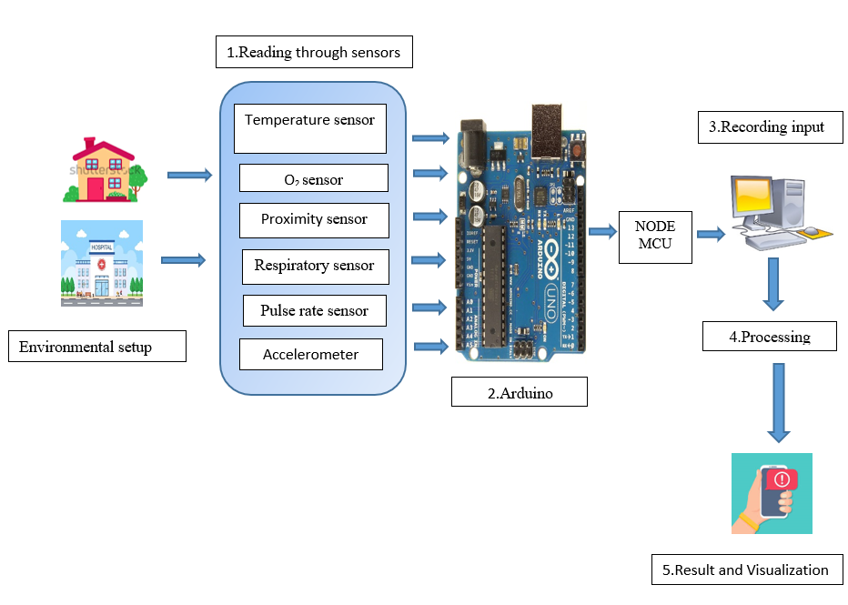
WORK FLOW

Slide 12
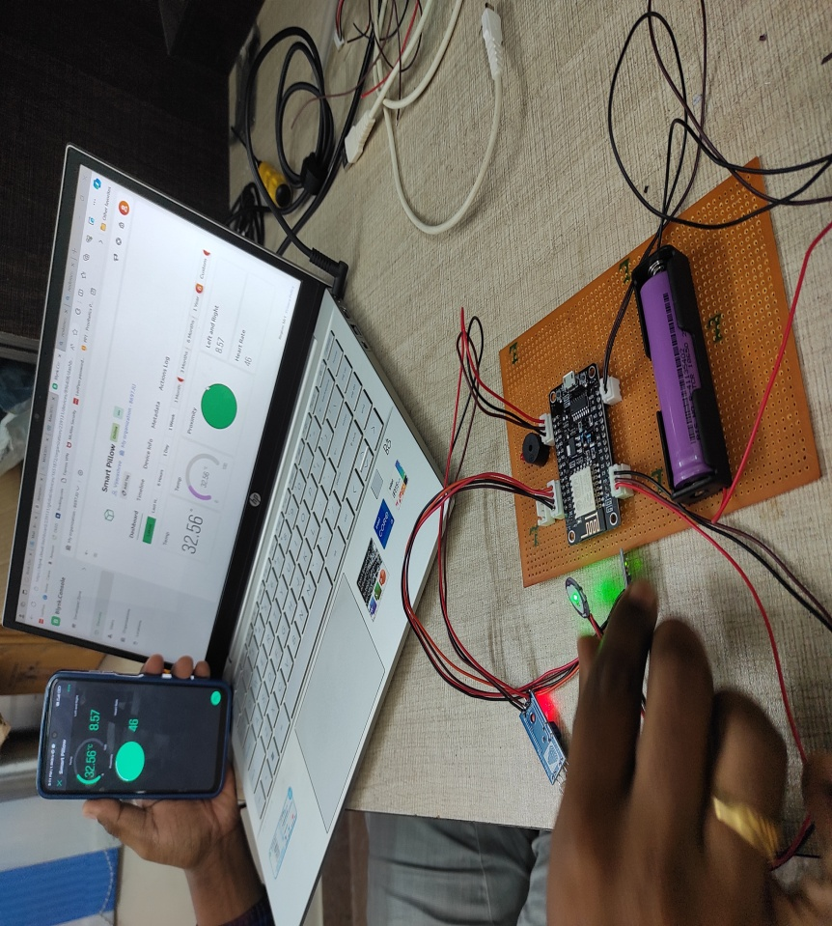
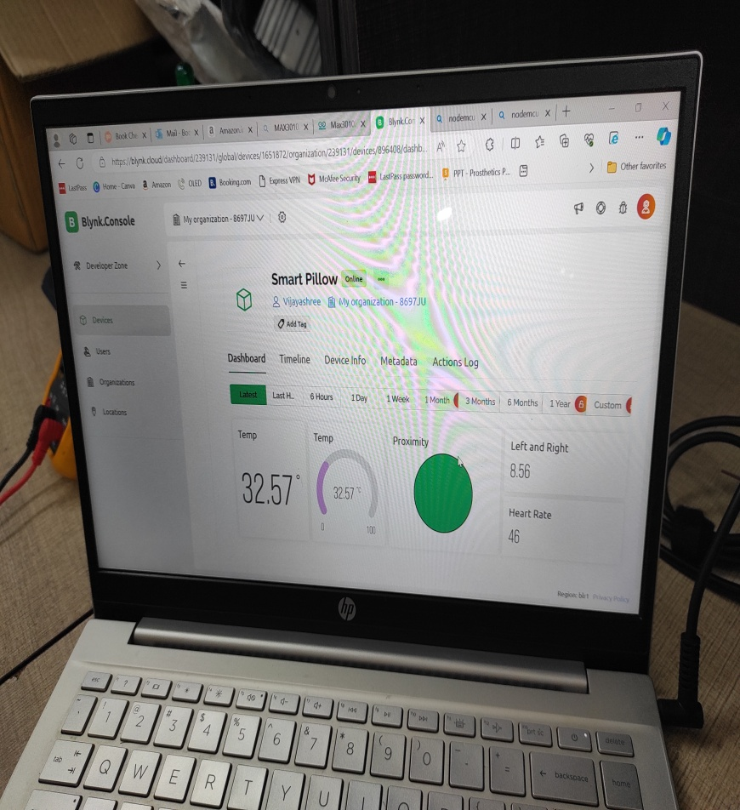
Experimental Setup

Slide 13
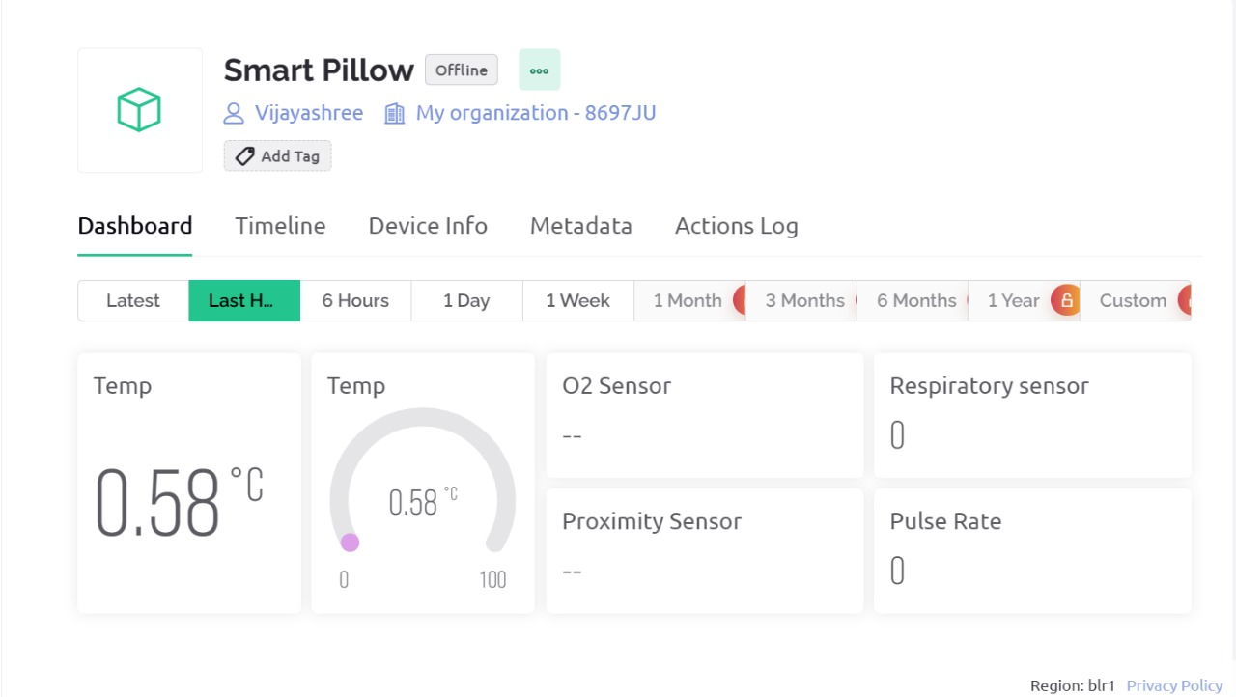
DIGITAL OUTPUT (BLYNK)

Slide 14
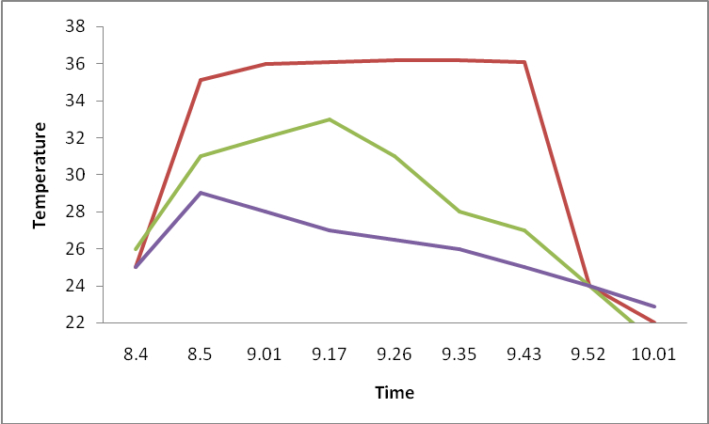
Measurement of Temperature

Slide 15
REFERENCES
Yamada, Shuori. Orthopaedic Pillow: Theory and Practice. Springer Nature, 2023.
Dong, Kai. "Triboelectric Nanogenerators as Sensing for Smart Home." Handbook of Triboelectric Nanogenerators. Cham: Springer International Publishing, 2023. 1621-1657.
Wang, Heng, et al. "SleepSense: Smart Pillow with Pressure-Sensitive FBG-Embedded Silicone Buttons." IEEE Sensors Journal (2023).
Kau, Lih-Jen, Mao-Yin Wang, and Houcheng Zhou. "Pressure-Sensor-Based Sleep Status and Quality Evaluation System." IEEE Sensors Journal 23.9 (2023): 9739-9754.
Zhu, Zhiyuan, Maoqiu Pu, and Zisheng Xu. "Sleep monitoring based on triboelectric nanogenerator: wearable and washable approach." Frontiers in Psychiatry 14 (2023): 1163003.
Moshayedi, Ata Jahangir, et al. "Recognition System for Ergonomic Mattress and Pillow: Design and Fabrication." IETE Journal of Research (2023): 1-19.
Gourlay, Banu. "Multidisciplinary development of electroencephalogram (EEG)-based smart head piece prototype for everyday environments monitoring." (2023).
Mekid, S., and K. Chenaoua. "IoT-Enabled Smart Mask for Monitoring Body Parameters and Location through Cloud." Internet of Things (2023): 100794.
Chen, Yanyan, et al. "The past, present, and future of sleep quality assessment and monitoring." Brain Research 1810 (2023): 148333.

Slide 16
Jeon, Yeong Jun, Sung Ho Park, and Soon Ju Kang. "Self-x based closed loop wearable IoT for real-time detection and resolution of sleep apnea." Internet of Things 22 (2023): 100767.
Wang, Heng, et al. "SleepSense: Smart Pillow with Pressure-Sensitive FBG-Embedded Silicone Buttons." IEEE Sensors Journal (2023).
MB, Nirmala, et al. "Detection of Stress through Sleeping Habits." Grenze International Journal of Engineering & Technology (GIJET) 9.1 (2023).
Baig, Mirza Mansoor, and Hamid Gholamhosseini. "Smart health monitoring systems: an overview of design and modeling." Journal of medical systems 37 (2013): 1-14.
Kou, Haiying, et al. "Smart pillow based on flexible and breathable triboelectric nanogenerator arrays for head movement monitoring during sleep." ACS Applied Materials & Interfaces 14.20 (2022): 23998-24007.
Xing, Huan, et al. "MXene/MWCNT electronic fabric with enhanced mechanical robustness on humidity sensing for real-time respiration monitoring." Sensors and Actuators B: Chemical 361 (2022): 131704.
Sangeetha, T., et al. "Smart mattress integrated with pressure sensor and IoT functions for sleep apnea detection." Measurement: Sensors 24 (2022): 100450.
Cao, Ting, et al. "Parametric study on the sleep thermal environment." Building Simulation. Tsinghua University Press, 2022.
He, Chunhua, et al. "A smart flexible vital signs and sleep monitoring belt based on MEMS triaxial accelerometer and pressure sensor." IEEE Internet of Things Journal 9.15 (2022): 14126-14136.

Slide 17
THANK YOU

