Slide 1
7TH INTERNATIONAL CONFERENCE ON HEALTH INFORMATION AND TECHNOLOGY DECEMBER 25-26, 2023 TOPIC: HEALTH INFORMATION AND TECHNOLOGY ORORGANIZED BY: CENTER FOR ACADEMIC & PROFESSIONAL CAREER DEVELOPMENT AND RESEARCH (CAPCDR) PRESENTED BY: UNDE PRIYANKA R.

Slide 2
Public Health & Technology
Public health is the science and art of disease prevention, life extension and promotion.
Through the organized work and informed choices of society, organizations and the public and private individuals, communities and individuals. The goal is to prevent disease, not cure it through case tracking and promotion of healthy behaviours.
This can only be achieved if the information is relevant to the health of the community to reach health professionals, planners, decision makers and managers at the right time where and when needed.

Slide 3
At first, they were mostly used for administrative and financial purposes, but in today’s ambitious and challenging healthcare in this scenario, healthcare providers are completely dependent on healthcare information technology (HIT) for timely and immediate access to health information. Every time During or after a patient encounter,
HIT allows the provider to collect, store, retrieve and deliver information about and between health facilities.
The health sector has always been supportive technologies. According to WHO (2004), they form the backbone of preventive services diagnose and treat illnesses and diseases

Slide 4
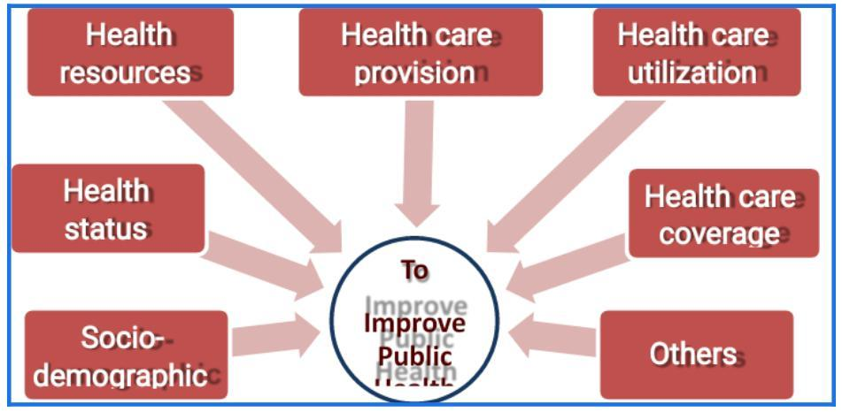
l

Slide 5
Health Information Technology
Health information needs and levels of information production.
A key component of implementing health information technology (HIT) is understanding what to collect, where to collect it, to whom to report it, and how and by whom this data is used as it is used to provide curative, preventive, rehabilitative and palliative care. Concern. Of the population. With this in mind, data needs, data collection tools and data output levels must be determined. Once defined and defined, it is easy for managers and service providers to move forward better in the implementation process.

Slide 6
Shows that data collection for the home visit begins at the patient, institution, regional, country and global levels, where the amount of data produced is more at the lower level than at the higher level.
To make an evidence-based decision, health care providers, managers, and decision makers must understand the health status of the population, the burden of disease, the types of health services needed at each level, and the progress of activities/programs.
At every level of the health system. If this complete, accurate and sufficient health information does not reach users in time, the goal of “health for all” will be impossible.

Slide 7
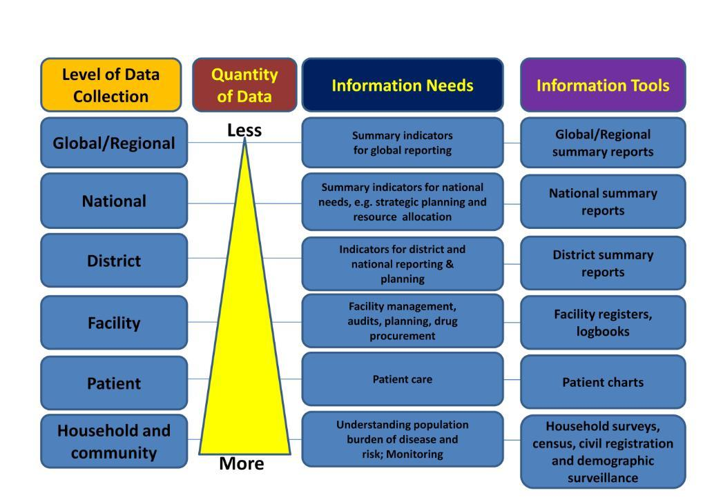

Slide 8
Health information needs and levels of information production A key component of implementing health information technology (HIT) is understanding what to collect, where to collect it, to whom to report it, and how and by whom this data is used as it is used to provide curative, preventive, rehabilitative and palliative care. Concern. Of the population. With this in mind, data needs, data collection tools and data output levels must be determined. Once defined and defined, it is easy for managers and service providers to move forward better in the implementation process.

Slide 9
