Slide 2
ABSTRACT
The Project Helping Our environment by Making useful Ecobricks (H.OM.E.) aimed to improve the cleanliness and orderliness of Kasiglahan Village National High School in solid waste through the use of Ecobricks. An Ecobrick is plastic bottles packed to a set density with used, clean, and dry plastics to achieve a building block that can be used over and
301446 – KASIGLAHAN VILLAGE NATIONAL HIGH SCHOOL

Slide 3
ABSTRACT
over again. Ecobrick is one of the solutions to plastic pollution all over the world. Ecobricks making aims to teach people, not only students, to learn how to refuse the single used plastic and to recycle those that are already used.
301446 – KASIGLAHAN VILLAGE NATIONAL HIGH SCHOOL

Slide 4
STATEMENT OF THE PROBLEM
1. What is the profile of the participants in terms of:
1.1. age,
1.2. sex, and
1.3. occupations?
301446 – KASIGLAHAN VILLAGE NATIONAL HIGH SCHOOL

Slide 5
STATEMENT OF THE PROBLEM
2. What is the impact of the Project HOME in terms of
2.1. cleanliness,
2.2. recycling,
2.3. creativeness and usefulness, and
2.4. proper disposal?
301446 – KASIGLAHAN VILLAGE NATIONAL HIGH SCHOOL

Slide 6
STATEMENT OF THE PROBLEM
3. What is the overall recommendation of the project HOME towards the environment?
301446 – KASIGLAHAN VILLAGE NATIONAL HIGH SCHOOL

Slide 7
Table 1
List of High Quality Ecobriks
Plastic Bottle Size | Minimum Ecobrik
500 ml | 175 grams
1000 ml or 1 liter | 350 grams
1500 ml or 1.5 liters | 525 grams
1750 ml or 1.75 liters | 613 grams
For the validity of the content, the list of High Quality Ecobriks was validated through www.GoBrik.com.
301446 – KASIGLAHAN VILLAGE NATIONAL HIGH SCHOOL

Slide 8
Figure 1
Conceptual Framework of the Study
INPUT
Ecobriks Seminar/Workshop
PROCESS
Collection, and Segregation of solid waste particularly single – used plastic
OUTPUT
Materials Recovery Facility (MRF)
Making of Ecobriks
Logging and Validation of Ecobriks
Other useful materials/module out of Ecobriks
Impact of project H.O.M.E
301446 – KASIGLAHAN VILLAGE NATIONAL HIGH SCHOOL

Slide 9
Figure 2
The Flow Chart Showing How the Project was Conceptualized
Collecting of clean and dry single – used plastic
Sorting of soft and hard plastic
Cutting of hard plastic into smaller pieces and soft plastic into bigger one
Packaging of plastics using bamboo stick and feeling compactness (“no “cracking sound”)
Stuffing of soft and hard plastic into used, dry, plastic bottle
Seminar / Workshop
Weighing according to suggested minimum weight
Logging the finished Ecobriks in www.Gobrick.com
Making of Milstein and Dieleman accepted modules
Construction of bigger design like Materials Recovery Facility (MRF)
301446 – KASIGLAHAN VILLAGE NATIONAL HIGH SCHOOL

Slide 10
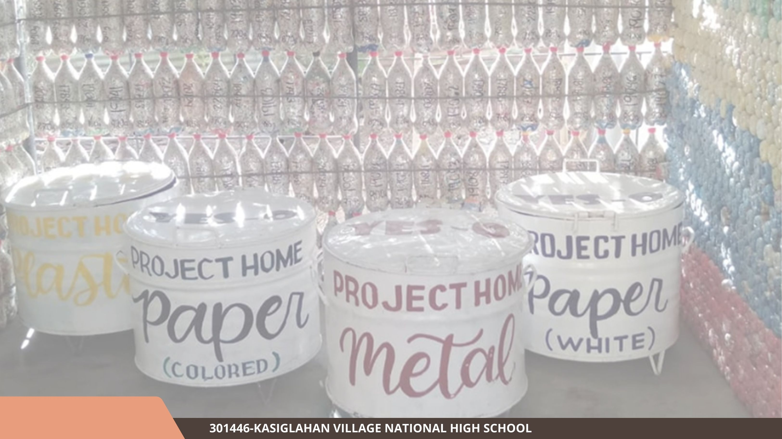
AGE | FREQUENCY | PERCENTAGE
10 - 20 | 58 | 61.70
21 - 30 | 10 | 10.63
31 - 40 | 12 | 12.77
41 - 50 | 14 | 14.89
51 – and above | 0 | 0

Slide 11
OCCUPATION | FREQUENCY | PERCENTAGE
STUDENTS | 62 | 65.96
TEACHERS | 32 | 34.04

