Slide 1
December 25-26,2023
TOPIC:DIGITAL TWIN TECHNOLOGY IN
HEALTHCARE SYSTEM
7th International Conference
On
Public Health & Technology
Organized by : Center for Academic & Professional Career
Developement and Research(CAPCDR)
Presented by. Ms. Sonali Mhaske

Slide 2
DIGITAL TWIN TECHNOLOGY
The digital twin is emerging as a transformative force in healthcare systems, revolutionizing the delivery of patient care.
Using real-time data integration, advanced analytics, and virtual simulations, digital twins provide better patient care, predictive analytics, optimization of clinical operations, and training and simulation capabilities.
Digital twins provide improved patient care by allowing medical professionals to collect and evaluate a multitude of patient data from several sources, such as wearables, medical equipment, and electronic health records (EHRs).
Customized treatment regimens are created possible by this comprehensive understanding of the patient, which takes into account personal traits, medical history, and current physiological data.
Healthcare practitioners can use digital twins to accurately diagnose patients, monitor them in real time, and provide patients the power to actively participate in their own care
Digital twin technology uses machine learning algorithms and patient data analysis to provide predictive analytics and preventive treatments.

Slide 3
ENHANCED PATIENT CARE THROUGH DIGITAL TWIN TECHNOLOGY
Healthcare professionals will be able to collect and evaluate a vast amount of patient data from a variety of sources, including wearables, medical gadgets, electronic health records (EHRs), and genetic data.
By providing patients with access to their digital twin data, including personalized health insights, treatment plans, and progress tracking, patients can become more engaged in managing their health.
This increased engagement leads to better adherence to treatment regimens, lifestyle modifications, and self-management practices.
Digital twins are able to recognize high-risk patients, anticipate possible problems, and suggest preventive actions by examining patient data and past trends.
In the end, this proactive approach to care improves patient safety and long-term results by enabling healthcare practitioners to intervene early, prevent adverse events, and optimize treatment regimens based on anticipated patient responses.
Digital twins empower patients to actively participate in their own care.

Slide 4
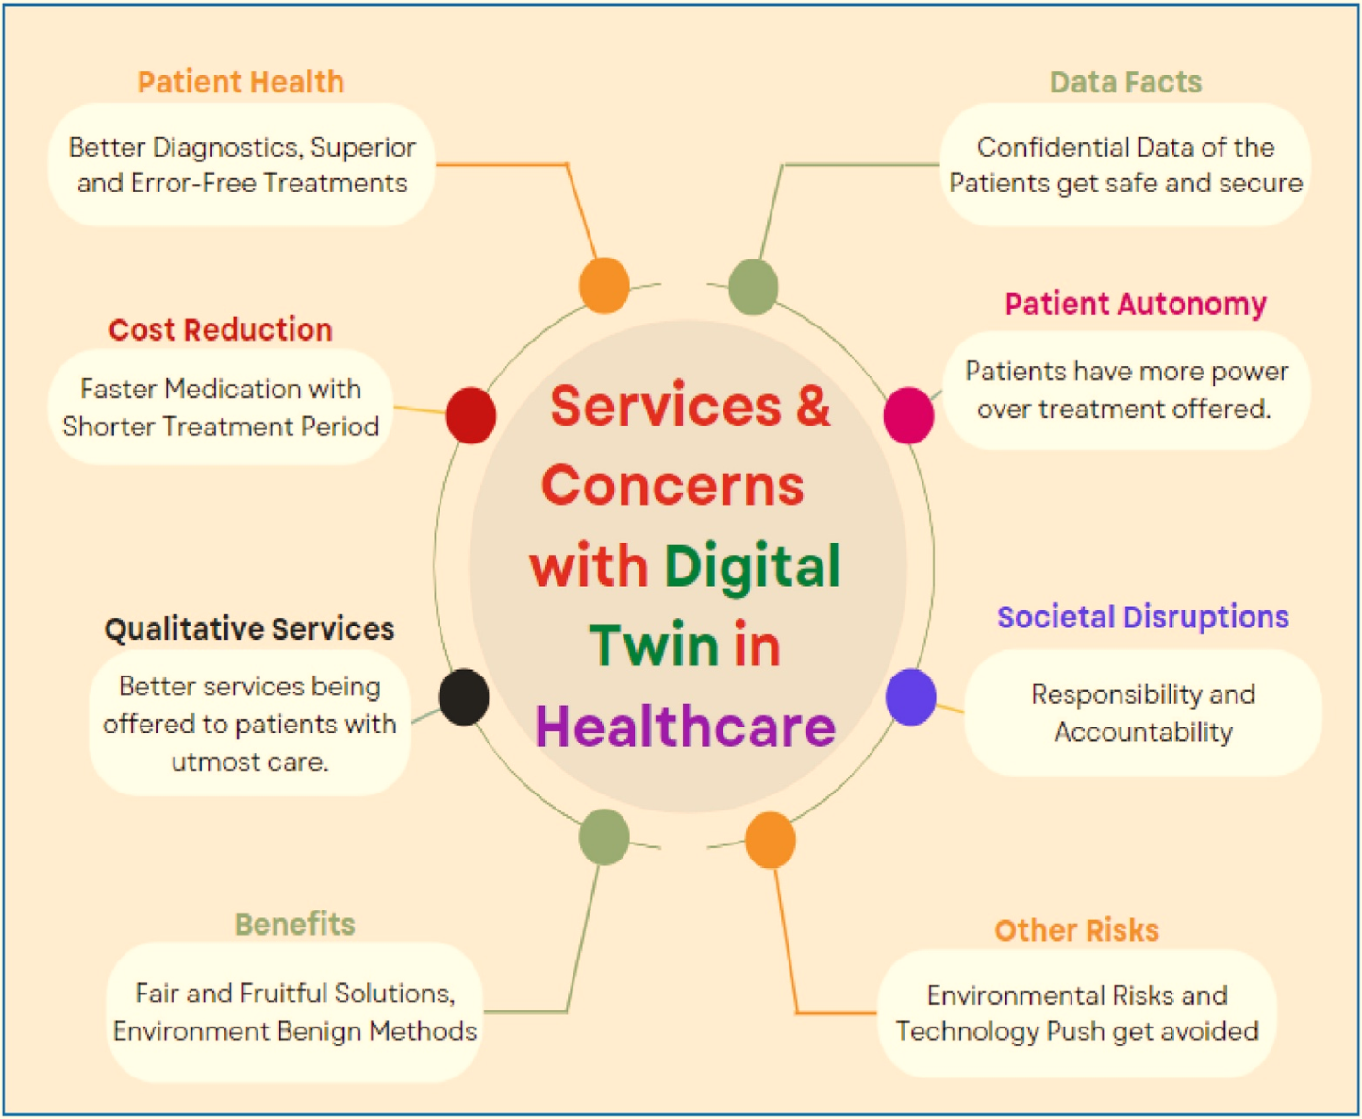
VARIOUS FEATURES AND SERVICES OF DIGITAL TWIN FOR HEALTHCARE
Fig. Services & concerns with digital twin in healthcare.

Slide 5
illustrates the different related services and issues using Digital Twin technology for healthcare.
It details the intelligent services offered by this most recent cutting-edge and supportive approach—a digital twin for the healthcare industry.
. It primarily focuses on patient health services, data-related facts and concerns, lowering the costs of patient treatment and care, high-quality services, challenges relating to societal disruptions, etc.
These services also demonstrate how patient care has improved during therapy to promote healing and a speedy recovery.
Four technologies are used by Digital Twin to generate visual representations, gather, store, and analyze data, and produce informative content.

Slide 6
PREDICTIVE ANALYTICS AND PREVENTIVE INTERVENTIONS THROUGH DIGITAL TWIN TECHNOLOGY
Using patient data and past trends, digital twins can model the course of a disease.
Digital twins have the ability to create prediction models to anticipate the course of a disease by examining trends, treatment outcomes, and patient features.
With the use of this data, medical professionals may better plan treatments, foresee future issues, and implement interventions that will either stop or reduce the advancement of the disease.
By taking into account the unique characteristics of each patient, including genetics, lifestyle, and response histories, digital twins enable individualized disease modeling that produces more precise forecasts and specialized interventions.

Slide 7
DIGITAL TWIN APPLICATIONS FOR HEALTHCARE
Sr.No. | Applications | Description
1 | Patient care | The implementation of Digital Twins can enhance researchers' understanding of customized medicine, patient care, and the management of persistent illnesses. Digital twins of the human body as a whole and of particular organs such as the kidneys, lungs, and heart are being developed at an advanced stage. Medical equipment, practices, and personnel are only a small part of effective resource management.
2 | Better personal health results | Digital Twin helps with the early diagnosis of chronic sickness to manage chronic disease in a large population by analyzing physiological and behavioural data. More coordinated and continuous basic research and development will be required in order to fully realize the promise of the digital twin. It makes complex assets and processes easier for businesses to understand and manage.

Slide 8
Sr. No. | Applications | Descriptions
3 | Diagnostics and medical training | A patient model created prior to the actual surgery is called a digital twin. To avoid damaging human anatomy, a multidisciplinary team performs virtual surgery for medical diagnostics and training. AI-driven research and digital twins will help hospitals and research facilities worldwide, enabling the widespread use of technology to improve health, education, and economic prospects
4 | Enhance medical innovation | Digital twins could help with medical innovation and regulatory approval in the healthcare industry. This method may one day help doctors maximise the effectiveness of personalised treatment plans for each patient. Individual and demographic data are integrated into computer-based or in silico models to create digital twins.
5 | Research and development | The Internet of Things is the primary technology used by all Digital Twin apps. Digital twin simulations are utilized in the healthcare sector to create models that supply data for R&D.

Slide 9
CONCLUSION
In summary, there is great potential for digital twin technology to transform healthcare systems and improve patient care. Digital twins provide individualized treatment plans, predictive analytics, enhanced clinical operations, and immersive training possibilities by combining real-time data, advanced analytics, and virtual simulations. Healthcare workers are better equipped to diagnose patients accurately, monitor them in real time, and take preventive measures to stop unfavorable outcomes when they use digital twins. Additionally, it fosters cooperative decision-making between patients and healthcare professionals and gives individuals the ability to actively engage in their own care. Digital twins also help healthcare organizations operate more efficiently by streamlining procedures, allocating resources optimally, and improving operational efficiency. Digital twin technology has enormous potential in the healthcare industry, and its application could lead to notable improvements in patient outcomes, safety, and innovation. But in order for it to be implemented successfully, issues with data privacy, interoperability, data quality, ethics, resource intensity, workflow integration, validation, education, scalability, and cultural shifts must be resolved. Digital twin technology has the potential to completely transform healthcare systems once these obstacles are overcome, resulting in better patient outcomes, more effective operations, and higher-quality care.

Slide 10
REFERENCE
1. Attaran M, Celik BG. Digital twin: benefits, use cases, challenges, and opportunities. Decis Anal J. (2023) 6:100165. doi: 10.1016/j.dajour.2023.100165
2. Armeni P, Polat I, De Rossi LM, Diaferia L, Meregalli S, Gatti A. Digital twins in healthcare: is it the beginning of a new era of evidence-based medicine? A critical review. J Pers Med. (2022) 12:1255. doi: 10.3390/jpm12081255
3. Cornetta K, Brown CG. Perspective: balancing personalized medicine and personalized care. Acad Med J Assoc Am Med Coll. (2013) 88:309–13. doi: 10.1097/ACM.0b013e3182806345
4. Jasemi M, Valizadeh L, Zamanzadeh V, Keogh B. A concept analysis of holistic care by hybrid model. Indian J Palliat Care. (2017) 23:71–80. doi: 10.4103/0973-1075.197960
5. van Dinter R, Tekinerdogan B, Catal C. Predictive maintenance using digital twins: a systematic literature review. Inf Softw Technol. (2022) 151:107008. doi: 10.1016/j.infsof.2022.107008

Slide 11
Thank You!

