Slide 1
BLOCKCHAIN TECHNOLOGY APPLICATIONS IN HEALTHCARE
Presenter Name:- Supekar Diksha B, Bagal Vaishnavi P and Ghalme Rutuja A.
Parikrama Diploma in Pharmaceutical Sciences, Kashti, Tal- Shrigonda, Dist- Ahmednagar, Maharashtra, India.

Slide 2
Agenda
INTRODUCTION
BLOCKCHAIN TECHNOLOGY
APPLICATIONS IN HEALTHCARE

Slide 3
Introduction
INTRODUCTION: The major Issues facing contemporary healthcare systems are excessive maintenance and administration expenditures [1]. The healthcare system is a multifaceted, intricate system that includes many areas, each with its own set of stakeholders, including patients, practitioners, researchers, managers, and support workers [2]. Consequently, managing and classifying patient data becomes an enormous task [3,4]. The difficulty is compounded by the fact that various healthcare areas have diverse data structures and operations. These factors make it extremely difficult for different healthcare areas to effectively exchange information about healthcare [5].Modes:

Slide 4
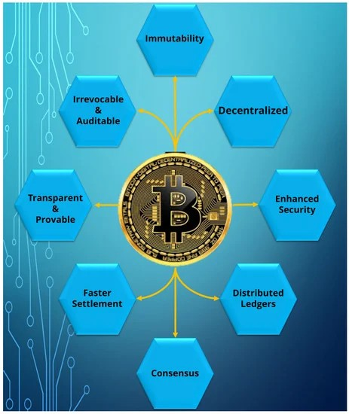

Slide 5
To tackle health information records and exchange, a system is required to be developed, managed, and maintained. A third party develops and maintains traditional personal health record and electronic health record systems, with trust, privacy, and data security remaining important challenges [6]. However, the third-party-based existing healthcare recording systems cannot satisfy stakeholders’ privacy needs [7]. As a result, the traditional electronic healthcare model lacks transparency because of privacy and data security issues.
The development, management, and upkeep of a system is necessary to address health information records and interchange. Traditional personal health record and electronic health record systems are developed and maintained by a third party; trust, privacy, and data security are still major obstacles [6]. Nevertheless, stakeholders’ demands for privacy cannot be met by the third-party-based healthcare recording systems now in place [7]. Because of privacy and data security concerns, the conventional electronic healthcare approach lacks transparency.
Because of privacy and data security concerns, the conventional electronic healthcare approach lacks transparency.
Blockchain technology has tremendous potential in addressing security-related issues and the challenging challenge of massive and extremely diversified data in healthcare systems. [8]
Blockchain is a digital ledger, peer-to-peer network, and decentralized, distributed database [9].

Slide 6
The blockchain facilitates the safe transfer of information between parties by connecting numerous computers through nodes and does not require any transactions to create new blocks. The client can use a blockchain that is encrypted to access all authorized and verified medical information. Anybody can add a new chain to the block and select transactions. A blockchain’s master key is a hash, and it can provide unique identifiers for cryptocurrencies to add data by utilizing this hash function.
Stakeholders are reluctant to cooperate for the exchange of health information since traditional electronic health record and personal health record-based health information exchange systems have not been able to address privacy and security-related concerns.
This has led to an increase in healthcare costs, which is very expensive for both patients and healthcare providers. These days, researchers and governments are looking to blockchain technology to address these issues connected to trust. According to IBM, a number of prominent healthcare firms believe blockchain will modernize healthcare administration systems and create a decentralized architecture for the exchange of electronic health information, which will significantly alter the healthcare system [10].
The blockchain technology market is expected to reach over $500 million in revenue by 2022 [11]. Despite the fact that blockchain technology has been the subject of numerous research in the healthcare sector, the body of current literature does not offer a complete picture of the application areas. Thus, it becomes necessary to carry out a thorough investigation into the potential uses of blockchain technology in the healthcare sector.

Slide 7
These days, a lot of servers are constructed with the ability to assist customers via mobile devices. With the help of numerous apps and mobile devices, it is now feasible to generate and send enormous amounts of medical data on a weekly or daily basis thanks to internet services. Many challenges, including those related to cost, strategy, preserving uniformity, and individual behavioral constraints on services, can be addressed by the current healthcare system [12]. Nonetheless, suppliers to the healthcare system don’t always take advantage of the newest advancements in technology inside the supply chain. For instance, they do not make appropriate use of the recent collection and distribution of medical supplies. Indeed, according to a research on Healthcare Finance, almost USD 25.7 billion is
Annually for needless operations and supply management [13]. To ameliorate the constraints and meet the growing demands for better healthcare, a significant amount of work must be concentrated on developing a smart healthcare system. It might work on design and development problems based on smart tools, devices, upgraded facilities, and modern healthcare infrastructure. Additionally, it might create intelligent healthcare using biosensors, customer-connected apps, and the most recent emergency response technologies.
[14]. Thus, in order to create a more effective network, we must ascertain which consensus algorithms are already in use in numerous blockchain networks and which ones function well with IoT-based infrastructure to enhance healthcare services. [15]. Distributed Data Storage System (DDSS), a quicker data sharing mechanism, offers an additional solution to blockchain’s massive data storage issue [16].

Slide 8
It tracks several papers with the same name in one location by using file translation and data caching. But occasionally, when a large file is uploaded to DDSS, it breaks the file up into multiple smaller data objects—256 kb, for instance—and connects each of these items to an empty object so that Distributed Hash Tables (DHT) can be used to recover the entire file [17].
Some sensors can collect data automatically from users and can transfer them to a certain storage or cloud for further processing by physicians, nurses, and medical staff [18]. Several pieces of rules and regulations have been proposed to save individual patients’ privacy. These laws always require appropriate security management for controlling, sharing, and exchanging the health of patient data, and failure to follow them is strongly prosecuted, with severe penalties being imposed on electronic healthcare systems (EHRs
Certain sensors have the ability to automatically gather user data and send it to a specific storage location or cloud so that doctors, nurses, and other medical professionals can process it further [18]. A number of laws and guidelines have been put forth to protect the privacy of certain patients. In order to monitor, share, and exchange patient health data, these regulations always demand effective security management. Violation of these rules is strictly prohibited, and electronic healthcare systems (EHRs) risk facing harsh fines.
[19]. Nearly 70% of healthcare executives anticipate that blockchain would have a significant impact on improving the clinical trial system, health domain, regulatory compliance, and developing a decentralized framework for exchanging electronic health records (EHRs), according to an IBM survey. [20].

Slide 9
Blockchain-based healthcare management solutions are becoming more and more common in both the academic and practical domains due to the availability of improved data security and administration at a reduced cost. Over the past ten years, there has been a dramatic increase in research interest in blockchain-based healthcare systems. Comprehensive information gathering and depiction of previous actions in this domain are lacking for future research. Current review papers summarize current advances in this topic in brief and point out the advantages and disadvantages of the solutions proposed by scholars.
These review papers, however, do not offer a thorough analysis of all the various facets of blockchain in the healthcare system, including the research themes being pursued, the healthcare domains where blockchain is most commonly applied, applications of blockchain in particular domains, and current blockchain-based healthcare systems. Comprehensive information gathering and depiction of previous actions in this domain are lacking for future research.

Slide 10
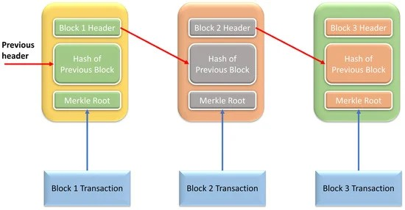

Slide 11
References
McClean, S.; Gillespie, J.; Garg, L.; Barton, M.; Scotney, B.; Kullerton, K. Using phase-type models to cost stroke patient care across health, social and community services. Eur. J. Oper. Res. 2014, 236, 190–199. [Google Scholar] [CrossRef]
Soltanisehat, L.; Alizadeh, R.; Hao, H.; Choo, K.K.R. Technical, Temporal, and Spatial Research Challenges and Opportunities in Blockchain-Based Healthcare: A Systematic Literature Review. IEEE Trans. Eng. Manag. 2023, 70, 353–368. [Google Scholar] [CrossRef]
Xing, W.; Bei, Y. Medical Health Big Data Classification Based on KNN Classification Algorithm. IEEE Access 2020, 8, 28808–28819. [Google Scholar] [CrossRef]
Khan, A.A.; Wagan, A.A.; Laghari, A.A.; Gilal, A.R.; Aziz, I.A.; Talpur, B.A. BIoMT: A State-of-the-Art Consortium Serverless Network Architecture for Healthcare System Using Blockchain Smart Contracts. IEEE Access 2022, 10, 78887–78898. [Google Scholar] [CrossRef]
Quadery, S.E.U.; Hasan, M.; Khan, M.M. Consumer side economic perception of telemedicine during COVID-19 era: A survey on Bangladesh’s perspective. Inform. Med. Unlocked 2021, 27, 100797. [Google Scholar] [CrossRef] [PubMed]

Slide 12
Tomlinson, M.; Rotheram-Borus, M.J.; Swartz, L.; Tsai, A.C. Scaling up mhealth: Where is the evidence. PLoS Med. 2013, 10, e1001382. [Google Scholar] [CrossRef][Green Version]
Chanda, J.N.; Chowdhury, I.A.; Peyaru, M.; Barua, S.; Islam, M.; Hasan, M. Healthcare Monitoring System for Dedicated COVID-19 Hospitals or Isolation Centers. In Proceedings of the 2021 IEEE Mysore Sub Section International Conference (MysuruCon), Hassan, India, 24–25 October 2021; pp. 405–410. [Google Scholar]
Cagigas, D.; Clifton, J.; Diaz-Fuentes, D.; Fernández-Gutiérrez, M. Blockchain for Public Services: A Systematic Literature Review. IEEE Access 2021, 9, 13904–13921. [Google Scholar] [CrossRef]
Jabeen, F.; Hamid, Z.; Akhunzada, A.; Abdul, W.; Ghouzali, S. Trust and Reputation Management in Healthcare Systems: Taxonomy, Requirements and Open Issues. IEEE Access 2018, 6, 17246–17263. [Google Scholar] [CrossRef]
Ghayvat, H.; Pandya, S.; Bhattacharya, P.; Zuhair, M.; Rashid, M.; Hakak, S.; Dev, K. CP-BDHCA: Blockchain-Based Confidentiality-Privacy Preserving Big Data Scheme for Healthcare Clouds and Applications. IEEE J. Biomed. Health Inform. 2022, 26, 1937–1948. [Google Scholar] [CrossRef]
Wang, S.; Ouyang, L.; Yuan, Y.; Ni, X.; Han, X.; Wang, F.Y. Blockchain-Enabled Smart Contracts: Architecture, Applications, and Future Trends. IEEE Trans. Syst. Man Cybern. Syst. 2019, 49, 2266–2277. [Google Scholar] [CrossRef]

Slide 13
Khatri, S.; Alzahrani, F.A.; Ansari, M.T.J.; Agrawal, A.; Kumar, R.; Khan, R.A. A Systematic Analysis on Blockchain Integration with Healthcare Domain: Scope and Challenges. IEEE Access 2021, 9, 84666–84687. [Google Scholar] [CrossRef]
Omar, I.A.; Jayaraman, R.; Debe, M.S.; Salah, K.; Yaqoob, I.; Omar, M. Automating Procurement Contracts in the Healthcare Supply Chain Using Blockchain Smart Contracts. IEEE Access 2021, 9, 37397–37409. [Google Scholar] [CrossRef]
Shynu, P.G.; Menon, V.G.; Kumar, R.L.; Kadry, S.; Nam, Y. Blockchain-Based Secure Healthcare Application for Diabetic-Cardio Disease Prediction in Fog Computing. IEEE Access 2021, 9, 45706–45720. [Google Scholar] [CrossRef]
Sun, Z.H.; Chen, Z.; Cao, S.; Ming, X. Potential Requirements and Opportunities of Blockchain-Based Industrial IoT in Supply Chain: A Survey. IEEE Trans. Comput. Soc. Syst. 2022, 9, 1469–1483. [Google Scholar] [CrossRef]

Slide 14
Thank you

