Slide 1
7th International Conference
On
Public Health & Technology
December 25- 26, 2023
TOPIC : PUBIC HEALTH AND SMART THERMOMETER
TECHNOLOGY
Organized by : Center for Academic & Professional Career
Development & Research (CAPCDR)
Presented By : Rutuja Nimbalkar, Pravin Mane, Pathan Nuzhat

Slide 2
Introduction
In medicine, the term monitoring usually refers to the process of systematic and continuous gathering of information on the functioning of various organs and systems of the human body for controlling of the course of the disease, early detection of exacerbations and determination of the effectiveness of the administered treatment.
Currently, because of the large number of highly specific devices and methods for diagnostics, there is no problem with establishing the exact diagnosis in the majority of clinical cases. However, there are no precise, safe, and accessible to common user devices for objective monitoring of the course of the disease or therapy efficiency at home for the majority of the most widespread diseases, which are the main cause of death (vascular, inflammatory, oncology, etc.). In fact, before the appearance of Smart Thermometer Technology, possibilities of objective home monitoring of chronic diseases were restricted by monitoring of hypertension (with tonometer) and diabetes mellitus (with glucometer). This need can be successfully satisfied with unification of the process of self-examination and automated issuing of digital and/or text indicators.

Slide 3
Thermography diagnostics has high sensitivity and low specificity. For example, infrared thermography has sensitivity of 97% and specificity of only 44% in the examination for the purpose of detection of breast cancer . Because of this as well as the absolute safety, infrared thermography is ideal for monitoring of a wide range of diseases (inflammatory, neoplastic, vascular) after establishing diagnosis.
Smart Thermometer Technology
Basing on the accumulated experience of thermography studies, we have developed Smart Thermometer Technology. The technology is intended for monitoring of inflammatory, vascular, and oncology diseases of the organs that are situated close to skin, as well as skin diseases. This technology is recommended for monitoring of already diagnosed diseases, for controlling the dynamics of pathologic process and effectiveness of treatment at home. Below is the list of diseases for monitoring or which Smart Thermometer Technology is recommended (by International Statistical Classification of Diseases and Related Health Problems 10th Revision):

Slide 4
• Chapter II Neoplasms Melanoma and other malignant neoplasms of skin (C43-C44)
• Chapter IX Diseases of the circulatory system Diseases of arteries, arterioles and capillaries (I70- I79)
• Chapter X Diseases of the respiratory system Acute upper respiratory infections (J00-J06)
Smart Thermometer Technology for monitoring of diseases is carried out in the following way, the basic sequence of actions of the average person or medical staff is described below.
Smart Thermometer (Figure 1(a)) includes infrared sensor with the tool for providing the constant distance and the angle between the examined area of the human body and infrared sensor, control button , power supply, and wireless connection unit (GPRS, IEEE 802.11, 802.15) for connecting to user’s device for receiving, processing, and saving of information (Figure 1(b)), for example, to personal computer with web camera, tablet computer, smartphone. The program for Smart Thermometer Technology implementation is downloaded to the user’s device before the beginning of Smart Thermometer operation.

Slide 5
Operation Procedure of Smart Thermometer
The image of the examined area is received and displayed on the screen in the form of a photo at the first self-examination session. The ready set of pre-measurement points for temperature measurement contained in the program is fixed on the image of the on the area of human skin surface.
Images of the examined area with the pre-measurement points for temperature measurement on the area of human skin surface are entered into the memory once for receiving the template that is saved in the memory for further use in the monitoring process (Figure 2, operation procedure of Smart Thermometer is explained in the example of knee joint arthritis). The saved template is extracted from the device’s memory for repeated monitoring sessions.
Then, the temperature of the examined area in each point is measured with fast-operating infrared sensor and information on the temperature data in each point is received (Figure 3). Self-examination of one anatomical area takes no more than 1 minute.

Slide 6
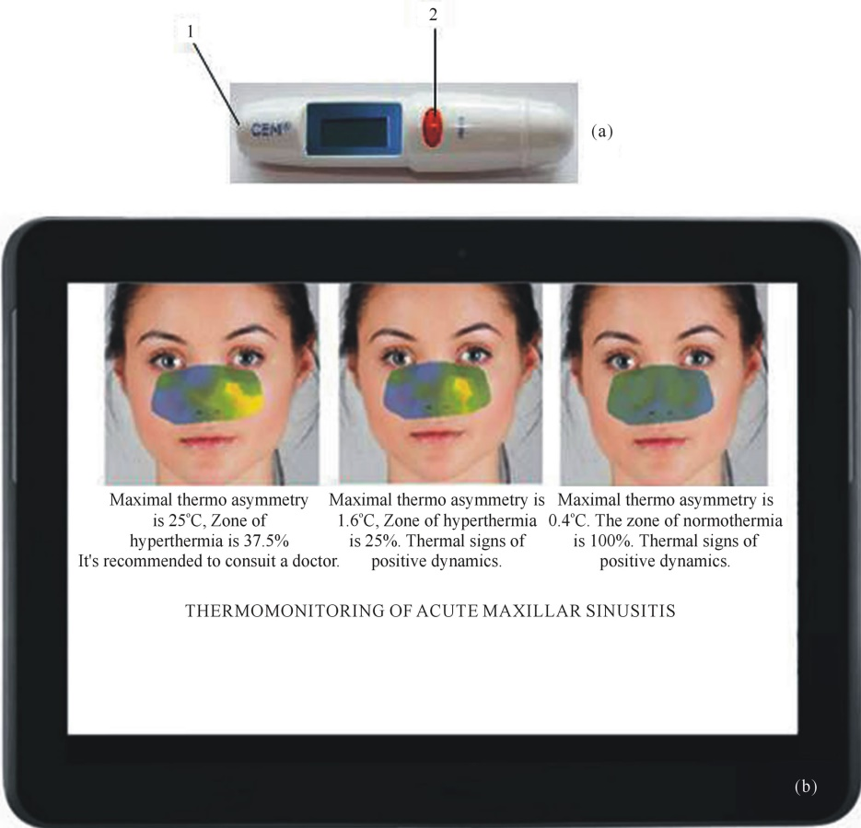
According to the results of the first session of examination, the necessary for interpretation numeric indexes are determined automatically (for example, maximal difference of points’ temperatures, the area of hypoand hyper-thermia in the examined area, and others); text conclusions that reflect the results of analysis are issued automatically. However, independent significance of the data from the first examination session is insignificant because of the known low specificity of thermography method. This data has the added value only for the specialist, not the average person, and only in conjunction with other clinical data necessary to establish the diagnosis.
Figure 1:- (а) Smart thermometer; (b Mobile device with thermo graphic software.

Slide 7
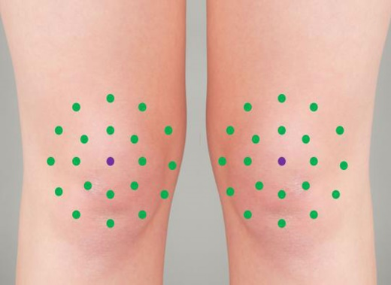
Figure 2 :- Individual template for
Monitoring of the condition of knee joints.
Measurement of temperature in the points by the template on the area under examination can be performed repeatedly during the time interval selected by the user. Numerical indexes, text messages, thermograms, graphs of temperature change can be issued to the user (Figure 4). In most of the cases, an average person can understand automatic conclusion on the results of monitoring

Slide 8
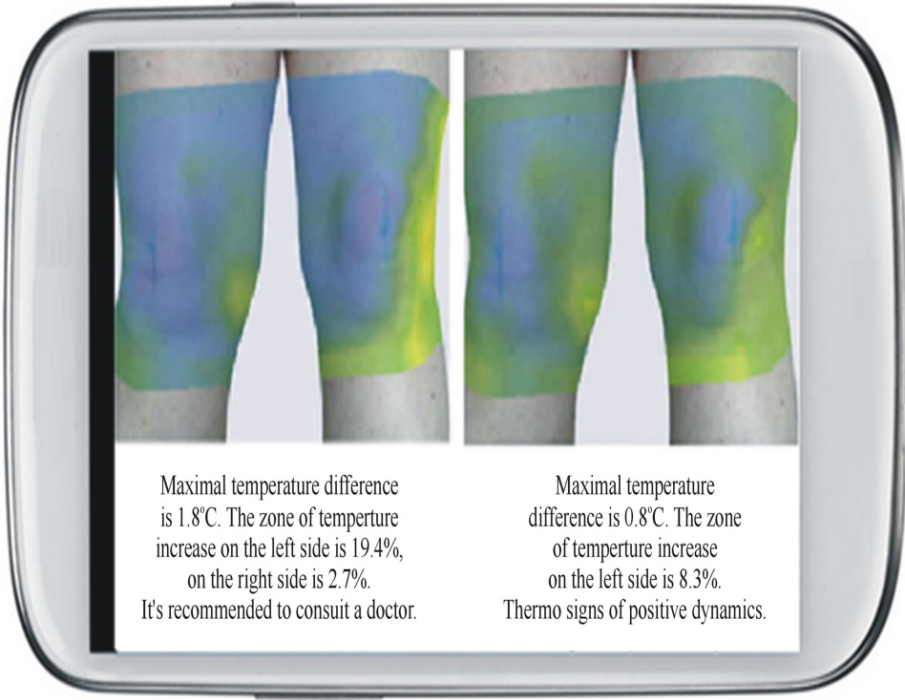
Figure 3:- The process of temperature
Measurement in the area of knee joint.
Figure 4. Thermograms of knee joints and automatic conclusion received during the process of monitoring of exacerbation chronic osteoarthritris.

Slide 9
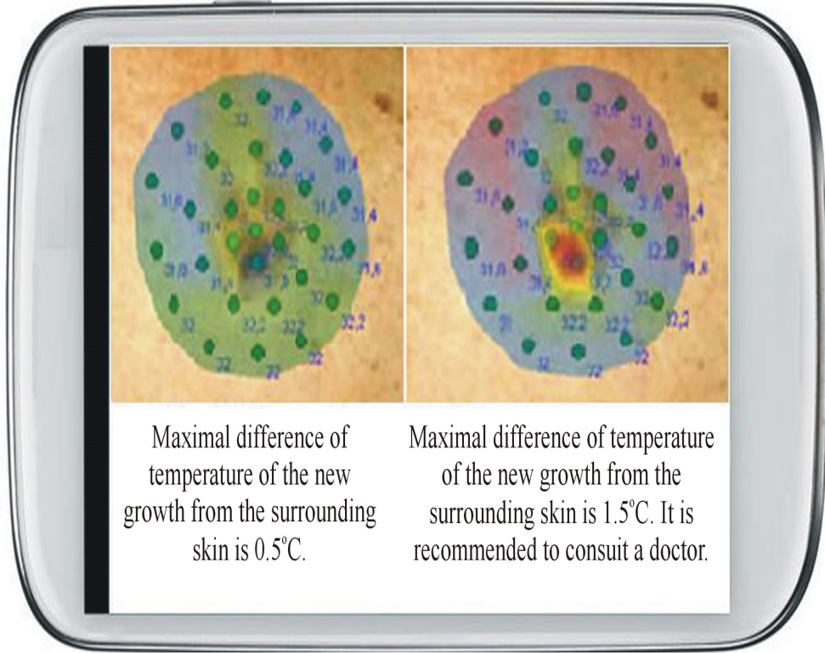
Figure 5 Shows an example of monitoring of nevus condition. According to the results of monitoring, significant increase of
Temperature of a nevus in comparison to the surrounding skin’s temperature is revealed, which can indicate its malignization . Therefore, conclusion for the second thermo gram is generated in red color and includes recommendation to consult with a doctor. In that way, timely notification of a user about the possible problem is realized.
Figure 5:- . Thermo monitoring
of nevus

Slide 10
Conclusions
Smart Thermometer has advantages of pyrometers and thermographs, but at the same time does not have their shortcomings:
It allows accurate positioning on the measurement points in each series of measurements.
It has fixed view spot, prevents the influence of air flows on the results of temperature measurements, prevents direct contact of the infrared sensor with the skin surface, and thus provides a low measuring error due to maximum unification of the distance and angle between the infrared sensor and the examined surface.
It is easy to use at home for self-examination and monitoring of chronic diseases (inflammatory, vascular, tumor) by average person.
The use of Smart Thermometer simplifies and reduces the cost of obtaining information about the course of a pathological process and/or the effectiveness of treatment for a large number of chronic diseases of organs, located close to skin surface and skin diseases (diseases of the joints, mammary and thyroid glands, Para nasal sinuses, etc.).

Slide 11
Developed for the first time, Smart Thermometer Technology is reliable, easy to use and affordable technology for home monitoring of widespread diseases. Applications for patents for Smart Thermometer Technology were submitted in many countries and several patents were already obtained. We have made a pilot batch of Smart Thermometer and successfully carried out clinical tests for the device. Smart Thermometer Technology is in the stage of full technological readiness for serial production.

Slide 12
REFERENCES
[1] B. B. Lahiri, S. Bagavathiappan, T. Jayakumar and J. Philip, “Medical Applications of Infrared Thermography: A Review,” Infrared Physics & Technology, Vol. 55, No. 4, 2012, pp. 221-235. http://dx.doi.org/10.1016/j.infrared.2012.03.007
[2] R. N. Lawson, “Implications of Surface Temperatures in the Diagnosis of Breast Cancers,” Canadian Medical Association Journal, No. 75, 1956, pp. 309-310.
[3] N. Arora, D. Martins, D. Ruggerio, et al., “Effectiveness of a Noninvasive Digital Infrared Thermal Imaging Sys- tem in the Detection of Breast Cancer,” The American Journal of Surgery, Vol. 196, No. 4, 2008, pp. 523-526.
[4] D. Mikulska, “Thermo graphic Examination of Cutaneus Melanocytic Nevi,” Annales Academiae Medicae Steti- nensis, Vol. 55, No.1, 2009, pp. 31-38.
[5] D. Kennedy, T. Lee and D. Seely, “A Comparative Re- view of Thermography as a Breast Screening Technique,” Integrative Cancer Therapies, Vol. 8, No. 1, 2009, pp. 9- 16.

