Slide 1

SMT. RADHABAI SARDA ARTS, COMMERCE & SCIENCE COLLEGE,
ANJANGAON SURJI.
TOPIC :Impact of Covide-19 on Animal Life during Covide -19
“ God loved the birds & created trees,
humans loved the birds & created cages’’
Guided By :- Asst.Prof.M.R. YEOTKAR

Slide 2
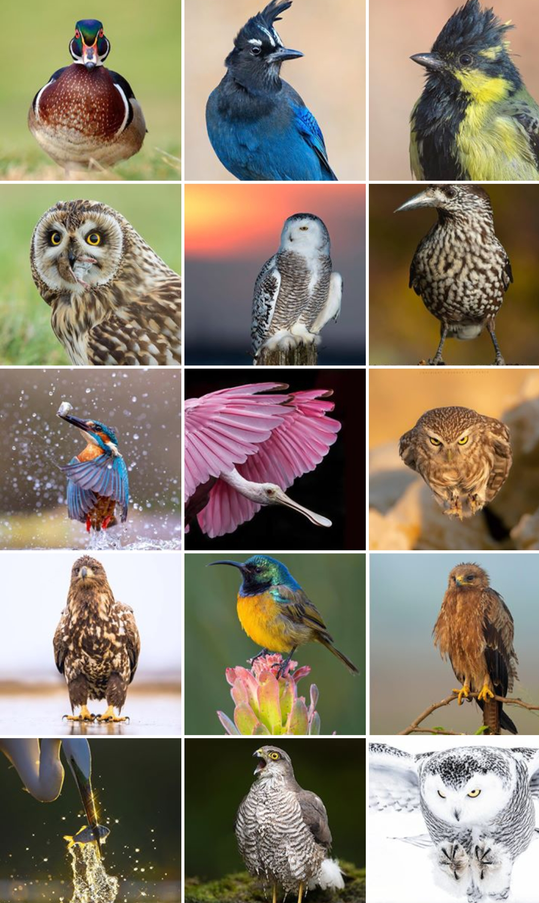
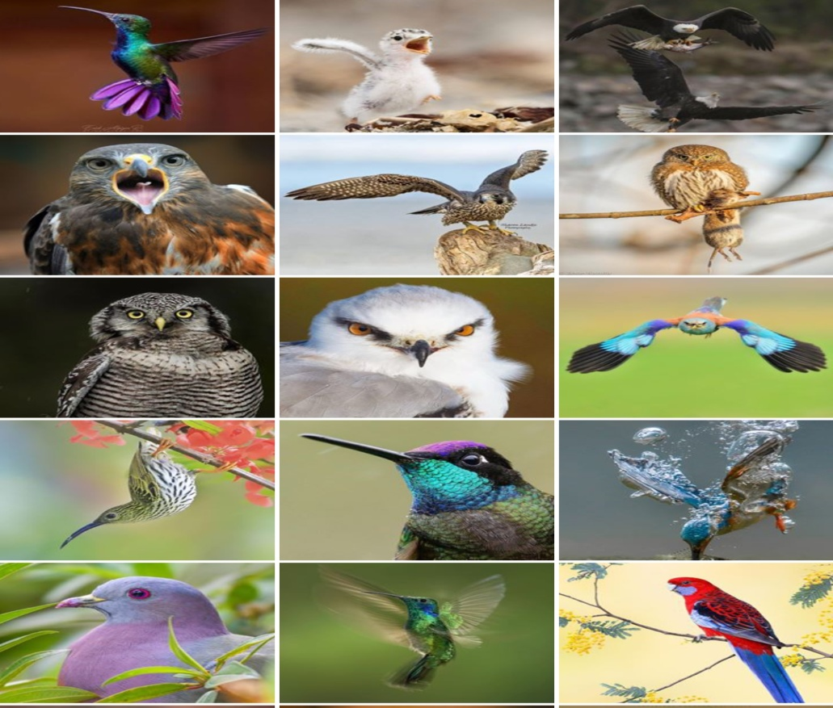
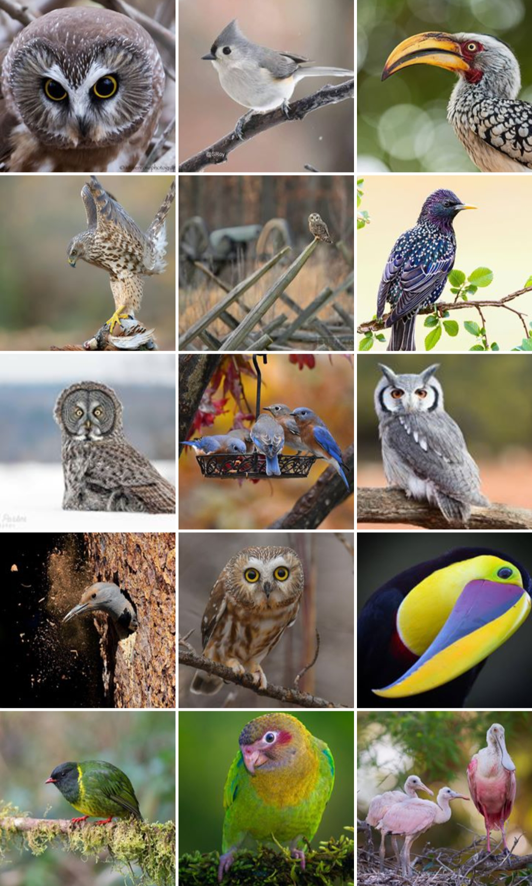
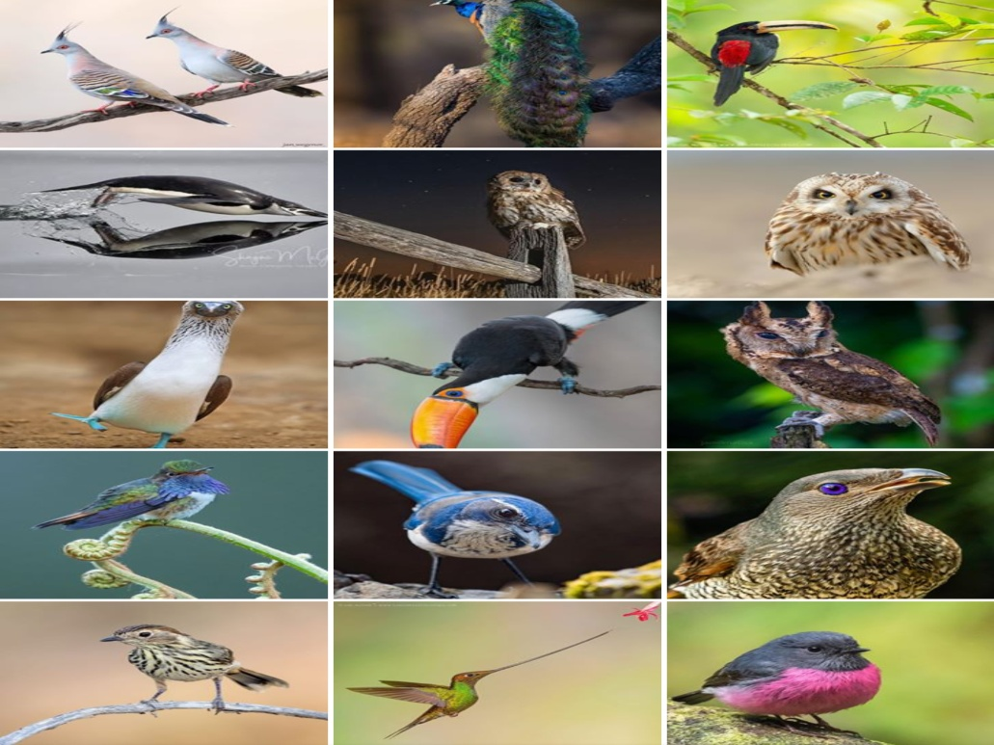

Slide 3
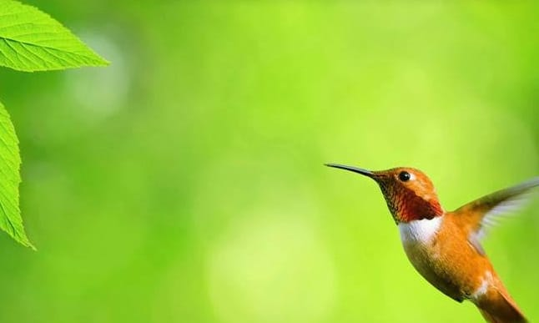
THE MOST BEAUTIFUL BIRDS IN THE WORLD
Introduction
There are approximately 10000species of birds are present in the world .There are so many colourful l and attractive birds . But we tell information about several birds . Birds are the second biggest group of vertebrates .
Birds are worm bodied creatures with wings and feathers . The body temperature of birds is generally higher than that of human.
Birds are the only group of the animal to possess feathers , they lay eggs ,have bills instead of teeth , four chambered heart and their skeleton is made-up of hollow bones.

Slide 4

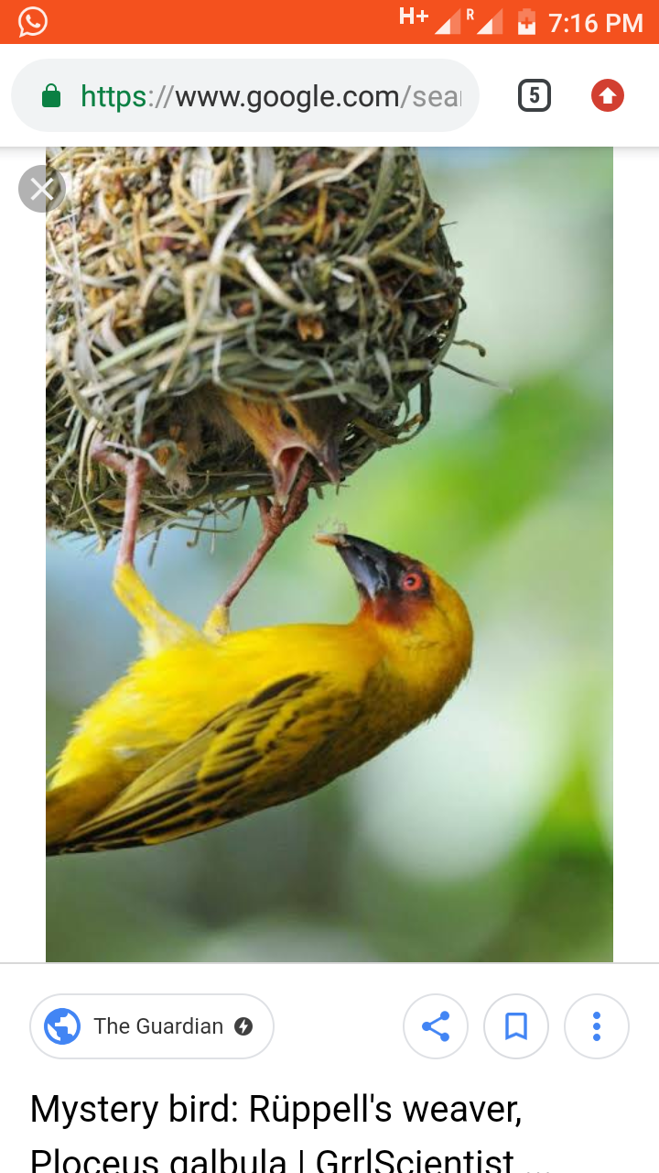
Baya weaver
Scientific classification
Kingdom : Animalia
Phylum : Chordata
Class : Aves
Family : Ploceidae
Genus : Ploceus
Species : P.philippinus
Introduction :- The baya weaver is a weaver bird found across the Indian subcontinent and south east Asia . Flocks of a these birds are found in grasslands, cultivated areas, scrub and secondary growth and they are best know for their hanging retort shaped nests woven from leaves . Most weaver birds are yellow , but their are also red , black verities . They are commonly known for their construction of elaborate nests.

Slide 5

General Characters
Baya weaver are sparrow size (15cm) and in there non breeding plumage , both males and females resemble females house sparrows
They have a stout conical bill and a short square tail
The Baya is like a wild sparrow but yellow.
Bill is horn coloured and no mask .
Baya weavers are social and gregarious bird.
It is extremely intelligent, obedient and docile.

Slide 6

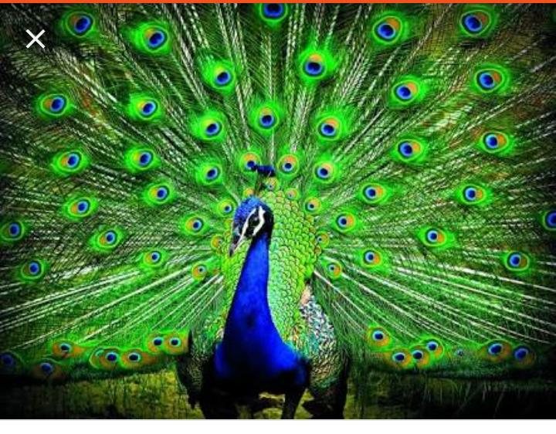
Peacock
Scientific Classification
Kingdom : Animalia
Phylum : Chordata
Class : Aves
Order : Galliformes
Family : Phasainidae
Subfamily : Phasianinae
Genus : Pavo
Species : Pavo cristatus
Introduction :- Common Name : Indian Pea foul , Scientific Name : Pavo cristatus
The national bird of a country is a designated representative of that country’s fauna. It should uphold certain core qualities of the nation it belong to. The national bird should be a prominent feature in the culture history of the country. Another point in favour of being chosen as the national bird is the beauty that it embodies. The indigenous nature of the bird another point while it is being considered as the national bird.

Slide 7

General Characters
Peacock is the National Bird of India.
The blue neck of Peacock is one of its most attractive features.
But then there are the feathers, which are very attractive too, especially when the peacock is in full plumage.
Peacock can live up to 20 years old.
It is most recognizable animal on the planet.

Slide 8
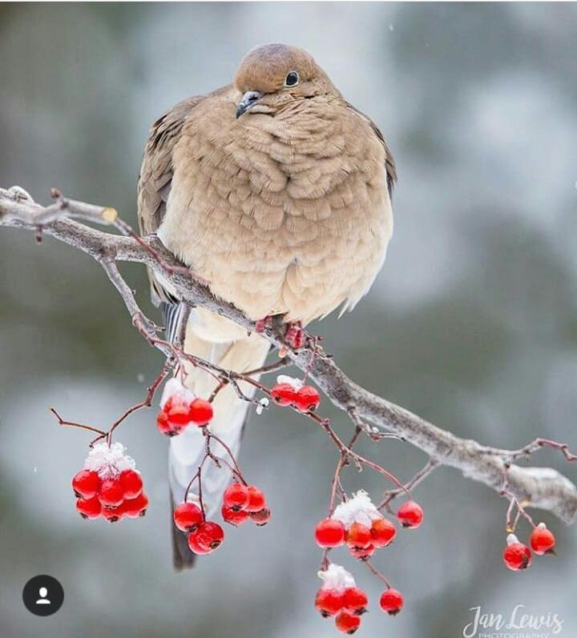
Mourning Dove
Scientific classification
Kingdom : Animilia
Phylum : Chordata
Class : Aves
Order : Columbiformes
Family : Columbidae
Genus : Zenaida
Species : Z. macroura
Introduction.
The bird is also known as the American Mourning Dove. It is one of the most abundant and widespread of all North American birds. It is also a leading game bird, with more than 20 million bird shot annually in the U.S., both for sport and for sport and for meat. Mourning doves eat almost exclusively seeds, which make up more than 99% of their diet. Rarely, they will eat snails or insects.

Slide 9
General Characters
The Birds also known as American mourninig or Rain dove.
Mourning doves are light grey and brown and generally muted in colour.
Males and females are similar in appearances.
The species is generally monogamous with two squabs per brood .
Both parents incubate and care for the young.

Slide 10
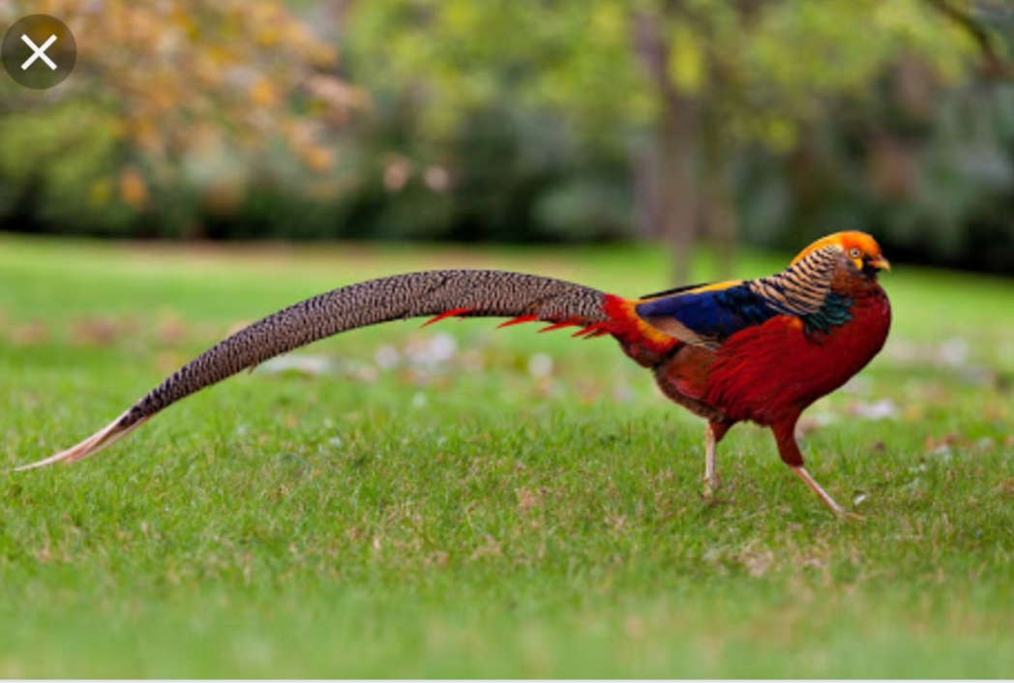
Female golden pheasant
Scientific classification
Kingdom : Animalia
Phylum : Chordata
Class : Aves
Family : Phasianidae
Genus : Chrysolophus
Species : C. Pictus
Introduction :- The golden pheasant or Chinese pheasant is a game bird. It is native to forests in mountainous areas of western china, but feral populations have been established in the United Kingdom . The adult male is 90-105 cm (35-41in ) in length, its tail accounting for two-thirds of the total length. It is unmistakable with its golden crest and rump and bright red body.

Slide 11

General Characters
The pheasant are one of the most popular pheasant keep by aviculturist.
Most of the people associate the pheasant as a game bird, because of their speed of flying.
The bird can lay 8-12 egg in April month between 22 to 23 days.
A male pheasant mature in 2 years and the female in 1year.
Baby pheasant called as rooster , cocks.
The male of these species is one of the most brillently coloured of the all bird.

Slide 12
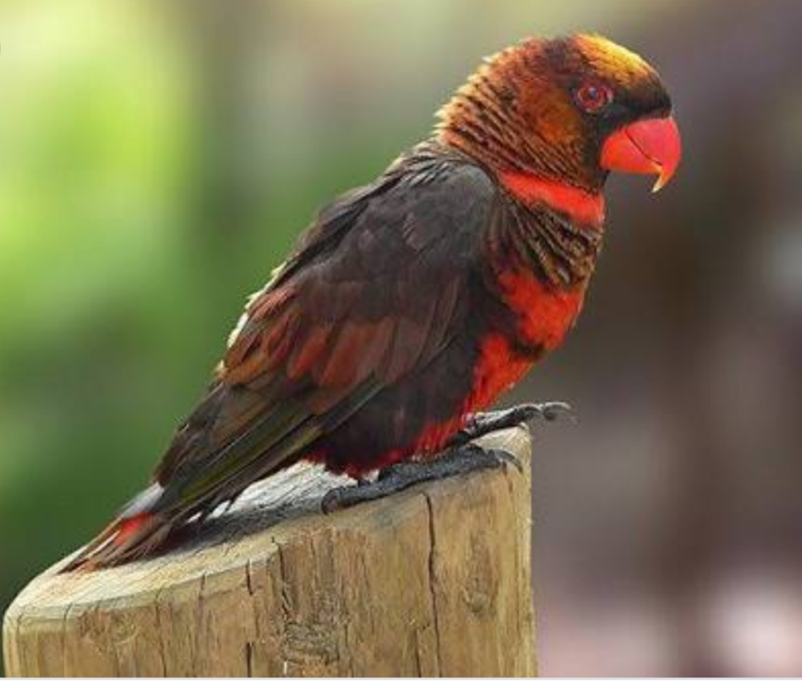
Dusky lory
Scientific classification
Kingdom : Animalia
Class : Chordata
Order : Psittaciformes
Family : Psittaculidae
Genus : Pseudeos
Species : P.fuscata
Introduction :- The dusky lory ( Pseudeos fuscata ) is a species of parrot in the family Psittaculidae. The dusky lory is short – tailed about 25 cm ( 10 in) long. It is mainly brown and has a whitish back and rump. It has two colour phases; the band across the upper chest together with its abdomen are either yellow or orange. The beak is dark orange and there is an area of bare orange skin at the base of its lower mandible. The irises are red and the legs are grey. The male and female are identical in external appearance. The dusky lory’s native range includes New Guinea below about 2500m in both the Indonesian (West Papua ), and Papua New Guinean zones of the island. It is also native to the island of.

Slide 13
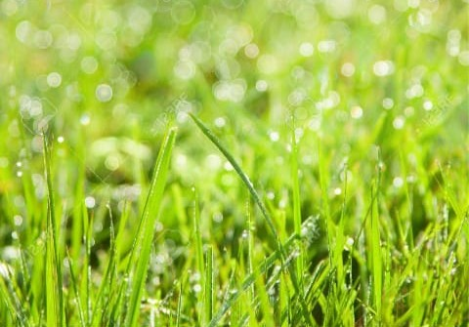
General Character
The Dusky Lories are known as Bonded Lories or simply “Duskies”
They occur naturally in New Gained where they are most common
Dusky Lories or Lorikeets are nectar feeders they do not eat seed, instead consuming nectar, pollen, vegetable.
The life span is of 13 years.
The reach reproductive maturity when they are about 2 to 2.5 years old. The Average clutch consists of 2-3 eggs, which are incubated for 24-25 days.

Slide 14
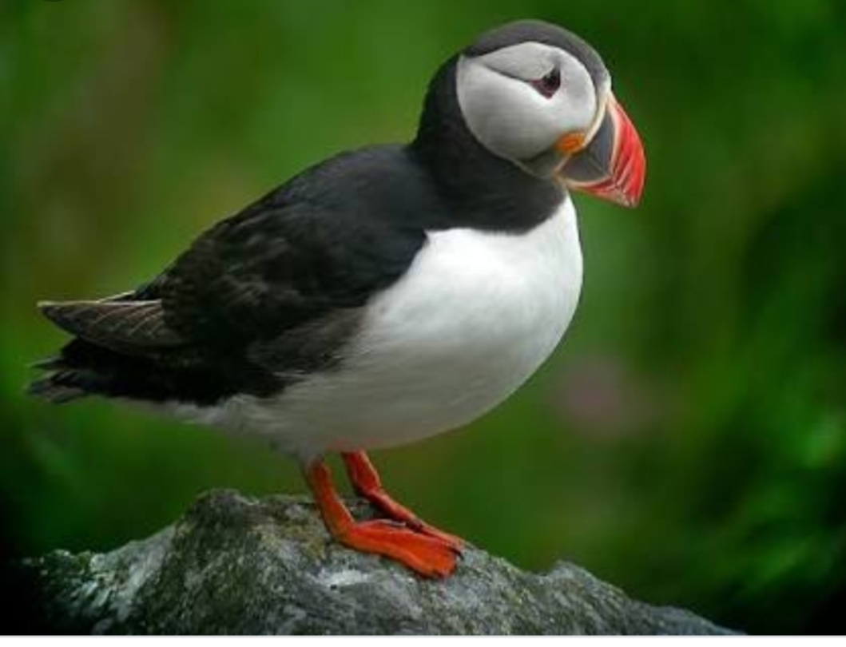
Atlantic Puffin
Scientific classification
Kingdom :Animalia
Phylum : Chordata
Class : Aves
Order : Charadriiformes
Family : Alcidae
Genus : Fratercula
Species : F. arctica
Introduction :- The Atlantic puffin ( Fratercula arctica ), also known as the common puffin, is a species of seabird in the auk family. The juvenile does not have brightly coloured head ornamentation, its bill is narrower and is dark- grey with a yellowish – brown tip, and its legs and feet are also dark. Puffins from northern population are typically larger than in the south and population are generally considered a different subspecies. After about 6 week, it is fully fledged and makes its way at night to the sea. The puffin has a black crown and back, pale grey cheek patches and white under parts. Its board , boldly marked red and black beak and orange legs contrast with its plumage. It moults while at sea in the winter and some of the bright – coloured facial characteristics are lost, with colour returning again during the spring. The external appearance of the adult male and female are identical, thought the male is usually slightly larger.

Slide 15

General Characters
Puffin are any of three small species of alcids (auks). These are pelagic seabirds that feet primarily by driving in the water.
60% of the World’s puffins live near Iceland. Puffins are specially adapted to living on the open sea.
It have penguins like colouring but they sport a colourful beak. Some to dud them the ‘sea parrot’.
Puffins eat small fish, such as sand eels. Puffin diet various from colony to colony.
Female puffin lays a single white egg that is incubated by both parent until it hatches up to six week later in the burrow.

Slide 16
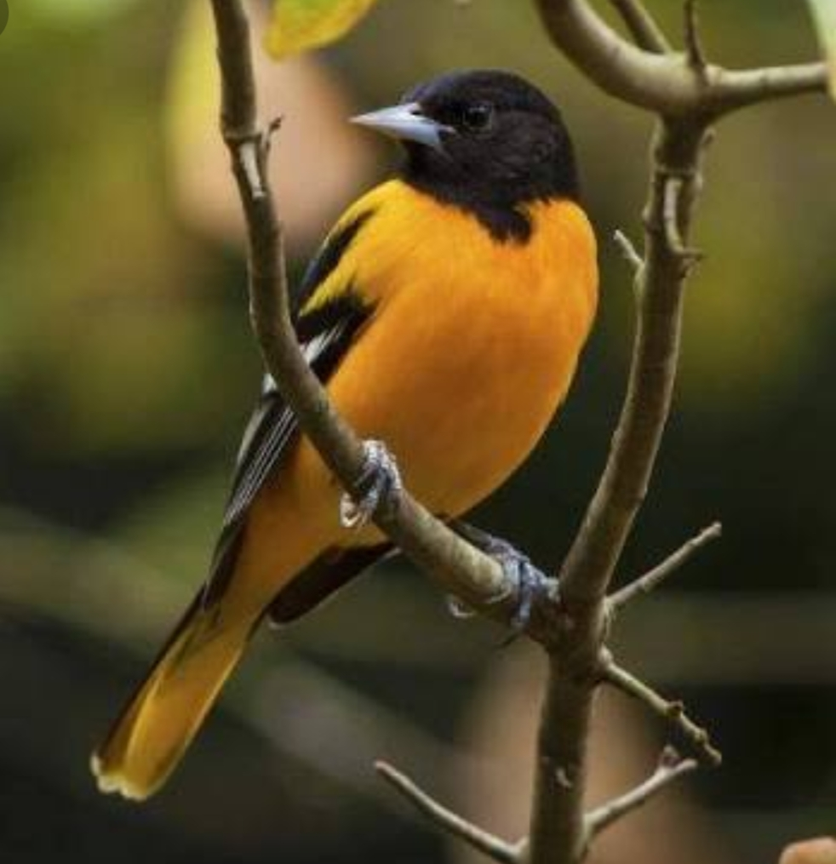
Baltimore oriole
Scientific classification
Kingdom : Animlia
Phylum : Chordata
Class : Aves
Family : Icteridae
Genus : Icterus
Species : I. galbula
Introduction :- The Baltimore oriole ( Icterus galbula) is a small icterid blackbird common in eastern North America as a migratory breeding bird. The Baltimore oriole is the state bird of Maryland. It is also the inspiration for the Baltimore Orioles baseball team. Baltimore orioles are found in the Nearctic in summer, primarily the eastern United State.
The male oriole is slightly largerthan the female , although the size dimorphism is minimal by icterid standards. The adult male is orange on the under parts shoulder patch and rump, with some birds appearing a very deep flaming orange and other appearing yellowish – orange.

Slide 17
General Characters
Baltimore oriole’s identifying Characteristics is the white and orange stripe on their folded wing a called a wing bar. Their bill is pointed and silvery.
Like many other birds, the female Baltimore Oriole is the primary nest builder. Making a hanging nest made from plant fibres and suspended from a branch 6 to 90 feet above ground.
Bluish white to pale gray, with brown and black marking concentrated at larger end. Incubation is by female, about 12-14 days.
Baltimore orioles are on their wintering grounds in Florida, Central America, and the northern part of South America.
Popular oriole foods include is they especially love Jelly, grape jelly and orange marmalade.

Slide 18
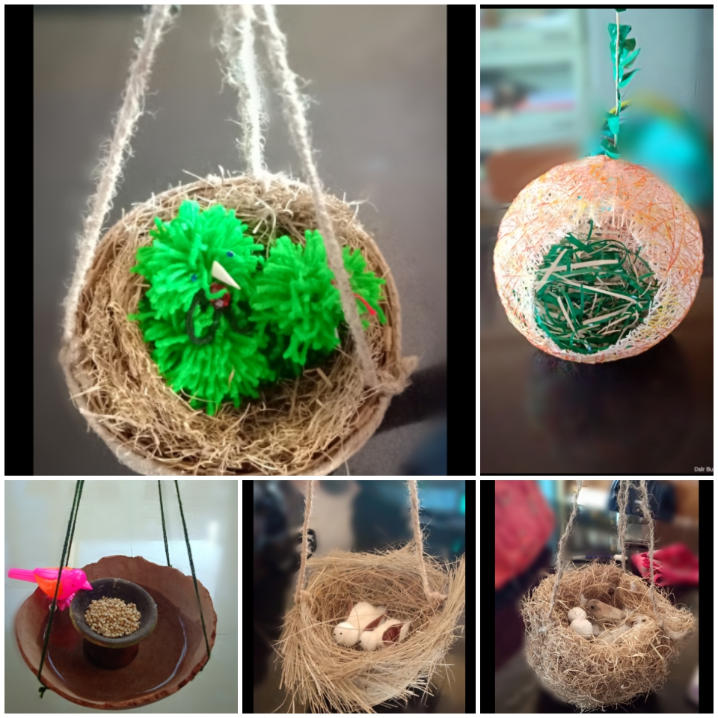
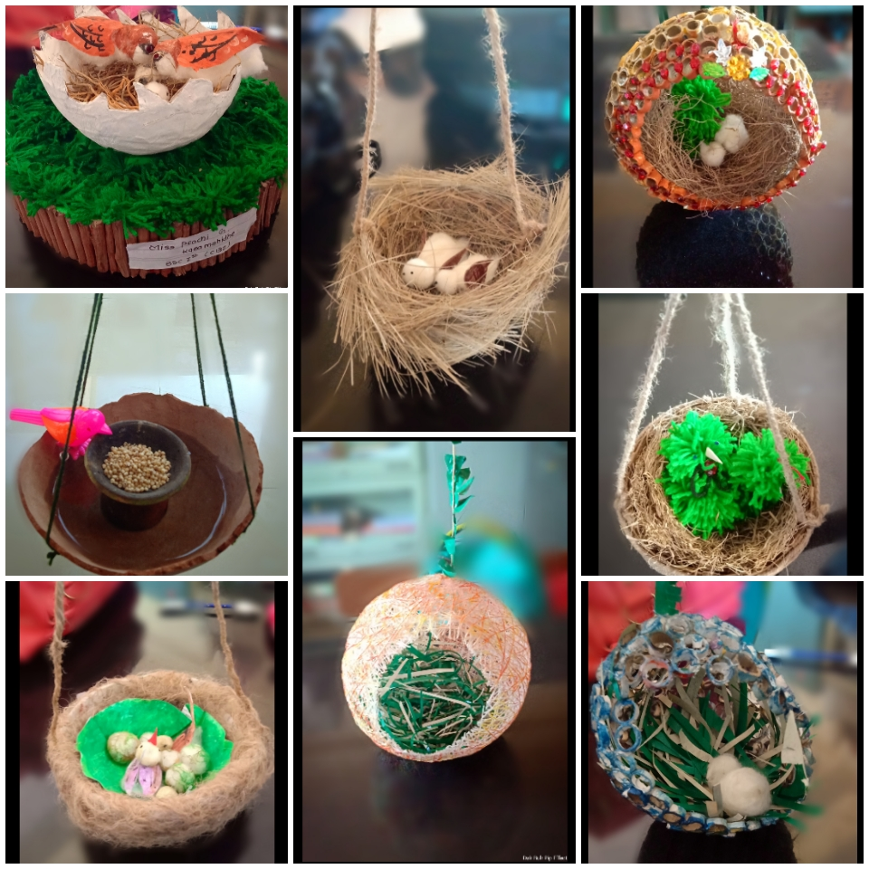
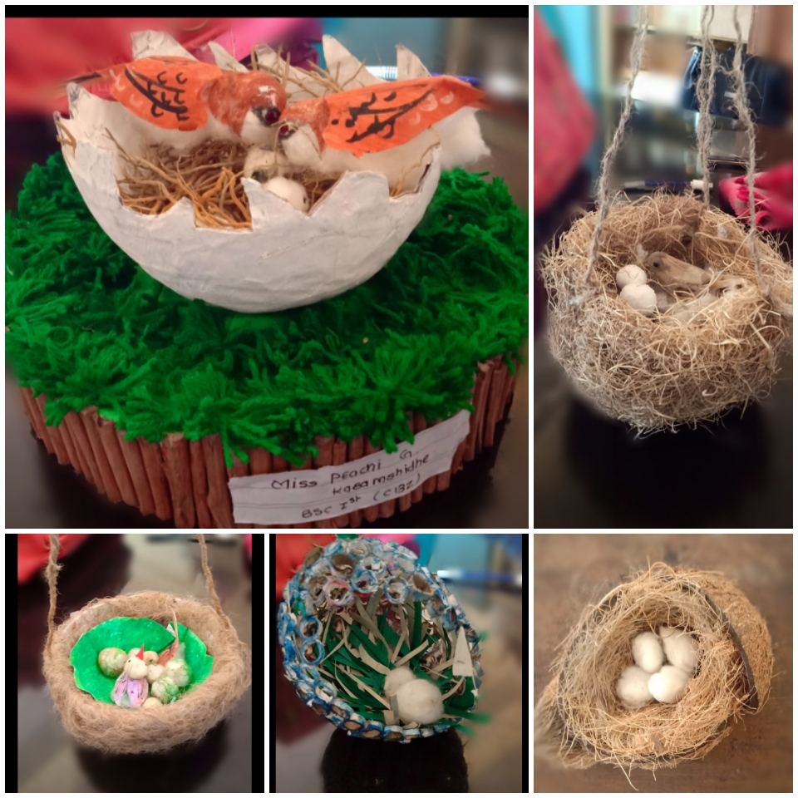

Slide 20
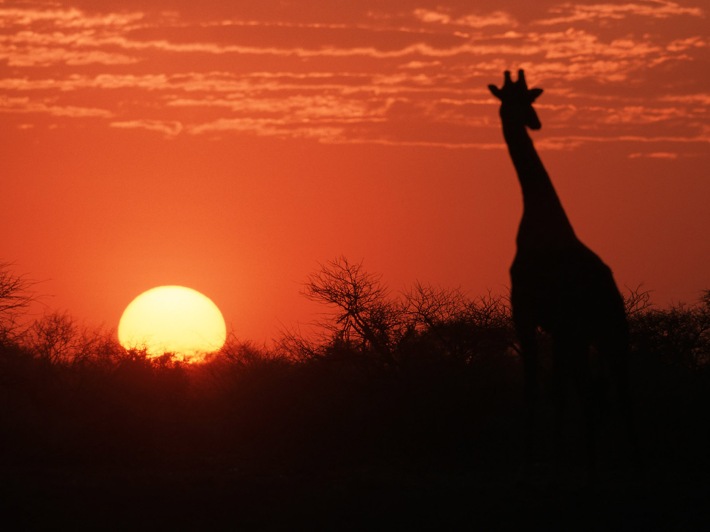
Guided By :-
Dr. M.R. Yeotkar
Associate Professor
Smt.Radhabai Sarda Arts Commerce and Science College,Anjangaon
-

Slide 21
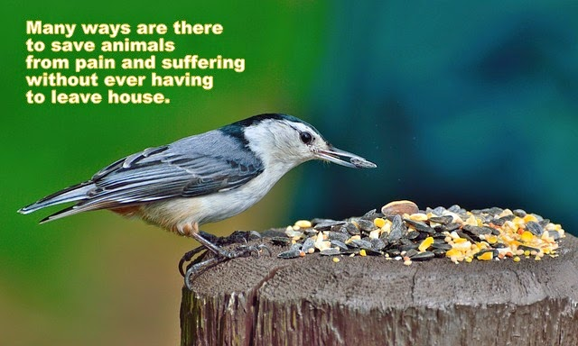
Thank You

