Slide 1
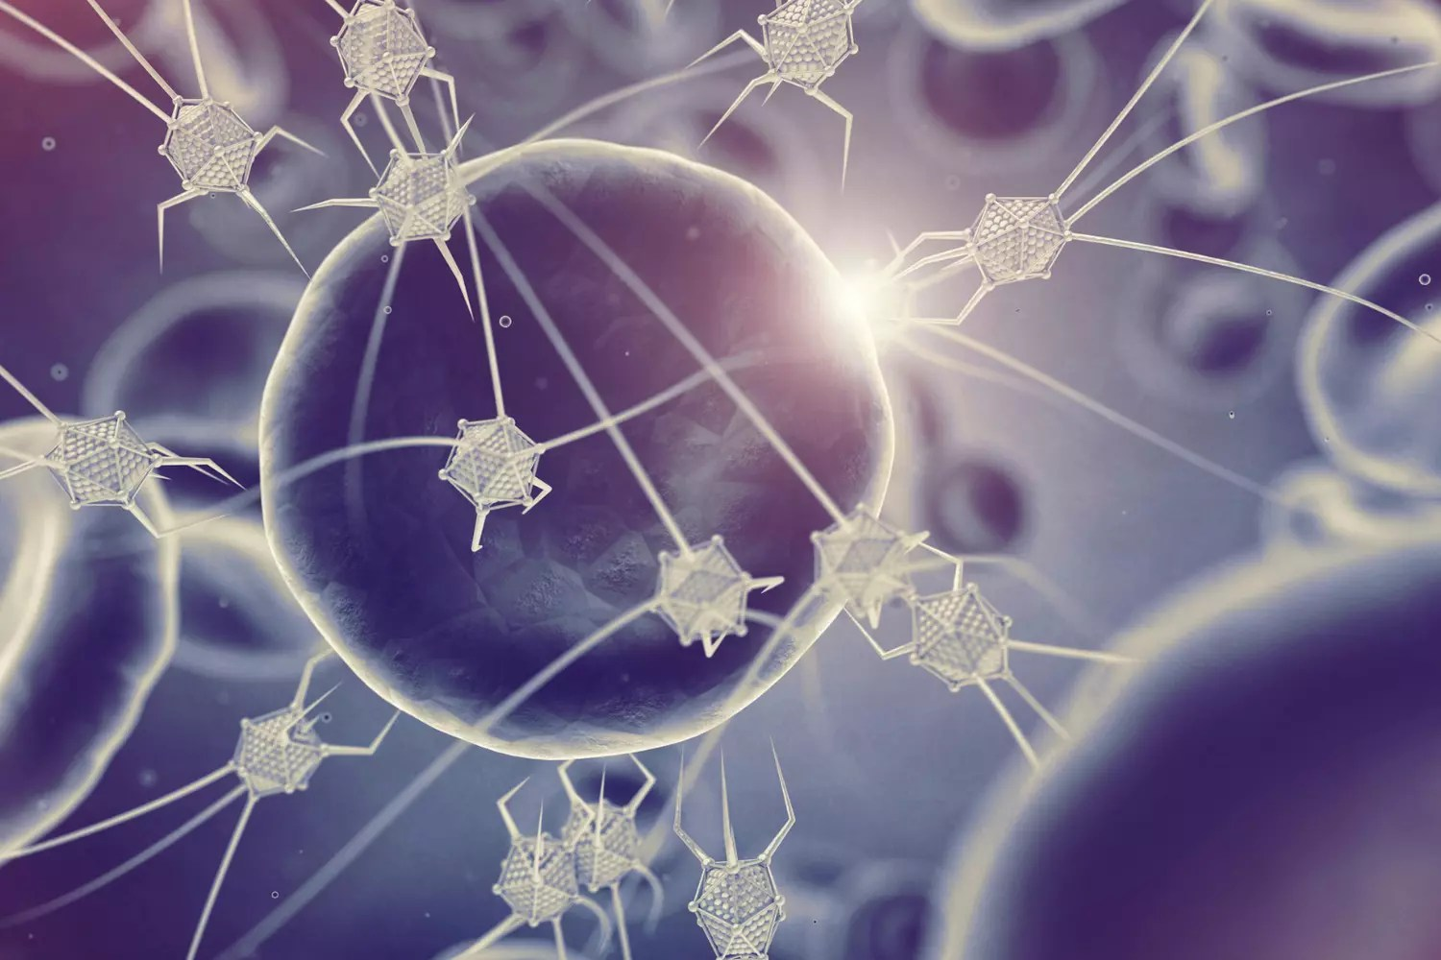
NANOTECHNOLOGY AND PUBLIC HEALTH
Rushikesh Haribhau Hirade
Parikrama Diploma in Pharmaceutical Sciences, Kashti, Tal- Shrigonda, Dist- Ahmednagar,
Maharashtra, India,
Why it matters because it is so little
Nanoparticle characteristics and behavior are not merely scaled-down versions of those of microparticles and microdevices. At times, the characteristics and actions exhibit radical differences, surprising variations, and unpredictability. There are quantum effects. Since smaller is more practical, we as responsible scientists and technologists need to reconsider; smaller now carries new, poorly known concerns. Substances undergo changes in their characteristics below 100 nm, including: Increased power ,Varied color,More erratic,More harmful (70 nm particles pass through the lung's alveolar surfaces, 50 nm via cells, 30 nm through the central nervous system, and the transport of particles smaller than 20 nm is not well understood.)Nanoscale items are highly helpful due to certain unique qualities, yet these properties also come with new concerns. It would be unwise for us to overlook the dangers in favor of the benefits alone.

Slide 2
Various nanotechnology types
Particles used in burn dressings, medication delivery systems, metabolic system monitoring, in vivo cell tracking, and capsules containing hemoglobin are examples of biomedical nanotechnology.development), quantum dots that attack cancer cells, and bone prosthesis made using nanotechnology. Nanoparticles may soon be found in food packaging and perhaps in food itself. Sunscreen creams (BASF, L'Oreal), lipsticks and other beauty products, and scents with nanoparticles are examples of current nanotech cosmetics.
Paints, building supplies, tennis rackets and balls, tires, automobile bodywork (Toyota), and plastic interiors of cars are examples of materials that have been nanoengineered.(Renault) to provide long-lasting paper, materials that are deodorant and stain-resistant, and strength and lightness.
Environmental nanotechnology encompasses a range of self-cleaning or toxin-repellent surfaces as well as sensors for testing water.
The development of convergent-nanotech (nanobiotech hybrids) includes the utilization of molecular motors and DNA as nanomaterials. as prototypes for "nano-robots" in biology.

Slide 3
CURRENTLY, THERE IS NO SAFETY ASSESSMENT
In 2003, Vicki Colvin, the director of Rice University's Center for Biological and Environmental Nanotechnology in Houston, Texas, stated the following on nanotechnology: In an area where there are more12,000 citations annually, we were shocked to see that there had never been any toxicity studies specifically focused on synthetic nanoparticles or any earlier study in creating risk assessment models for nanomaterials"'2). The majority of the time, nanotech goods are being produced without any knowledge of their safety or even the methodology for assessing them. The characteristics of a chemical substance vary at the nanoscale, as we have already said, therefore nanoparticle safety evaluation will need to work on different scientific concepts from current particulate evaluation.
Furthermore, the precise nanoparticles at what sizes that can cross different cell and tissue barriers remain unclear. American cosmetics already include titanium oxide nanoparticles.revealed that they ranged in size from around 20 to 50 nanometers; as a result, a large number of these would be able to enter cells in the central nervous system and build up in organs3. The majority of the tests that have been conducted involve trials like the three-month direct injection of single-walled carbon tubes into the lungs of rats, making them of little utility. Numerous safety review programs are under underway, and some producers of nanoparticles are coating their particles or using other strategies to reduce any possible harmful effects.

Slide 4
CONCLUSION
Based on the precautionary principle, there is currently an urgent ethical need for Japan to join other governments worldwide in launching an international initiative to interfere in the continued development, manufacturing, and marketing of nanotechnological goods while conducting precautionary research. as well as rule. An intergovernmental panel should be established to regulate nanotechnology in all its forms based on the scientific understanding required to weigh the possible benefits and hazards to mankind. This panel should interact with consumers and non-profit organizations. If mankind is to genuinely benefit from nanotechnology, then prudence and collaboration are essential for its advancement.

Slide 5
References
Royal Society. Nanoscience and nanotechnologies: opportunities and uncertainties. Report published jointly by Royal Society and Royal Academy of Engineering, London, 29th July 2004.
2) Colvin V. Responsible Nanotechnology: Looking Beyond the Good News. www.eurekalert.org, 2003.
3) European Union. Nanotechnologies: A preliminary risk analysis. workshop organized in Brussels on 1–2 March 2004 by the Health and Consumer Protection Directorate General of the European Commission. http://europa.eu.int / comm/health/ ph_ risk / events _ risk _ en. Htm.
4) ETC Group. Nano's Troubled Waters, (containing `Ten Toxic Warnings'). April 2004. http://www.etcgroup.org/documents/GT_TroubledWater_April1. pdf.
5) Dunford R, Salinaro A, Cai L et al. Chemical oxidation and DNA damage catalysed by inorganic sunscreen ingredients. FEBS Letters 1997; 418: 87–90. 6) Brown D. Nano litterbugs? Experts See Potential

