Slide 1
Assessing The Importance of ICT Specialization Among Senior Secondary Students in Kastina, Katsina Local Government
BY
Raji Abdullahi Egigogo*¹, Muhammad Tijjani Naniya²and Almansir Mansir³
1,2.3 Department of Software Engineering and Cyber Security, Al-Qalam University, Katsina, Nigeria
PRESENTED AT
CAPCDR 7th Conference ON " Public Health and Technology"
^{25-26TH} DECEMBER, 2023

Slide 2
Presentation Outline
Title Slide | 01
Introduction and Background of the Study | 02
Statement of the Problem | 03
Research Aim and Objectives | 04
Research Methodology | 05
Results | 06
Conclusion | 07

Slide 3
INTRODUCTION AND BACKGROUND
01
02
03
04
The integration of Information and Communication Technology (ICT) into education is increasingly vital for preparing students to thrive in the digital age (Valverde-Berrocoso et al., 2022).
ICT encompasses tools and techniques used to
process and communicate data, including computers, the
Internet, broadcasting technologies (such as radio and
television), and telephones(Boruah, 2022).
Its rapid
development is reshaping various sectors including banking,
health, defense, economy, oil and gas, and notably,
education
According to Amutha, (2020), ICT is driving
significant societal changes, particularly in education,
offering both students and educators opportunities to
personalize learning and teaching.
The government has
notably improved ICT infrastructure and connectivity across
educational institutions, granting students access to digital
technologies like computers, internet connectivity, and
software applications (Ogwuche & Elaigwu, 2022).

Slide 4
STATEMENT OF THE PROBLEM
In Katsina Local Government Area, ICT specialization
among secondary school students holds paramount
importance for academic success, career development, and
overall well-being.
However, challenges such as limited
access to ICT resources, shortage of qualified ICT teachers,
and lack of awareness regarding ICT's significance hinder
students from fully benefiting from ICT education
Addressing these challenges involves providing adequate
ICT resources to secondary schools, training more qualified
ICT teachers, and raising awareness among parents and
educators about the importance of ICT education

Slide 5
RESEARCH AIM AND OBJECTIVES
The aim of this study is to accesses the importance
of ICT specialization among senior secondary
school students in Katsina local government,
katsina.

Slide 6
OBJECTIVES OF THE STUDY
To identify the benefit of ICT specialization among senior secondary schools.
To identify the challenges faced among senior secondary school student in ICT specialization
To assess the academic impact of ICT specialization among senior secondary school students.
To propose recommendations for improving the effectiveness of ICT specialization programs in senior secondary schools.

Slide 7
RESEARCH METHODS AND METHODOLOGY
This stage explained tools, techniques use in carrying out research and how the research is done.
The total number of the students from the selected schools is 130 and the sample size was determined by the use of Krejcie and Morgan table (1970). Based on table the sample size for the study becomes 97. The data was collected through the use of questionnaire. 97 questionnaires were distributed to the 97 respondents through the use of simple radom sampling technique and utilized frequency, percentage and T-test statistics for analysis.

Slide 8
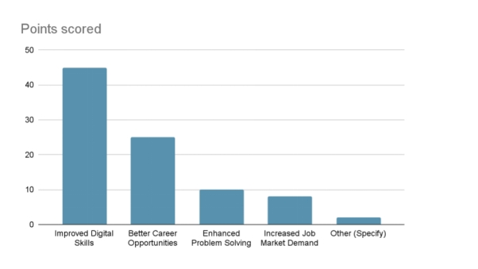
RESULTS
Table 1: What are the benefits of ICT Specialization among secondary school students?
S/N | Benefits of ICT specialization | Frequency | Percentage (%)
1 | Improved Digital Skills | 45 | 50
2 | Better Career Opportunities | 25 | 27.78
3 | Enhanced Problem Solving | 10 | 11.11
4 | Increased Job Market Demand | 8 | 8.89
5 | Other (Specify) | 2 | 2.22
 | TOTAL | 90 | 100
Benefits of ICT specialization

Slide 9
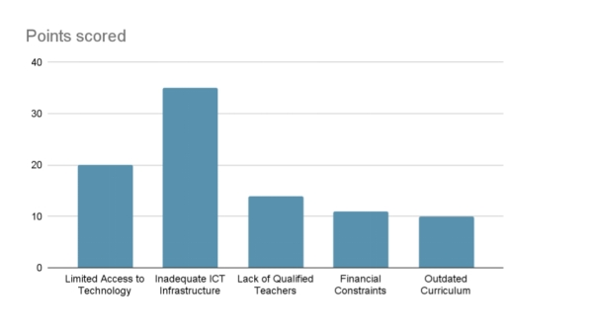
RESULTS
2. What are the challenges of ICT specialization among secondary school students?
S/N | Challenges of ICT specialization | Frequency | Percentage (%)
1 | Limited Access to Technology | 20 | 22.22
2 | Inadequate ICT Infrastructure | 35 | 38.89
3 | Lack of Qualified Teachers | 14 | 15.56
4 | Financial Constraints | 11 | 12.22
5 | Outdated Curriculum | 10 | 11.11
 | Total | 90 | 100
Challenges of ICT specialization

Slide 10
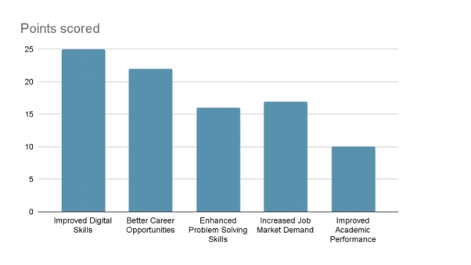
RESULTS
3. What are the impacts of ICT specialization among secondary school students?
S/N | Impacts of ICT specialization | Frequency | Percentage (%)
1 | Improved Digital Skills | 25 | 27.28
2 | Better Career Opportunities | 16 | 17.87
3 | Enhanced Problem Solving Skills | 17 | 18.89
4 | Increased Job Market Demand | 17 | 18.89
5 | Improved Academic Performance | 10 | 11.11
 | Total | 90 | 100
Impacts of ICT specialization

Slide 11
RESULTS
4. What are the best practices to improve the effectiveness of ICT specialization among senior secondary school students?
S/N | Best practices to improve the effectiveness of ICT specialization | Frequency | Percentage (%
 | Improved Digital Skills | 20 | 22.22
 | Better Career Opportunities | 16 | 17.78
 | Enhanced Problem Solving Skills | 14 | 15.56
 | Increased Job Market Demand | 10 | 11.11
 | Improved Academic Performance | 30 | 33.33
 | Total | 90 | 100
Best practices to improve the effectiveness of ICT specialization

Slide 12
RESULTS
Table 5: t-test statistics of the respondents on the benefits of ICT Specialization among secondary school students
Respondents | Mean | Std. Dev. | df | Sig. | Decision
Male | 4.58 | .379 | 310 | 0.07 | Supported
Female | 4.42 | .527
The result revealed that the male has a mean (std. dev.) of 4.58 (.379) and the female have a mean (std. dev.) of 4.42 (.527) Since the P-value (0.07) is greater than the alpha value (0.05), this indicates that there is no evidence against the null hypothesis. Therefore, the hypothesis is accepted.

Slide 13
RESULTS
Table 6: t-test statistics of the respondents on the challenges faced among senior secondary school student in ICT specialization.
Respondents | Mean | Std. Dev. | df | Sig. | Decision
Male | 4.38 | .319 | 310 | 0.15 | Supported
Female | 4.37 | .317
The result revealed that the male has a mean (std. dev.) of 4.38 (.319) and the female have a mean (std. dev.) of 4.37 (.317) Since the P-value (0.15) is greater than the alpha value (0.05), this indicates that there is no evidence against the null hypothesis. Therefore, the hypothesis is accepted.

Slide 14
RESULTS
Table 7: t-test statistics of the respondents on the challenges faced among senior secondary school student in ICT specialization.
Respondents | Mean | Std. Dev. | df | Sig. | Decision
Male | 4.38 | .319 | 310 | 0.15 | Supported
Female | 4.37 | .317
The result revealed that the male has a mean (std. dev.) of 4.48 (.312) and the female have a mean (std. dev.) of 4.39 (.311) Since the P-value (0.22) is greater than the alpha value (0.05), this indicates that there is no evidence against the null hypothesis. Therefore, the hypothesis is accepted.

Slide 15
CONCLUSION
The study emphasizes the crucial importance of ICT education and infrastructure in secondary schools. It highlights deficiencies in computer teachers' skills and inadequate infrastructure such as computers, internet access, and software. The research strongly recommends government intervention, proposing mandatory teacher training in ICT and providing essential infrastructure. Overall, investing in ICT resources, training proficient educators, updating curricula, and adopting innovative teaching methods are seen as vital steps to improve academic performance, digital skills, career opportunities, problem-solving abilities, and students' competitiveness in the job market.

Slide 16
THANK YOU FOR LISTENING

