Slide 1
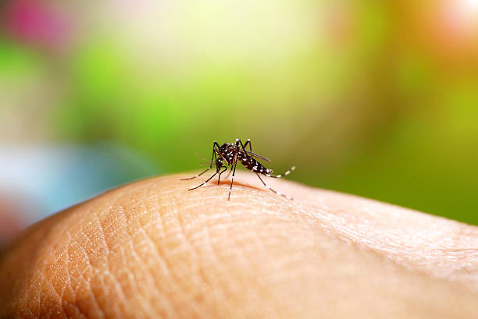
DENGUE
Hogale Krushna Nanasaheb
Parikrama Diploma in Pharmaceutical Sciences, Kashti, Tal- Shrigonda, Dist- Ahmednagar,
Maharashtra, India,
THE DENGUE VIRUS HISTORY
The dengue virus was discovered in Calcutta (now Kolkata) in 1944 from blood samples of US soldiers4, and in Japan in 1943 by inoculating patient serum in nursing mice 14. Madras (now Chennai) saw the first epidemic of clinical dengue-like sickness in 1780, while Kolkata and the Eastern Coast of India saw the first epidemic of dengue fever in India that was confirmed by microbiological testing in 1963–196416–18. The initial A significant DHF epidemic struck the Philippines in 1953–1954, and the DF/DHF19 outbreak quickly spread throughout the world. DHF was present in the neighboring nations but not in India. given that all the risk factors were present, for unclear reasons. Since 198820–22, the DHF has been boiling in various parts of India. In India, the first significant nationwide DHF/DSS outbreaks struck in 1996, initially affecting the regions surrounding Delhi 23 and Lucknow 24 before spreading over the entire nation 25.

Slide 2
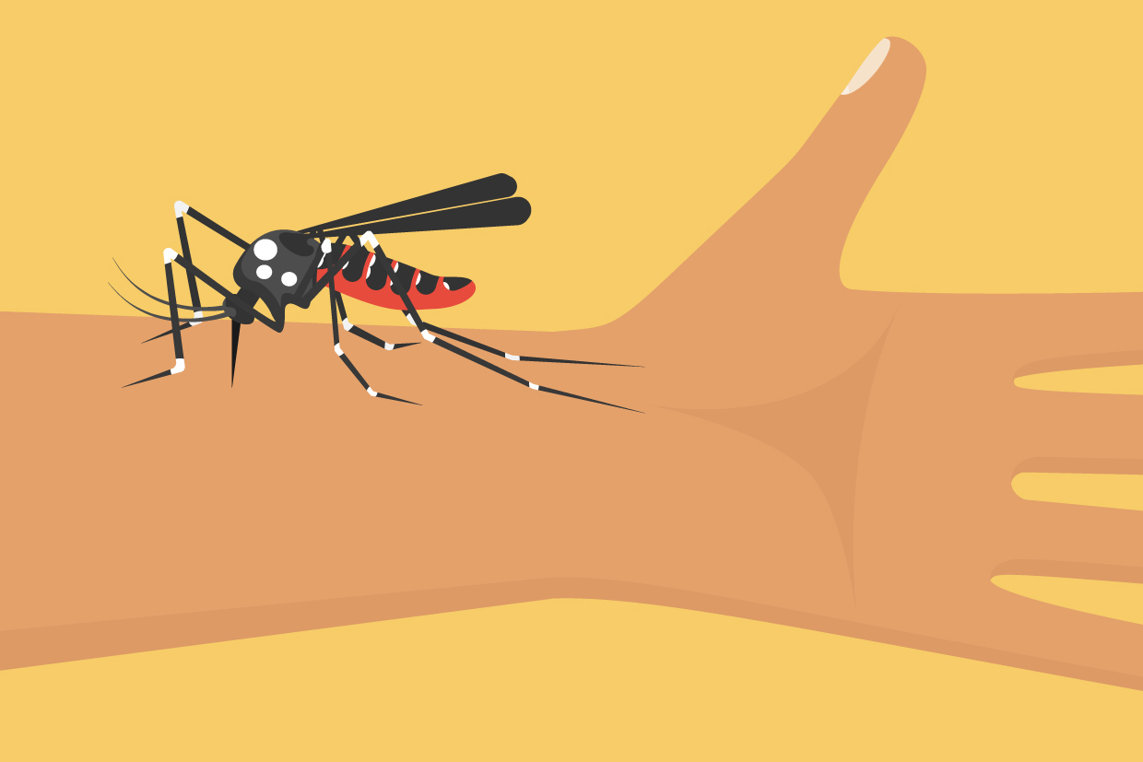
ENDOMEDICINE OF DENGUE FEVER
Traveling abroad, a growing human population, and urbanization all provide the ideal environment for the mosquito vector Ae. aegyti to thrive, which allows the virus to spread to new locations and cause serious pandemics (13, 28, 29). Over 100 nations in Africa, America, the Eastern Mediterranean, Southeast Asia, and the Western Pacific have an endemic dengue epidemic; Southeast Asia and the Western Pacific are the most afflicted regions in the region13,30–32. The first two DENV serotypes were found in the 1950s in Thailand and the Philippines4, where the first case of DHF was found. The third and fourth serotypes were found in 195426. Since then, DHF has documented significant cases among children in regions ranging from Asia to Africa and the Pacific4 that resulted in hospitalization and death. Roughly half of the world's population, or 2.5 billion, are currently d's population2 is susceptible to dengue, and 50 million cases worldwide are reported each year4.

Slide 3
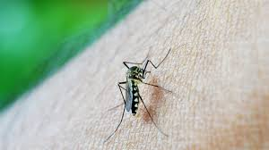
PATHOPHYSIOLOGY DENGUE FEVER
Bite bites from female Ae. aegypti mosquitoes carrying the Flavivirus are the cause of dengue infection. The virus takes three to fourteen days to fully incubate after biting a person3,30. During this time, the victim may have fever, headache, rash, nausea, and joint and musculoskeletal pain3,13. This classic DF typically lasts 5-7 days6 and recorded temperatures from 39-400 C. During this time, the virus may enter the peripheral bloodstream and harm lymph nodes and blood arteries if treatment is not received.resulting in DHF, which manifests as symptoms like gums, bleeding from the nose, or bleeding beneath the skin30. Breathing difficulties are another issue that DHF patients have, and severe development might result in DSS.
DSS is able to use result in death if the right care is not given. The body and legs of Aedes mosquitoes are black with white patterns, and they are tiny. For female mosquitoes to lay viable eggs, they must bite humans or other animals and draw blood. The development of an egg takes two to three days. Dengue's primary vector, Ae. aegypti, has successfully adapted to life in cities26,29 and consistently reproduces in stagnant containers. Eggs require moisture to grow, taking 24 to 72 hours70. Bite from mosquitoes is the only way DENV can spread. DENV is frequently spread from one to person through domestic occur from mosquitoes 6. A mosquito bite from a patient with DF/DHF70 causes an outbreak. The virus replicates in the lymph nodes and travels through the lymph and blood to other tissues after being transferred to a new human host by infected mosquitoes. It is vital to comprehend the DENV life cycle in order to find a possible antiviral treatment.

Slide 4
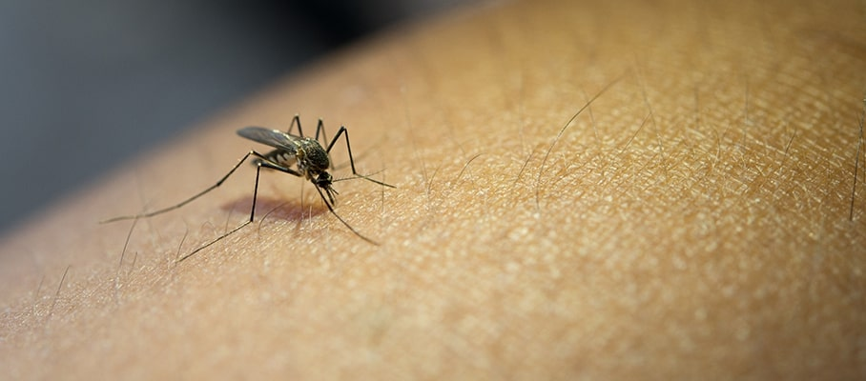
SUMMARY OF RESEARCH ON PLANT SPECIES USED TO TREAT DENGUE
Due to their little or nonexistent side effects, the use of medicinal plants and herbal remedies to treat a wide range of illnesses is expanding throughout the world. The sections that follow list a few types of medicinal plants with anti-dengue properties from a variety of groups have been studied. We also describe the species and their separated chemical that are traditionally used to treat dengue. Phloxeroides Alternanthera Alternanthera philoxeroides is a member of the Amaranthaceae family. A. philoxeroides is an aquatic plant that is submerged in water and is also known as "Alligator Weed." It is currently encroaching on Australia, but it came from South America. In vitro84 research was done to examine the impact of A. philoxeroides extracts against the dengue virus. To ascertain A. philoxeroides's cytotoxicity on C6/36 cell lines, an MTT experiment was used. An extract of A. philoxeroides' coumarins had the least amount of toxicity on cells (TD50 = 535.91), whereas an A. philoxeroides petroleum ether extract exhibited the greatest ability to suppress the dengue virus (ED50 = 47.43).

Slide 5
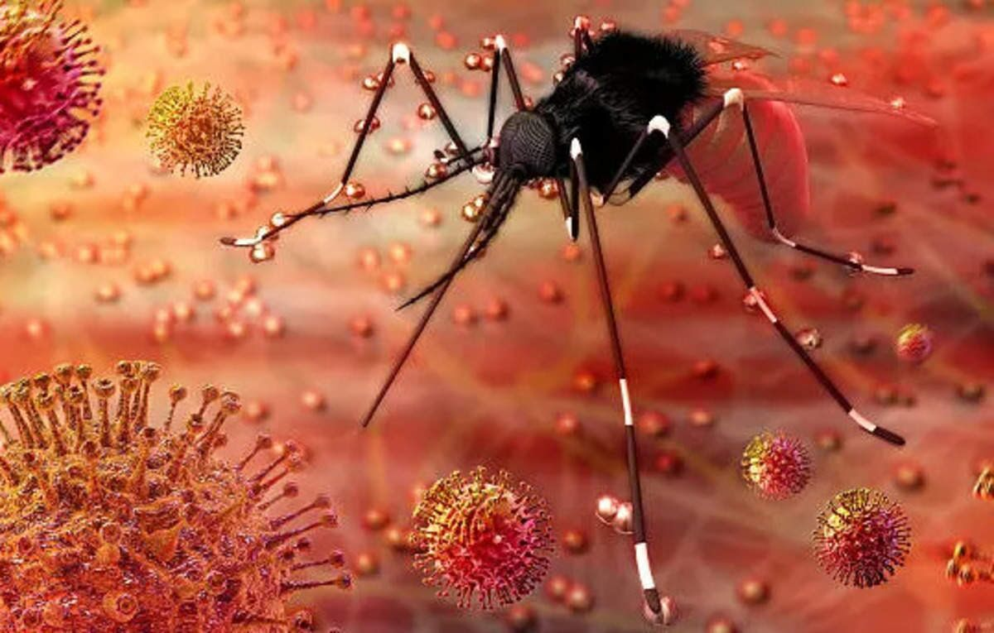
CONCLUSION
The creation of novel anti-dengue products utilizing bioactive chemicals is imperative to identify anti-dengue medications that are both less harmful and more effective. Consequently, any in-depth research on the Further in vitro and in vivo animal testing, followed by toxicity and clinical testing, should be conducted on the potential of plants that have identified active chemicals that have demonstrated anti-dengue action. Using this approach could lead to the identification of a promising molecule that could be improved and used to create novel anti-dengue drugs. Research on medications made from medicinal plants found throughout the continents could be beneficial to both national and individual health. Furthermore, these findings might result in the creation of extremely effective and secure dengue medicines. But in order to find possible anti-dengue herbs.

Slide 6
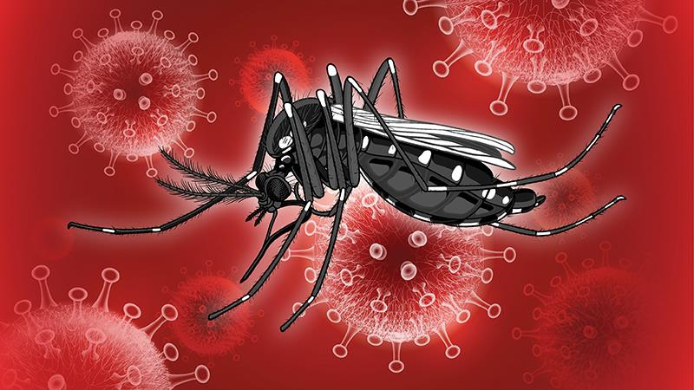
REFERENCE :-
1) An effective preventive agent for the in vitro Dengue virus is an algal-derived DL-galactan hybrid, according to Talarico LB, Zibetti RGM, Noseda MD, Duarte MER, Damonte EB, et al. illness”, Planta Med, 73:1464–1468, 2007.
2) "Effect of Thai medicinal plant extracts against Dengue virus in vitro," MU J Pharm, Klawikkan N, Nukoolkarn V, Jirakanjanakir N, Yoksan S, Wiwat C, Thirapanmethee K, et al. 38(1-2): 13–18, 2011.
3) Guzman A, Isturiz RE. “Update on the global spread of dengue”, Int J Antimicrob Agents, 2010, 36S:S40–S42.
4) WHO. World Health Organization. “Dengue and severe dengue”. Fact Sheet, 2012. http://www.who.int/mediacentre/factsheets/fs 117/en/
5) "The inhibitory actions of Houttuynia cordata aqueous extract on Dengue" by Leardkamolkarn V, Srigulpanit W, Phurimsak C, Kumkate S, Himakoun L, Sripanidkulchai B, et al.
6) The inhibitory effects of Houttuynia cordata aqueous extract on Dengue were observed by Leardkamolkarn V, Srigulpanit W, Phurimsak C, Kumkate S, Himakoun L, Sripanidkulchai B, in addition to others.

