Slide 1
7th International Conference
on
Public Health & Technology
December 25-26, 2023
SURVEY ON PHARMACY MANAGEMENT SYSTEM
Organized by Center of Academic & Professional Career Development & Research ( CAPCDR )
Pawar Vaishanvi & Rathod Shrinivas

Slide 2
SURVEY ON PHARMACY MANAGEMENT SYSTEM
Pharmacy management system is a management system designed to improve your accuracy and increase safety and time saving in the shop. It is based on a system that helps pharmacies improve management price and safety. This system allows the user to enter the manufacturing date and expiration date of a particular drug during stock replenishment and sales transactions. This system displays a list of product expiration reports on the specified date before the product expires. The system also includes manual entry when new stock arrives medicines and also the transport of medicines from the pharmacy in a limited period of time, e.g. monthly or every other month, the pharmacist may wish to prepare a report on the shipment or delivery of the medication pharmacy, for example taking information about medicines. expiration date, purchase date, number the medicines/type of medicine were left in the pharmacy. A manual system is currently used when used in a pharmacy. The pharmacist must also manually check all medications in the pharmacy. This usually leads to failures due to the pharmacy's workload and deadlines.

Slide 3
Developing and producing a medication management system is the first approach interface with other systems that input user data or information. Medicines Board the system is part of management. Based on this, the data and some other information are integrated into the system through the system's user interface or from isolated data sources
Usually medicine management system requires information related to :
1. Provider: entity called manager or product a a product that acts as a link between the source or manufacturer of the drug and the user. Any medication the factory has information about the function and use of the drug, the method of use, the expiration date, ingredients and side effects of drugs.
2. Client: Because the device has the opposite function as a provider. The customer is unit that means the buyer of the products made in the shop and the shop, i.e. who has a warehouse. Also for everyone The client or the patient collects information in the system, either the doctor or the client. This is information complaints and medication recommendations.
3. Warehouse: an entity called a warehouse, which means storage space to properly meet the market demand.
4. Daily Sales Control is an abstract entity that includes related topics such as total annual costs, applications and more. So we got 3 main points/functions that define for a pharmacy management system own: The list of prescription drugs (Medicine Information), which is updated in real time in the Patient Registry and there the events should be systematically recorded.

Slide 4
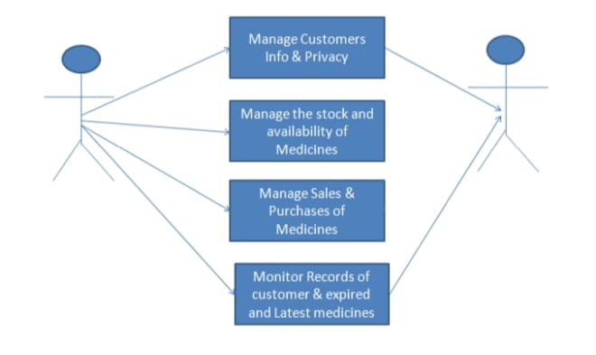
Fig. 1 Research Notes
Fig. 2 Visual Proposed system flow

Slide 5
Conclusion-
This understand that this pharmacy management system is very easy to work and saves a lot of time because this system is indispensable for managing details such as regular customer records, medicines stock, etc. doing. pharmacy system can significantly improve operational management and thus streamline the process. This allows to automate the process of Pharmacists collecting and retrieving information, improving the response time of the sales and also no time lag in delivering the medicines within no time delay for customer Bookkeeping and older managing terms are sometimes terribly pathetic and complicated. This system removes complexity of all things

Slide 6
THANK YOU!

