Slide 1
Antenatal Care and its implication on children mortality: An intersectionality Approach
Kundan Kumar
Research scholar

Slide 2
Introduction
single- axis framework of analysis framework of intersectionality
Term coined by- Crenshaw in 1989 to conceptualize the suffering of black women which differ from both the black men and white women
can be regarded as a theory, paradigm, methodology, lens or framework (Hankivsky, 2014).
human lives cannot be reduced to single factor
A human life is exposed to various privilege and exploitation and thus these experiences are not additive rather they mix and create a new whole. The intersectionality approach focuses on heterogeneity among homogeneity i.e. differences among those categories which are earlier or on a casual look considered as similar.
intersectionality framework is used to analyze the differences among women of different social groups to get the antenatal care services and its implication on the children mortality.
Antenatal Services (ANC) or pre- natal services are those services which a woman gets while she is pregnant.
World Health Organization (WHO) recommended that all pregnant women must get ante- natal care in first trimester of pregnancy followed by 4 ANC visit at regular time interval.

Slide 3
Literature review
goal of intersectionality informed analysis is to map health inequalities with more precision Hankivsky and kapilashrami (2018)
mentioned that how the intersectionality approach leads to reduce the health inequality in UK. Kapilasharami et al (2015)
health status of children Mukhopadhayay ( 2015) focus on regional differences between north India and south India class inequality dominate caste inequality which in turn dominate gender inequality for all level of stunting in rural north India while caste inequality dominate class inequality and class inequality dominate gender inequality in rural south India for severe stunting.
dealt in depth of the socio- cultural tradition for women in India and thus conclude that there are differences exist between women of different identities. The dalit women are double discriminated for being the women as well as being the dalit. Haq(2013)
Stones et al (2004) have worked on inequality in antenatal care in rural north India comprising the states of Bihar, UP, MP and Rajasthan based
Rani et al (2008) have compared the antenatal care between north and south India quality of services provided is better in south India compared to north India

Slide 4
Objective This paper focuses on health inequality in antenatal care and its implication on children mortality among different social groups of women in Bihar.
Data source
secondary data is collected from NFHS- 4
The samples are collected through two – stage sample design for rural as well as urban areas. In the first stage village or census enumeration block are selected and in the second stage 22 houses are selected randomly.
Methodology
analysis of data, bar graph, composite bar graph, scatter plot and correlation coefficient is used.
In scatter plot, different data set are represented on x and y axis respectively. The dot represents the nature of relationship.
Correlation coefficient is the mathematical way of representing the nature of relationship between two meaningful variables.

Slide 5
Discussion and analysis
Patriarchy is deep rooted in India and its states. Therefore, all women are oppressed and have to suffer.
But sufferings of all women are not the same. This is because women life are not shaped by one identity marker i.e. gender but there are many identity markers which intersect to differently to produce different outcome for the women of different identity.
differences in income, education, freedom, social status culture etc available to them. Thus, there lie differences in privilege and oppression on the life of different women

Slide 6
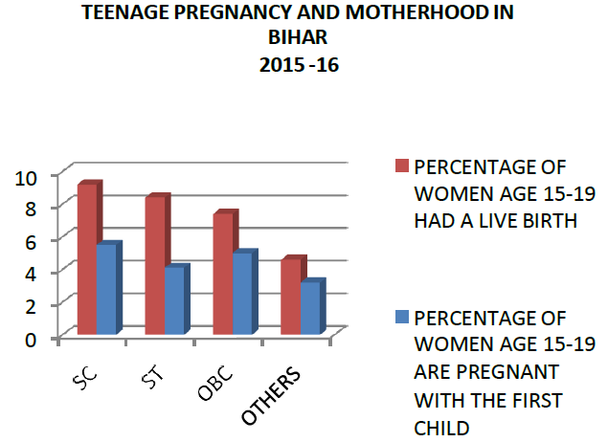
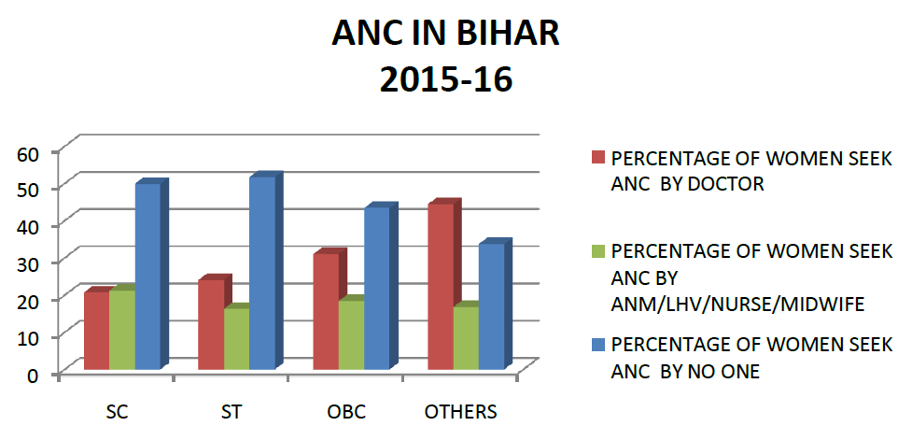

Slide 7
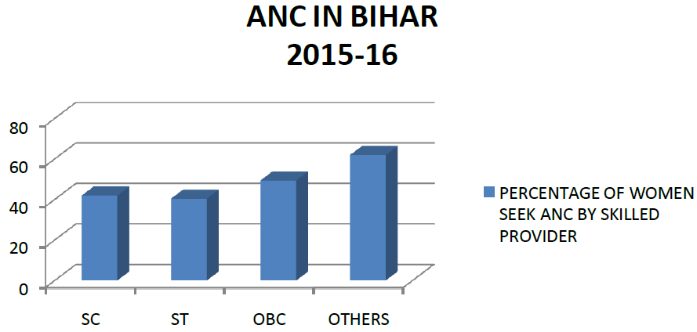
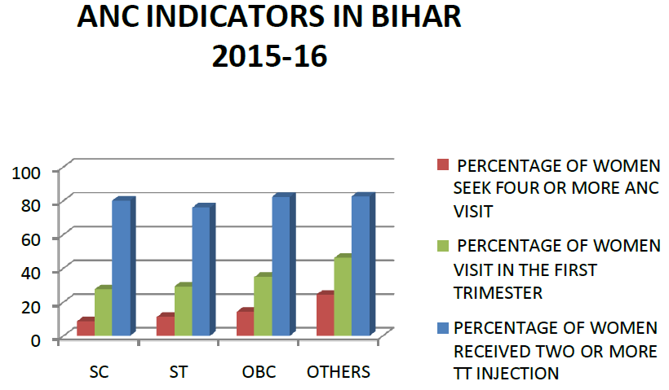

Slide 8
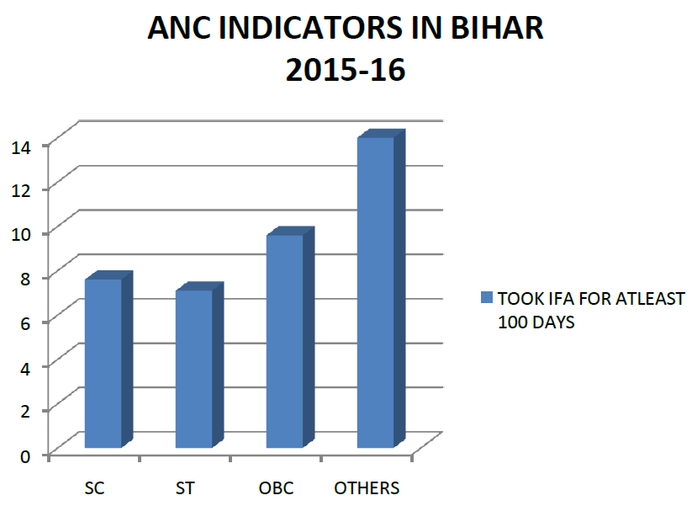
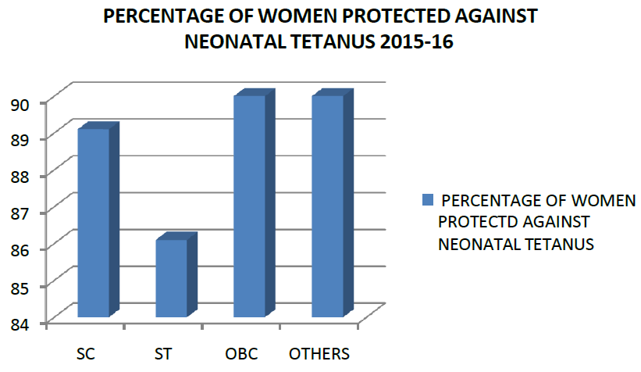

Slide 9
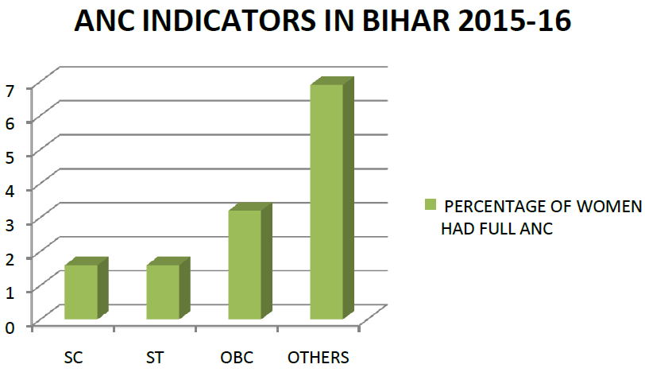
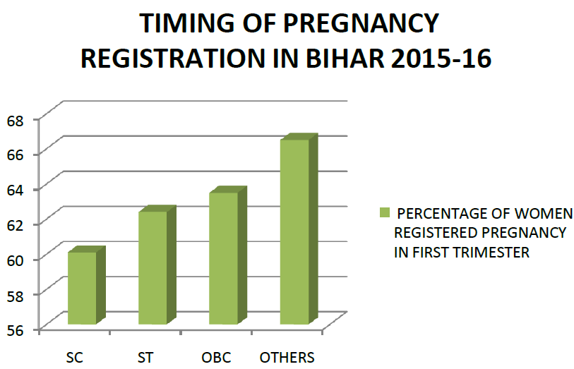

Slide 10
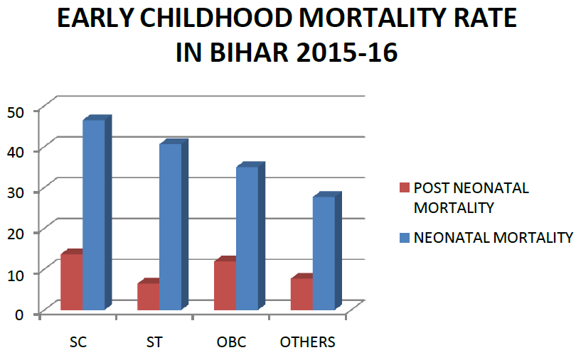
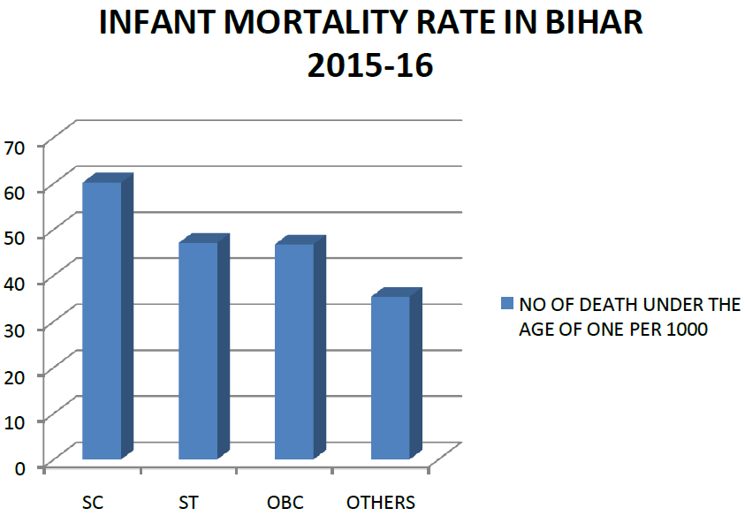

Slide 11
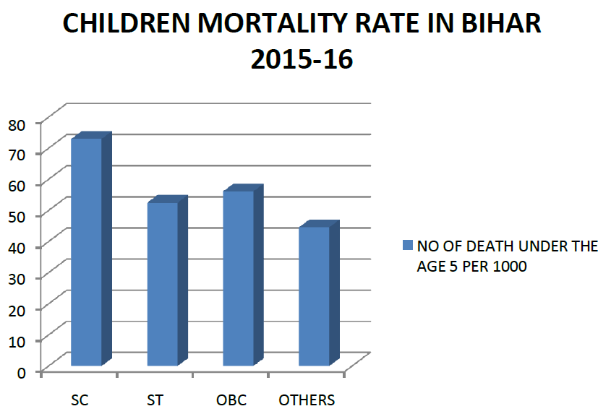

Slide 12
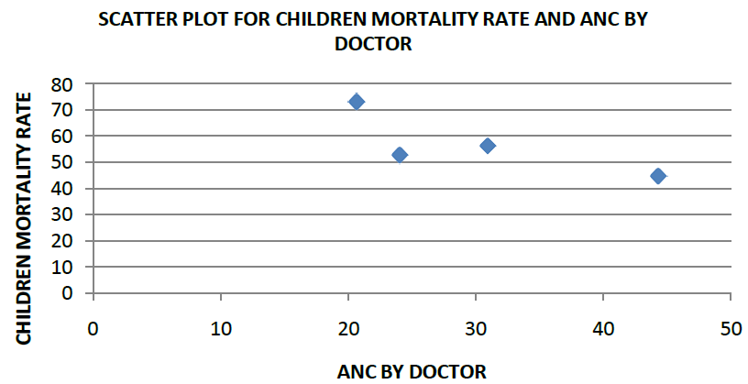
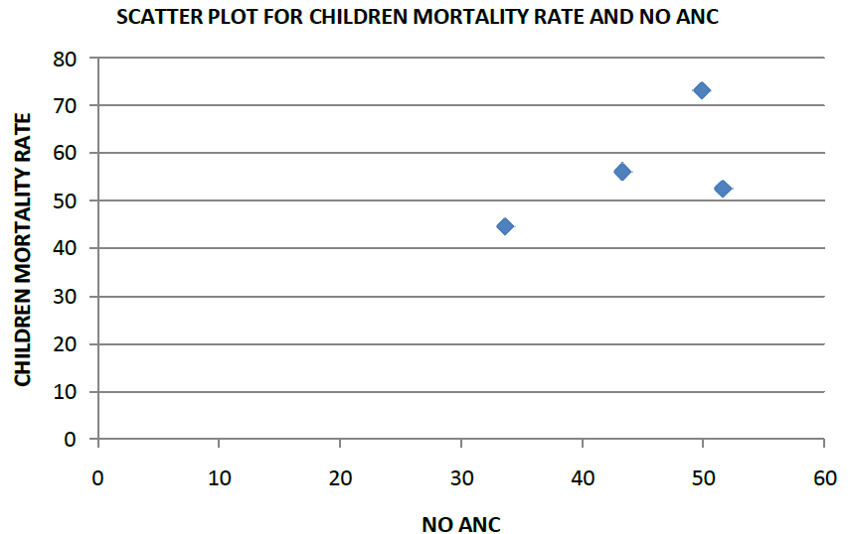
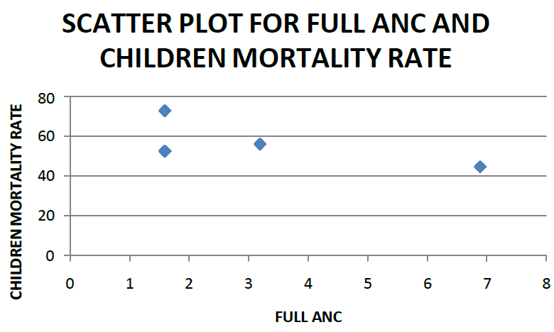
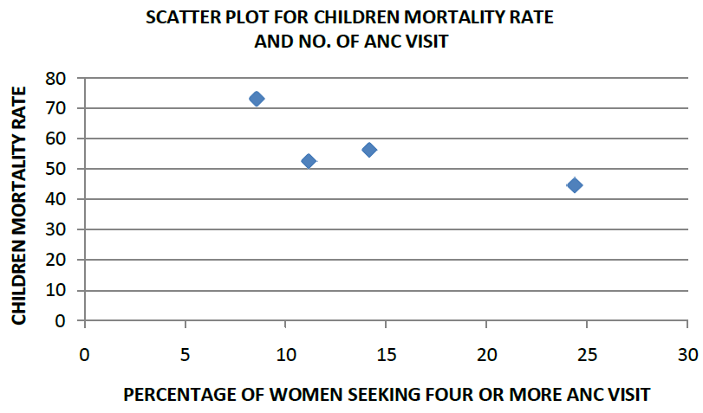

Slide 13
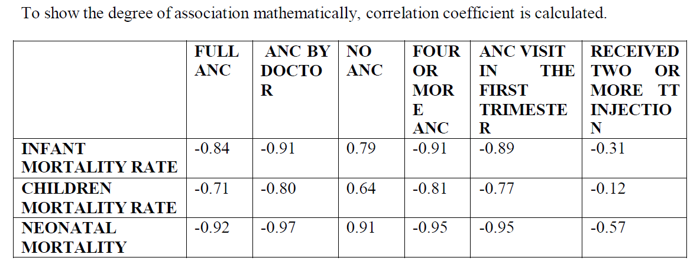
1. There exists the very high negative correlation between the full ANC, ANC by doctor, four or more ANC, ANC visit in the first trimester and the mortality rate.
2. There exist the poor negative correlation between the women received two or more TT injection and mortality rate.
3. There exist the moderate correlation between the women received two or more TT injection and neonatal mortality rate.
4. There exist the very high positive correlation between the no ANC and neonatal and infant mortality rate.
5. There exists the moderate positive correlation between the no ANC and children mortality rate.

Slide 14
conclusion
ANC services are not available to all women in the same way.
It result in differentials mortality rate among children
Intersectionality framework must be utilized in policy formulation.
Special consideration must be given to marginalized women among women

