Slide 1
Tele-Health Triumph: A Public Health Perspective
Department of Pharmaceutics, PES Modern College of Pharmacy, Moshi (for Ladies), Pin code- 412105, Pune, India. Savitribai Phule Pune University, Maharashtra.
Presented by ,
Ms. Vaishnavi E. Bhosale
M pharmaceutics,
Second Year.

Slide 2
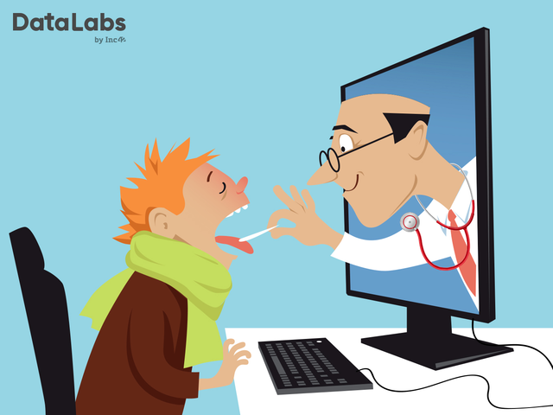
WHAT IS TELEMEDICINE?
"Tele" is a Greek word meaning
“distance”, and “mederi” is a
Latin word meaning “to heal”.
It is often used as the umbrella
term to encompass healthcare
delivery in addition to other
activities such as education,
research, health surveillance,
and public health promotion.

Slide 3
WHEN DID TELEMEDICINE START?
Healthcare has always been in high demand, from house calls to on-demand urgent care centers. Nobody plans ahead for strep throat or a twisted ankle, after all. Patients in the present day need round-the-clock access to their doctors, and doctors can now profit from providing remote care through telemedicine. Creating an online connection between patients and doctors may encourage patients to take a more active role in monitoring and recording their medical care, which could lead to better health outcomes. The diagnosis and treatment of illness constitute health care. The process of diagnosing a disease consists of two main steps: gathering patient history and current medical records, then analyzing the data to determine the illness's underlying cause.

Slide 4
HISTORY OF TELEMEDICINE IN INDIA
Several telemedicine initiatives in India have gained significant success, and a few noteworthy examples include:
(1) The initiation of mammography services by Sri Ganga Ram Hospital in Delhi,
(2) The implementation of tele-oncology services at the Regional Cancer Centre in Trivandrum,
(3) The provision of surgical services at the Sanjay Gandhi Postgraduate Institute of Medical Sciences in Lucknow.

Slide 5
ELEMENTS FOR TELEMEDICINE IN INDIA
Context
RMP and patient identification
Mode of Communication
Consent
Kind of advice
Patient assessment
Handling patients

Slide 6
ADVANTAGES OF TELEMEDICINE
1. Addressing Resource Deficiency
3. Enhancing Access to Super Specialty Care
4. Contributing to Universal Health Coverage (UHC)
5. Eliminating In-Person Visits
6. Reducing Travel-Related Burdens
2. Mitigating Urban Concentration

Slide 7
BARRIERS TO TELEMEDICINE
Infrastructure Deficiency as a Primary Barrier
Rural Areas' Digitalization Gap
Internet Penetration Challenges
Broadband Infrastructure Deficiency
Limitations in Diagnosis and Treatment
Challenges of Remote Consultations
Training Healthcare Personnel

Slide 8
APPLICATION OF TELEMEDICINE
APPLICATION OF TELEMEDICINE
Remote Consultations
Telemonitoring of Patients
Diagnostic Imaging and Test Interpretation
Specialist Consultations
Prescription and Medication Management
Follow-up Care
Mental Health Support
Chronic Disease Management
Health Education and Promotion
Emergency Medical Consultations

