Slide 1
DEVELOPMENT OF A PROGRAM USING ARTIFICIAL INTELLIGENCE IN ENGLISH LANGUAGE LEARNING FOR THE STUDENTS OF SECONDARY LEVEL AND TO TEST ITS EFFECTIVENESS.
Dr. RAJSHREE RATHOD
ASSOCIATE PROFESSIOR
TILAK COLLEGE OF EDUCATION,
PUNE,MAHARASHTRA,INDIA

Slide 2
Introduction
Artificial intelligence is an emerging field in educational teaching.
AI is transforming various industries and education is no exception for that.
with the help of artificial intelligence English language learning become more personalised, efficient, and engaging.
AI technologies are profoundly transforming traditional learning paradigms across various educational levels and disciplines.

Slide 3
Theoretical Background Of The Research
Behaviorism: Behaviorism posits that learning is a result of conditioned responses to stimuli. In AI-based learning, this theory can be applied through adaptive reinforcement of correct responses and gradual shaping of behavior through repeated practice and feedback.
Cognitivism: Cognitivism emphasizes the role of mental processes, such as memory, attention, and problem-solving, in learning. AI can be used to create cognitive models that adapt content delivery based on learners' cognitive states, ensuring that lessons align with their mental capacities.
Constructivism: Constructivism suggests that learners actively build knowledge through experiences and interactions. AI-based programs can facilitate constructivist learning by providing opportunities for exploration, problem-solving, and collaboration.

Slide 4
Theoretical Background Of The Research
Zone of Proximal Development (ZPD):
ZPD, proposed by Vygotsky, focuses on the difference between what a learner can do independently and with support. AI can provide scaffolded support, offering hints, guidance, and adaptive challenges to help learners progress within their ZPD.
Experiential Learning: Experiential learning theory posits that learning is most effective when tied to direct experience. AI-based simulations and virtual reality can provide experiential learning environments for hands-on practice.
Bloom's Taxonomy: Bloom's taxonomy categorizes learning objectives into cognitive domains, from knowledge recall to complex problem-solving. AI can support learners in progressing through these levels by providing appropriate challenges and activities.
Multiple Intelligences: Multiple intelligences theory suggests that learners have diverse strengths and preferences. AI can offer a range of learning modalities, such as visual, auditory, and kinesthetic, to accommodate different intelligences.

Slide 5
Enhanced Language Skills
Flexibility and Convenience
Language Immersion
5
Improved Engagement
4
6
Increased learner
engagement
3
Need And Importance Of The Study
7
Adaptive
Learning
Greater capacity
for learning
2
8
Greater knowledge
transfer, Improved
attitude towards
learning
Personalized Learning
1
9

Slide 6
Research Questions
What difficulties did the teachers face in teaching English language to Secondary school students? (obj. no. 1)
What teaching methods did teachers use other than traditional methods to teach English subject to Secondary school students? (objective no. 1)
What kind of a program can be prepared by using new methods and implement them in the class for teaching English in secondary school students? (Objective no. 2)
How does the developed program help students to learn and retain the concepts effectively? (Objective no. 3)
1
2
3
4

Slide 7
Objectives of the Study:
To find out the existing teaching methods and difficulties faced by the English teacher for teaching English subject for secondary school students.
To develop Elevate English-AI- Powered learning programme for secondary school students for English subject and to test its effectiveness.
To find out the retention of developed program.
To know the opinion of participant students about the developed programme

Slide 8
Hypothesis
Research Hypothesis
Developed programme is effective for Secondary school students in English subject.
The pretest and post test scores of two groups differ after the implementation of programme.

Slide 9
Null hypothesis:
Following Null Hypothesis were stated for the study:
Ho₁: There is no significant difference between the mean scores of experimental and control group on the post test.
Ho₂: There is no significant difference between the mean scores of experimental and control group on the Retention Test.

Slide 10
Scope, Limitations and Delimitations
Scope
The results is applicable to the secondary school students for learning the English subject.
A program for secondary school students enhances their understanding of the new concepts of English subject.
Limitations:
There is no control on attitude, readiness, age, attention, interest and motivation of the students.
Conclusions of the study depends on responses given by the participants to the programme and achievement test.
The validity of the program developed by the researcher is determined from the inputs given by the selected experts.

Slide 11
Population and Sample
All the secondary schools affiliated to SSC Board in Pune city.
90 secondary school students

Slide 12
Research Method
Multi Method Research:-
Objective-2
Product Development Method
Objective -1
Objective -2
Survey Method
Experimental Method
02
01
03

Slide 13
Research Method
Research at a Glance
Mixed method procedure for survey and Experiment (QUAN+ QUAL)
Multi method Research
Applied Research

Slide 14
Research Design
Two group pre-test-post-test design
Where,
01-Pretest
X- Experimental Group
C- Control Group
02- Post-test
03- Retention test
01 | X | 02 | 03
01 | C | 02 | 03

Slide 15
Variables
Independent Variable
AI Programme prepared by the Researcher
Dependent Variable
Scores of achievement test and Retention test.
Extraneous Variables
Age
Test
Content
Test Administrator
Gender

Slide 16
Tools for Data Collection
Feedback Sheet
Retention Test of 50 Marks
Post Test of 50 marks
Pre Test of 50 marks
Survey Questionnaire

Slide 17
Statistical Tools
Experiment
Test
Feedback sheet students
t-test
Percentage
Qualitative analysis

Slide 18
Procedure of the Research
Review of Related Literature
Conducted the Survey
Validation & Finalisation of the Questionnaire
Developed the Pertest
Developed the Programme
Analysis of the Pertest
Conducted the Pretest
Developed the Survey Questionnaire
Analysis of the Survey
Validation of Pretest
Validation & Finalisation Programme
Implementated of the Programme
Conducted the Post Test
Conducted the Retention Test
Data Analysis
Major Findings & Conclusion
Groups were equated

Slide 19
Elevate English-AI- Powered learning programme for secondary school students
Conversation
Quizzes
correct mistakes
Beautify/ Simplify the text
Learn New concepts
Vocabulary
Advise and tips
Creat a list
Translation
Pronunciation.

Slide 20
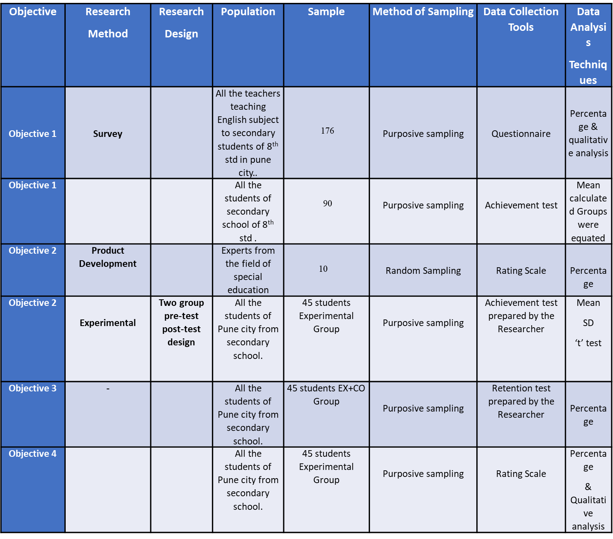
OBJECTIVEWISE RESEARCH METHODOLOGY

Slide 21
Objective wise Conclusions:
Traditional methods are mostly used in Secondary schools for teaching English.
AI- Powered learning programme for secondary school students is effective for learning and retention.
.
The students had a positive opinion regarding the AI programme.
Elevate English-AI- Powered learning programme for secondary school students is very useful for learning English subject.
01
02
03
04

Slide 22
Main conclusion
Elevate English-AI- Powered learning programme for secondary school students enhances learning and retention for secondary school students.

Slide 23
Contribution of the Study to the field of education:
This research has made a significant contribution to: -
The study has contributed for the teachers of Secondary school in terms of teaching methodology to the secondary students.
The study will help the secondary teachers in implementing the new paradigms of English teaching.
The product in this study will be useful for the teachers to plan their teaching Scientifically and Systematically during the English language teaching.
This research will defiantly enhance the secondary students’ achievement in English language learning.
The product developed in this study will be useful for Secondary school students from special, integrated, or inclusive schools and different boards schools.
The Product may be useful for teachers while teaching other subjects at different levels and special students also.

Slide 24
Suggestions and Recommendations for Further Research
Similar studies can be done on different School subjects.
Further researches can be focus on training teachers and students for using different AI tools for effective teaching learning.
Further researchers can undertake where complete syllabus may be developed using AI Powered tools and published in the Form of book.
Further Researches can be done to different level Students.
Such kind of programme can be prepared for other level students with suitable modifications and More activity based, effective programmes can be developed for lower classes of Schools.

Slide 25
Suggestions and Recommendations for Further Research
Suggestions for Further Research:
05
06
Comparative Studies can be undertaken
04
with suitable modification
Other Level Students
03
01
02
Complete syllabus may be developed
Different School subjects
Technology for effective teaching learning.

Slide 26
ChatGPT is pretty smart but it's still new and a work in progress so it could still make errors. Use it like a helpful tool or assistant not as an authority figure or a master.

Slide 27
References .
Ausubel: (2015) Meaningful Learning Theory, Subsumption Theory & Motivational Theory. (n.d.).Retrieved from http://www.cimtprelims.wikia.com/wiki/Ausubel:_Meaningful_Learning_Theory,_Subsumpsion_Theory,_%26_Motivational_Theory
Best, J.W., & Kahn, J. V. (2005). Research in Education (9th ed.). New Delhi: Prentice Hall of India Private Limited.
Best, J. W., & Kahn, J. V. (2009). Research in Education. (10th ed.). New Delhi: Prentice Hall of India Pvt. Ltd.
Creswell, J. W. (2012). Educational Research. (4th ed.). New Delhi: Prentice Hall of India Pvt. Ltd.
Creswell, J. W. (2014). Research Design – Qualitative, Quantitative and Mixed Method Approaches. (4th ed.). Thousand Oaks: California. SAGE Publications.

Slide 28
Garrett, H .E., & Woodworth, R. S. (1991). Statistics in Psychology and Education. Bombay: Vakils, Feffer and Simsons Limite
Kaul.L.(2011), Methodology of Educational Research. (4th ed.). Noida: Vikas Publishing House.
Pandya, S. (2010). Educational Research, APH Publishing Corporation, New Delhi.
Sanshodhan Margdarshan Maalika. Pushp pandharave Sadhan Nirmiti Sanshodhan. (2006). YCMOU, Nasik, p 20, 21

Slide 29
Websites: -
https://scholar.google.co.in/scholar?q=Artificial+intelligence+in+language+learning&hl=en&as_sdt=0&as_vis=1&oi=scholart
https://www.edtechreview.in/elearning/five-ai-powered-tools-that-can-help-you-with-language-learning/
https://www.analyticssteps.com/blogs/5-advantages-using-ai-language-learning
https://www.sciencedirect.com/science/article/pii/S1877050920320512
https://www.frontiersin.org/research-topics/34437/using-artificial-intelligence-technology-for-language-learning
https://www.researchgate.net/publication/342050108_Artificial_Intelligence_AI_A_Review_of_its_Uses_in_Language_Teaching_and_Learning

