Slide 1
The Significance of Applying the Kaizen Principle to Language Learning
U. PUSHPALATHA
Assistant Professor of English
KCG College of Technology, Chennai
Tamilnadu, India

Slide 2

What is Kaizen Principle?

Slide 3
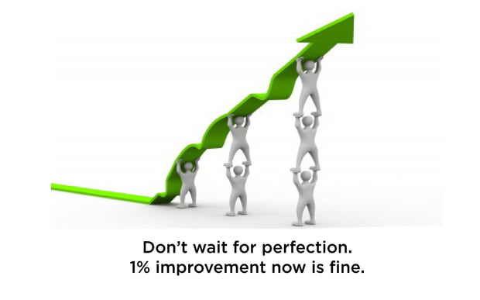
Continuous Improvement

Slide 4
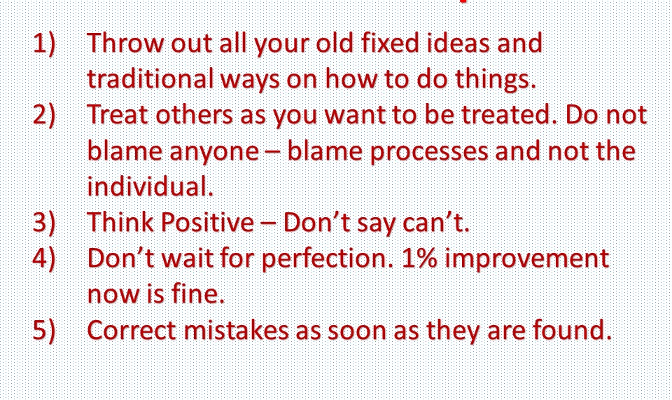
Some Kaizen Principles

Slide 5
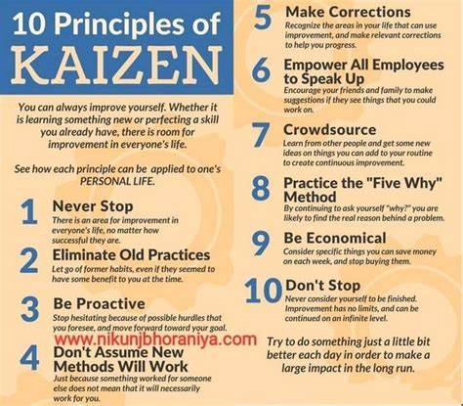

Slide 6
In progress and Benefits of Kaizen
New ideas
Gamification
Set realistic goals
Flexible, Simple pedagogy

Slide 7

New ideas

Slide 8
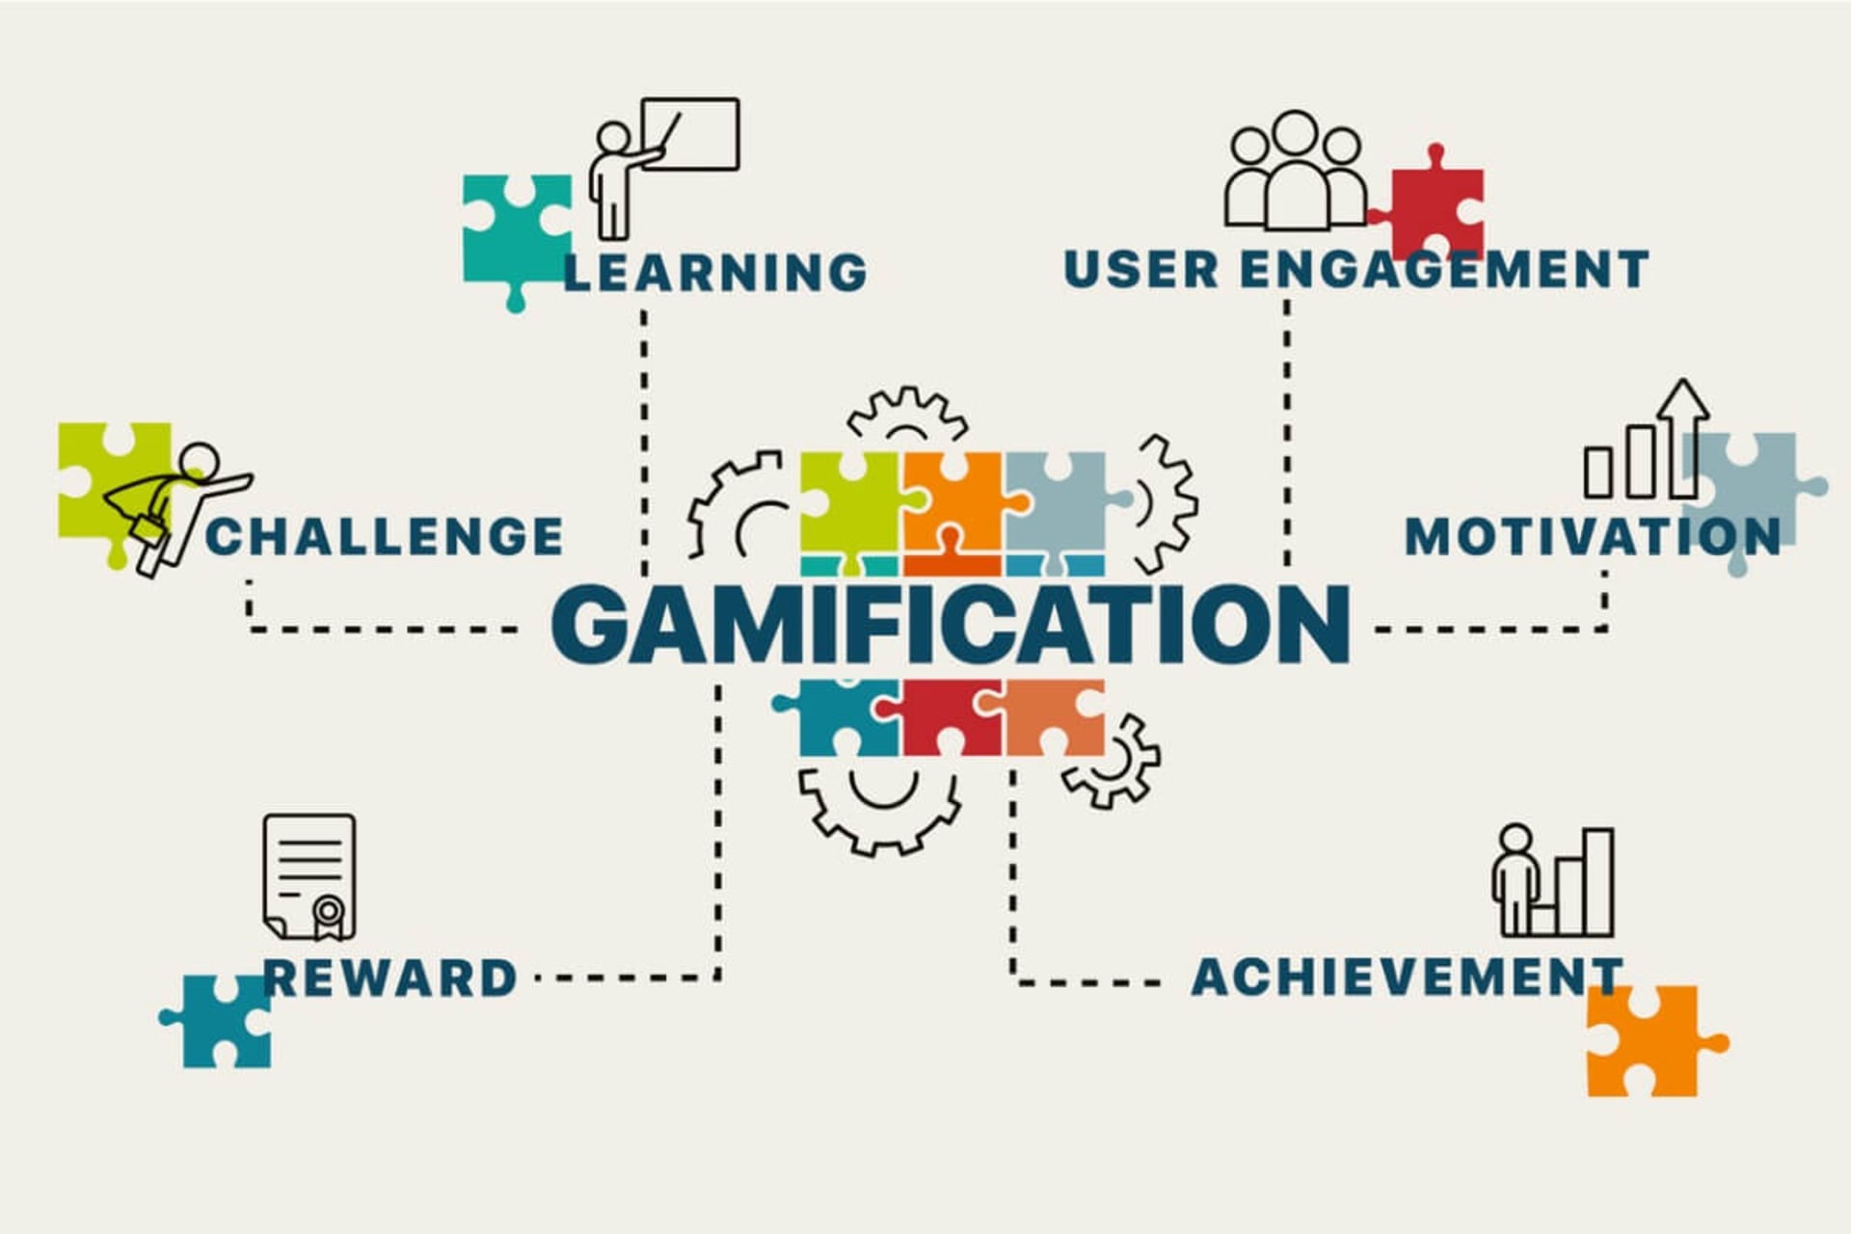
Gamification

Slide 9

Set realistic goals

Slide 10


