Slide 1
EFFECT OF DUST ON THE PERFORMANCE OF PV PANEL AND PROPOSING EFFECTIVE CLEANING TECHNIQUES
BY
UTHMAN MUHAMMAD IBRAHIM
SUPERVISED BY: Dr. SADIK UMAR

Slide 2
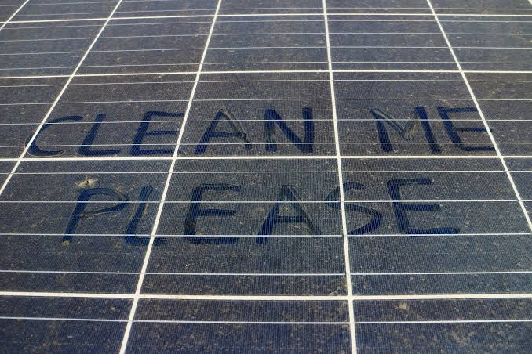
Introoduction
Dust is a major ecological factor that must be considered during the development of materials for the production of PV modules which has a massive effect on solar cell performance, (Bagnold et al, 2012) Due to air pollution, the energy production of solar modules might be reduced by more than 60, (Asl-Soleimani et al,2001) The effect of dust particles on the solar panels also depends upon the local areas where the panels are installed. (Kaldellis et al, 2011), but the performance of PV panels can be recovered by adopting various types of cleaning techniques, (Sayyah et al, 2014). The effect of dust on the performance of PV cells mainly depends on the material used for their construction and the environmental factors in which these PV cells are to be used.

Slide 3
Statement of Problems
Aim and Objectives
Significant of this Study

Slide 4
CAUSES OF DUST ACCUMULATION
The energy production of PV panels is profoundly affected by several factors, such as the wind speed and direction, shading, temperature, cleanliness, air pollution, etc.. A slight change in the climatic conditions affects the solar irradiance as well as the ambient temperature, thus, leading to differences in the output energy obtained from the PV panels. The dust, which can be measured in micron layers, can accumulate over a certain period on the PV panels based on the environment, dust type, location, and installation of the solar plant.

Slide 5
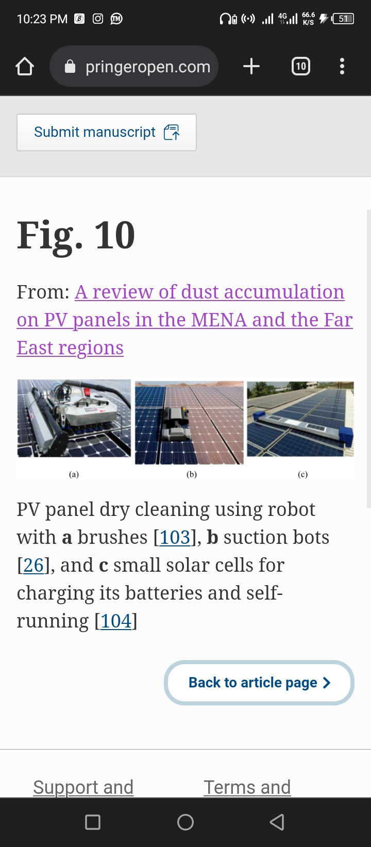
MECHANICAL CLEANING
Most of the mechanical cleaning systems use wipers and brushes. They move either vertically or horizontally, based on the dirt location. The mechanical cleaning systems can be activated either manually or automatically

Slide 6
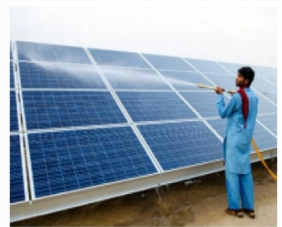
MANUAL CLEANING OF PV PANELS
Manual cleaning is accustomed mostly to water cleaning techniques by labor. The cleaning techniques are chosen according to the location of the plant and the availability of water resources. This method uses manpower in order to remove bird wastes, and cemented dust from the surface of the PV panel

Slide 7
CONCLUSION
It is evident with succinct literature survey that the performance of PV modules is truly inﬂuenced by the aggregation of dust particles on their surfaces. The effect of accumulated dust particles on the PV panels depend upon the geographical conditions in which PV panels are to be worked out. Moreover, it is observed that the efficiency of uncleaned panels may reduce up to 70%, if modern technology like artiﬁcial intelligence is not adopted for their cleaning purposes. The life and the output performance of the PV modules can only be increased by adopting the proper policy of the cleaning process. The cleaning frequency should be adopted after every three weeks, if the modules are working in the dusty areas.

Slide 8
THANK YOU

