Slide 1
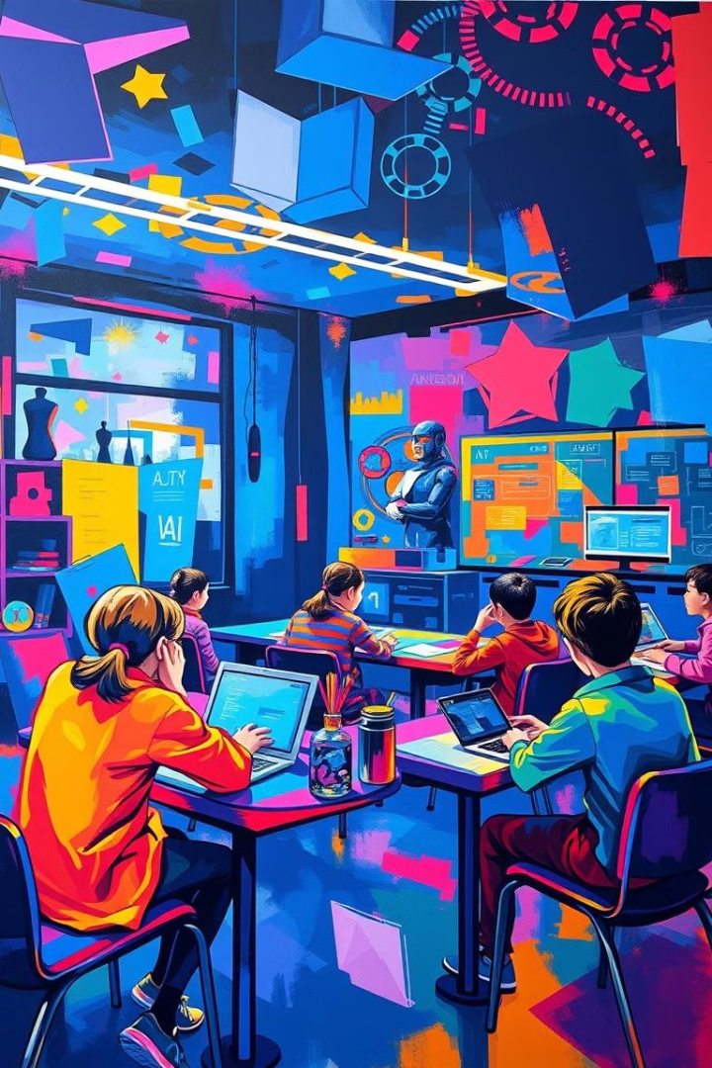

Innovative AI Pedagogies: Measuring Their Impact on Student Engagement and Achievement in Mauritius
This presentation explores the impact of innovative AI-powered teaching methods on student engagement and academic performance in Mauritius.
by Chitisha Gunnoo

Slide 2
Introduction: The Importance of Innovative Teaching Methods in the Digital Age
Evolving Learning Landscape
Addressing Educational Challenges
The digital age has transformed the way we learn and teach. Innovative technologies, including AI, offer new possibilities for personalized learning experiences.
Innovative teaching methods are critical for addressing educational challenges, such as limited resources, diverse learning needs, and evolving skill requirements.

Slide 3
Diverse AI Applications
Lack of Standardized Metrics
Introduction of AI in Education
Research Gap
The Problem

Slide 4
Central Research Questions:
How do innovative AI pedagogies affect student engagement in different learning contexts?
What measurable impacts do these approaches have on student achievement?
How do students perceive the integration of AI in their learning processes, and what factors influence engagement and achievement?

Slide 5
Importance of Addressing These Questions:
Critical for educators, policymakers, and technology developers.
Informs decisions about implementation and scaling of AI technologies in education.
Aims to enhance the quality of education and improve student outcomes.

Slide 6

Literature Review: Existing Research on AI-Powered Learning Approaches
Personalized Learning
Automated Assessment
AI algorithms can tailor learning experiences to individual student needs, providing personalized feedback and adaptive learning paths.
AI-powered assessment tools can provide real-time feedback, identify learning gaps, and reduce the workload of teachers.
Adaptive Learning Systems
Adaptive learning systems adjust the difficulty level and content based on student performance, fostering deeper engagement and mastery.

Slide 7

Research Methodology: Experimental Design and Data Collection Strategies
1
Design: Randomized controlled trial comparing traditional and AI-enhanced classrooms.
2
Data Collection: Pre- and post-tests, student surveys, teacher interviews, classroom observations.
3
Data Analysis: Statistical analysis to identify significant differences in student engagement and academic performance.

Slide 8
Findings: Measuring the Impact on Student Engagement and Academic Performance
15%
10%
Engagement
Performance
Students in AI-enhanced classrooms showed a 15% increase in engagement, as measured by participation and attendance.
Students in AI-enhanced classrooms achieved a 10% improvement in academic performance, reflected in test scores and grades.

Slide 9

Challenges and Limitations: Addressing Barriers to Effective Implementation
Accessibility
Teacher Training
Data Privacy
Ensuring equitable access to AI-powered learning technologies for all students, regardless of socioeconomic background.
Providing teachers with adequate training and support to effectively integrate AI tools into their teaching practices.
Protecting student data privacy and ensuring responsible use of AI-collected information.

Slide 10




Implications for Educators and Policymakers in Mauritius
Personalized Learning
AI can personalize learning experiences, addressing individual student needs and accelerating progress.
Teacher Empowerment
AI can free up teachers from administrative tasks, allowing them to focus on personalized instruction and student support.
Data-Driven Decisions
AI can provide data-driven insights to guide instructional decisions and inform educational policy.

Slide 11
Recommendations for Future Research and Scalable Deployment
Longitudinal Studies
1
Conduct longitudinal studies to assess the long-term impact of AI on student outcomes.
Teacher Feedback
2
Gather comprehensive feedback from teachers on the effectiveness and challenges of AI-powered tools.
Public-Private Partnerships
3
Foster collaboration between the government, private sector, and research institutions to promote AI in education.

