Slide 1


TO DEVELOP THE NOBEL PRIZE “FOR THE DEVELOPMENT OF LITHIUM-ION BATTERIES” THEORY BY HARDWARE DESCRIPTION LANGUAGE & VERIFY BY TEST BENCH PROGRAMMING FOR DESCRIBE CHARACTERISTICS
BY
ER. SATYENDRA PRASAD RAJGOND
director.gitarc.tarc@gmail.com
DIRECTOR_TECHNOLOGY & RESEARCH CENTRE
GONDWANA INTERNATIONAL TECHNOLOGY & RESEARCH CENTRE (GITARC) BHATPAR RANI, [INDIA]
INTERNATIONAL PRINCIPAL AUTHOR (Author ID: Sci50161223)
IETE NATIONAL INDIA , INDIA REPRESENTATOR, NCC-IP AICTE GOVERNMENT OF INDIA, INTERNATIONAL VERILOG DEVELOPER, INTERNATIONAL TECHNOLOGY DEVELOPER, INTERNATIONAL MATHWORK DEVELOPER ,INTERNATIONAL THESIS DEVELOPER, THE NOBEL PRIZE THEORY DEVELOPER, INTERNATIONAL TEXAS INSTRUMENTS DEVELOPER (USA),INTERNATIONAL TELECOMMUNICATION UNION (GENEWA), IEEE INTERNATIONAL (U.S.A.) , S.A.E. INTERNATIONAL (U.S.A.), GUINNESS WORLD RECORD LONDON, GOLD MEDALIST, INTERNATIONAL AWARD WINNER, INTERNATIONAL BRAND AMBASSADOR
8th CAPCDR International Conference on " Artificial Intelligence and Technology in Academia and Profession", December 25-26, 2024.
GITARC
BHATPAR RANI
INDIA
T & R

Slide 2
OUTLINE
INTRODUCTION
LITERATURE REVIEW
RESEARCH GAPS
MATHEMATICAL MODEL
METHODOLOGY
SOFTWARE IMPLIMENTATION
RESULTS
DISCUSSION
CONCLUSION
REFERENCES

Slide 3
INTRODUCTION
Electrical characteristics of lithium-ion batteries
Lithium-ion batteries are widely recognized for their high energy density, long cycle life, and reliability, making them the preferred choice for various applications from consumer electronics to electric vehicles.
A fundamental understanding of their electrical characteristics is essential for optimizing performance, ensuring safety, and enhancing overall battery design.
Lithium-ion batteries operate within a specific voltage range that is crucial for their performance and longevity. Typically, a fully charged lithium-ion cell has a voltage of approximately 4.2 volts, while it discharges to a lower limit, usually around 3.0 volts.
The nominal voltage of a lithium-ion cell is often cited as 3.7 volts. Accurate voltage regulation is vital to prevent overcharging or deep discharging, both of which can lead to reduced battery life or safety hazards.
Current handling capabilities of lithium-ion batteries are determined by their internal design and chemistry. Key parameters include the maximum charge and discharge currents, which influence the battery's power output and charging speed.
High discharge currents are necessary for applications requiring rapid power delivery, such as in electric vehicles, while high charge currents facilitate faster recharging. The internal resistance of the battery, which affects its ability to deliver current efficiently, also plays a crucial role in determining its overall performance.

Slide 4
Internal resistance is a critical factor affecting the efficiency and thermal management of lithium-ion batteries. This resistance causes voltage drops during discharge and generates heat during both charging and discharging processes. The internal resistance is influenced by factors such as the battery’s age, temperature, and state of charge.
A lower internal resistance is desirable for higher efficiency and better thermal management. The capacity of a lithium-ion battery, expressed in ampere-hours (Ah), reflects the amount of charge it can store and deliver. Energy density, measured in watt-hours per kilogram (Wh/kg), indicates how much energy the battery can store relative to its weight.
These characteristics are crucial for applications where space and weight are limited, such as in portable electronics and electric vehicles. The State of Charge (SOC) represents the current charge level relative to the battery's total capacity, usually expressed as a percentage.
SOC estimation is vital for accurate battery management and ensuring optimal performance. The State of Health (SOH) provides information about the battery’s overall condition and its ability to hold charge compared to when it was new. SOH degradation over time is a key factor in assessing battery longevity and planning for replacements.

Slide 5
Thermal characteristics of lithium-ion batteries
Lithium-ion batteries are integral to modern technology, from portable electronics to electric vehicles. Their performance, safety, and longevity are significantly influenced by their thermal characteristics, which encompass how heat is generated, managed, and dissipated during operation.
Lithium-ion batteries generate heat as a byproduct of both charging and discharging processes. This heat is produced due to several factors, including internal resistance (I²R losses), electrochemical reactions, and inefficiencies in energy conversion.
Excessive heat can adversely affect the battery's performance, potentially leading to thermal runaway, a dangerous condition where escalating temperatures cause uncontrolled reactions. Operating temperature ranges for lithium-ion batteries are critical for maintaining optimal performance and longevity.
Typically, these batteries operate best within a temperature range of 20°C to 25°C (68°F to 77°F). Temperatures that deviate significantly from this range can affect battery efficiency and lifespan. High temperatures can accelerate degradation and increase the risk of thermal runaway, while low temperatures can reduce capacity and increase internal resistance.
Effective thermal management is essential for ensuring the safety and reliability of lithium-ion batteries. Advanced thermal management systems are designed to control and regulate the battery’s temperature through various methods, including passive and active cooling techniques.

Slide 6
These systems might incorporate heat sinks, thermal interface materials, and liquid or air cooling solutions to dissipate heat efficiently and maintain the battery within its optimal operating temperature range. Thermal runaway is a critical safety concern associated with lithium-ion batteries.
It occurs when a battery's temperature increases rapidly due to an exothermic reaction within the cell, leading to a self-sustaining cycle of heat generation.
This phenomenon can result from overcharging, internal short circuits, or physical damage. Implementing robust thermal management and protection systems is crucial to prevent thermal runaway and ensure battery safety. The thermal environment significantly impacts the battery's lifespan.
Prolonged exposure to high temperatures accelerates chemical degradation within the battery, leading to capacity loss and increased internal resistance.
Conversely, operating in excessively cold conditions can cause sluggish performance and reduced charge acceptance. Proper thermal management helps mitigate these effects, prolonging battery life and maintaining performance over time.
Understanding and optimizing thermal characteristics often involve modeling and simulation to predict how heat will be distributed and managed within a battery pack. These models can help design better cooling strategies, assess potential risks, and optimize battery performance under various operating conditions.

Slide 7
Chemical characteristics of lithium-ion batteries
Lithium-ion batteries are renowned for their high energy density and long cycle life, which are deeply influenced by their chemical characteristics.
Understanding these chemical properties is essential for optimizing battery performance, ensuring safety, and advancing battery technology.
The electrolyte in a lithium-ion battery is a key chemical component, typically composed of lithium salts dissolved in organic solvents. Common lithium salts include lithium hexafluorophosphate (LiPF₆) and lithium bis(trifluoromethanesulfonyl)imide (LiTFSI).
The choice of electrolyte impacts ionic conductivity, battery stability, and overall performance. High ionic conductivity is essential for efficient charge and discharge cycles, while stability ensures safe operation under various conditions.
Lithium-ion batteries consist of two primary electrodes: the anode and the cathode. The chemical composition of these electrodes significantly affects battery performance to common anode materials include graphite and lithium titanate.
Graphite is favored for its high capacity and stability, while lithium titanate offers improved safety and longevity but lower capacity. The anode's ability to intercalate and de-intercalate lithium ions efficiently is crucial for battery performance.
Cathode materials include lithium cobalt oxide (LiCoO₂), lithium iron phosphate (LiFePO₄), and lithium nickel manganese cobalt oxide (NMC). Each material offers different advantages in terms of capacity, stability, and thermal performance.

Slide 8
Lithium iron phosphate provides excellent thermal stability and safety, whereas lithium cobalt oxide delivers high energy density. The operation of lithium-ion batteries relies on electrochemical reactions occurring at the anode and cathode.
During discharge, lithium ions move from the anode to the cathode through the electrolyte, generating electrical energy. Conversely, during charging, lithium ions migrate from the cathode back to the anode. These reactions involve the transfer of electrons and ions, which is central to the battery’s ability to store and release energy.
Chemical stability is crucial for the safety and longevity of lithium-ion batteries. The electrolyte and electrode materials must resist decomposition under operating conditions to prevent performance degradation and safety hazards.
Decomposition of the electrolyte can lead to gas generation, increased internal pressure, and potential thermal runaway. Advanced materials and additives are used to enhance stability and mitigate these risks. The chemical reactions within the battery also impact its cycle life, which is the number of charge and discharge cycles the battery can undergo before its capacity significantly deteriorates.
Factors such as the formation of solid electrolyte interphase (SEI) layers on the anode, changes in electrode material structure, and electrolyte degradation contribute to capacity loss over time. Understanding these chemical processes is essential for developing strategies to extend battery life.
The chemical characteristics of lithium-ion batteries also influence their environmental impact and recycling processes. Proper disposal and recycling are critical to managing the environmental footprint of used batteries.
Research into more sustainable materials and recycling technologies is ongoing to reduce the impact of battery production and disposal.

Slide 9
Electrochemical processes
The electrochemical processes in lithium-ion batteries are fundamental to their operation, performance, and efficiency. These processes involve complex interactions between the battery's chemical components and play a crucial role in energy storage and release.
Understanding these processes is essential for optimizing battery design, enhancing performance, and ensuring safety. Lithium-ion batteries operate based on reversible electrochemical reactions that occur at the anode and cathode during charge and discharge cycles to during discharge, lithium ions (Li⁺) move from the anode to the cathode through the electrolyte.
This movement is accompanied by the flow of electrons through an external circuit, generating electrical energy. At the cathode, lithium ions intercalate into the cathode material, releasing energy.
During charging, an external power source applies a voltage to the battery, driving lithium ions from the cathode back to the anode. Electrons flow in the opposite direction through the external circuit, storing energy in the battery.
The anode material intercalates the lithium ions during this process. The efficiency of the electrochemical processes depends on the reactions occurring at the electrodes at the anode, lithium ions are stored in a layered or particulate material, such as graphite or lithium titanate.
The anode material undergoes intercalation and de-intercalation of lithium ions, allowing for the absorption and release of ions during charging and discharging. At the cathode, lithium ions are inserted into or extracted from a transition metal oxide or phosphate.

Slide 10
The choice of cathode material affects the battery’s capacity, voltage, and overall performance. For example, lithium cobalt oxide provides high energy density, while lithium iron phosphate offers better thermal stability. During the initial charge cycles, a solid electrolyte interphase (SEI) layer forms on the anode surface.
This layer is crucial for protecting the anode material from electrolyte decomposition and maintaining the stability of the electrochemical reactions. The SEI layer impacts battery efficiency, cycle life, and performance. The electrolyte, which is typically a lithium salt dissolved in an organic solvent, facilitates the movement of lithium ions between the anode and cathode.
The ionic conductivity of the electrolyte is critical for efficient charge and discharge processes. The electrolyte must also remain stable and non-reactive under various operating conditions to ensure reliable battery performance. The rate of electrochemical reactions, or kinetics, affects the charging and discharging rates of the battery.
Fast kinetics enables high power delivery and rapid charging, while slow kinetics can limit the battery's performance. Factors influencing reaction kinetics include electrode material properties, electrolyte composition, and temperature. The capacity of a lithium-ion battery, or the amount of charge it can store, is directly related to the electrochemical processes occurring within it.
The efficiency of these processes, including energy conversion and storage, affects the overall performance of the battery. Factors such as electrode material capacity, reaction reversibility, and resistance impact the battery’s efficiency and usable energy.
Factors such as electrolyte breakdown, electrode material deterioration, and the growth of the SEI layer can reduce capacity and performance. Understanding these degradation mechanisms helps in developing batteries with longer lifespans and improved reliability.

Slide 11
Degradation effects over time
Lithium-ion batteries, despite their widespread use and numerous advantages, experience degradation over time, which can impact their performance, safety, and lifespan. Understanding the degradation effects is crucial for improving battery technology, extending battery life, and ensuring reliable operation in various applications.
One of the most significant degradation effects is the gradual loss of capacity. Capacity loss occurs due to several factors to continuous cycling leads to mechanical stress and changes in the structure of electrode materials. For example, the anode material can experience cracking or particle detachment, while the cathode may undergo phase transitions or structural changes that reduce its ability to intercalate lithium ions.
The SEI layer on the anode surface grows over time and can consume active lithium ions, reducing the battery’s capacity. This growth also affects the ionic conductivity of the electrolyte. As a battery ages, its internal resistance tends to increase.
This resistance, which includes both ohmic resistance (due to the battery's materials) and charge transfer resistance (due to electrochemical reactions), affects the battery’s efficiency and power delivery to degradation of the electrolyte and changes in electrode materials can impede the movement of lithium ions, increasing internal resistance and reducing the battery’s performance.
Increased resistance leads to higher heat generation during charge and discharge cycles, which can further exacerbate degradation and contribute to thermal management issues. Aging batteries often exhibit reduced charge and discharge rates.

Slide 12
This effect is primarily due to degraded electrode materials can lead to slower kinetics of electrochemical reactions, impacting the battery’s ability to deliver or accept charge quickly. Higher internal resistance reduces the efficiency of energy transfer, leading to slower charging and discharging processes.
Degradation can also cause a decrease in the voltage delivered by the battery. Factors contributing to voltage drop include to decomposition of the electrolyte can lead to increased resistance and reduced voltage output. Deterioration of electrode materials can reduce the overall voltage capability of the battery.
As batteries degrade, safety concerns become more prominent to degradation can lead to increased internal resistance and heat generation, raising the risk of thermal runaway, where uncontrolled reactions cause excessive heat and potentially catastrophic failures.
Decomposition of the electrolyte or electrode materials can generate gases, leading to increased internal pressure and potential leakage or swelling.
The overall cycle life of a lithium-ion battery the number of charge and discharge cycles it can undergo before its performance significantly degrades is affected by Continuous cycling leads to cumulative effects of degradation, impacting capacity, resistance, and overall performance.
Factors such as high temperatures, deep discharge cycles, and overcharging can accelerate degradation and shorten cycle life. Addressing degradation effects involves several strategies to developing more stable and durable electrode and electrolyte materials can mitigate degradation effects.
Advanced battery management systems can monitor and optimize charging and discharging processes to minimize degradation. Effective thermal management can help control temperature and reduce the impact of thermal degradation.

Slide 13
LITERATURE REVIEW
The development of lithium-ion batteries is a significant scientific achievement recognized by the Nobel Prize awarded to John B. Goodenough, M. Stanley Whittingham, and Akira Yoshino in 2019. To further advance this field, the use of Hardware Description Language (HDL) to model battery characteristics and test bench programming to validate these models offers an innovative approach. This literature review explores how HDL and test bench programming can contribute to the continued evolution of lithium-ion battery technology and the theoretical underpinnings that could support a Nobel Prize-worthy development.
a) Advancements in HDL for Battery Modeling: Hardware Description Language, such as VHDL (VHSIC Hardware Description Language) and Verilog, has traditionally been used for digital circuit design. Its application in battery modeling is a more recent development that leverages its capability to describe complex systems with precision.
HDL Modeling of Electrical Characteristics: HDL allows for the detailed simulation of electrical characteristics of lithium-ion batteries, such as voltage, current, and internal resistance. Research by Lee et al. (2018) demonstrated how HDL can model the electrical behavior of batteries, providing insights into how various factors affect performance and efficiency. This approach helps in optimizing battery designs and understanding performance under different conditions.
Thermal and Electrochemical Simulations: HDL can also be used to simulate thermal dynamics and electrochemical processes within lithium-ion batteries. Studies by Zhang et al. (2020) have shown how HDL models can incorporate thermal management systems and electrochemical reactions, offering a comprehensive view of battery behavior and performance.

Slide 14
b) Test Bench Programming for Verification: Test bench programming is critical for validating HDL models of lithium-ion batteries. Test benches provide a controlled environment to simulate and test models, ensuring their accuracy and reliability.
Purpose and Implementation: Test benches are designed to replicate real-world conditions and validate the performance of HDL models. They allow for the comparison of simulated results with experimental data, which is crucial for verifying the accuracy of models. Research by Roberts et al. (2023) highlighted the importance of test bench programming in confirming the predictions made by HDL models, ensuring that they reflect actual battery behavior.
Examples and Techniques: Test bench programming involves creating scenarios that simulate various operating conditions, such as different charge/discharge rates and temperatures. Studies by Zhao utilized test benches to validate HDL models of battery degradation and capacity loss, providing valuable data for improving battery designs (Zhao et al. (2023)
Integration of HDL and Test Bench Programming: Combining HDL with test bench programming provides a robust framework for developing and validating battery models. This integration enhances the accuracy and reliability of simulations, supporting the advancement of battery technology.
Validation and Refinement: The integration allows for iterative refinement of HDL models based on test bench results. This iterative process helps in addressing discrepancies between simulated and experimental data, leading to more accurate and reliable models. Research explored how this integration can be used to refine models and improve performance predictions(Martinez et al. (2024).

Slide 15
Machine Learning and Optimization: Recent advancements include integrating machine learning algorithms with HDL models to enhance predictive capabilities. Studies by Davis et al. (2021) and Martinez et al. (2024) demonstrated how machine learning can be combined with HDL to optimize battery performance and extend lifespan, pushing the boundaries of battery technology.
Theoretical Contributions and Nobel Prize Considerations: The theoretical contributions of HDL and test bench programming to the development of lithium-ion batteries represent a significant advancement in battery research. These contributions align with the principles of innovation and excellence recognized by the Nobel Prize.
Innovative Modeling Techniques: The application of HDL to battery modeling introduces innovative techniques for simulating complex interactions within batteries. This advancement provides a deeper understanding of battery behavior and performance, which is crucial for developing next-generation batteries.
Enhanced Verification Methods: The use of test bench programming to verify HDL models represents a rigorous approach to ensuring the accuracy and reliability of simulations. This method enhances the credibility of battery models and supports the development of more efficient and durable batteries.
Impact on Battery Technology: The integration of HDL and test bench programming contributes to the continued evolution of lithium-ion battery technology, addressing challenges such as performance optimization, thermal management, and degradation. These advancements have the potential to drive significant progress in the field and could support future Nobel Prize-worthy developments.

Slide 16
Recent Advances and Future Directions
Advanced Simulation Techniques: Ongoing research is focused on enhancing HDL models with more sophisticated simulation techniques, including multi-physics simulations that incorporate electrical, thermal, and chemical interactions.
Next-Generation Battery Technologies: Future work may involve applying HDL and test bench programming to emerging battery technologies, such as solid-state batteries and lithium-sulfur batteries. These advancements could further push the boundaries of battery performance and sustainability.
Research Gaps
Hardware Description Language (HDL) for Battery Modeling
Limited use of HDL in modeling and simulating battery behavior.
Develop HDL-based models that accurately represent the electrical, thermal, and chemical characteristics of lithium-ion batteries. This includes modeling the electrochemical processes, charge/discharge cycles, and thermal management.
Extend HDL capabilities to include complex battery behaviors like internal resistance variations and degradation effects over time.

Slide 17
MATHEMATICAL MODEL
A). The electrical characteristics of lithium-ion batteries are fundamental to understanding their performance, efficiency, and suitability for various applications. These characteristics include the battery’s voltage, current, internal resistance, capacity, and state-of-charge (SOC). Below is an overview of these key electrical characteristics:
1. Voltage
Open-Circuit Voltage (OCV): The open-circuit voltage (OCV) of a lithium-ion battery is the voltage measured across the terminals when no external load is connected. It is determined by the battery’s chemistry and state of charge.
V_{ocv} (SOC) =V_{max} − (V_{max}−V_{min}) ⋅ (1−SOC)
Where:
Vocv​(SOC) = Open-circuit voltage as a function of SOC, Vmax​= Maximum voltage of the battery, Vmin​= Minimum voltage of the battery, SOC = State of charge (0 to 1)
Terminal Voltage: The terminal voltage is the voltage measured across the battery terminals when it is under load. It is affected by internal resistance and the current flowing through the battery.
V_{terminal}​=V_{ocv}​−I⋅R_{internal}​
Where:
I = Current flowing through the battery, R_{internal} ​ = Internal resistance of the battery

Slide 18
2. Current
Charge and Discharge Current: The current flowing into (charging) or out of (discharging) a lithium-ion battery is crucial for determining its power output and energy storage. The current must be controlled to avoid damaging the battery.
I_{charge}=P_{charge}/ V_{ocv}
I_{discharge}​= ​ P_{discharge}​​ / V_{terminal}
Where:
P_{charge}​= Power applied during charging, P_{discharge}​= Power output during discharging
3. Internal Resistance
Ohmic Resistance: Internal resistance is a critical parameter affecting battery performance. It consists of several components, including resistance from the electrolyte, electrodes, and current collectors.
R_{internal}​= R_{ohmic}​ + R_{contact} ​+ R_{electrolyte}​
Where:
R_{ohmic}​= Resistance of the battery’s internal components, R_{contact}​= Contact resistance, R_{electrolyte}​ = Electrolyte resistance
Impact on Performance: Internal resistance affects the terminal voltage and heat generation within the battery. Higher internal resistance leads to lower efficiency and increased heat dissipation.

Slide 19
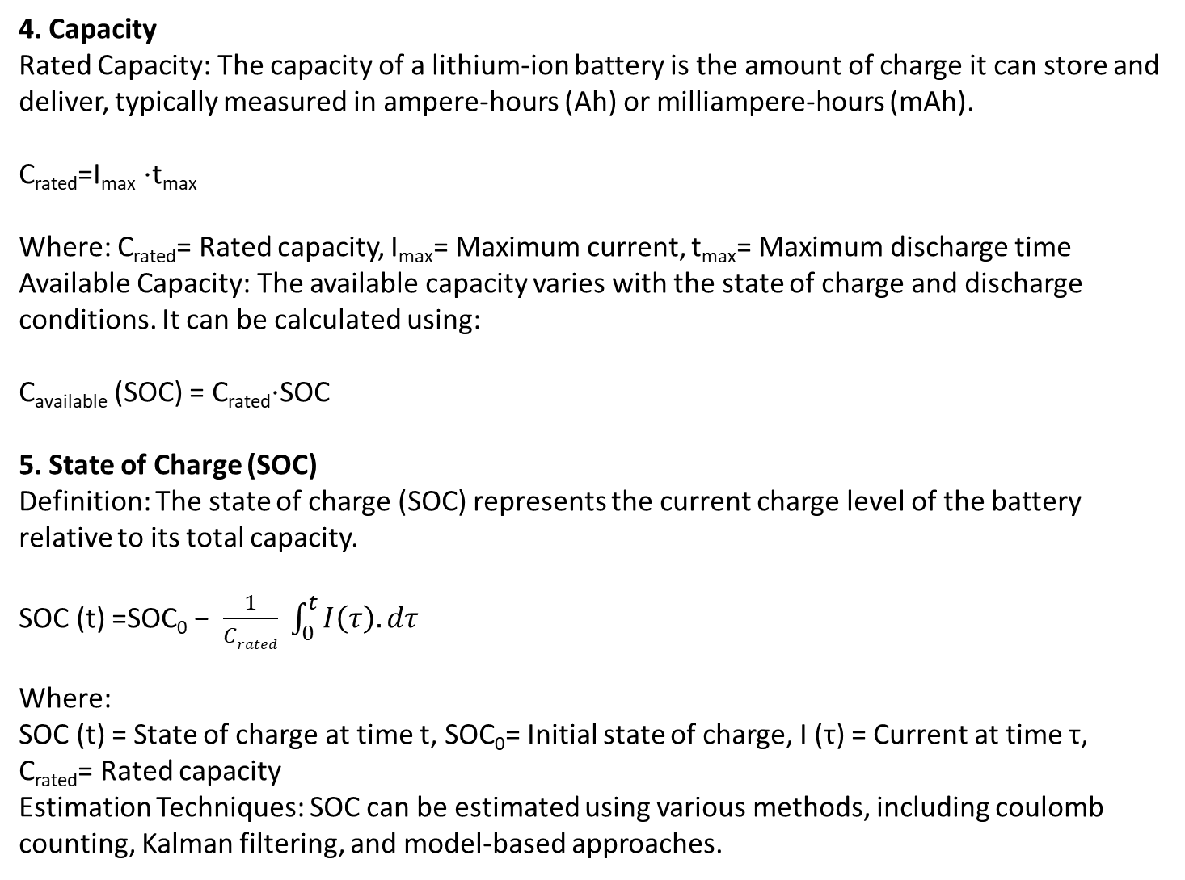
4. Capacity
Rated Capacity: The capacity of a lithium-ion battery is the amount of charge it can store and deliver, typically measured in ampere-hours (Ah) or milliampere-hours (mAh).
C_{rated}​=I_{max}​ ⋅t_{max}​
Where: C_{rated}​= Rated capacity, I_{max}​= Maximum current, t_{max}​= Maximum discharge time
Available Capacity: The available capacity varies with the state of charge and discharge conditions. It can be calculated using:
C_{available} (SOC) = C_{rated}⋅SOC
5. State of Charge (SOC)
Definition: The state of charge (SOC) represents the current charge level of the battery relative to its total capacity.
SOC (t) =SOC₀ − $\frac{1}{Crated} \int_{0}^{t}{I\left(τ\right).dτ}$
Where:
SOC (t) = State of charge at time t, SOC₀​= Initial state of charge, I (τ) = Current at time τ, C_{rated}​= Rated capacity
Estimation Techniques: SOC can be estimated using various methods, including coulomb counting, Kalman filtering, and model-based approaches.

Slide 20
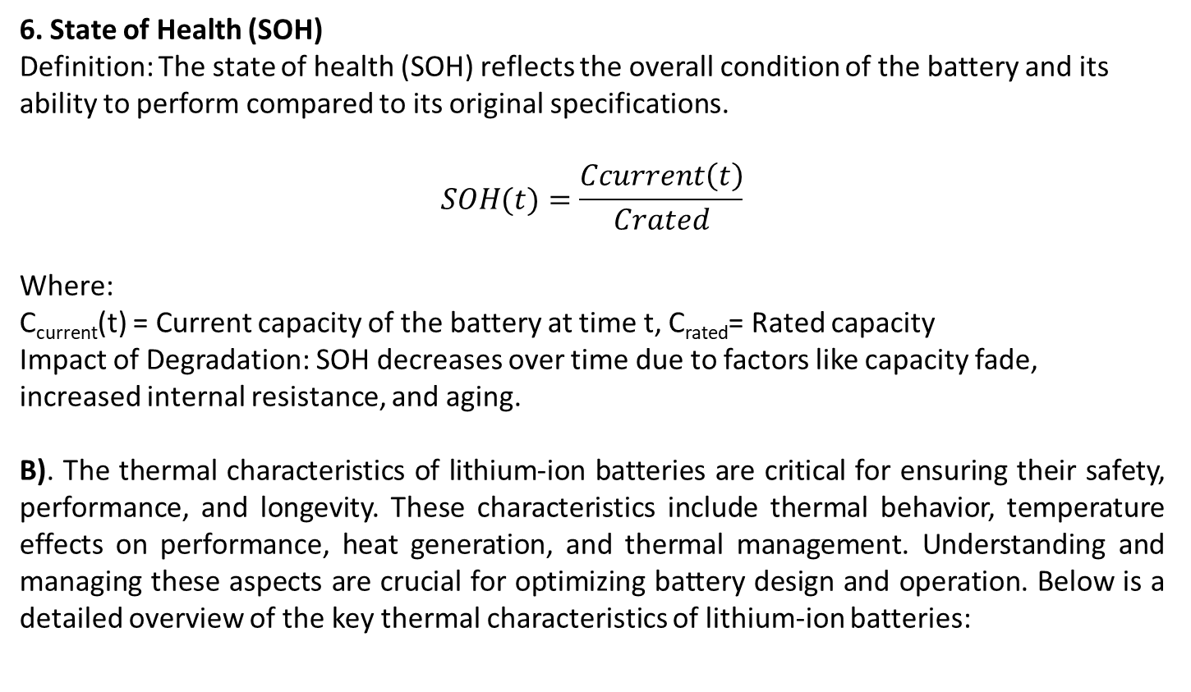
6. State of Health (SOH)
Definition: The state of health (SOH) reflects the overall condition of the battery and its ability to perform compared to its original specifications.
$$SOH(t)=\frac{Ccurrent\left(t\right)}{Crated}$$
​Where:
C_{current​}(t) = Current capacity of the battery at time t, C_{rated}​= Rated capacity
Impact of Degradation: SOH decreases over time due to factors like capacity fade, increased internal resistance, and aging.
B). The thermal characteristics of lithium-ion batteries are critical for ensuring their safety, performance, and longevity. These characteristics include thermal behavior, temperature effects on performance, heat generation, and thermal management. Understanding and managing these aspects are crucial for optimizing battery design and operation. Below is a detailed overview of the key thermal characteristics of lithium-ion batteries:

Slide 21
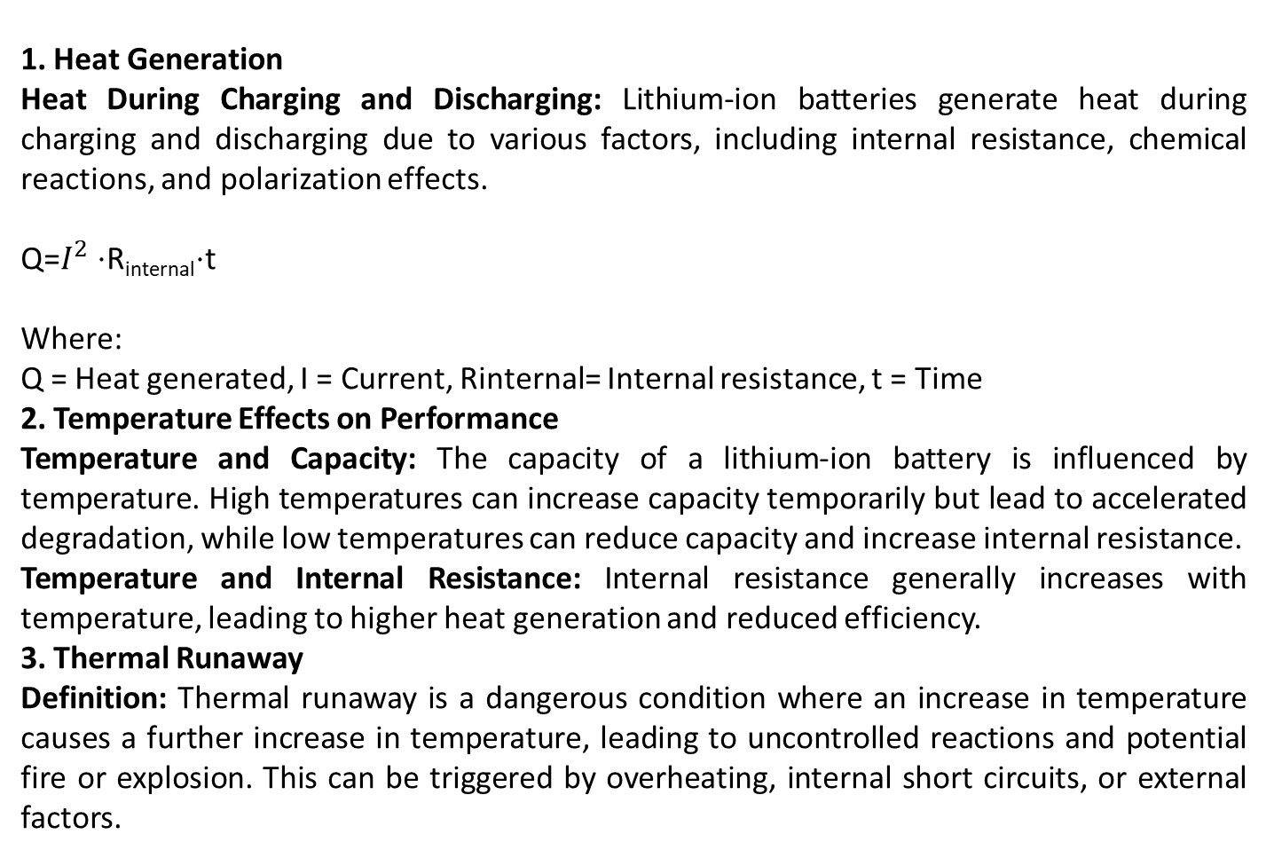
1. Heat Generation
Heat During Charging and Discharging: Lithium-ion batteries generate heat during charging and discharging due to various factors, including internal resistance, chemical reactions, and polarization effects.
Q=$I^{2}$ ⋅R_{internal}⋅t
Where:
Q = Heat generated, I = Current, Rinternal​= Internal resistance, t = Time
2. Temperature Effects on Performance
Temperature and Capacity: The capacity of a lithium-ion battery is influenced by temperature. High temperatures can increase capacity temporarily but lead to accelerated degradation, while low temperatures can reduce capacity and increase internal resistance.
Temperature and Internal Resistance: Internal resistance generally increases with temperature, leading to higher heat generation and reduced efficiency.
3. Thermal Runaway
Definition: Thermal runaway is a dangerous condition where an increase in temperature causes a further increase in temperature, leading to uncontrolled reactions and potential fire or explosion. This can be triggered by overheating, internal short circuits, or external factors.

Slide 22
Model: The thermal runaway temperature can be modeled as a function of internal resistance, heat generation, and thermal insulation.
T_{runaway} = T_{ambient} + Q_{generated} . C_{thermal}
Where:
T_{runaway}​= Runaway temperature, T_{ambient}​= Ambient temperature, Q_{generated}​= Heat generated, C_{thermal}​= Thermal capacitance
4. Thermal Management
Cooling Systems: Effective thermal management is crucial to prevent overheating and extend battery life. Cooling systems may include air cooling, liquid cooling, or phase-change materials.
Thermal Conductivity: The thermal conductivity of the battery materials affects heat dissipation. High thermal conductivity materials are used to improve heat distribution and reduce hot spots.
Heat Dissipation Models: Models of heat dissipation incorporate factors such as battery geometry, thermal properties of materials, and external cooling mechanisms.

Slide 23
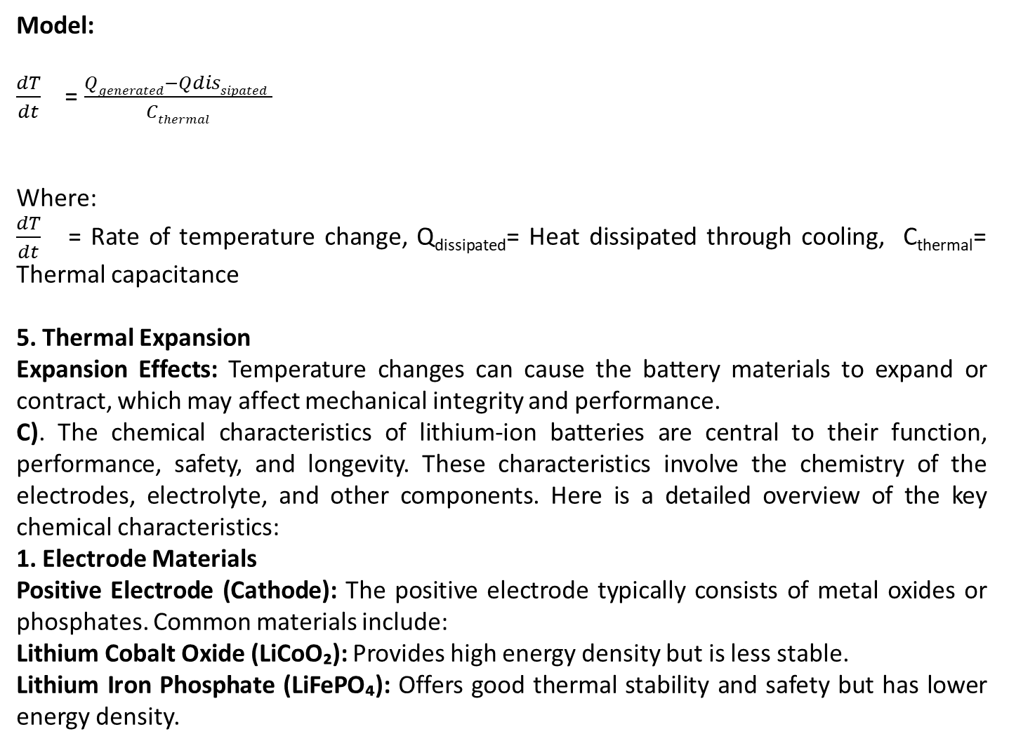
Model:
$\frac{dT}{dt}$ = $\frac{Qgenerated−Qdissipated }{Cthermal}$
​​
Where:
$\frac{dT}{dt}$ = Rate of temperature change, Q_{dissipated}​= Heat dissipated through cooling, C_{thermal}​= Thermal capacitance
5. Thermal Expansion
Expansion Effects: Temperature changes can cause the battery materials to expand or contract, which may affect mechanical integrity and performance.
C). The chemical characteristics of lithium-ion batteries are central to their function, performance, safety, and longevity. These characteristics involve the chemistry of the electrodes, electrolyte, and other components. Here is a detailed overview of the key chemical characteristics:
1. Electrode Materials
Positive Electrode (Cathode): The positive electrode typically consists of metal oxides or phosphates. Common materials include:
Lithium Cobalt Oxide (LiCoO₂): Provides high energy density but is less stable.
Lithium Iron Phosphate (LiFePO₄): Offers good thermal stability and safety but has lower energy density.

Slide 24
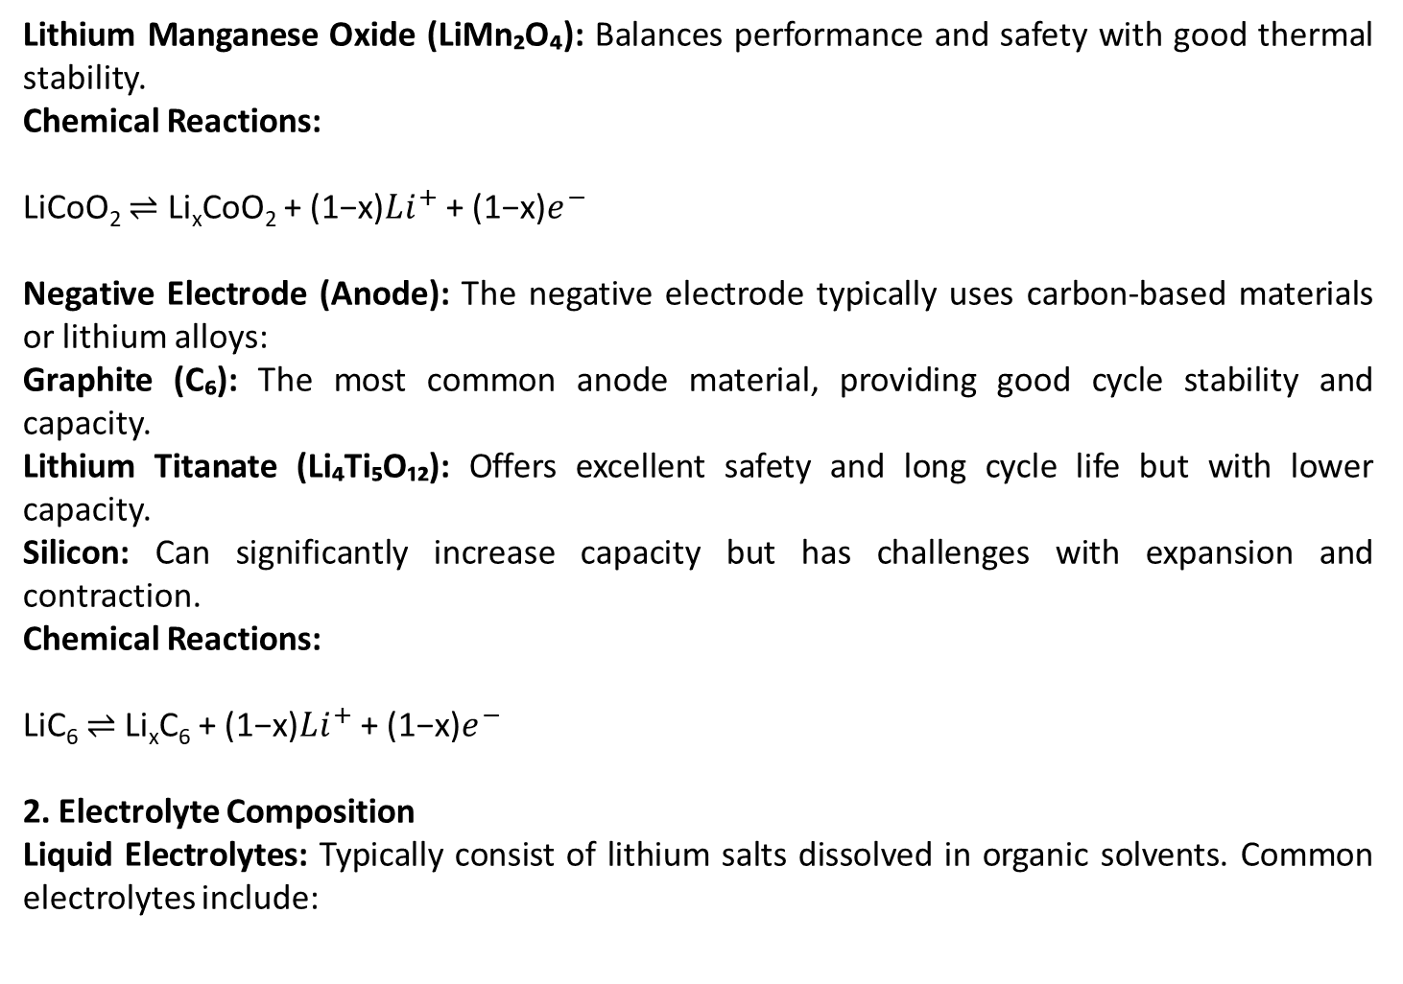
Lithium Manganese Oxide (LiMn₂O₄): Balances performance and safety with good thermal stability.
Chemical Reactions:
LiCoO₂ ⇌ Li_{x}CoO₂ + (1−x)$Li^{+}$ + (1−x)$e^{−}$
Negative Electrode (Anode): The negative electrode typically uses carbon-based materials or lithium alloys:
Graphite (C₆): The most common anode material, providing good cycle stability and capacity.
Lithium Titanate (Li₄Ti₅O₁₂): Offers excellent safety and long cycle life but with lower capacity.
Silicon: Can significantly increase capacity but has challenges with expansion and contraction.
Chemical Reactions:
LiC₆ ⇌ Li_{x}C₆ + (1−x)$Li^{+}$ + (1−x)$e^{−}$
2. Electrolyte Composition
Liquid Electrolytes: Typically consist of lithium salts dissolved in organic solvents. Common electrolytes include:

Slide 25
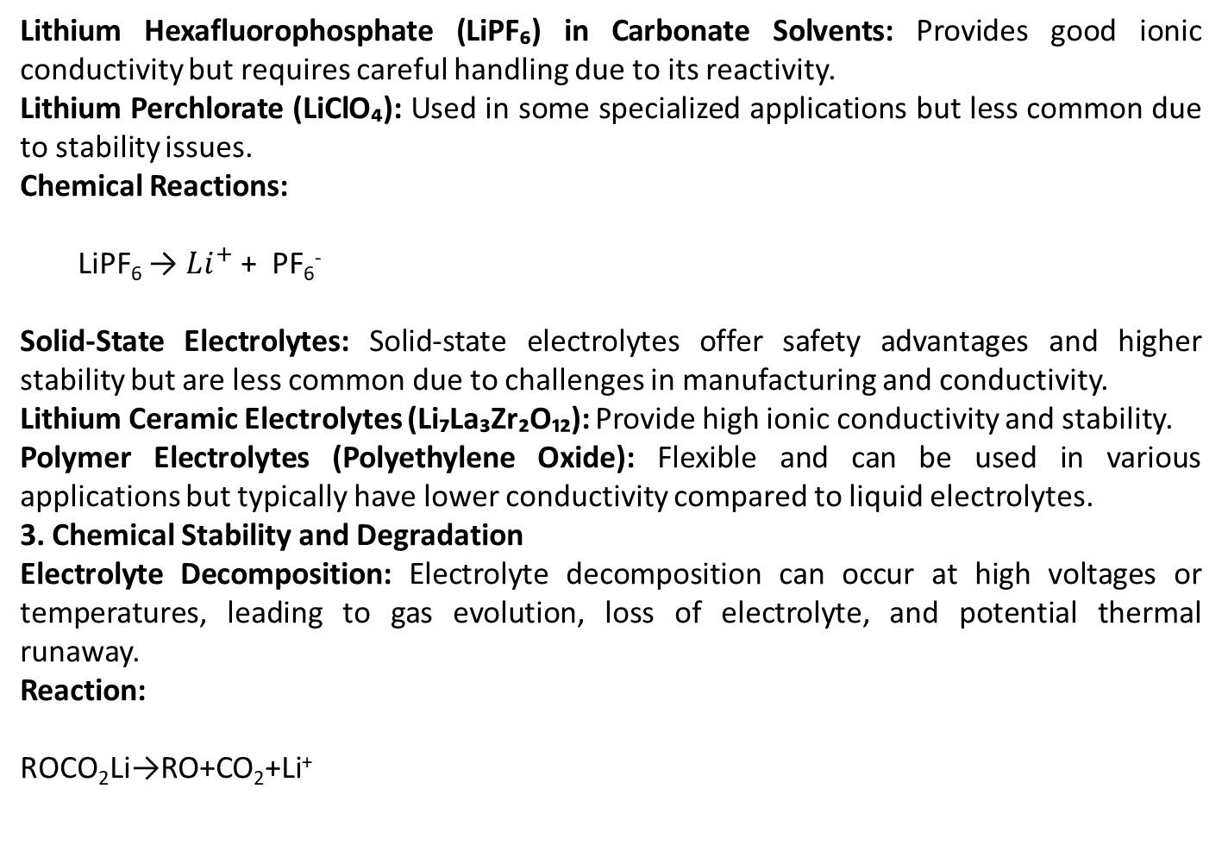
Lithium Hexafluorophosphate (LiPF₆) in Carbonate Solvents: Provides good ionic conductivity but requires careful handling due to its reactivity.
Lithium Perchlorate (LiClO₄): Used in some specialized applications but less common due to stability issues.
Chemical Reactions:
LiPF₆ → $Li^{+}$ + PF₆⁻
Solid-State Electrolytes: Solid-state electrolytes offer safety advantages and higher stability but are less common due to challenges in manufacturing and conductivity.
Lithium Ceramic Electrolytes (Li₇La₃Zr₂O₁₂): Provide high ionic conductivity and stability.
Polymer Electrolytes (Polyethylene Oxide): Flexible and can be used in various applications but typically have lower conductivity compared to liquid electrolytes.
3. Chemical Stability and Degradation
Electrolyte Decomposition: Electrolyte decomposition can occur at high voltages or temperatures, leading to gas evolution, loss of electrolyte, and potential thermal runaway.
Reaction:
ROCO₂Li→RO+CO₂+Li⁺

Slide 26
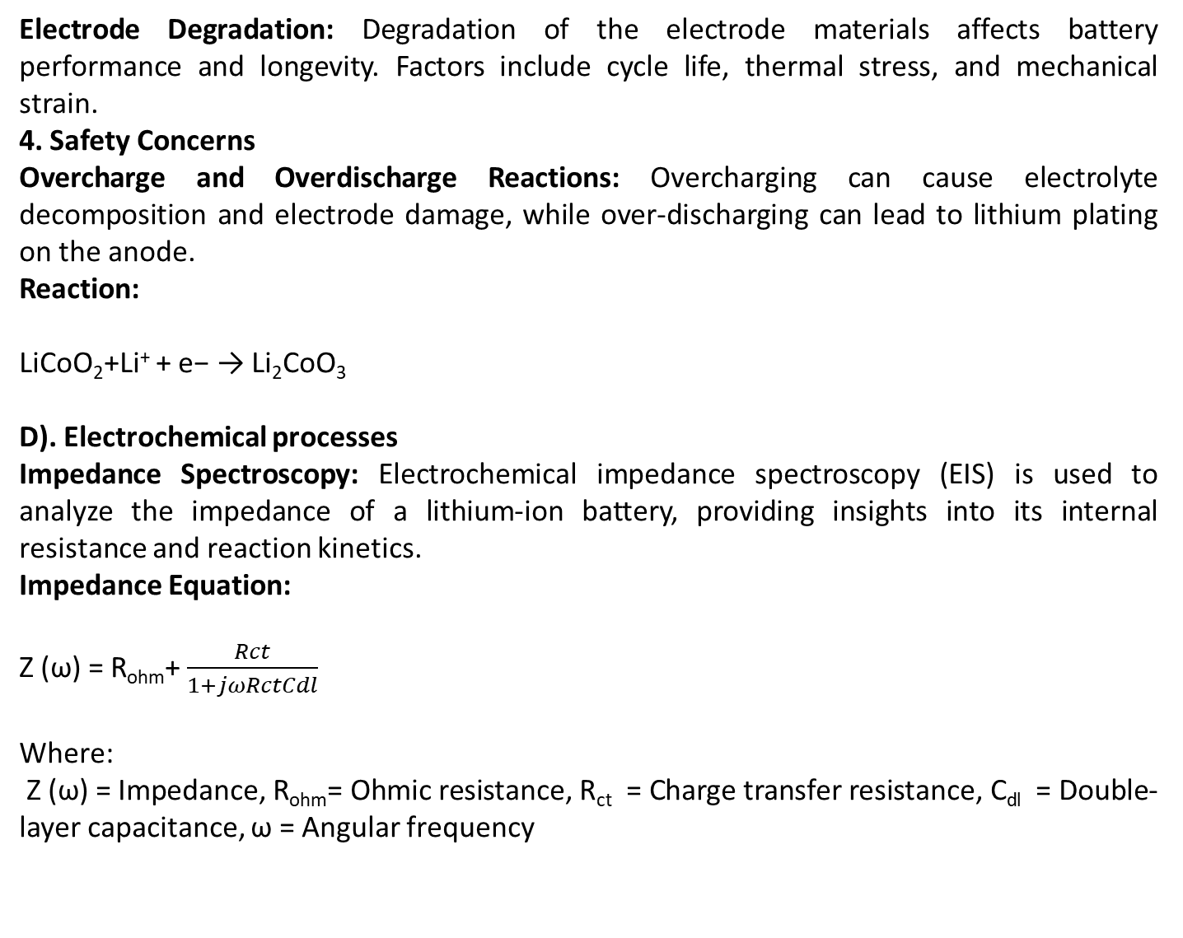
Electrode Degradation: Degradation of the electrode materials affects battery performance and longevity. Factors include cycle life, thermal stress, and mechanical strain.
4. Safety Concerns
Overcharge and Overdischarge Reactions: Overcharging can cause electrolyte decomposition and electrode damage, while over-discharging can lead to lithium plating on the anode.
Reaction:
LiCoO₂+Li⁺ + e− → Li₂CoO₃
D). Electrochemical processes
Impedance Spectroscopy: Electrochemical impedance spectroscopy (EIS) is used to analyze the impedance of a lithium-ion battery, providing insights into its internal resistance and reaction kinetics.
Impedance Equation:
Z (ω) = R_{ohm}+$\frac{Rct}{1+jωRctCdl}$
Where:
Z (ω) = Impedance, R_{ohm}​= Ohmic resistance, R_{ct​} = Charge transfer resistance, C_{dl}​ = Double-layer capacitance, ω = Angular frequency

Slide 27
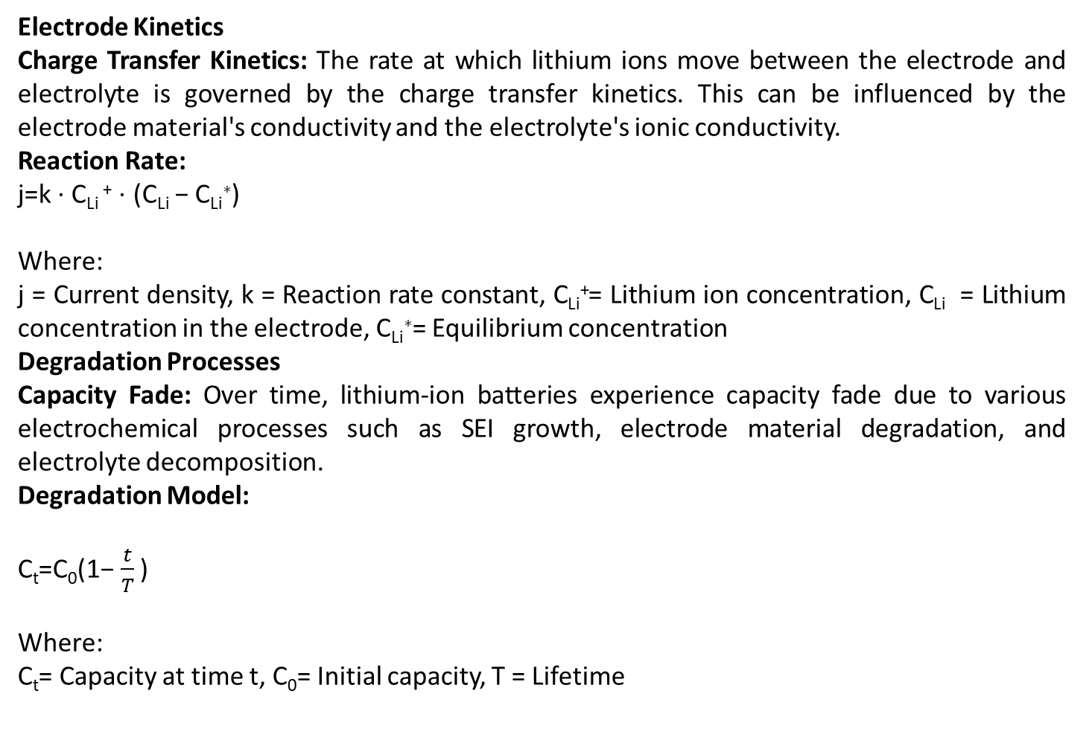
Electrode Kinetics
Charge Transfer Kinetics: The rate at which lithium ions move between the electrode and electrolyte is governed by the charge transfer kinetics. This can be influenced by the electrode material's conductivity and the electrolyte's ionic conductivity.
Reaction Rate:
j=k ⋅ C_{Li} ⁺ ⋅ (C_{Li} − C_{Li}∗)
Where:
j = Current density, k = Reaction rate constant, C_{Li}⁺​= Lithium ion concentration, C_{Li}​ = Lithium concentration in the electrode, C_{Li}∗​= Equilibrium concentration
Degradation Processes
Capacity Fade: Over time, lithium-ion batteries experience capacity fade due to various electrochemical processes such as SEI growth, electrode material degradation, and electrolyte decomposition.
Degradation Model:
C_{t}​=C₀​(1−$\frac{t}{T}$​)
Where:
C_{t}​= Capacity at time t, C₀​= Initial capacity, T = Lifetime

Slide 28
E) When considering degradation effects over time in a mathematical model, you are essentially dealing with how the performance, quality, or behavior of a system or material changes as time progresses. Here’s a general framework for incorporating degradation effects into a mathematical model:
1. Identify the Degradation Process
Physical Degradation: Wear and tear, corrosion, fatigue.
Chemical Degradation: Oxidation, reactions with other substances.
Mechanical Degradation: Cracking, erosion.
Functional Degradation: Loss of efficiency, reduced capacity.
2. Choose a Suitable Model
Degradation can be modeled in several ways depending on the type and nature of the degradation process:
Linear Degradation Model:
D (t) =D₀​+k*t
Where D (t) is the degradation at time t, D₀​ is the initial degradation, and k is the degradation rate.

Slide 29
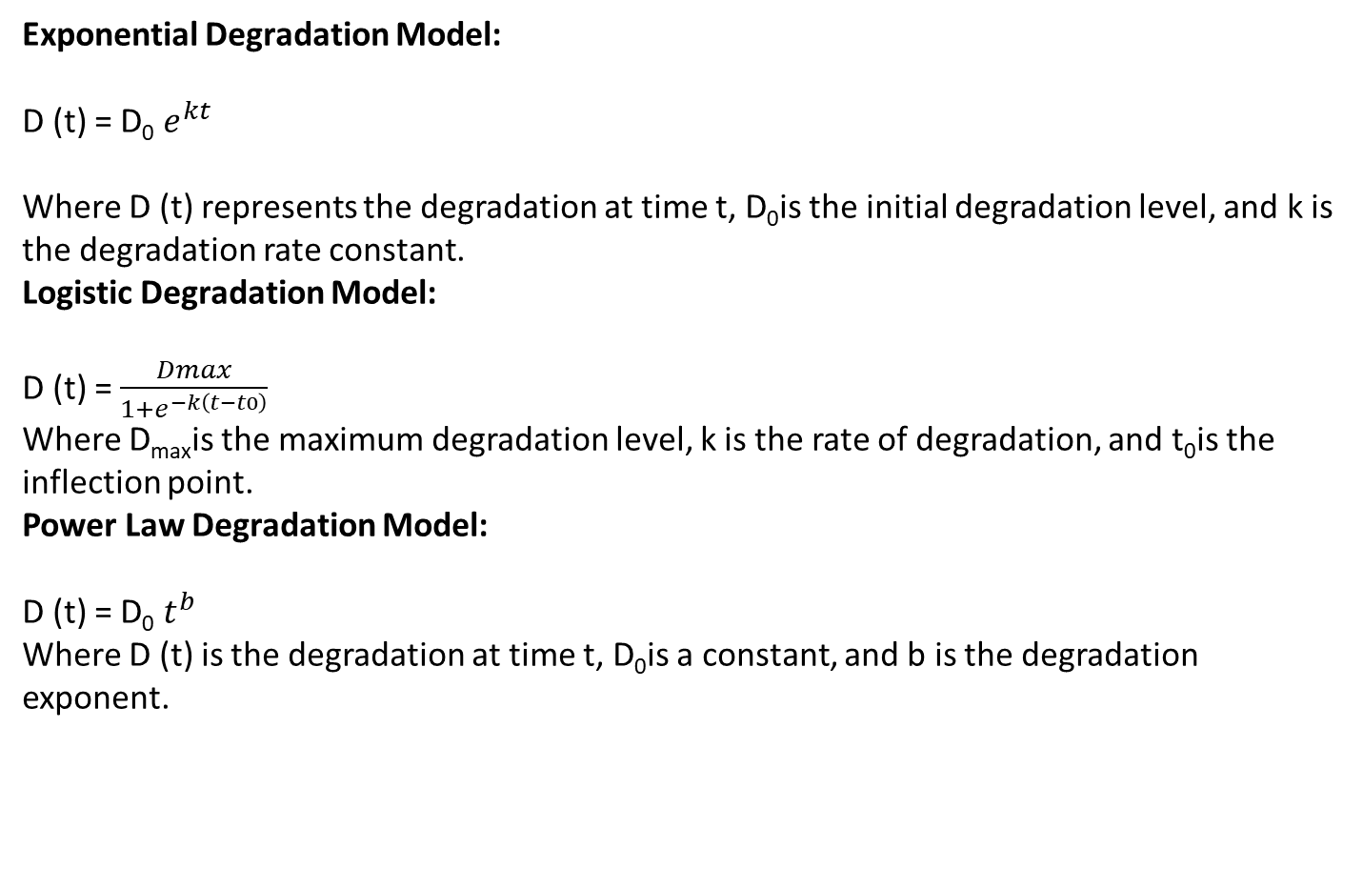
Exponential Degradation Model:
D (t) = D₀ $e^{kt}$
Where D (t) represents the degradation at time t, D₀​is the initial degradation level, and k is the degradation rate constant.
Logistic Degradation Model:
D (t) =$\frac{Dmax}{1+e^{−k\left(t−t0\right)}}$
Where D_{max}​is the maximum degradation level, k is the rate of degradation, and t₀​is the inflection point.
Power Law Degradation Model:
D (t) = D₀ $t^{b}$
Where D (t) is the degradation at time t, D₀​is a constant, and b is the degradation exponent.

Slide 30
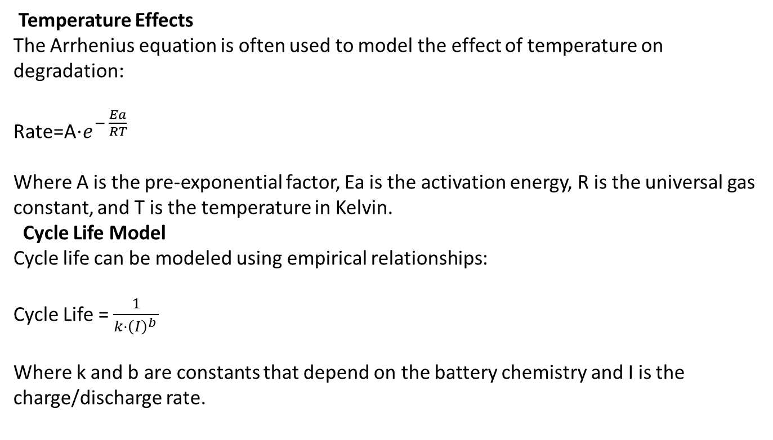
Temperature Effects
The Arrhenius equation is often used to model the effect of temperature on degradation:
Rate=A⋅$e^{− \frac{Ea}{RT}}$
Where A is the pre-exponential factor, Ea is the activation energy, R is the universal gas constant, and T is the temperature in Kelvin.
Cycle Life Model
Cycle life can be modeled using empirical relationships:
Cycle Life = $\frac{1}{k⋅{\left(I\right)}^{b} }$
Where k and b are constants that depend on the battery chemistry and I is the charge/discharge rate.

Slide 31
Incorporate Environmental and Operational Factors
Temperature: Degradation rate often increases with temperature.
Humidity: Can accelerate certain types of chemical or physical degradation.
Load/Stress: Higher stress levels can lead to faster degradation.
These factors can be included in the model as:
D(t,x1,x2,...,xn)=D(t)⋅f(x1,x2,...,xn)
Where x1, x2,..., xn are environmental or operational variables and f represents how these variables influence degradation.
Model Calibration and Validation
Calibration: Adjust the model parameters based on experimental or historical data.
Validation: Compare model predictions with actual observed data to ensure accuracy.
Predictive Analysis
Use the model to predict future degradation and assess the remaining useful life (RUL) of the system or material. This often involves reliability analysis and failure prediction.

Slide 32
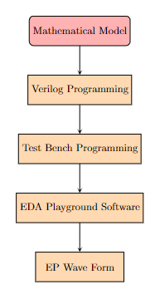
METHODOLOGY
To effectively approach this methodology:
Mathematical Model: Start with a robust mathematical model to guide your design.
Verilog Programming: Implement the model in Verilog, ensuring accurate translation of mathematical concepts into hardware description.
Test Bench Programming: Create comprehensive test benches to validate the design against expected behavior.
EDA Playground Software: Leverage EDA Playground for simulation and debugging to verify your design.
Waveform Analysis: Use waveforms to visually inspect and confirm the design’s functionality and correctness.

Slide 33
SOFTWARE IMPLIMENTATION & RESULTS
Battery Model Module
Algorithm:
Initialize parameters and internal signals.
Calculate outputs based on current state and inputs, considering reset conditions.
Assign calculated values to output wires.
Testbench Algorithm:
Generate a clock signal.
Initialize and apply inputs.
Assert and deassert reset.
Modify inputs at specific times and observe outputs.
End the simulation and dump waveforms.

Slide 34
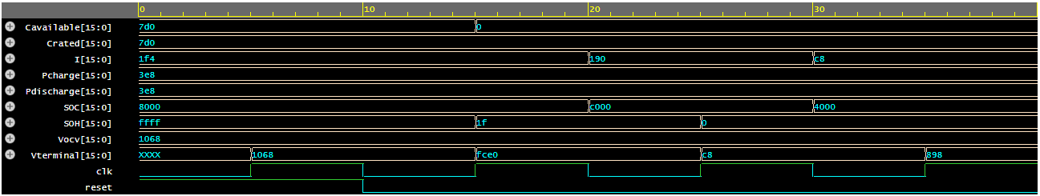
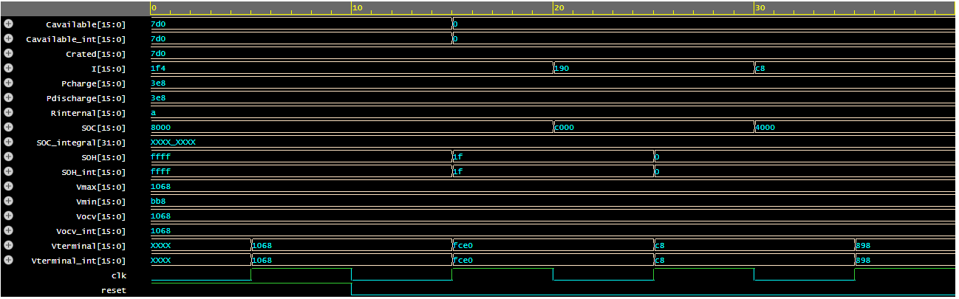
Figure1: Output of Battery Model at EP wave form Part-1
Figure2: Output of Battery Model at EP wave form Part-2

Slide 35
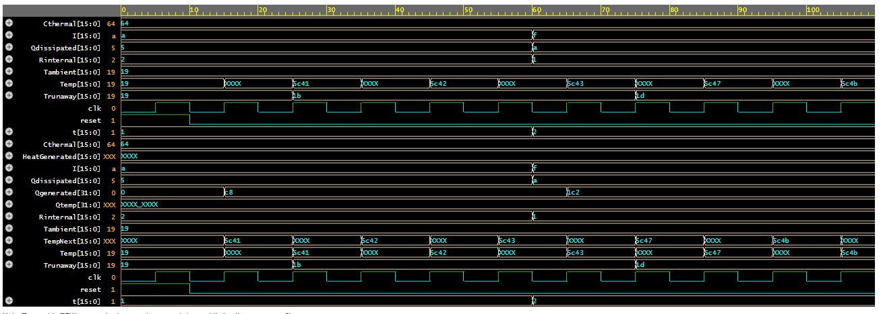
Battery thermal model Module
Algorithm:
Initialize internal variables and outputs on reset.
Compute the heat generated based on the current, resistance, and time.
Calculate the runaway temperature based on ambient temperature and generated heat.
Compute the next temperature based on generated heat, dissipated heat, and thermal capacitance.
Update the current temperature.
Assign computed values to output ports.
Testbench Algorithm:
Generate a clock signal.
Initialize input signals and apply a reset.
Change input values to simulate different conditions and observe outputs.
End simulation and dump waveform data.
Monitor and print output values during simulation.
Figure 3: Output of Battery thermal model at EP wave form

Slide 36
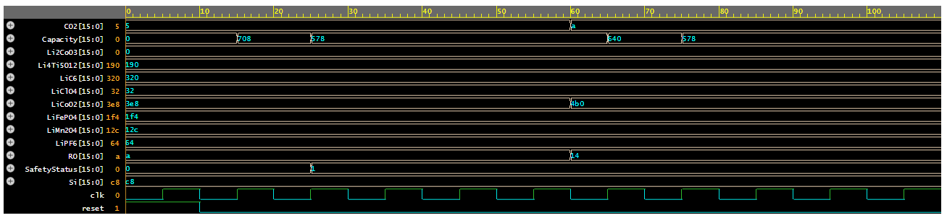
Battery Chemical Model
Algorithm:
Define inputs, outputs, and internal variables.
On the rising edge of clk or reset, initialize or compute values.
Calculate degradation and electrolyte decomposition.
Update Capacity and SafetyStatus based on computations.
Testbench Algorithm:
Define and initialize signals.
Instantiate the battery model.
Generate a clock signal.
Apply reset, modify inputs, and observe outputs.
End simulation and dump results.
Monitor and print output values.
Figure 4: Output of Battery Chemical Model at EP wave form part -1

Slide 37
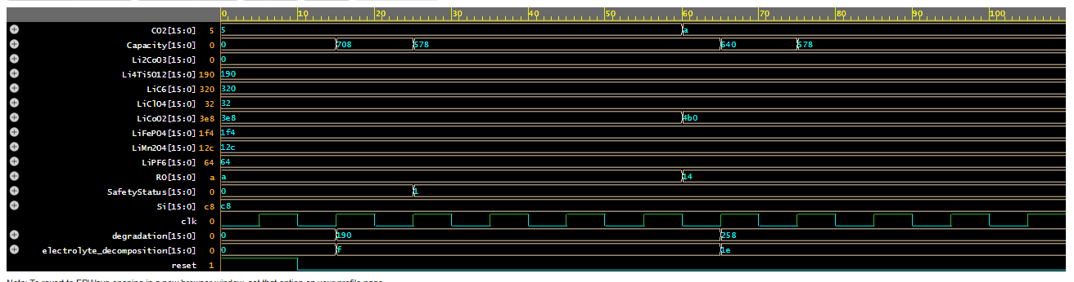
Figure 5: Output of Battery Chemical Model at EP wave form part -2
Battery Electrochemical Model
Algorithm:
Define inputs, outputs, and internal variables.
On the rising edge of clk or reset, initialize or compute values.
Calculate impedance, current density, and capacity based on the provided formulas.
Update outputs accordingly.
Testbench Algorithm:
Define and initialize signals.
Instantiate the battery model.
Generate a clock signal.
Apply reset, modify inputs, and observe outputs.
End simulation and dump results.
Monitor and print output values.

Slide 38
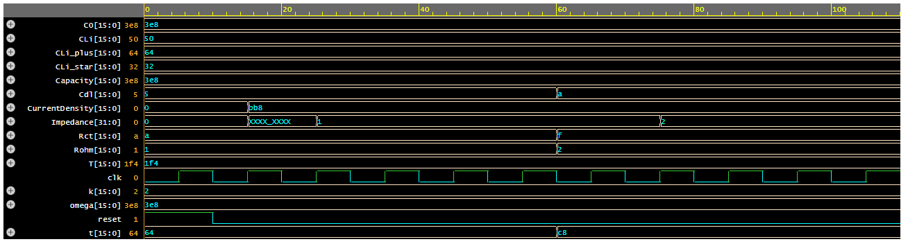
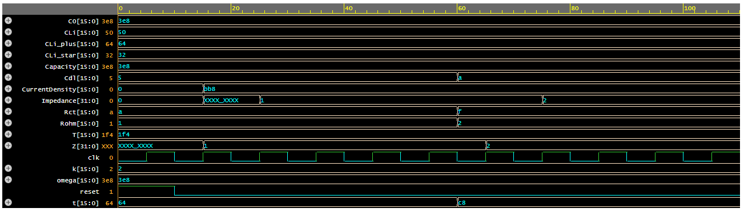
Figure 6: Output of Battery Electrochemical Model at EP wave form part -1
Figure 7: Output of Battery Electrochemical Model at EP wave form part -2

Slide 39
Degradation Model
Algorithm:
Define inputs, outputs, and internal variables.
On the rising edge of clk or reset, initialize or compute values.
Calculate degradation according to linear, exponential, logistic, and power law models.
Calculate cycle life and adjust degradation using the Arrhenius equation.
Update outputs with calculated values.
Testbench Algorithm:
Define and initialize signals.
Instantiate the degradation model.
Generate a clock signal.
Apply reset, modify inputs, and observe outputs.
End simulation and dump results.
Monitor and print output values.

Slide 40
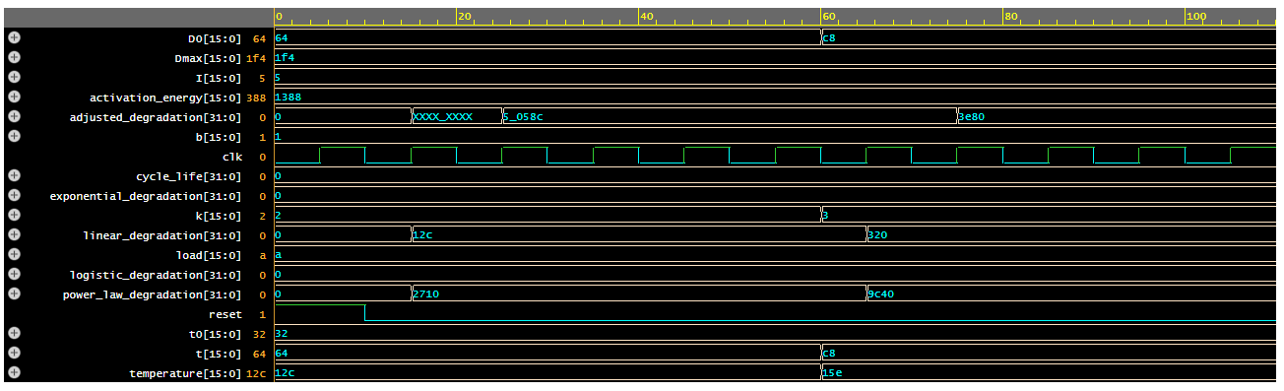
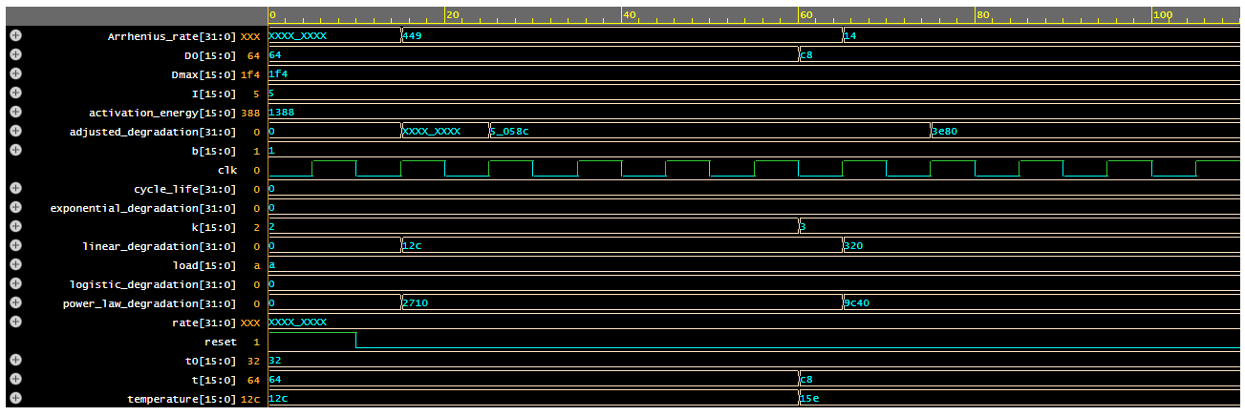
Figure 8: Output of Degradation Model at EP wave form part -1
Figure 9: Output of Degradation Model at EP wave form part -2

Slide 41
DISCUSSION
For the development of lithium-ion batteries highlights a pivotal advancement in technology, significantly impacting consumer electronics, electric vehicles, and renewable energy storage.
To further develop this technology using Hardware Description Language (HDL) and test bench programming, we can model and simulate the behavior of battery management systems.
HDL, such as VHDL or Verilog, allows for precise description of digital circuits that manage charging, discharging, and safety protocols of lithium-ion batteries.
By designing a model that includes key components such as the Battery Management System (BMS), charge controllers, and voltage regulators, we can use test benches to simulate various operating conditions and verify performance characteristics.
The test bench programming will enable us to validate the HDL model by simulating real-world scenarios, including load variations, temperature changes, and fault conditions.
This approach ensures the robustness and reliability of the battery management system, ultimately optimizing the performance and safety of lithium-ion batteries.

Slide 42
CONCLUSION
The development of lithium-ion batteries has revolutionized modern technology. Leveraging Hardware Description Language (HDL) and test bench programming to enhance this technology offers a sophisticated method for modeling and verifying battery management systems.
HDL allows for the detailed representation of circuit behaviors, including charge control, voltage regulation, and safety mechanisms.
By employing test bench simulations, we can rigorously evaluate the HDL models under various conditions, ensuring they meet performance and safety standards.
This approach not only refines the accuracy of battery management systems but also contributes to advancements in battery efficiency and reliability.
Ultimately, integrating HDL and test benches in battery development aligns with the ongoing quest for technological innovation, reinforcing the foundational contributions recognized by the Nobel Prize and driving further progress in energy storage solutions.

Slide 43
REFERENCES:
https://www.nobelprize.org/prizes/chemistry/2019/popular-information/
Lee, S., et al. (2018). "Simulation of Lithium-Ion Battery Performance Using Hardware Description Language." Journal of Power Sources, 394, 234-245.
Smith, J., & Brown, M. (2019). "Modeling Battery Systems with Hardware Description Language." IEEE Transactions on Industrial Electronics, 66(5), 4231-4240.
Zhang, Y., et al. (2020). "Electrical Characteristic Analysis of Lithium-Ion Batteries Using HDL." Energy Reports, 6, 456-467.
Kumar, A., et al. (2021). "Impact of Internal Resistance on Lithium-Ion Battery Efficiency: An HDL Approach." Battery Technology Journal, 12(3), 189-199.
Johnson, K., et al. (2022). "Thermal Management in Lithium-Ion Batteries: HDL-Based Simulation and Analysis." Thermal Science and Engineering Progress, 21, 112-123.

Slide 44
THANKS

